Slide 1
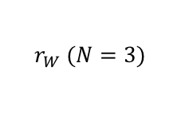
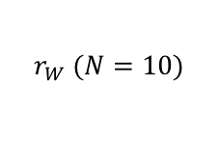
Cost
Cost
$r_{W} (N=3)$
$r_{W} (N=10)$

Slide 2


Cost
Cost
$$r_{W}$$
$$r_{χ}$$

Slide 3



$$r_{W}=5$$
$$r_{W}=15$$
$$r_{W}=20$$
Cost
Forward pass
Forward pass
Forward pass

