Slide 1

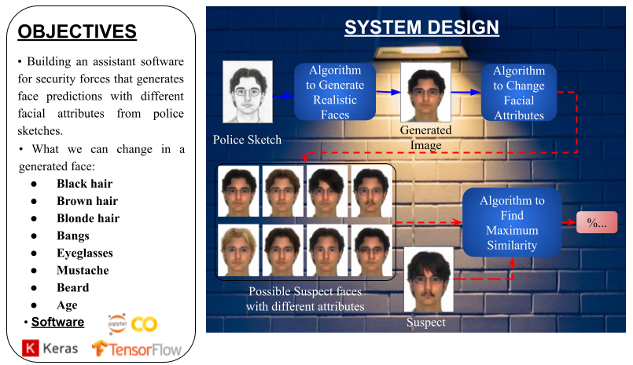
Rıdvan Balamur
Oğuzhan Yıldırım
Criminal Face Prediction From Police Sketches
Website link: http://criface.northeurope.cloudapp.azure.com:8080/

