Slide 1
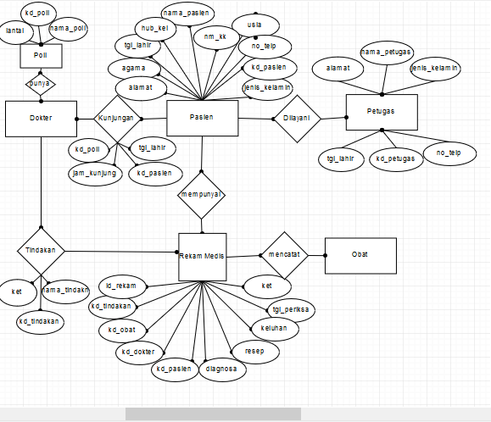
Entity Relation Diagram

Slide 2
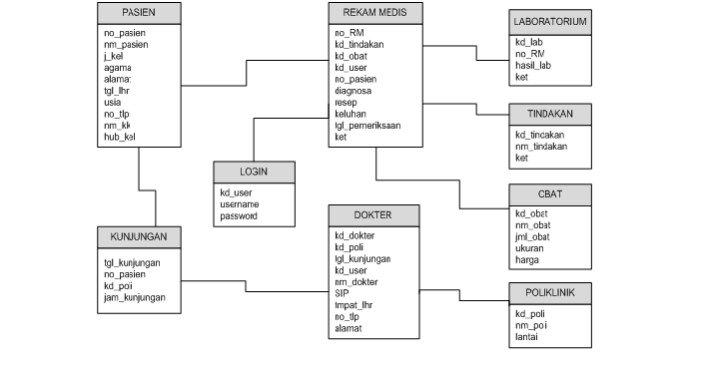
Struktur Tabel

Slide 3
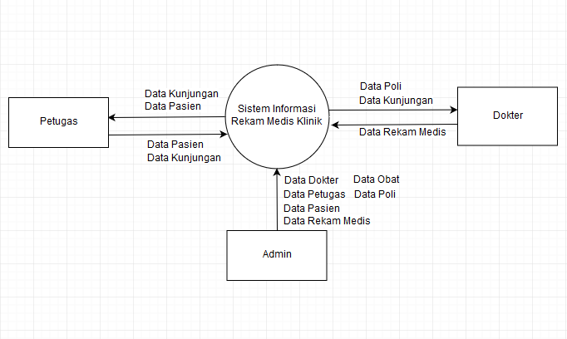
Data Flow Diagram

Slide 4
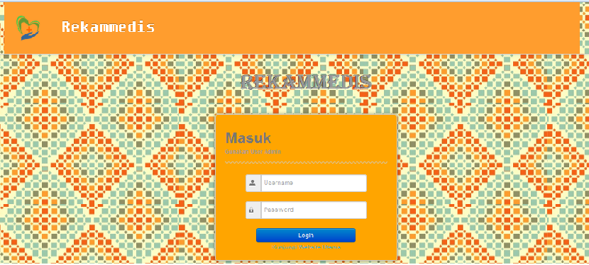
Tampilan Login

Slide 5
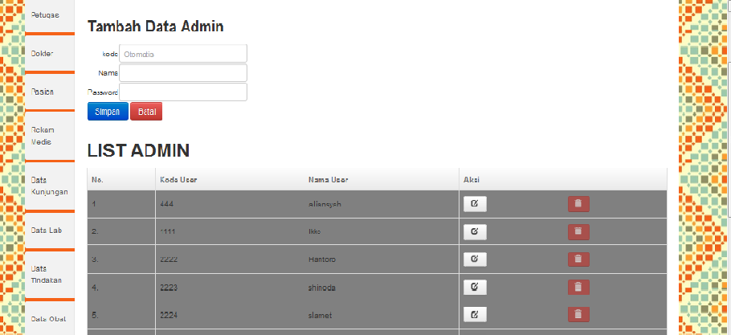
Tampilan input data admin

