Slide 1
Divine Departures
Done by: Ridzuan Azmi

Slide 2
Content
Divine departures app
Additional features

Slide 3
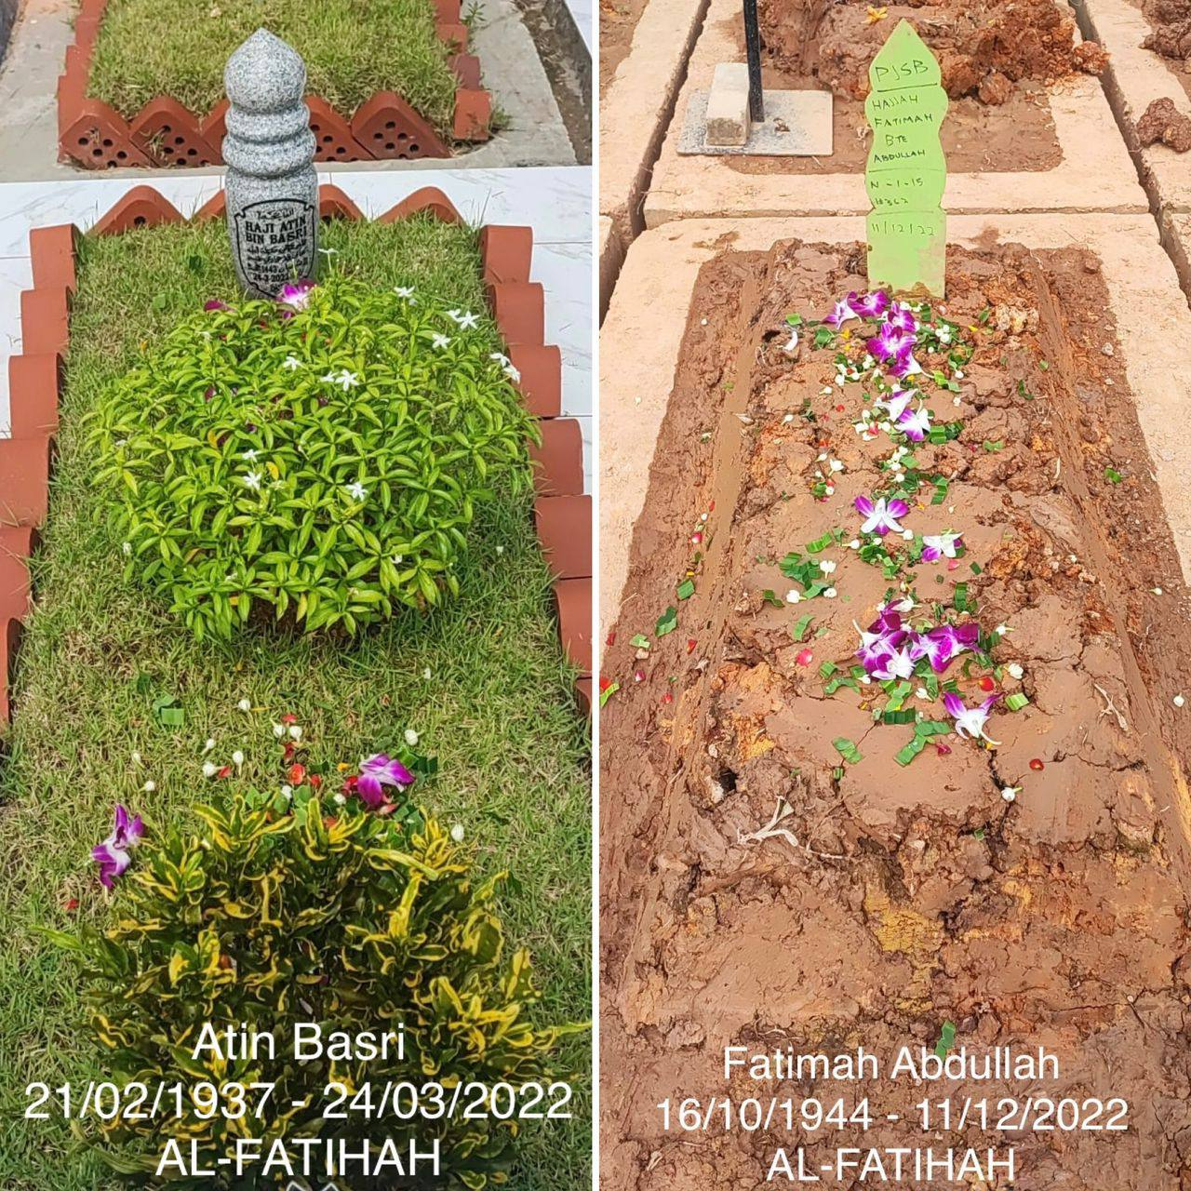
Divine Departures Context
For Malay/Muslim community (for now)
Allows user to order/design the grave of their loved ones after burial (tombstone materials, tiles, etc)
Order maintenance package to maintain the state of the grave

Slide 4
Additional Features (Spring Boot)
Spring Boot Security with JWT to authenticate
CSRF protection
Sending mail using Java Mail Sender
Using Stripe as a payment gateway

Slide 5
Additional Features (Angular)
Using Google Map
Angular Material UI framework
Using Service Worker

Slide 6
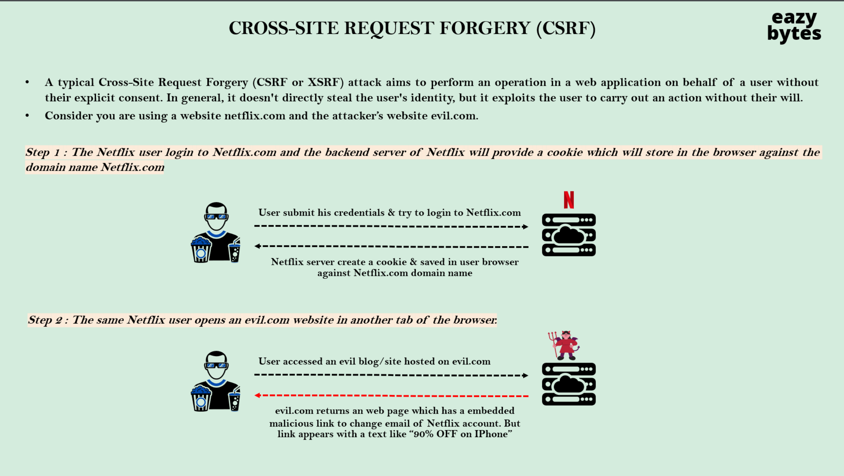
CSRF protection

Slide 7
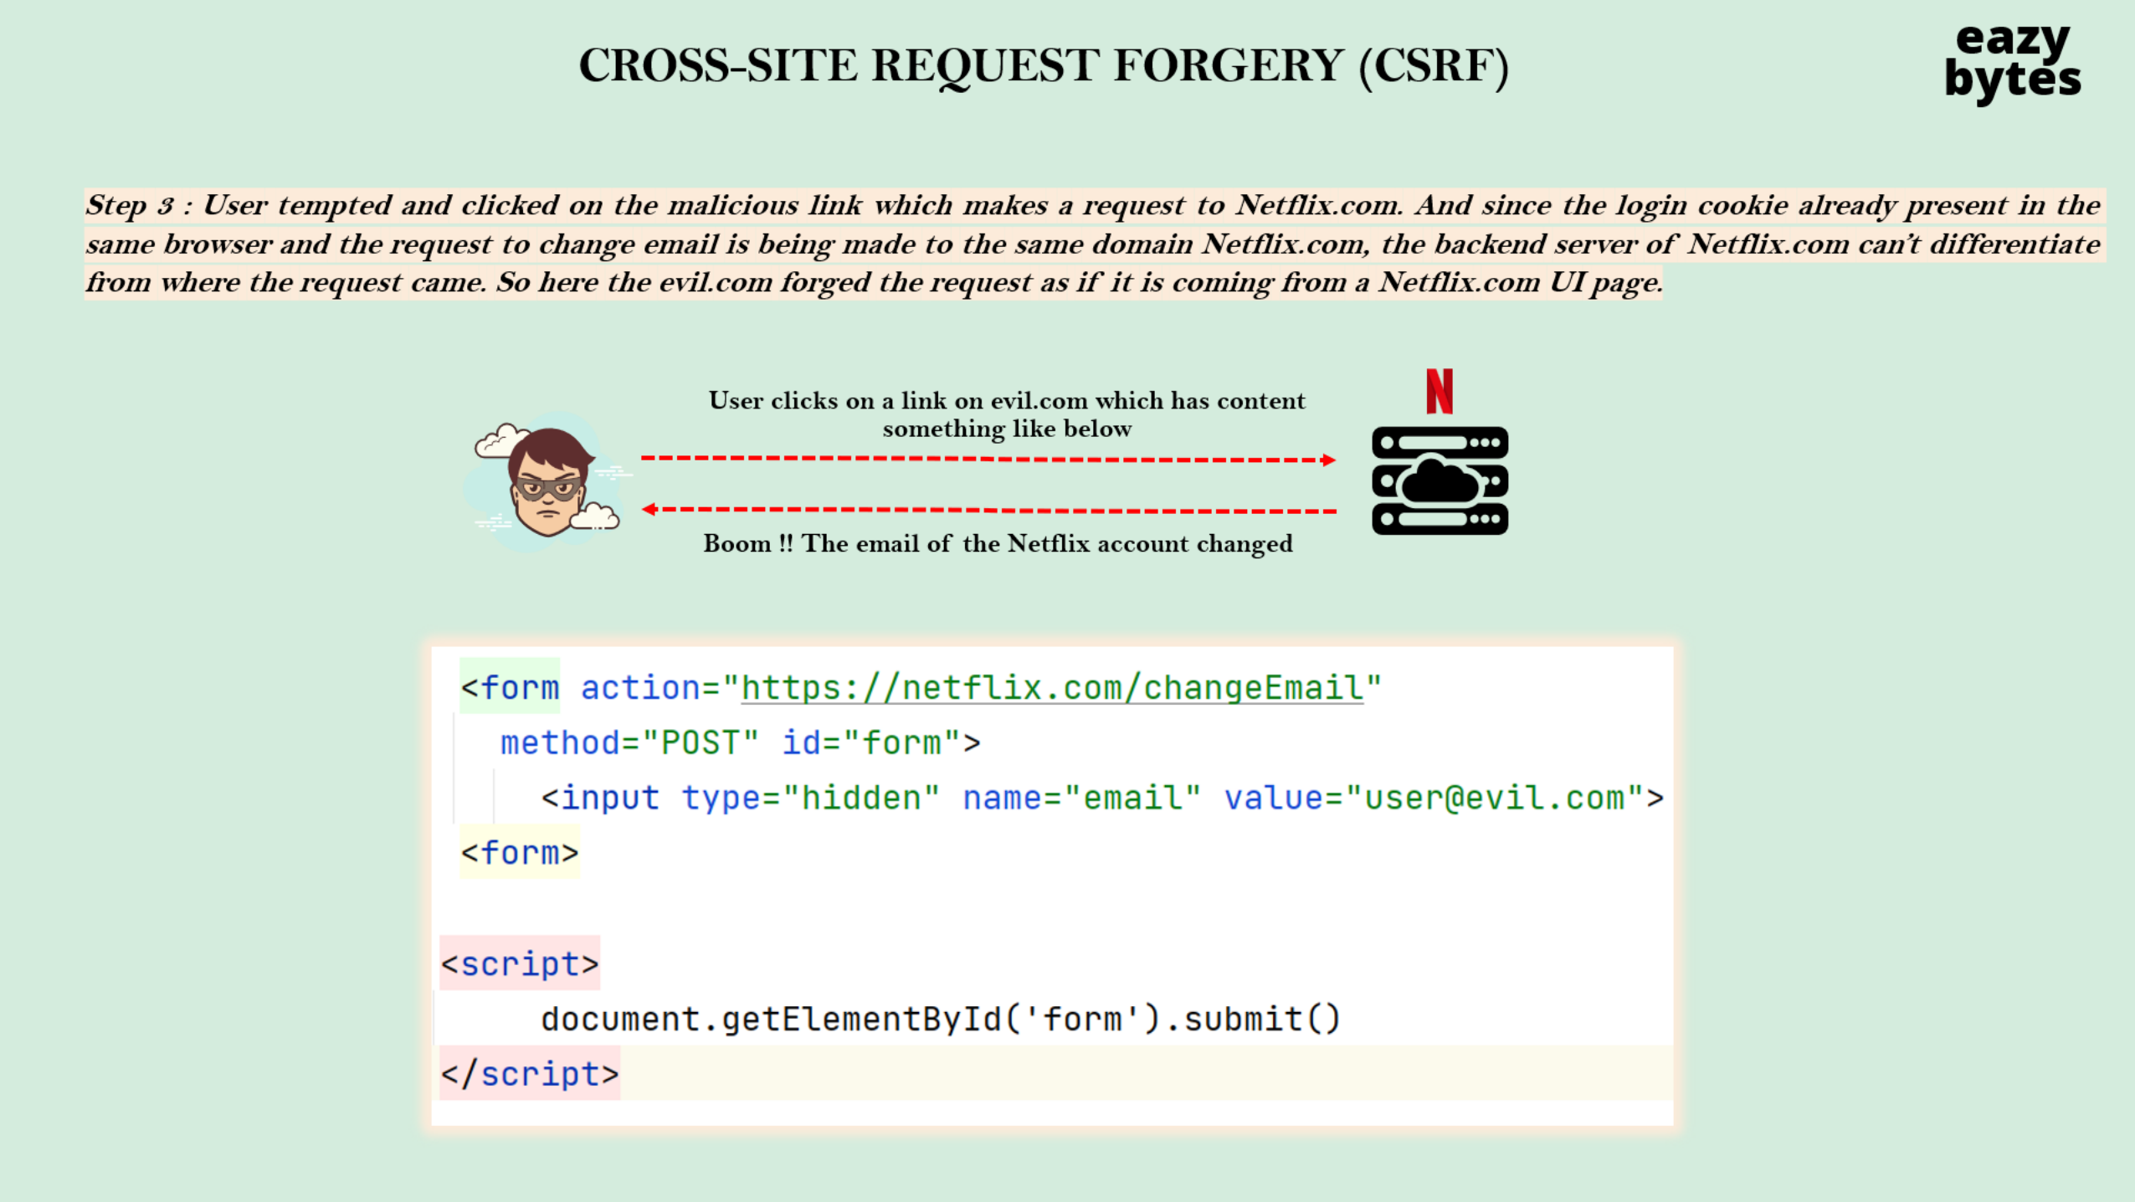

Slide 8
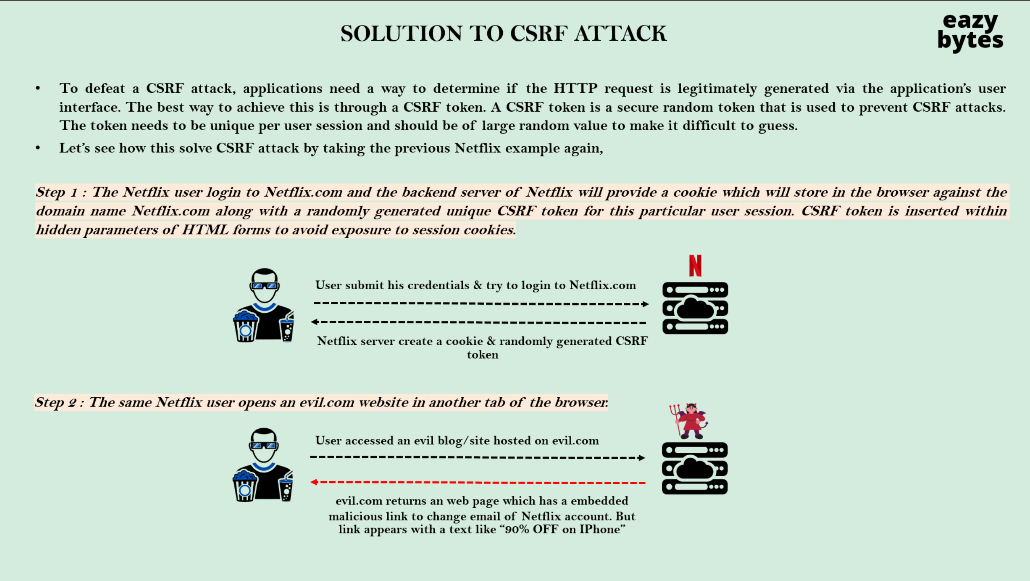

Slide 9
