Slide 1
Project Gladiator Online Exam System
Group Members
Riddhi Doshi
Neha Mahesha
Adya Thakur
Jay Chheda

Slide 2
INTRODUCTION
Technology has supported online examinations successfully for a number of years, and has progressively enhanced the online examination process over the years.
With the online examination system, the process of conducting examinations and processing results is made ease.
The system is developed using Hibernate, Spring Boot, Angular.

Slide 3
CASE STUDY
User Module - Students can register themselves and give exams for various subjects that are available at our portal. The User can give tests on different technical domains as per the requirement.
Admin will be responsible for adding different questions for the different levels of each subject. Admin can also apply various filters like search student details and view reports.

Slide 4
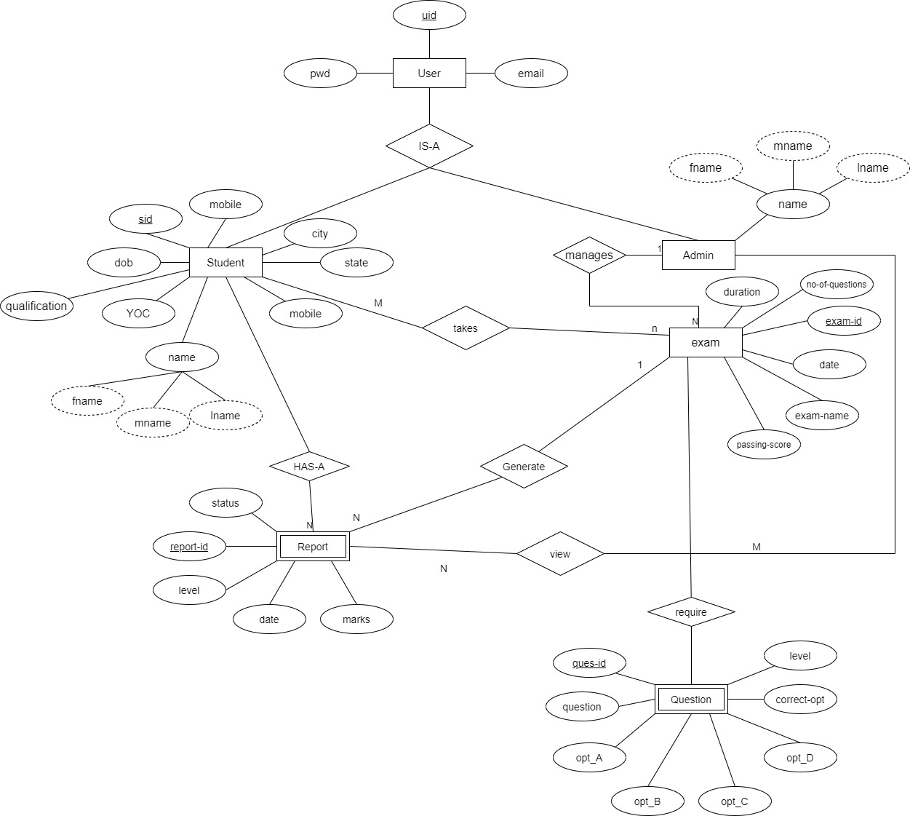
Entity-Relationship Diagram

Slide 5
USER MODULE
Registration
Login
Forgot Password
User Dashboard
Select Examination
Appear for Examination
Report Generation
About Us

Slide 6
ADMIN MODULE
Admin login
Admin Dashboard
About Us
Add Questions
Search Details
Remove Questions

Slide 7
Thank you!

