Slide 1

ZeusPlatformerGame: An OOP/EDP Showcase in Java
Welcome to the presentation on ZeusPlatformerGame, a 2D Mario-style platformer game developed entirely in Java. Our primary objective was to apply core Object-Oriented Programming (OOP) and Event-Driven Programming (EDP) concepts, while also utilizing Java Swing for the GUI and implementing robust file handling. We aimed to create an engaging and educational user experience.

Slide 2





Project Scope & Overview
Gameplay Mechanics
Players control a character, navigate platforms, collect coins, and avoid enemies.
Winning Condition
Reach the flag to successfully complete the level.
Java Swing Foundation
Built entirely using Java Swing for robust UI development.
Modular Design
Code is segmented into game logic, UI, audio, and utility modules.

Slide 3
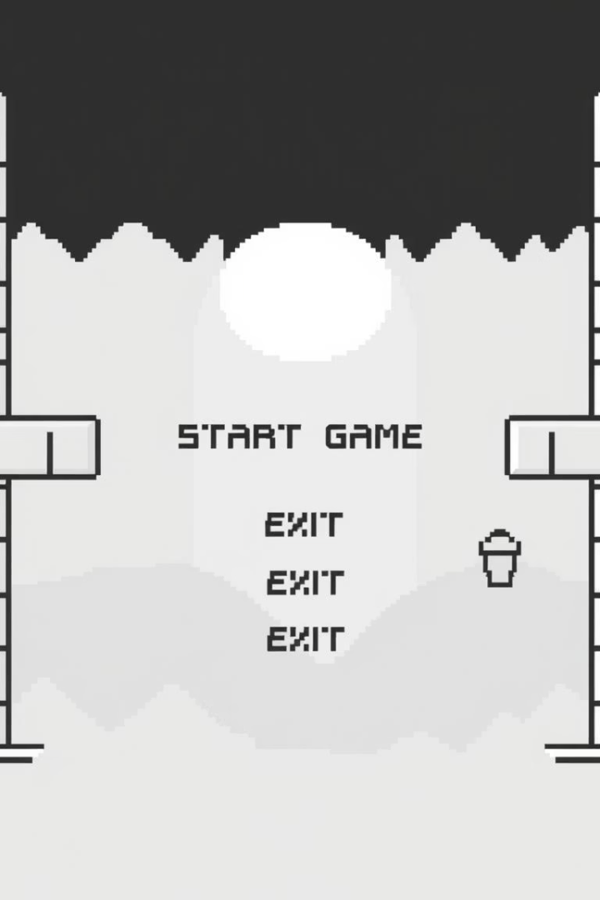
Core Gameplay & Features
Main Menu
Offers clear options to start or exit the game.
Dynamic Gameplay
Features a player, diverse enemies, collectible coins, and interactive blocks.
Audio Integration
Incorporates immersive sound effects and background music.
End Screens
Dedicated "Game Over" and "You Win" screens.

Slide 4
Object-Oriented Programming Concepts
Core Principles
Key Classes
Encapsulation: Data hidden within classes.
Player, Enemy, Coin, Block, Flag, Entity.
Inheritance: Reusing code from parent classes.
Entity class as superclass, demonstrating inheritance and polymorphism.
Polymorphism: Objects taking multiple forms.
Abstraction: Showing essential features.
Modular architecture: game logic, UI, audio, and utilities.

Slide 5








Event-Driven Programming & User Interaction
Input Events
Menu Navigation
Keyboard controls trigger game actions.
Mouse clicks navigate menu options.
Interactive Feedback
Responsive Actions
UI and sound provide immediate responses.
Application reacts dynamically to user inputs.

Slide 6
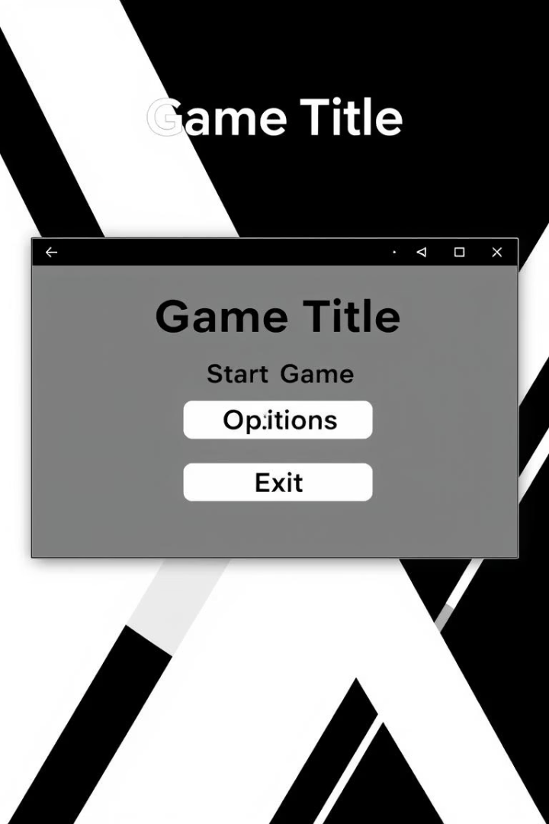
Graphical User Interface (GUI) Design
Swing Components
User-Friendly Layout
Utilizes JFrame, JPanel, JButton, and JLabel.
Clear navigation across all screens.
Multiple Screens
Includes Menu, Gameplay, Settings, and End screens.

Slide 7






File Handling & Data Persistence
Data Storage
High scores or progress are saved.
Java I/O Classes
Uses FileReader, FileWriter, BufferedReader, BufferedWriter.
Error Handling
Includes try-catch blocks for robustness.

Slide 8

Conclusion & Project Deliverables
Achievements
Seamless OOP/EDP integration, intuitive GUI, reliable file handling, engaging user experience.
Deliverables
Complete source code, comprehensive documentation, demo video, and this presentation.
Educational Value
Demonstrates practical skills in software development.

