Slide 1

VotingSystems: Simulating Philippine Elections in Java
Welcome, IT professors and students! This presentation introduces "VotingSystems," a Java desktop application simulating Philippine elections. Built with Java Swing, it offers a realistic, secure, and extensible system for national and local positions.

Slide 2
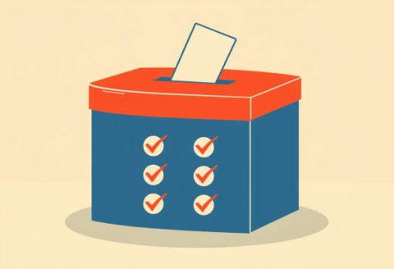
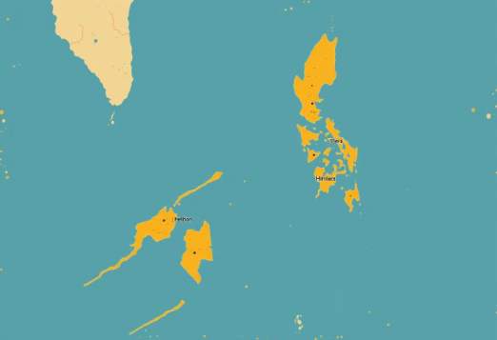

Core System Features
User Roles
Voting Rules
Place-Based Filtering
Admin for candidate management, voter for registration and casting ballots.
One vote per position, except for up to 12 unique senatorial votes.
Voters see only candidates relevant to their registered place.

Slide 3
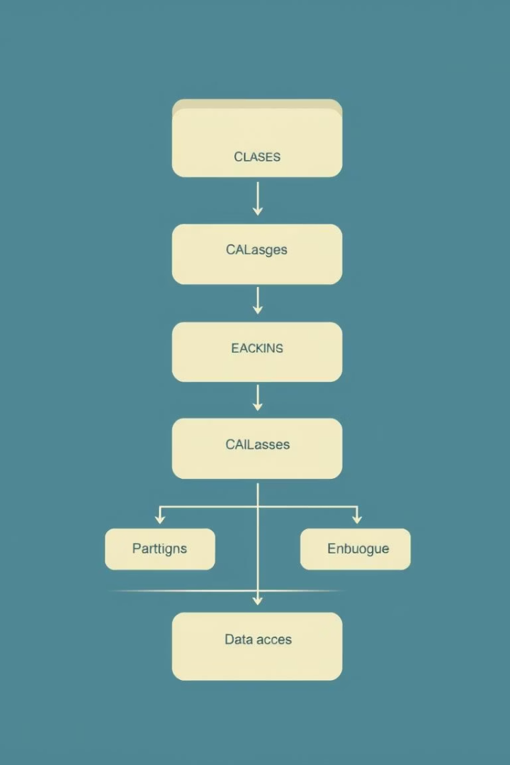
Object-Oriented Design Principles
Encapsulation
Each entity (Voter, Candidate, Admin, Vote) is a class with private fields and public methods.
Inheritance
Voter and Admin classes extend the common User class in the model/ package.
Polymorphism
Methods like canVoteFor() in Voter.java allow flexible voting rules.
Abstraction
VotingSystemManager.java handles all core business logic and data management.

Slide 4
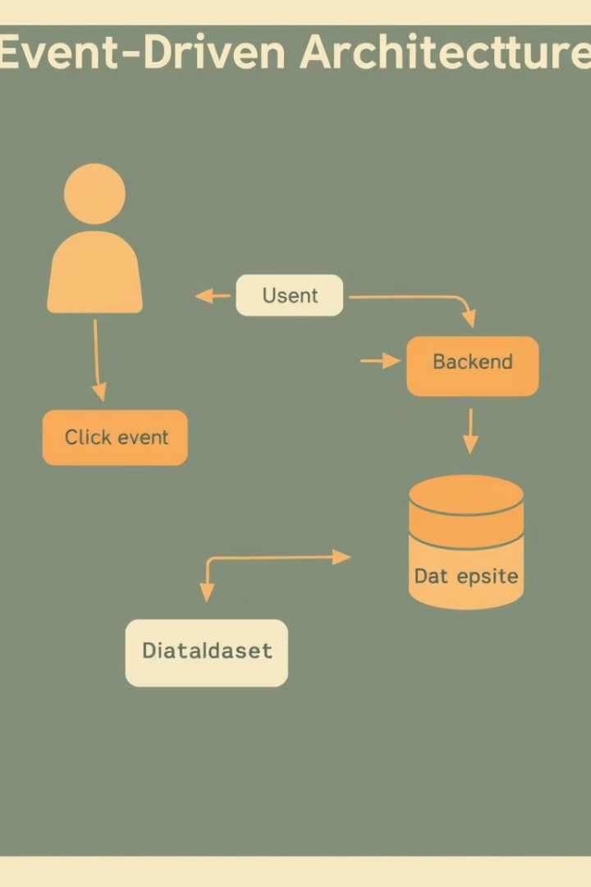



Event-Driven Programming
GUI Actions
Button clicks and form submissions trigger events.
Listener Handling
Handled by listeners in LoginScreen.java, AdminDashboard.java, and VoterDashboard.java.
Business Logic
Each user action initiates logic in VotingSystemManager.java.

Slide 5




Data Persistence: CSV File Handling
Data Storage
Robust Operations
All data saved in CSV files within the data/ directory (users.csv, candidates.csv, votes.csv, audit_log.csv).
Utilizes Apache Commons CSV for reliable file read/write operations, managed by VotingSystemManager.java.
Ensured Durability
Guarantees data preservation across sessions, enabling easy review and backup.

Slide 6

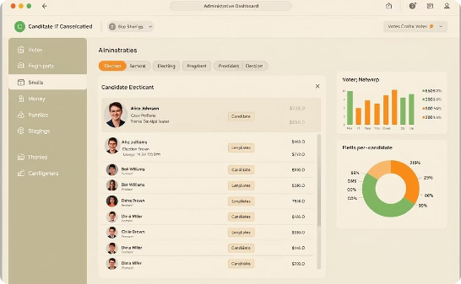
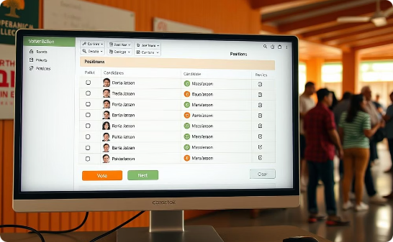
Functionality and User Experience
Login Screen (LoginScreen.java)
Admin Dashboard (AdminDashboard.java)
Voter Dashboard (VoterDashboard.java)
Secure user authentication.
Candidate management and system oversight.
Intuitive voting interface with real-time feedback.
The GUI is designed to be intuitive, ensuring ease of use for both administrators and voters, complete with comprehensive error handling.

Slide 7
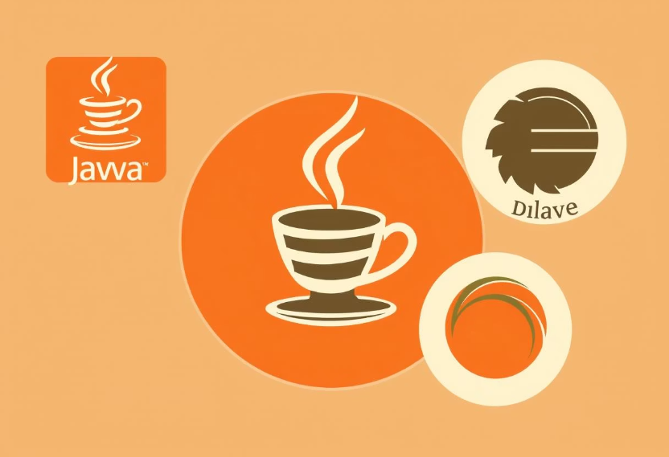
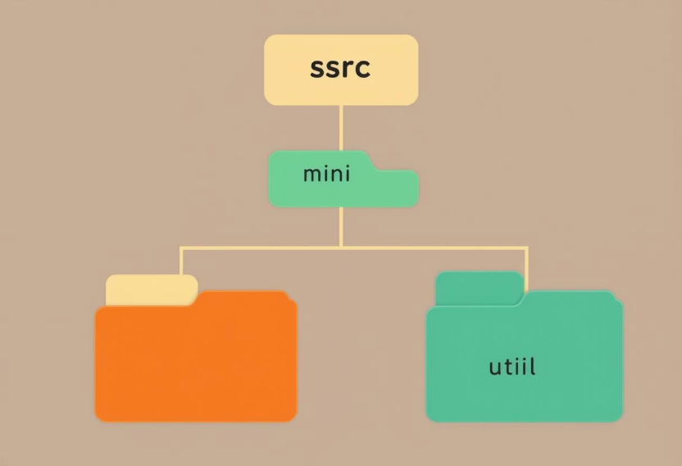
Project Setup and Structure
Prerequisites
Project Structure
JDK 24+
Import as Maven project (pom.xml)
Eclipse IDE
Main class: com.mycompany.votingsystems.VotingSystems
Maven
src/main/java/com/mycompany/votingsystems/ (gui/, model/, util/)
data/ for CSV storage

Slide 8





Conclusion and Q&A
Key Features
Security & Audit
User-Friendly
Realistic simulation, robust OOP and event-driven design.
Secure and auditable election process.
Designed for an optimal user experience.
Open Discussion
Questions on implementation, design choices, improvements.
VotingSystems offers a secure, extensible, and real-world relevant Java application for simulating Philippine elections. We invite your questions and feedback.

