Slide 1

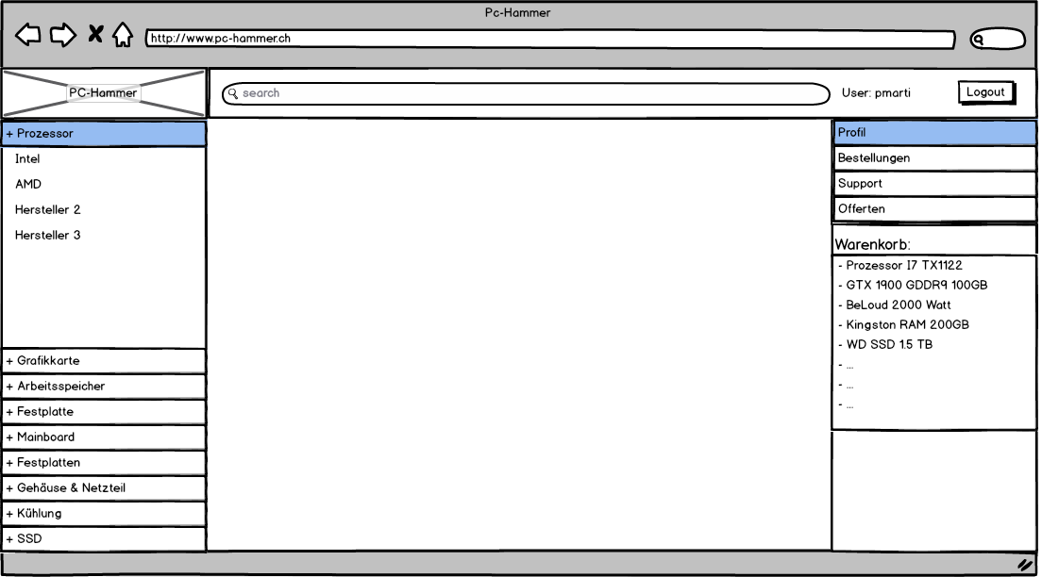
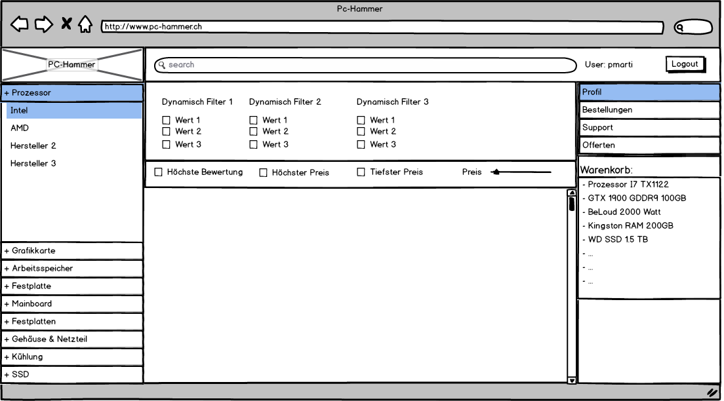
Project Review

Slide 2
Project Overview - Org
Show Task List

Slide 3
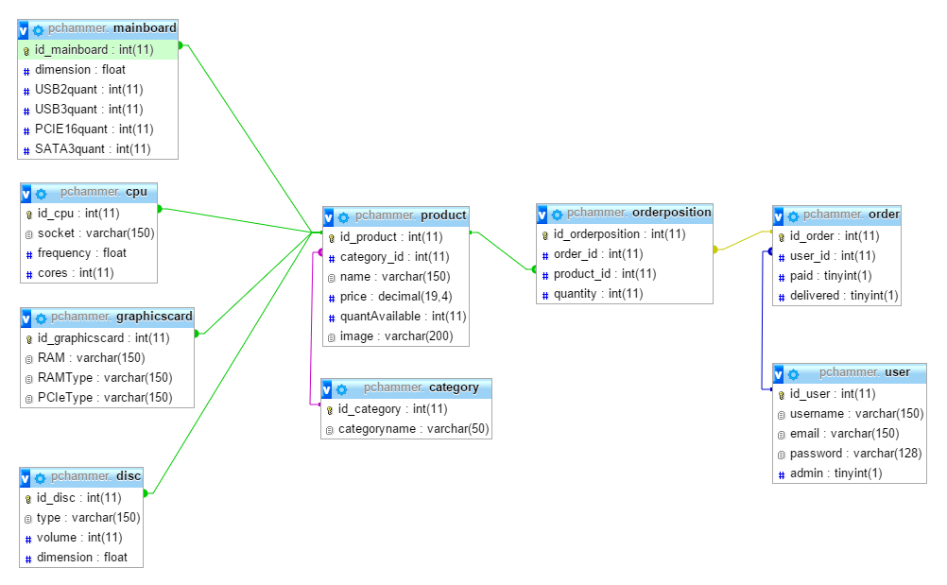
Project Overview - DB

Slide 4
Tasks – Best of
Template Engine
AJAX!
Database Design

Slide 5
Demo
Fancy!

Slide 6

Problems – Best of
Double Insert
JSON Encode
GIT Synchronization
Multilingual

Slide 7
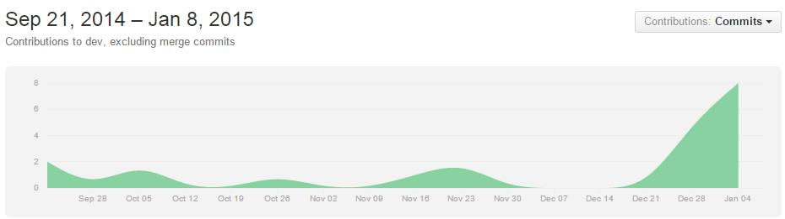
Conclusion
«Unterschätze die Arbeit nicht»

