Slide 1


Open Source & Data Virtualization
By Antoci Rosario – 2020-11-30 (Module 4 - BigDive)

Slide 2

~$whoami
Open Source Evangelist
Italian Linux Society - Board Director
IT Infrastructure Specialist at HPE CDS

Slide 3
After this lesson you should:
Open Source:
Comprehend the benefits of open source movement (product solutions, community benefits, career development etc..)
Data (Acquisition / Preparation / Virtualization / Visualization / Exploration) Pipeline!
Solid knowledge of the infrastructure level, containerization and dataflow,
Importance of data virtualization in substitution/support of general ETL solutions.

Slide 4

Part I - Open Source – Recap of a 22 years
What is open source?
Officially born in 1998, has its roots on Free Software movement founded in the 80s by Richard Matthew Stallman.
It’s basically started when the Linux Project was sustainable (1992/1993)
Open Source movement is guided by OSI (Open source Initiative)

Slide 5
Part I - Open Source - Community - Why it matters?
Open Source model is only sustainable with less constraints as possible,so the best entities who can really provide assistance, further development, documentation, beta testing and many other form of support are communities.
It’s useful for individuals to get into their local communities to learn and share open source knowledge.
At first there were Linux User Groups, now there are meetups for any kind of technology trends and even companies follows the “community model”.

Slide 6
Part I - Open Source – Enterprise – Why it matters?
Different approaches to businesses: from the economic model to the organization perspective
Cooperation and collaboration, less competition on technology discoveries
Less static, more creative
No forms of lock-in
Ultimate Open Source Report by RedHat Inc.

Slide 7
Part I - Open Source – Enterprise – Business model
Professional services
Open-source software can also be commercialized from selling services, such as training, technical support, or consulting, rather than the software itself.
Software as a Service
This kind of business is discouraged by FSF, but it’s spreading since the Internet Era.
Crowdsourcing, several core library, sometimes forgotten live by that (Ex. GNU gpg, sponsored by Facebook and Google).

Slide 8
Part II – Data Virtualization
Once upon a time in... datacenter:
RDBMS: single/multiple instance of same type
BI: simple
Standard reports
Ready, steady, go!

Slide 9
Part II – Data Virtualization
Nowadays...

Slide 10

Part II – Data Virtualization

Slide 11

Part II – Data Virtualization

Slide 12
Part II – Data Virtualization

Slide 13


Part II – Data Virtualization with Dremio

Slide 14
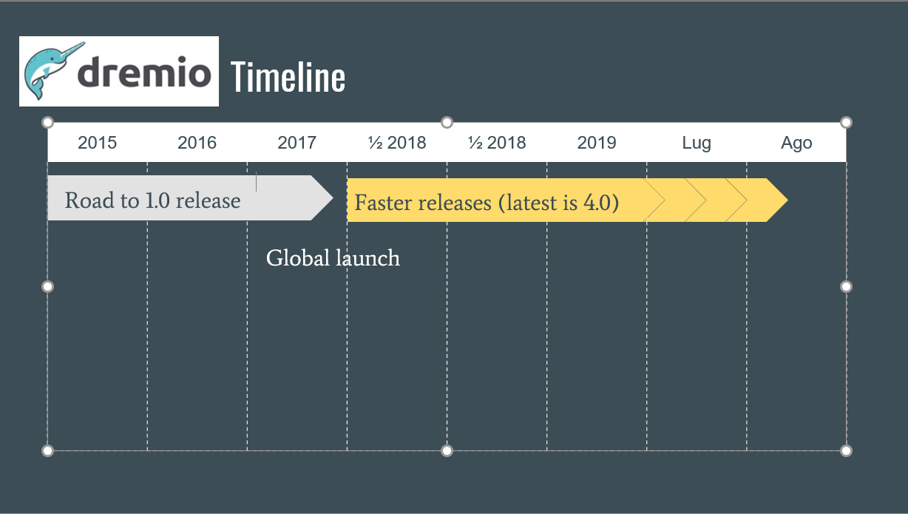
Part II – Data Virtualization with Dremio

Slide 15

Part II – Data Virtualization
What is it?
● Apache Arrow is an open source project that enables columnar in-memory data processing and interchange, optimized for memory and CPU (Intel)
● Used by an incredibly amount of projects
Python and R above all.
● Columnar on memory
Dremio is the first execution engine built on Apache Arrow
What does it means?
● SIMD Paradigm
● Really fast reads (over 10 GB/s)
● Data in-memory is maintained off-heap in the Arrow format avoiding slowness.

Slide 16

Part II – Data Virtualization

Slide 17

Part II – Data Virtualization – Interactions before

Slide 18

Part II – Data Virtualization – Interactions after

Slide 19


Apache & (Columnar on Disk)
What are they?
Apache Parquet and Apache ORC are open source projects that enables columnar data storage.
So what?
● Parquet compress efficiently
● With ORC, storing data in a columnar format lets the reader read, decompress, and process only the values that are required for the current query

Slide 20

(DB or not DB?)
What is it?
Not a DB.
- Standard SQL
- Query Optimizator
- Connect to third-party data sources, browse metadata, and optimize by pushing the computation to the data
So what?
● Useful for Dremio Data Reflections
● You can talk SQL to NoSQL sources.

Slide 21
Part II – Data Reflections
What are they?
Dremio supports two fundamental types of Data Reflections: Raw Reflections and Aggregation
So what?
● Raw Reflections preserve row-level fidelity of the anchor dataset. A Raw Reflection includes one or morefields from the anchor dataset, and is sorted and partitioned by specific fields. You can use Raw Reflectionsto perform a number of optimizations
● Aggregation Reflections maintain summary data about the anchor dataset, so are useful to reduce the dataset target (BE AWARE OF CARDINALITY!!)

Slide 22

Part II – Data Reflections

Slide 23

Part II – Dremio utilization – Data Driven

Slide 24

Part II – Dremio utilization – Data Driven

Slide 25
Part II – Encryption and security
Dremio leverages both TLS (SSL) and Kerberos.
When connecting to a secure Hadoop cluster, Dremio communicates securely with the Hadoop services via Kerberos.
For other data sources, Dremio supports the standard wire-level encryption scheme of the source system.

Slide 26
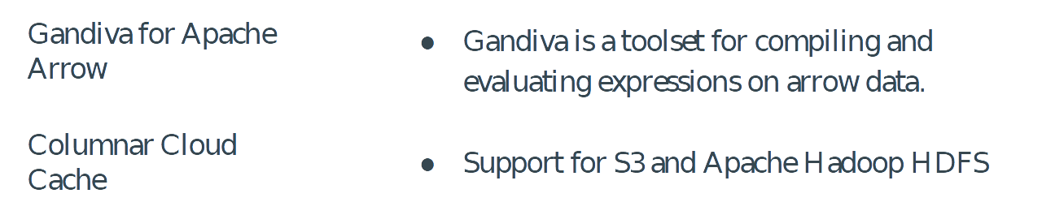
Part II - Other feature C3, Gandiva...

Slide 27

Part II - Columnar Cloud Cache: Overview

Slide 28
Part II – Data Virtualization
Let’s start with a todo list…
Create an infrastructure to run our test, step by step.
Create an app for simulate data source(s)
Data ingestion with different methods
Example of Data Virtualization
Data Exploration and recap of the playground
Bonus track: Data visualization

Slide 29
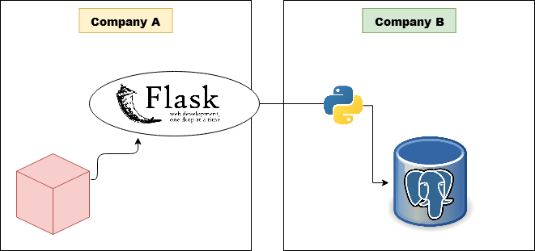
Practical setup – Data Collection, Mock API with Python

