Slide 1
Index Tracking with wAVaR
Seungmoon Rieh

Slide 2
Index Tracking
Replicate certain Index fund
Passive portfolio management strategy
All stocks vs Subset of stocks

Slide 3
Tracking Error
Unavoidable
Subset of stocks
Should be Minimized

Slide 4
Goal?
Max Tracking performance
Min Tracking error

Slide 5
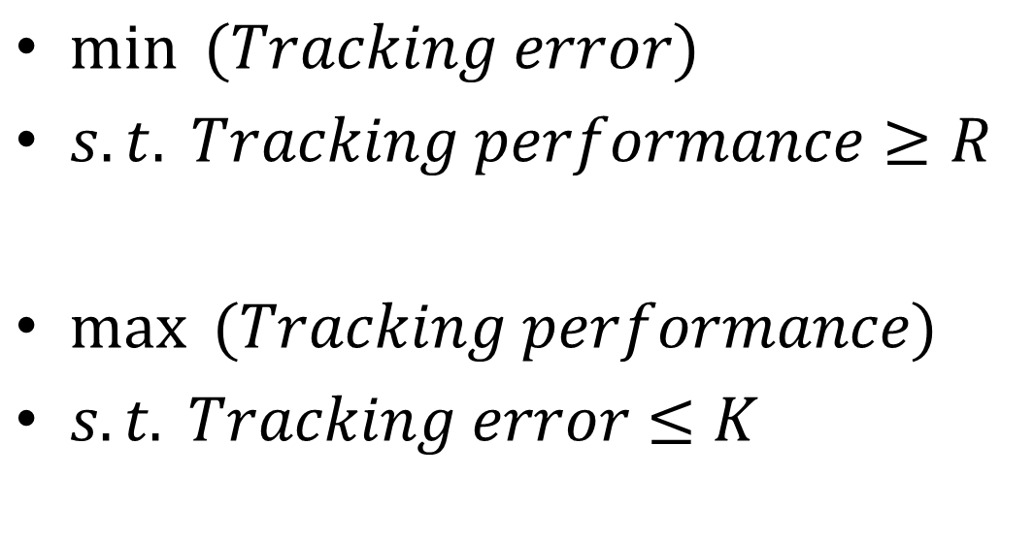
Two formulations
$\min{ (Tracking error)}$
$s.t. Tracking performance≥R$
$\max{ (Tracking performance)}$
$s.t. Tracking error≤K$

Slide 6
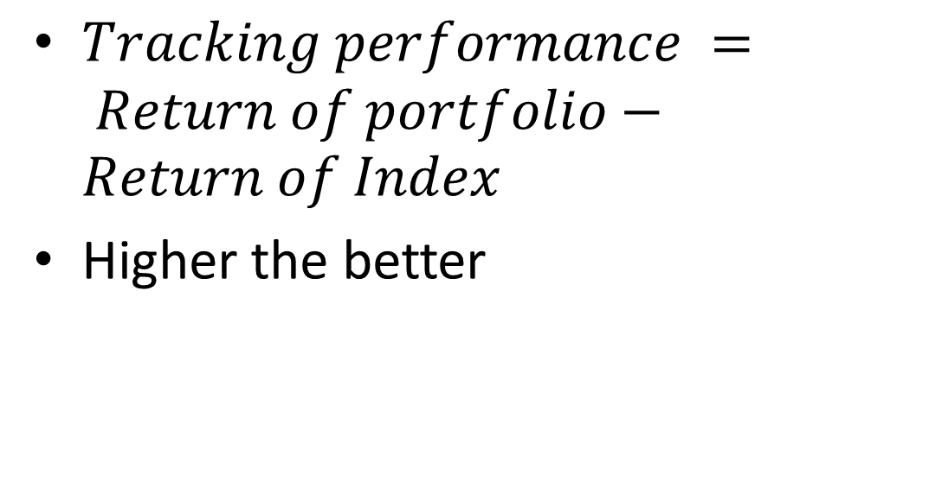
Tracking Performance
$Tracking performance = Return of portfolio−Return of Index$
Higher the better

Slide 7
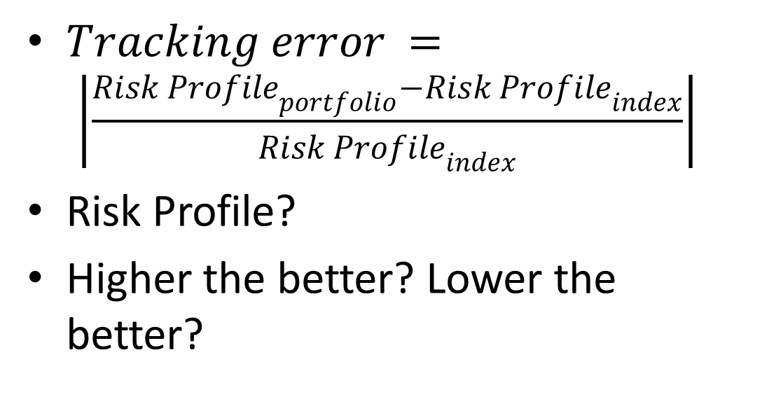
Tracking Error
$Tracking error = \left|\frac{{Risk Profile}_{portfolio}−{Risk Profile}_{index}}{{Risk Profile}_{index}}\right|$
Risk Profile?
Higher the better? Lower the better?

Slide 8
How to select stocks?
How many?
Based on what?

Slide 9
How to select stocks?
Beta
Correlation
Market cap
Sector

Slide 10
How to select stocks?
SPDR ~ 240 stocks
So pick ~ <240 stocks
Select exact proportion from each sector
Order by Market cap

Slide 11
Assumption
Risk taking
Risk neutral
Risk averse
Short term? Long term?

Slide 12
Extreme events
Low probability high impact event that can cripple investor
Long term investor V.S. Short term investor

Slide 13
How to measure risk
Variance (MVO)
Standard deviation
Mean absolute deviation (MAD)
Expected? Tail Loss (ETL)

Slide 14
Where risk come from?
Uncertainty
Broader term than risk
Uncertainty in stock return (thus portfolio return) in the future

Slide 15
Model Uncertainty
History
Weighted history
Distribution
Normal?

Slide 16
What can be risk measure
Must financially make sense
Coherent risk measure
Need to satisfy four axioms

Slide 17
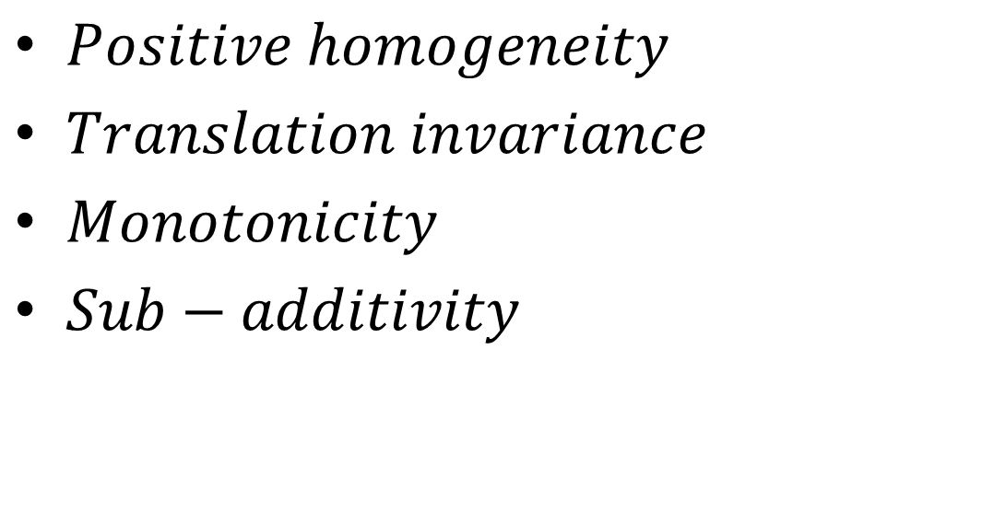
Coherent risk measure
$Positive homogeneity$
$Translation invariance$
$Monotonicity$
$Sub−additivity$

Slide 18
Deviation measure
Symmetric penalization
Risk attitude of investors?
Coherent?

Slide 19
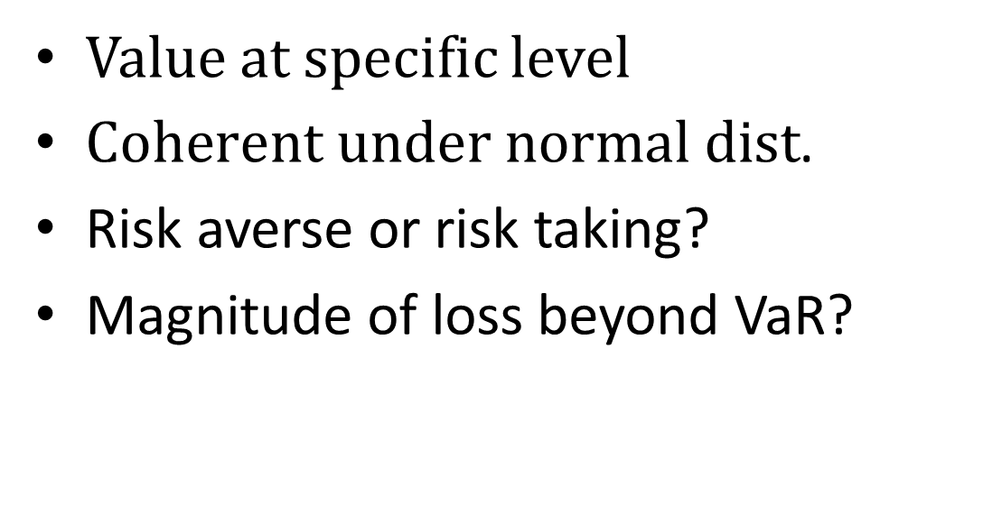
Value at risk
Value at specific level
$Coherent under normal dist$.
Risk averse or risk taking?
Magnitude of loss beyond VaR?

Slide 20
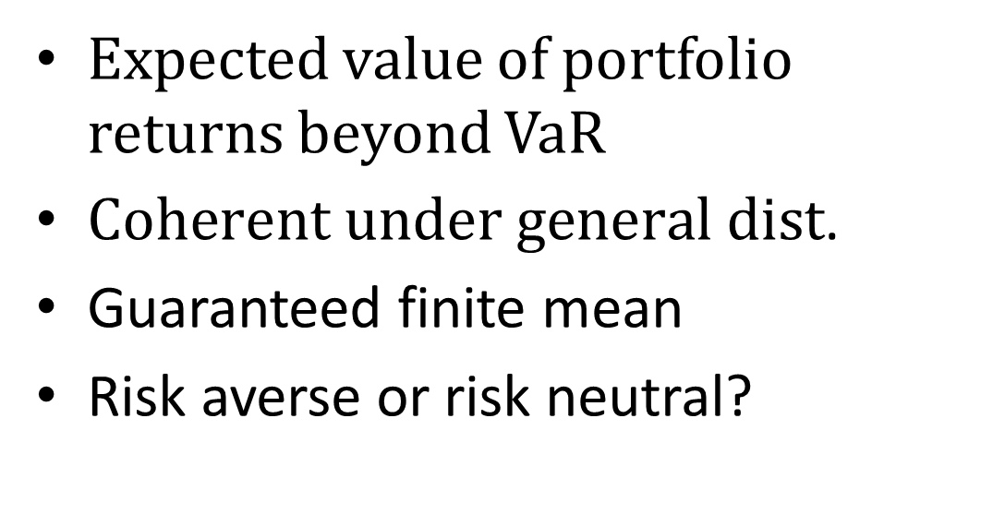
Average Value at risk
Expected value of portfolio returns beyond VaR
$Coherent under general dist$.
Guaranteed finite mean
Risk averse or risk neutral?

Slide 21
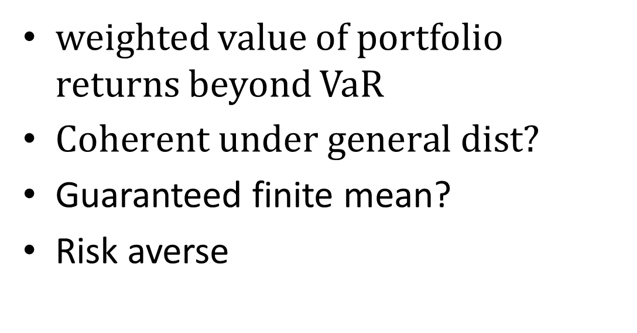
weighted Average Value at risk
weighted value of portfolio returns beyond VaR
$Coherent under general dist?$
Guaranteed finite mean?
Risk averse

Slide 22
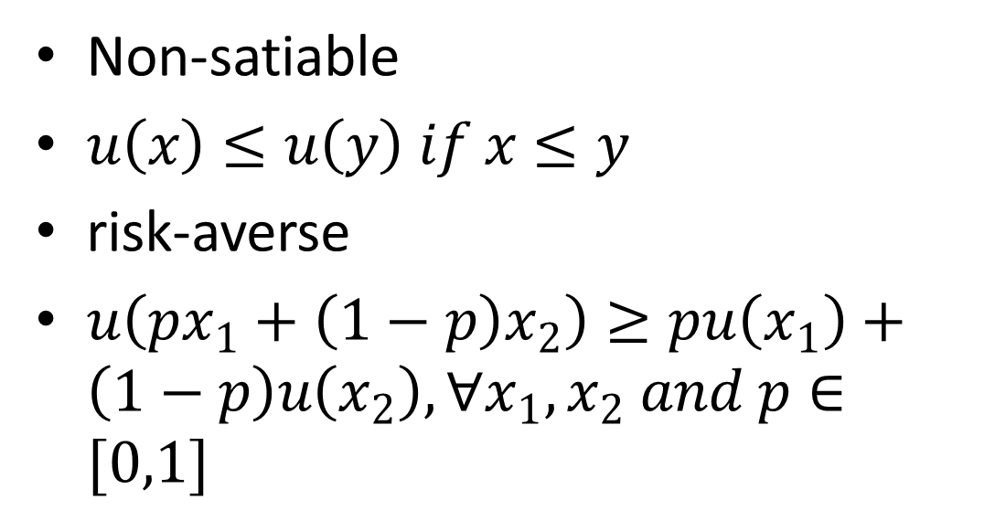
Utility function
Non-satiable
$u\left(x\right)≤u\left(y\right) if x≤y$
risk-averse
$u\left(px_{1}+\left(1−p\right)x_{2}\right)≥pu\left(x_{1}\right)+\left(1−p\right)u\left(x_{2}\right), ∀x_{1},x_{2} and p∈[0,1]$

Slide 23
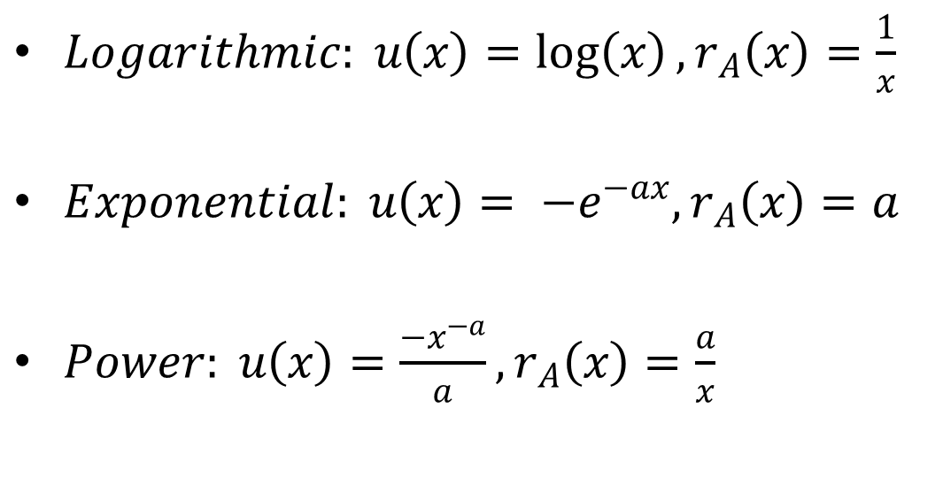
Nonsatiable & Risk-averse
$Logarithmic: u\left(x\right)=\log\left(x\right), r_{A}\left(x\right)=\frac{1}{x}$
$Exponential: u\left(x\right)= −e^{−ax}, r_{A}\left(x\right)=a$
$Power: u\left(x\right)=\frac{−x^{−a}}{a}, r_{A}\left(x\right)=\frac{a}{x}$

Slide 24
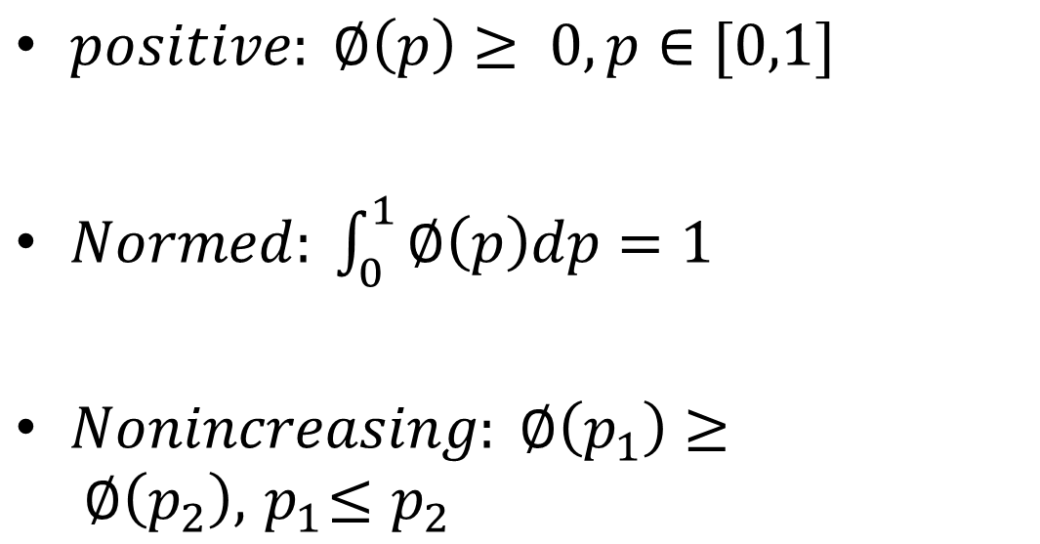
Coherency Axiom(Acerbi?)
$positive: ∅\left(p\right)≥ 0, p∈[0,1]$
$Normed: \int_{0}^{1}{∅\left(p\right)dp}=1$
$Nonincreasing: ∅\left(p_{1}\right)≥ ∅\left(p_{2}\right), { p}_{1}≤p_{2}$

Slide 25
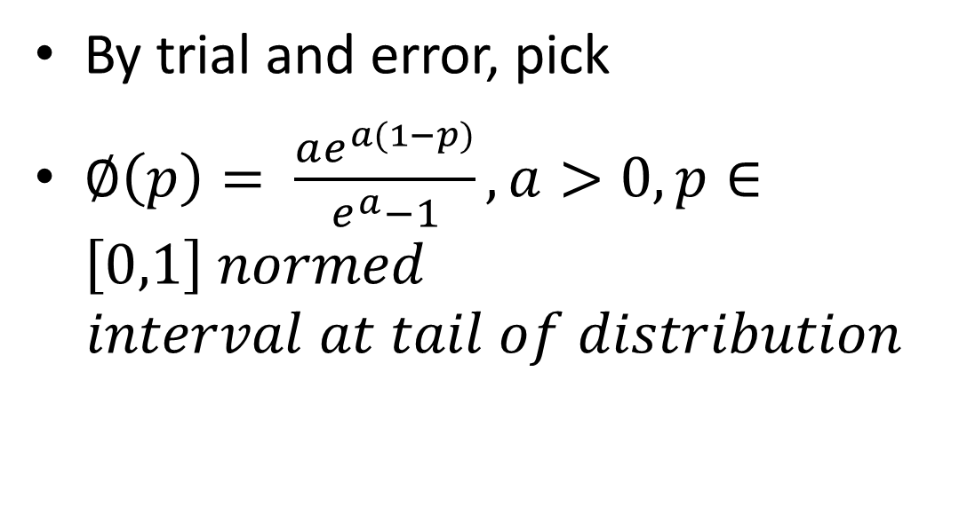
Utility function
By trial and error, pick
$∅\left(p\right)= \frac{ae^{a(1−p)}}{e^{a}−1}, a>0, p∈\left[0,1\right] normed$
$$interval at tail of distribution$$

Slide 26
Axiom for coherency 1
Nominator is positive
Denominator is also positive
Whole thing is positve

Slide 27
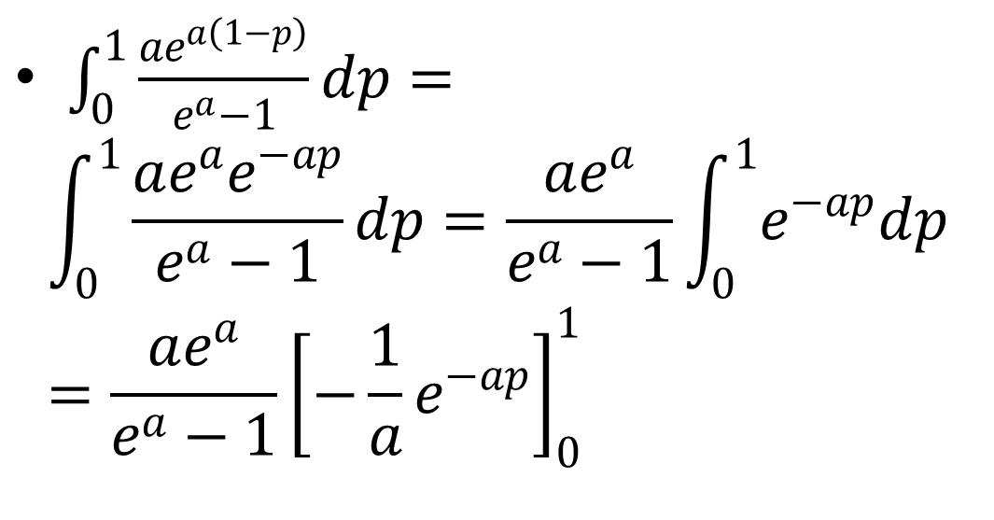
Axiom for coherency 2
$\int_{0}^{1}{\frac{ae^{a\left(1−p\right)}}{e^{a}−1}dp}=$
$$\int_{0}^{1}{\frac{ae^{a}e^{−ap}}{e^{a}−1}dp}=\frac{ae^{a}}{e^{a}−1}\int_{0}^{1}{e^{−ap}dp}=\frac{ae^{a}}{e^{a}−1}{\left[−\frac{1}{a}e^{−ap}\right]}_{0}^{1}$$

Slide 28
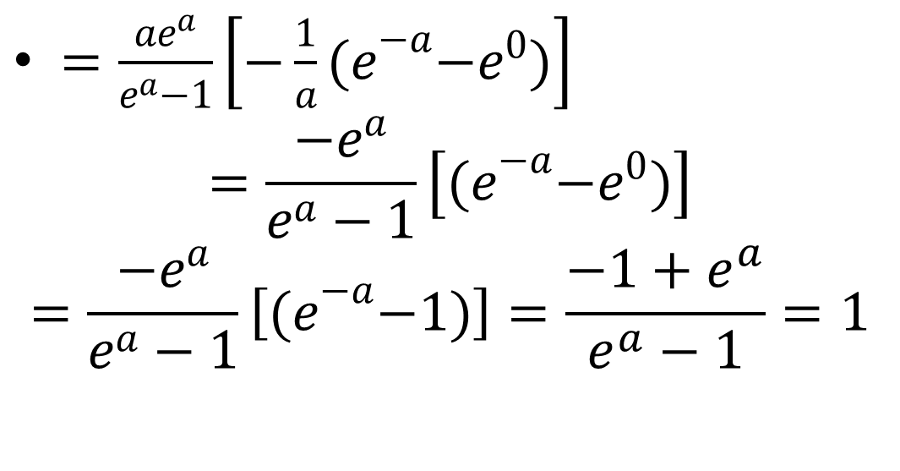
Axiom for coherency 2
$=\frac{ae^{a}}{e^{a}−1}\left[−\frac{1}{a}{(e}^{−a}−e^{0})\right]$
$$=\frac{−e^{a}}{e^{a}−1}\left[{(e}^{−a}−e^{0})\right]$$
$$=\frac{−e^{a}}{e^{a}−1}\left[{(e}^{−a}−1)\right]=\frac{−1+e^{a}}{e^{a}−1}=1$$

Slide 29

Axiom for coherency 3
$∅′\left(p\right)= \frac{−a^{2}e^{a(1−p)}}{e^{a}−1}, a>0$

Slide 30
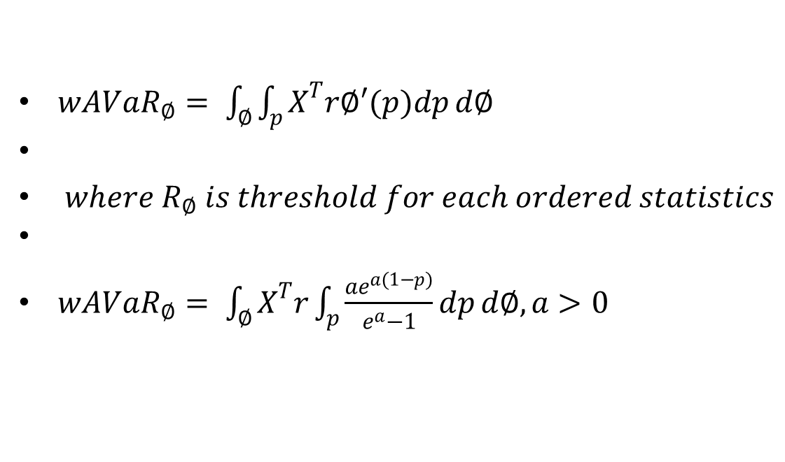
wAVaR
${wAVaR}_{∅}= \int_{∅}{\int_{p}{X^{T}r∅′(p)dp}}d∅$
$where R_{∅} is threshold for each ordered statistics$
${wAVaR}_{∅}= \int_{∅}{X^{T}r\int_{p}{\frac{ae^{a(1−p)}}{e^{a}−1}dp}}d∅,a>0$

Slide 31
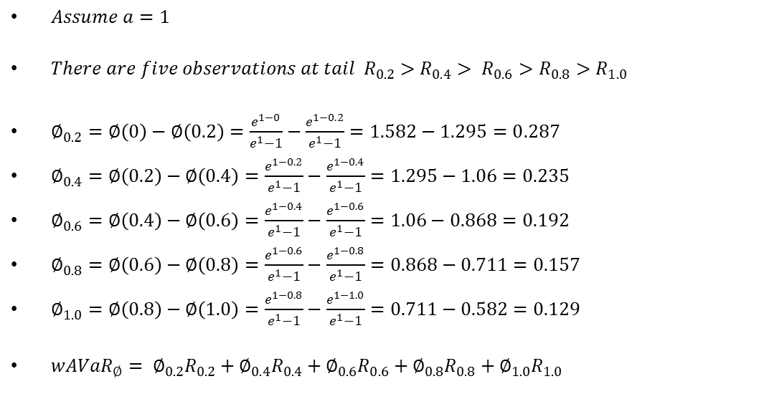
Example
$Assume a=1$
$There are five observations at tail R_{0.2}>R_{0.4}> R_{0.6}>R_{0.8}>R_{1.0}$
$∅_{0.2}=∅\left(0\right)−∅\left(0.2\right)=\frac{e^{1−0}}{e^{1}−1}−\frac{e^{1−0.2}}{e^{1}−1}=1.582−1.295=0.287$
$∅_{0.4}=∅\left(0.2\right)−∅\left(0.4\right)=\frac{e^{1−0.2}}{e^{1}−1}−\frac{e^{1−0.4}}{e^{1}−1}=1.295−1.06=0.235$
$∅_{0.6}=∅\left(0.4\right)−∅\left(0.6\right)=\frac{e^{1−0.4}}{e^{1}−1}−\frac{e^{1−0.6}}{e^{1}−1}=1.06−0.868=0.192$
$∅_{0.8}=∅\left(0.6\right)−∅\left(0.8\right)=\frac{e^{1−0.6}}{e^{1}−1}−\frac{e^{1−0.8}}{e^{1}−1}=0.868−0.711=0.157$
$∅_{1.0}=∅\left(0.8\right)−∅\left(1.0\right)=\frac{e^{1−0.8}}{e^{1}−1}−\frac{e^{1−1.0}}{e^{1}−1}=0.711−0.582=0.129$
${wAVaR}_{∅}= ∅_{0.2}R_{0.2}+∅_{0.4}R_{0.4}+∅_{0.6}R_{0.6}+∅_{0.8}R_{0.8}+∅_{1.0}R_{1.0}$

Slide 32
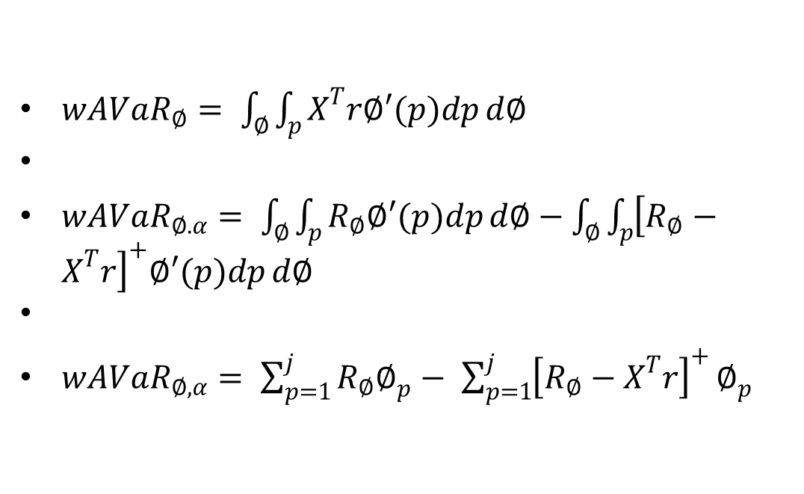
Rockafellar, T and Uryasev S.
${wAVaR}_{∅}= \int_{∅}{\int_{p}{X^{T}r∅′(p)dp}}d∅$
${wAVaR}_{∅.α}= \int_{∅}{\int_{p}{R_{∅}∅′(p)dp}}d∅−\int_{∅}{\int_{p}{{\left[R_{∅}−X^{T}r\right]}^{+}∅′(p)dp}}d∅$
$wAVaR_{∅,α}= \sum_{p=1}^{j}{R_{∅}∅_{p}}− \sum_{p=1}^{j}{{\left[R_{∅}−X^{T}r\right]}^{+}}∅_{p}$

Slide 33

Optimization framework
$\max{x^{T}r}$
Such that $\left|\frac{{wAVaR}_{α}^{x}−{wAVaR}_{a}^{X}}{{wAVaR}_{a}^{X}}\right|≤K$
$x^{T}1=1$
$ub≤x<lb$

Slide 34
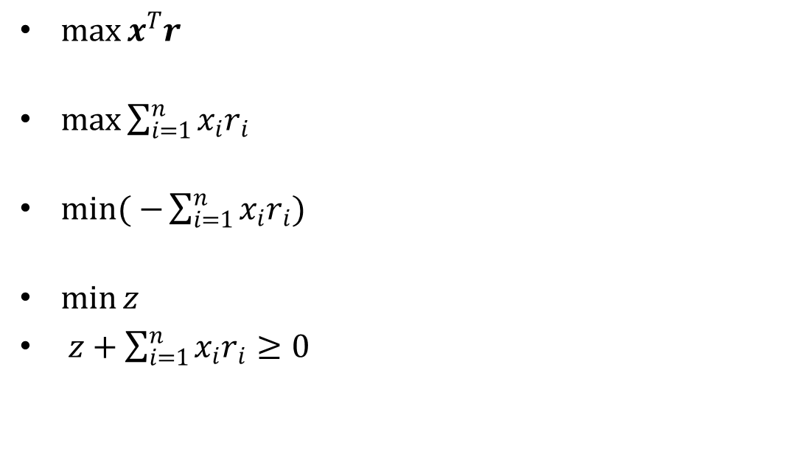
Uncertainty in Obj. fun.
$\max{x^{T}r}$
$\max{\sum_{i=1}^{n}{x_{i}r_{i}}}$
$\min{( −\sum_{i=1}^{n}{x_{i}r_{i}})}$
$\min{z }$
$z+\sum_{i=1}^{n}{x_{i}r_{i}}≥0$

Slide 35
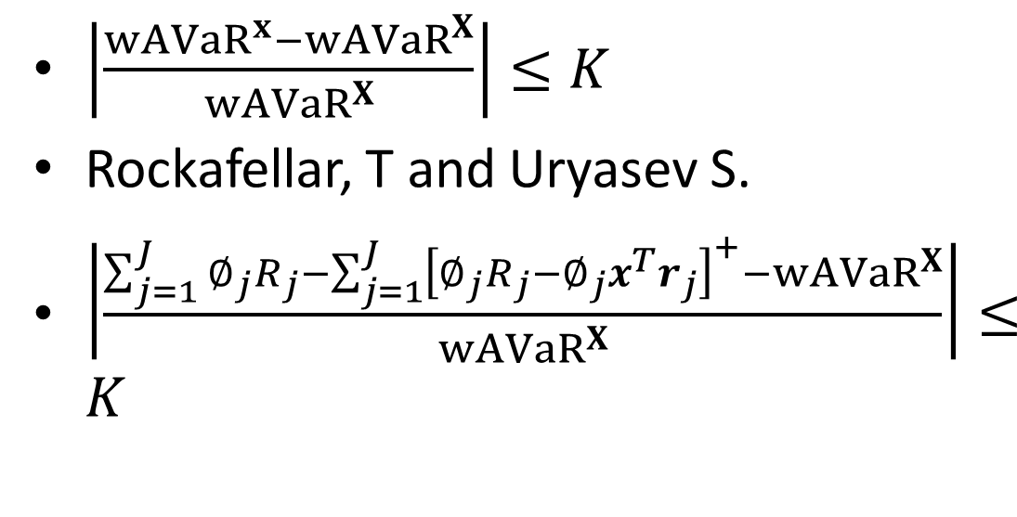
Tracking Error
$\left|\frac{{wAVaR}^{x}−{wAVaR}^{X}}{{wAVaR}^{X}}\right|≤K$
Rockafellar, T and Uryasev S.
$\left|\frac{\sum_{j=1}^{J}{∅_{j}R_{j}}−\sum_{j=1}^{J}{{\left[∅_{j}R_{j}−∅_{j}x^{T}r_{j}\right]}^{+}}−{wAVaR}^{X}}{{wAVaR}^{X}}\right|≤K$

Slide 36
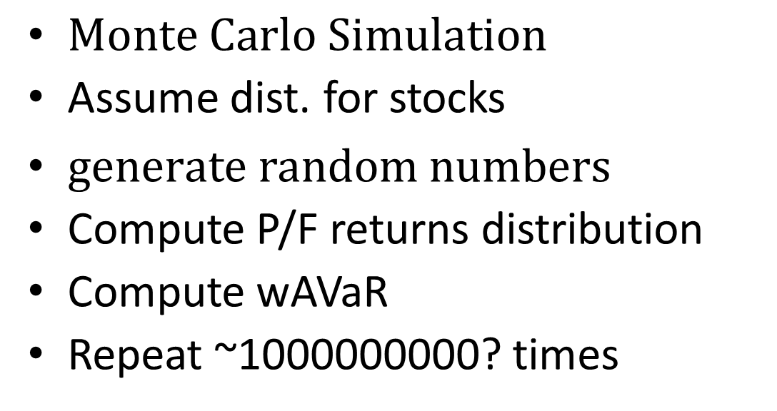

${wAVaR}^{X}$?
$Monte Carlo Simulation$
Assume dist. for stocks
$generate random numbers$
Compute P/F returns distribution
Compute wAVaR
Repeat ~1000000000? times

Slide 37
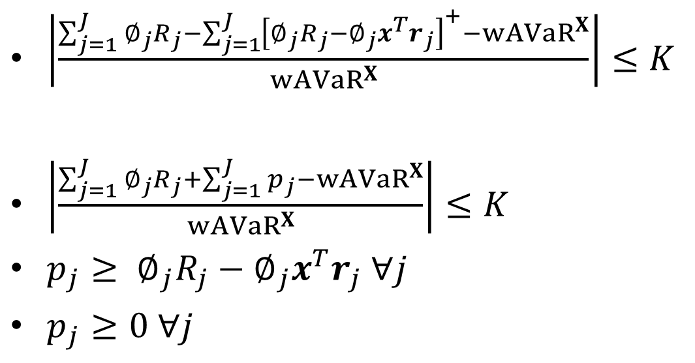
Wang, M., Xu, C., Xu, F., and Xue, H.
$\left|\frac{\sum_{j=1}^{J}{∅_{j}R_{j}}−\sum_{j=1}^{J}{{\left[∅_{j}R_{j}−∅_{j}x^{T}r_{j}\right]}^{+}}−{wAVaR}^{X}}{{wAVaR}^{X}}\right|≤K$
$\left|\frac{\sum_{j=1}^{J}{∅_{j}R_{j}}+\sum_{j=1}^{J}{p_{j}}−{wAVaR}^{X}}{{wAVaR}^{X}}\right|≤K$
$p_{j}≥ ∅_{j}R_{j}−∅_{j}x^{T}r_{j} ∀j$
$p_{j}≥0 ∀j$

Slide 38
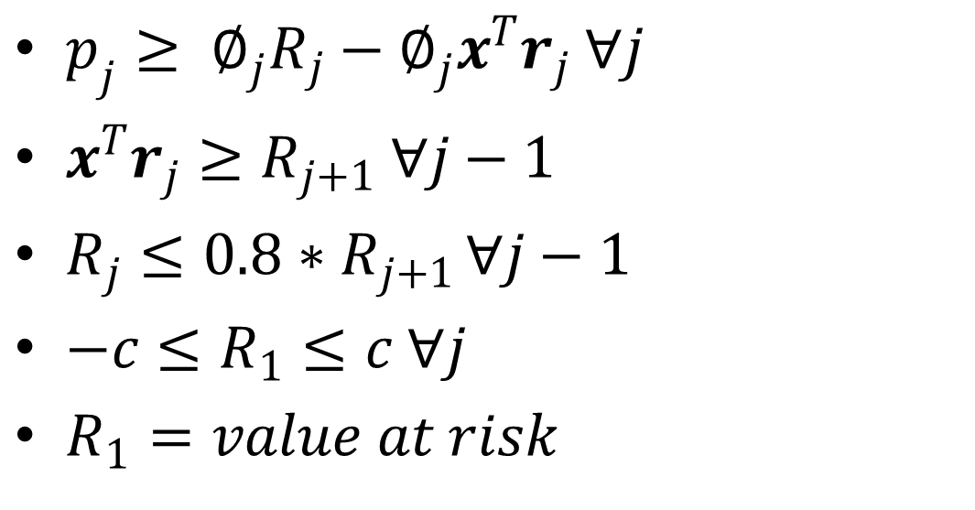
Ordered Statistics
$p_{j}≥ ∅_{j}R_{j}−∅_{j}x^{T}r_{j} ∀j$
$x^{T}r_{j}≥R_{j+1} ∀j−1$
$R_{j}≤{0.8∗R}_{j+1 }∀j−1$
$−c≤R_{1}≤c ∀j$
$R_{1}=value at risk$

Slide 39
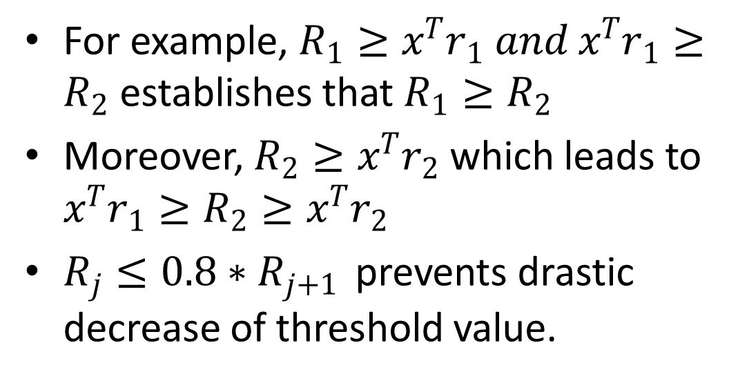
Ordered Statistics
For example, $R_{1}≥x^{T}r_{1} and x^{T}r_{1}≥R_{2}$establishes that $R_{1}≥R_{2}$
Moreover, $R_{2}≥x^{T}r_{2}$ which leads to $x^{T}r_{1}≥R_{2}≥x^{T}r_{2}$
$R_{j}≤{0.8∗R}_{j+1 }$ prevents drastic decrease of threshold value.

Slide 40
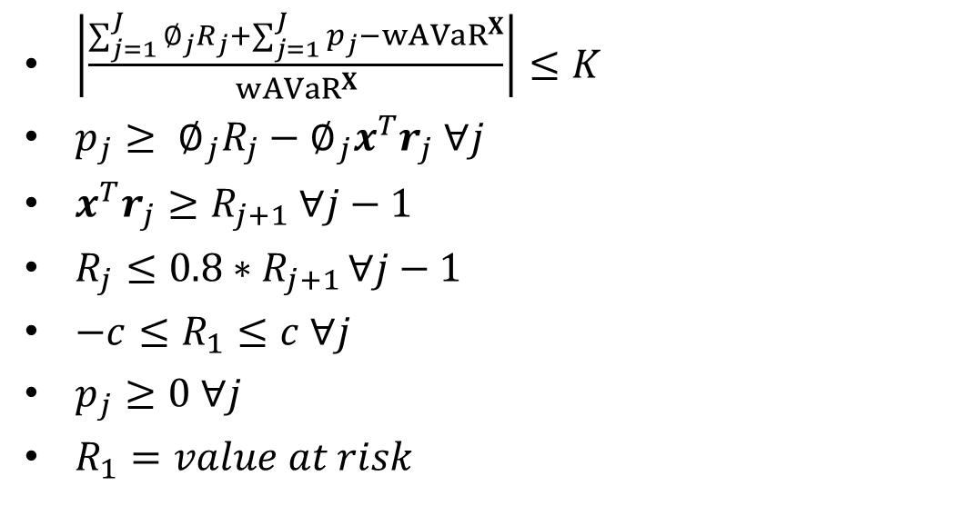
Tracking Error
$\left|\frac{\sum_{j=1}^{J}{∅_{j}R_{j}}+\sum_{j=1}^{J}{p_{j}}−{wAVaR}^{X}}{{wAVaR}^{X}}\right|≤K$
$p_{j}≥ ∅_{j}R_{j}−∅_{j}x^{T}r_{j} ∀j$
$x^{T}r_{j}≥R_{j+1} ∀j−1$
$R_{j}≤{0.8∗R}_{j+1 }∀j−1$
$−c≤R_{1}≤c ∀j$
$p_{j}≥0 ∀j$
$R_{1}=value at risk$

Slide 41
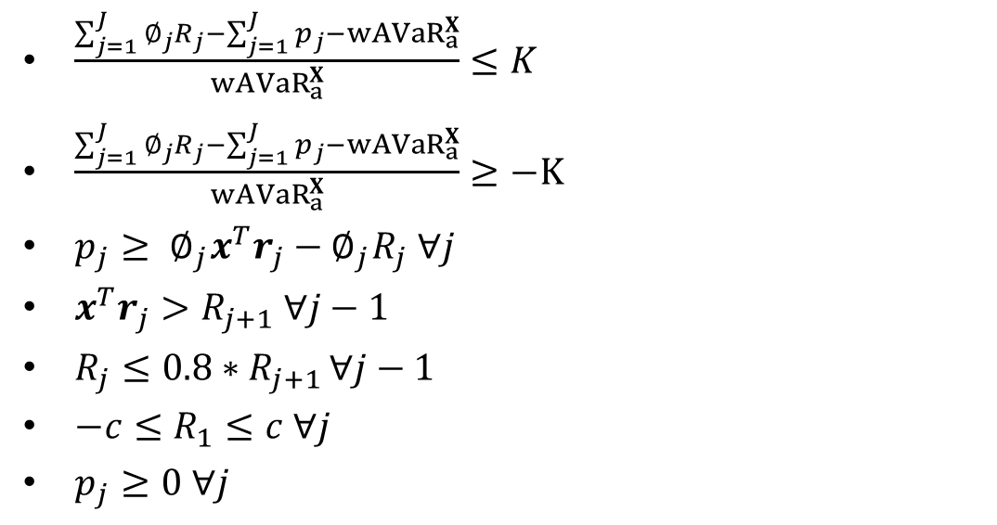
Extract absolute value
$\frac{\sum_{j=1}^{J}{∅_{j}R_{j}}−\sum_{j=1}^{J}{p_{j}}−{wAVaR}_{a}^{X}}{{wAVaR}_{a}^{X}}≤K$
$\frac{\sum_{j=1}^{J}{∅_{j}R_{j}}−\sum_{j=1}^{J}{p_{j}}−{wAVaR}_{a}^{X}}{{wAVaR}_{a}^{X}}≥−K$
$p_{j}≥ ∅_{j}x^{T}r_{j}−∅_{j}R_{j} ∀j$
$x^{T}r_{j}>R_{j+1} ∀j−1$
$R_{j}≤{0.8∗R}_{j+1 }∀j−1$
$−c≤R_{1}≤c ∀j$
$p_{j}≥0 ∀j$

Slide 42
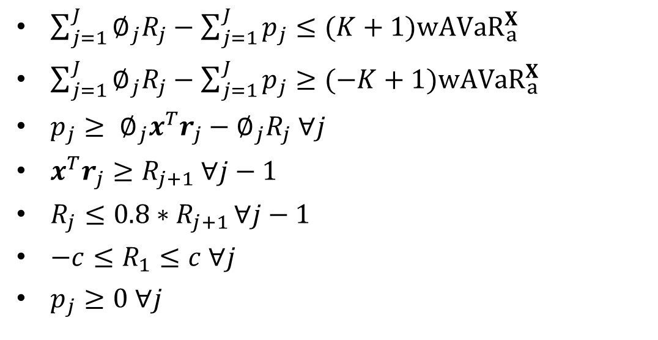
Reorder
$\sum_{j=1}^{J}{∅_{j}R_{j}}−\sum_{j=1}^{J}{p_{j}}≤(K+1){wAVaR}_{a}^{X}$
$\sum_{j=1}^{J}{∅_{j}R_{j}}−\sum_{j=1}^{J}{p_{j}}≥(−K+1){wAVaR}_{a}^{X}$
$p_{j}≥ ∅_{j}x^{T}r_{j}−∅_{j}R_{j} ∀j$
$x^{T}r_{j}≥R_{j+1} ∀j−1$
$R_{j}≤{0.8∗R}_{j+1 }∀j−1$
$−c≤R_{1}≤c ∀j$
$p_{j}≥0 ∀j$

Slide 43
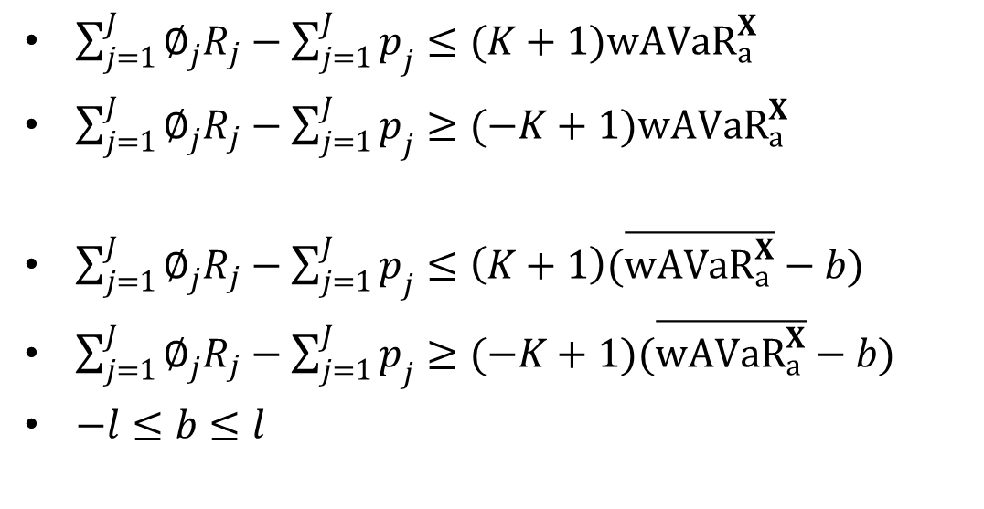

Uncertainty in ${wAVaR}_{a}^{X}$?
$\sum_{j=1}^{J}{∅_{j}R_{j}}−\sum_{j=1}^{J}{p_{j}}≤(K+1){wAVaR}_{a}^{X}$
$\sum_{j=1}^{J}{∅_{j}R_{j}}−\sum_{j=1}^{J}{p_{j}}≥(−K+1){wAVaR}_{a}^{X}$
$\sum_{j=1}^{J}{∅_{j}R_{j}}−\sum_{j=1}^{J}{p_{j}}≤\left(K+1\right)(\overline{{wAVaR}_{a}^{X}}−b)$
$\sum_{j=1}^{J}{∅_{j}R_{j}}−\sum_{j=1}^{J}{p_{j}}≥(−K+1)(\overline{{wAVaR}_{a}^{X}}−b)$
$−l≤b≤l$

Slide 44
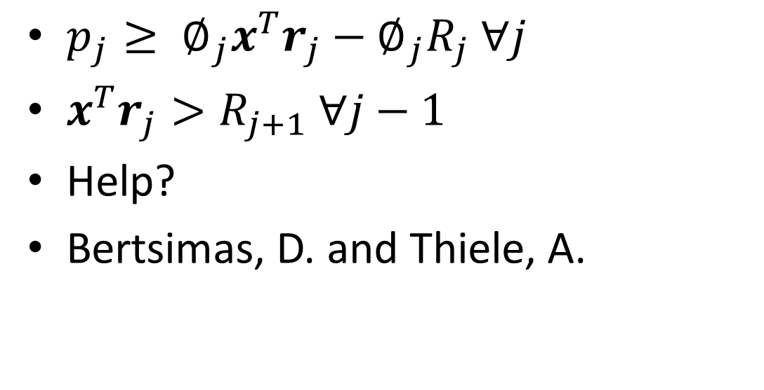
Hard constraints
$p_{j}≥ ∅_{j}x^{T}r_{j}−∅_{j}R_{j} ∀j$
$x^{T}r_{j}>R_{j+1} ∀j−1$
Help?
Bertsimas, D. and Thiele, A.

Slide 45
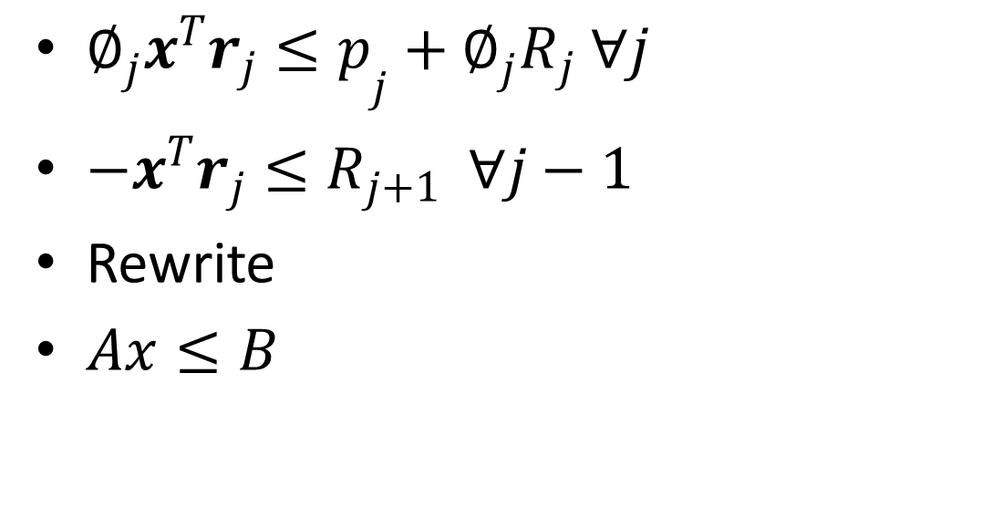
Reorder & rewrite
${∅_{j}x^{T}r_{j}≤p}_{j}+∅_{j}R_{j} ∀j$
${−x}^{T}r_{j}≤R_{j+1} ∀j−1$
Rewrite
$Ax≤B$

Slide 46
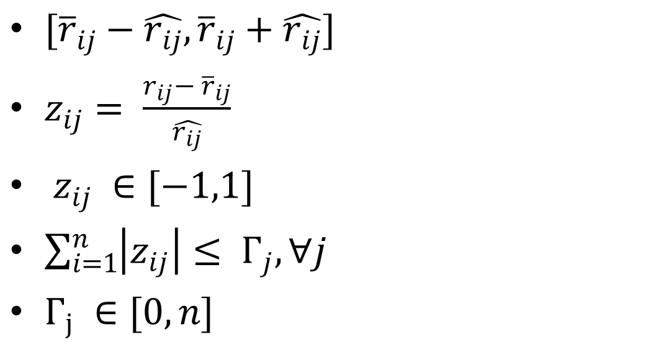
Forecast range
$[{\overline{r}}_{ij}−\hat{r_{ij}},{\overline{r}}_{ij}+\hat{r_{ij}}]$
$z_{ij}= \frac{r_{ij}− {\overline{r}}_{ij}}{\hat{r_{ij}}}$
$z_{ij} ∈[−1,1]$
$\sum_{i=1}^{n}{\left|z_{ij}\right|}≤ Γ_{j}, ∀j$
$Γ_{j} ∈[0,n]$

Slide 47
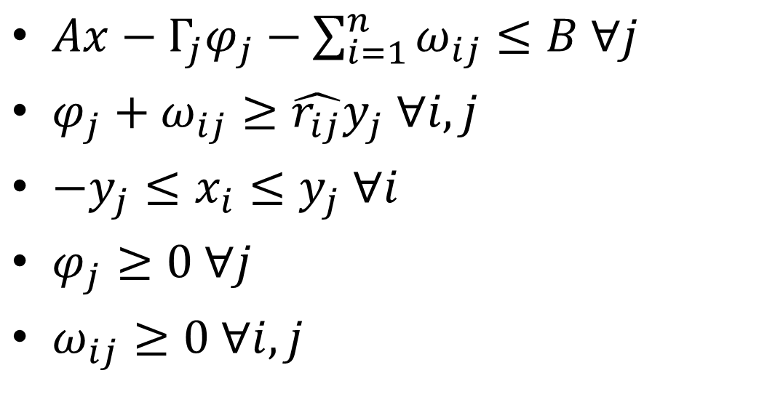
Bertsimas, D. and Thiele, A.
$Ax−Γ_{j}φ_{j}−\sum_{i=1}^{n}{ω_{ij}}≤B ∀j$
$φ_{j}+ω_{ij}≥\hat{r_{ij}}y_{j} ∀i,j$
$−y_{j}≤x_{i}≤y_{j} ∀i$
$φ_{j}≥0 ∀j$
$ω_{ij}≥0 ∀i,j$

Slide 48
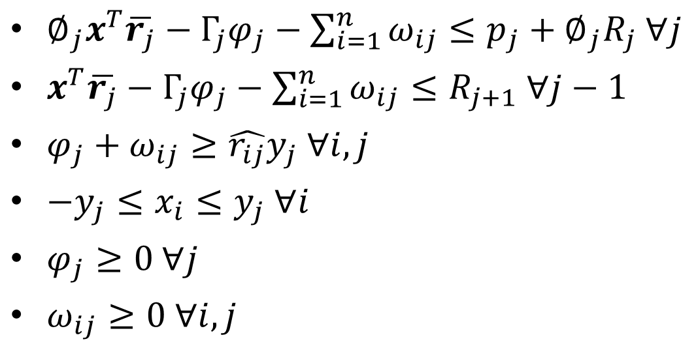
Bertsimas, D. and Thiele, A.
$∅_{j}x^{T}\overline{r_{j}}−Γ_{j}φ_{j}−\sum_{i=1}^{n}{ω_{ij}}≤p_{j}+∅_{j}R_{j} ∀j$
$x^{T}\overline{r_{j}}−Γ_{j}φ_{j}−\sum_{i=1}^{n}{ω_{ij}}≤R_{j+1} ∀j−1$
$φ_{j}+ω_{ij}≥\hat{r_{ij}}y_{j} ∀i,j$
$−y_{j}≤x_{i}≤y_{j} ∀i$
$φ_{j}≥0 ∀j$
$ω_{ij}≥0 ∀i,j$

Slide 49

Final Model
$\begin{aligned}min \\ x_{i},p_{j},ω_{ij},φ_{j},y_{j},a,b,z \end{aligned}{z }$
$z+\sum_{i=1}^{n}{x_{i}r_{i}}≥0$
$\sum_{j=1}^{J}{∅_{j}R_{j}}+\sum_{j=1}^{J}{p_{j}}≥\left(K+1\right)(\overline{{wAVaR}_{a}^{X}}−b)$
$\sum_{j=1}^{J}{∅_{j}R_{j}}+\sum_{j=1}^{J}{p_{j}}≤(−K+1)(\overline{{wAVaR}_{a}^{X}}−b)$
$−l≤b≤l$
$∅_{j}x^{T}\overline{r_{j}}−Γ_{j}φ_{j}−\sum_{i=1}^{n}{ω_{ij}}≤p_{j}+∅_{j}R_{j} ∀j$
$x^{T}\overline{r_{j}}−Γ_{j}φ_{j}−\sum_{i=1}^{n}{ω_{ij}}≤R_{j+1} ∀j−1$
$R_{j}≤{0.8∗R}_{j+1 }∀j−1$
$φ_{j}+ω_{ij}≥\hat{r_{ij}}y_{j} ∀i,j$
$−y_{j}≤x_{i}≤y_{j} ∀i$
$φ_{j}≥0 ∀j$
$ω_{ij}≥0 ∀i,j$
$−c≤R_{1}≤c$
$p_{j}≥0 ∀j$
$x^{T}1=1$
$ub≤x<lb$

Slide 50
Variables & constraints
i+j+i*j+j+i+j+1+1
= ij + 2i + 3j + 2 vars
1+1+1+j+(j-1)-(j-1)+i*j+i+i
= ij + 2i + 3j + 1 ieq const
1 eq const
Similar? Just coincidence

Slide 51
Investopedia
The S&P 500 is a U.S.market index that gives investors an idea of the overall movement in the U.S.equity market. The value of the S&P 500 constantly changes based on the movement of 500 underlying stocks. The index is computed by weighted average market capitalization.

Slide 52

$${wAVaR}_{a}^{X}$$
Can be estimated by historical value
Can also be estimated by simulation

Slide 53
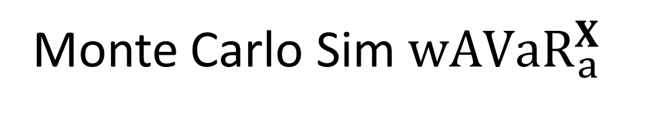
Monte Carlo Sim${wAVaR}_{a}^{X}$
% load X, weights of assets in Index
load dailyprice1.mat;
j = 10;
% calculate weights for observation at tail
w = zeros(j,1);
ARA = 1;
for a = 1:j
w(a,1) = ARA*exp(ARA*(1-((a-1)/j)))/(exp(ARA)-1) - ARA*exp(ARA*(1-a/j))/(exp(ARA)-1);
end

Slide 54
Monte Carlo Sim${wAVaR}_{a}^{X}$
wAVaR = zeros(10,1);
for c = 1:100000
k = size(X);
I = k(1); % number of assets
J = 10*j; % total number of observation for 90% interval
r = trnd(3,I,J)/10; % generate random daily return for each stock
rp = (X'*r); % return for Index
rp = sort(rp,'ascend'); % sort return such that most negative is at top
a = 0.9;
level = round((1-a)*J); % confidence level
rp = rp(:,1:level); % pick return at tail
VaR = rp(level); % value at risk of return for Index
w = sort(w,'descend'); % sort weight such that highest is at top
wAVaR(c) = rp*w; % weighted average value of return for Index
end

Slide 55
Monte Carlo Sim${wAVaR}_{a}^{X}$
% save to file
save('wAVaR.mat','wAVaR');
Only Need to do this once!
Load wAVaR.mat when needed

Slide 56

${wAVaR}_{a}^{X}$ confidence Interval
load wAVaR.mat;
u_estimate = mean(wAVaR);
s = std(wAVaR);
% 90% z score from normal dist = 1.645
xp = u_estimate + 1.645*s/sqrt(100000);
xn = u_estimate - 1.645*s/sqrt(100000);
u_hat = xp - u_estimate;
save('ci.mat','u_estimate','u_hat');

Slide 57
From solve.m
>> u_estimate
u_estimate =
-0.0272
>> u_hat
u_hat =
2.4196e-05

Slide 58
Monte Carlo Sim rij
% Estimate average daily return of each stock for j observations at tail
rij = zeros(i,j);
rij_hat = zeros(i*j,1);
for a = 1:j
r_gen = trnd(3,i,100000)/10;
r_estimate = mean(r_gen,2);
s = std(r_gen,0,2);
% 90% z score from normal dist = 1.645
xp = r_estimate + 1.645*s/sqrt(100000);
xn = r_estimate - 1.645*s/sqrt(100000);
rij(:,a) = [r_estimate];
rij_hat(i*(j-1)+1:i*j) = [xp - r_estimate]/10;
end

Slide 59
Stratify
filename = 'S&P500.xlsx';
[ndata, text] = xlsread(filename);
% S1 to S10 holds stock belonging to each industry sector
S1 = [];
S2 = [];
S3 = [];
S4 = [];
S5 = [];
S6 = [];
S7 = [];
S8 = [];
S9 = [];
S10 = [];
% s1 to s10 represent number of stocks to be included from each industry
% sector
s1 = 16;
s2 = 36;
s3 = 22;
s4 = 22;
s5 = 45;
s6 = 27;
s7 = 25;
s8 = 15;
s9 = 29;
s10 = 15;

Slide 60
Stratify
i = 1;
while i < N - 1
%sector number 10: Communications
while ndata(i) == 10
i = i + 1;
end
S1 = text(i-s1:i-1);
%sector number 11: Comsumer discretionary
while ndata(i) == 11
i = i + 1;
end
S2 = text(i-s2:i-1);
%sector number 12: Consumer staples
while ndata(i) == 12
i = i + 1;
end
S3 = text(i-s3:i-1);
%sector number 13: Energy
while ndata(i) == 13
i = i + 1;
end
S4 = text(i-s4:i-1);
%sector number 14: Financials
while ndata(i) == 14
i = i + 1;
end

Slide 61
Stratify
S5 = text(i-s5:i-1);
%sector number 15: Health care
while ndata(i) == 15
i = i + 1;
end
S6 = text(i-s6:i-1);
%sector number 16: Industrials
while ndata(i) == 16
i = i + 1;
end
S7 = text(i-s7:i-1);
%sector number 17: Materials
while ndata(i) == 17
i = i + 1;
end
S8 = text(i-s8:i-1);
%sector number 18: Technology
while ndata(i) == 18
i = i + 1;
end
S9 = text(i-s9:i-1);
%sector number 19: Utilities
while ndata(i) == 19
i = i + 1;
end
S10 = text(i-s10:i-1);
end

Slide 62
Stratify
% Array to hold weights for stocks in S&P500
X = zeros(N,1);
for a = 2*N+3:3*N+2
X(1+a-1005) = ndata(a);
end
% Array to hold tickers for stock
stock = [S1;S2;S3;S4;S5;S6;S7;S8;S9;S10];
% generate comma separated list from cell array. This step is needed to
% read prices from Yahoo Finance
n = s1+s2+s3+s4+s5+s6+s7+s8+s9+s10;
stocks = cell(1,n);
a = stock';
for i = 1:n
stocks{i} = a{:,i};
end

Slide 63
Read Price
% start date
sD = '00';
sM = '01';
sY = ‘2004';
% end date
eD = '01';
eM = '01';
eY = '2014';
% using monthly prices
period = 'd';
dataFormat = 'cvs';
% number of periods
t = 2520; %252*10
% let p be the price matrix
pd = zeros(n,t+1);

Slide 64
Read Price
for a = 1:n
urlname=['http://ichart.finance.yahoo.com/table.csv?'...
'&s=' stocks{a} '&d=' eD '&e=' eM '&f=' eY '&g=' period '&a=' sD '&b=' sM '&c=' sY '&ignore=.' dataFormat];
buff_reader=java.io.BufferedReader(java.io.InputStreamReader(openStream(java.net.URL(urlname))));
% from the time period 1
b = 1;
% skip the first line
line = buff_reader.readLine;
while b<=t+1
line = char(buff_reader.readLine);
sepInd = strfind(line,',');
% price of stock s at time t (most recent to past)
try pd(a,b) = str2double(line(sepInd(6)+1:end)); catch end
b = b+1;
end
end
save('dailyprice1.mat','pd','t','n','stocks','X');
Only need to do this once!

Slide 65
Geom. Avg. of return
% Calculating geometrical average daily return for stocks.
% For stocks without historical price information, set u = 0
u = zeros(n,1);
for a = 1:n
if p(a,t) == 0
u(a) = 0;
else
u(a) = (p(a,1) - p(a,t)) / p(a,t);
end
end
u = (u+1).^(1/t)-1;

Slide 66
Get rid of stocks w/ no his.
% Some stocks do not have historical price information.
% Let index matrix contain stocks without historical
% price information bewteen chosen time period
index = [];
i = 1;
for a = 1:n
if u(a) == 0
index(i) = a;
i = i + 1;
end
end
% Calculating geometrical average daily return for stocks after removing
% stocks without historical price information.
u = removerows(u,'ind',index);

Slide 67
Return for each day -> wAVaR
% Calculating historical daily return for 252 days
e = size(index);
e = e(2);
r = zeros(n-e,t);
for a = 1:n
for b = 1:t
r(a,b) = ((p(a,b) - p(a,b+1))/p(a,b));
end
end
% remove stocks without historical price information
r = removerows(r,'ind',index);

Slide 68
Weights
% Calculate weights for portfolio return observation at tail
w = zeros(j,1);
ARA = 1;
for a = 1:j
w(a,1) = ARA*exp(ARA*(1-((a-1)/j)))/(exp(ARA)-1) - ARA*exp(ARA*(1-a/j))/(exp(ARA)-1);
end

Slide 69
Input Parameters
% Number of stocks in portfolio
i = size(u);
i = i(1);
% Number of observations at tail.
j = 5;
% Input parameters for optimization framework
K = 0.05;
gamma = 30*ones(j,1);

Slide 70
Remember Final Model?
$\begin{aligned}min \\ x_{i},p_{j},ω_{ij},φ_{j},y_{j},a,b,z \end{aligned}{z }$
$z+\sum_{i=1}^{n}{x_{i}r_{i}}≥0$
$\sum_{j=1}^{J}{∅_{j}R_{j}}+\sum_{j=1}^{J}{p_{j}}≥\left(K+1\right)(\overline{{wAVaR}_{a}^{X}}−b)$
$\sum_{j=1}^{J}{∅_{j}R_{j}}+\sum_{j=1}^{J}{p_{j}}≤(−K+1)(\overline{{wAVaR}_{a}^{X}}−b)$
$−l≤b≤l$
$∅_{j}x^{T}\overline{r_{j}}−Γ_{j}φ_{j}−\sum_{i=1}^{n}{ω_{ij}}≤p_{j}+∅_{j}R_{j} ∀j$
$x^{T}\overline{r_{j}}−Γ_{j}φ_{j}−\sum_{i=1}^{n}{ω_{ij}}≤R_{j+1} ∀j−1$
$R_{j}≤{0.8∗R}_{j+1 }∀j−1$
$φ_{j}+ω_{ij}≥\hat{r_{ij}}y_{j} ∀i,j$
$−y_{j}≤x_{i}≤y_{j} ∀i$
$φ_{j}≥0 ∀j$
$ω_{ij}≥0 ∀i,j$
$−c≤R_{1}≤c$
$p_{j}≥0 ∀j$
$x^{T}1=1$
$ub≤x<lb$

Slide 71

Rewrite
$\begin{aligned}min \\ x_{i},p_{j},ω_{ij},φ_{j},y_{j},R,a,b,z \end{aligned}{z }$
$− z−\sum_{i=1}^{n}{x_{i}r_{i}}≤0$
$\left(K+1\right)b−\sum_{j=1}^{J}{p_{j}}+\sum_{j=1}^{J}{∅_{j}R_{j}}≤\left(K+1\right)\overline{{wAVaR}_{a}^{X}}$
$\left(K−1\right)b+\sum_{j=1}^{J}{p_{j}}−\sum_{j=1}^{J}{∅_{j}R_{j}}≤(K−1)\overline{{wAVaR}_{a}^{X}}$
$−l≤b≤l$
$∅_{j}x^{T}\overline{r_{j}}−Γ_{j}φ_{j}−\sum_{i=1}^{n}{ω_{ij}}−p_{j}−∅_{j}R_{j}≤0 ∀j$
$x^{T}\overline{r_{j}}−Γ_{j}φ_{j}−\sum_{i=1}^{n}{ω_{ij}}+R_{j+1}≤0 ∀j−1$
$R_{j}−{0.8∗R}_{j+1 }≤0 ∀j−1$
$−φ_{j}−ω_{ij}+\hat{r_{ij}}y_{i}≤ 0 ∀i,j$
$x_{i}−y_{i}≤0 ∀i$
$−x_{i}−y_{i}≤0 ∀i$
$φ_{j}≥0 ∀j$
$ω_{ij}≥0 ∀i,j$
$−c≤R_{1}≤c$
$p_{j}≥0 ∀j$
$x^{T}1=1$
$ub≤x<lb$

Slide 72
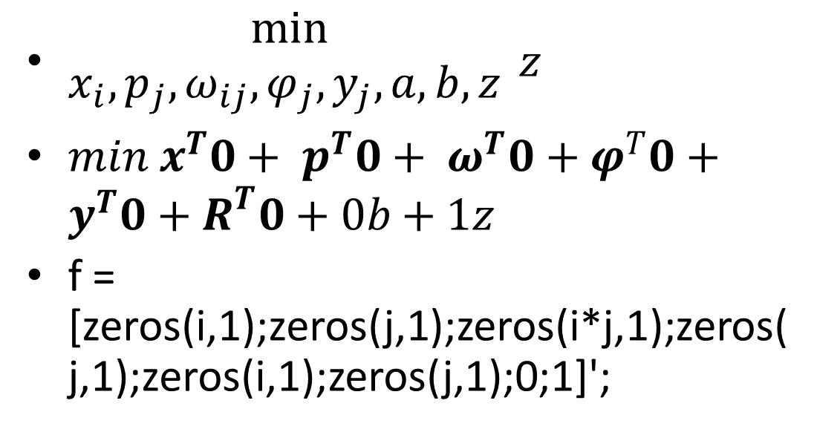
Math programming
$\begin{aligned}min \\ x_{i},p_{j},ω_{ij},φ_{j},y_{j},a,b,z \end{aligned}{z }$
$min x^{T}0+ p^{T}0+ ω^{T}0+φ^{T}0+y^{T}0+R^{T}0+0b+1z$
f = [zeros(i,1);zeros(j,1);zeros(i*j,1);zeros(j,1);zeros(i,1);zeros(j,1);0;1]';

Slide 73
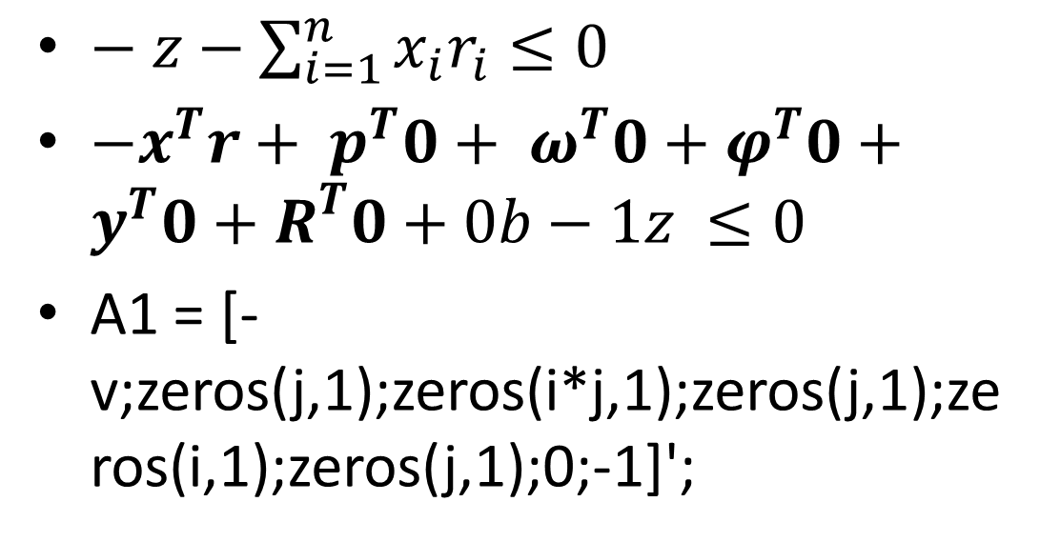
Math programming
$− z−\sum_{i=1}^{n}{x_{i}r_{i}}≤0$
$−x^{T}r+ p^{T}0+ ω^{T}0+φ^{T}0+y^{T}0+R^{T}0+0b−1z ≤0$
A1 = [-v;zeros(j,1);zeros(i*j,1);zeros(j,1);zeros(i,1);zeros(j,1);0;-1]';

Slide 74
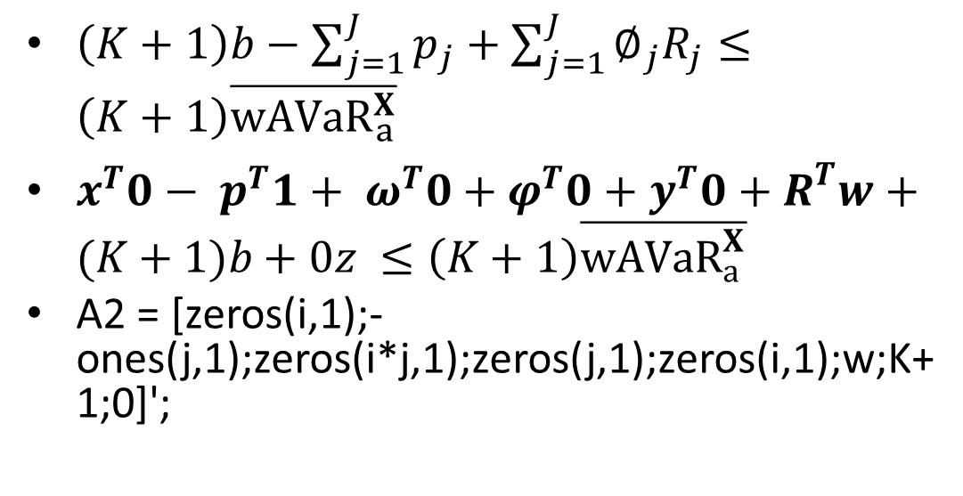
Math programming
$\left(K+1\right)b−\sum_{j=1}^{J}{p_{j}}+\sum_{j=1}^{J}{∅_{j}R_{j}}≤\left(K+1\right)\overline{{wAVaR}_{a}^{X}}$
$x^{T}0− p^{T}1+ ω^{T}0+φ^{T}0+y^{T}0+R^{T}w+(K+1)b+0z ≤\left(K+1\right)\overline{{wAVaR}_{a}^{X}}$
A2 = [zeros(i,1);-ones(j,1);zeros(i*j,1);zeros(j,1);zeros(i,1);w;K+1;0]';

Slide 75
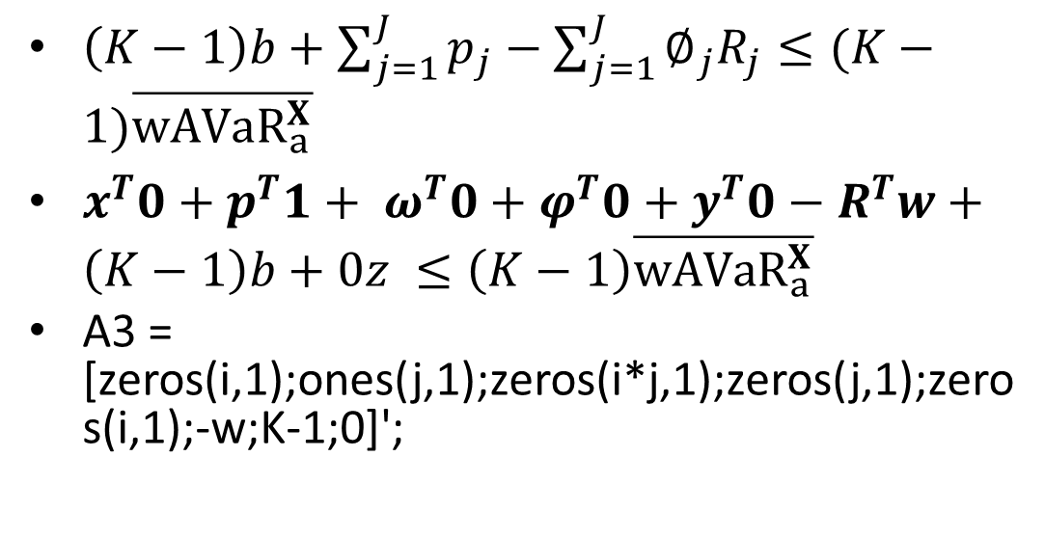
Math programming
$\left(K−1\right)b+\sum_{j=1}^{J}{p_{j}}−\sum_{j=1}^{J}{∅_{j}R_{j}}≤(K−1)\overline{{wAVaR}_{a}^{X}}$
$x^{T}0+p^{T}1+ ω^{T}0+φ^{T}0+y^{T}0−R^{T}w+\left(K−1\right)b+0z ≤\left(K−1\right)\overline{{wAVaR}_{a}^{X}}$
A3 = [zeros(i,1);ones(j,1);zeros(i*j,1);zeros(j,1);zeros(i,1);-w;K-1;0]';

Slide 76
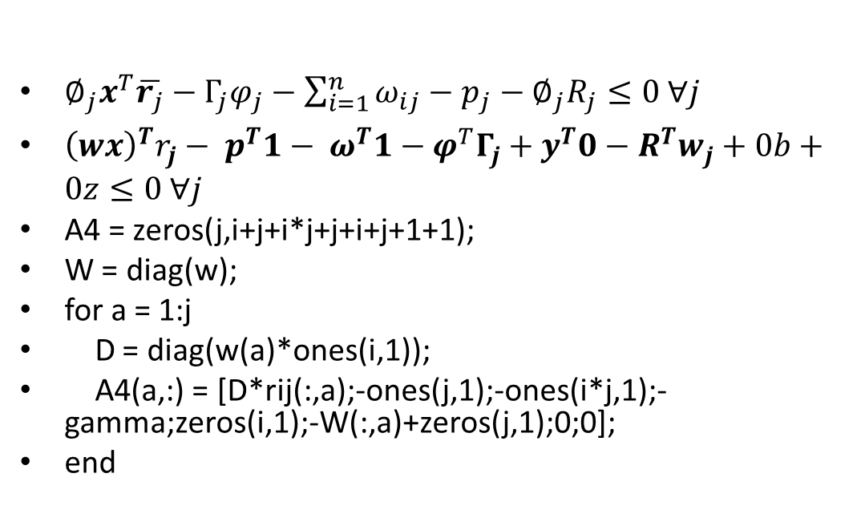
Math programming
$∅_{j}x^{T}\overline{r_{j}}−Γ_{j}φ_{j}−\sum_{i=1}^{n}{ω_{ij}}−p_{j}−∅_{j}R_{j}≤0 ∀j$
${\left(wx\right)}^{T}r_{j}− p^{T}1− ω^{T}1−φ^{T}Γ_{j}+y^{T}0−R^{T}w_{j}+0b+0z≤0 ∀j$
A4 = zeros(j,i+j+i*j+j+i+j+1+1);
W = diag(w);
for a = 1:j
D = diag(w(a)*ones(i,1));
A4(a,:) = [D*rij(:,a);-ones(j,1);-ones(i*j,1);-gamma;zeros(i,1);-W(:,a)+zeros(j,1);0;0];
end

Slide 77
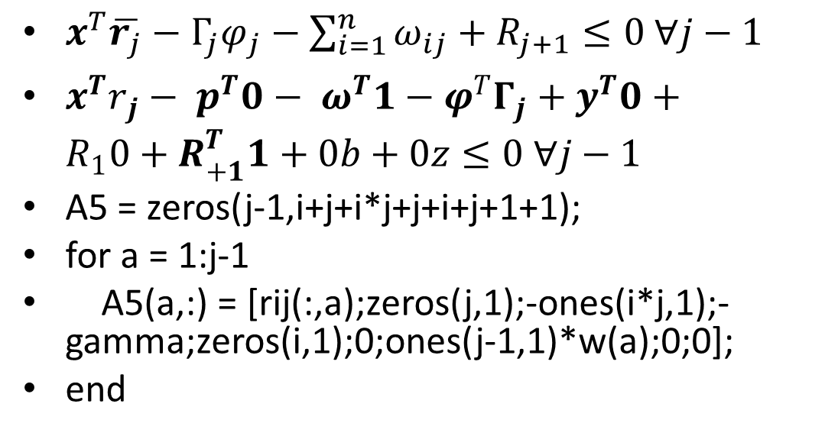
Math programming
$x^{T}\overline{r_{j}}−Γ_{j}φ_{j}−\sum_{i=1}^{n}{ω_{ij}}+R_{j+1}≤0 ∀j−1$
$x^{T}r_{j}− p^{T}0− ω^{T}1−φ^{T}Γ_{j}+y^{T}0+{R_{1}0+R}_{+1}^{T}1+0b+0z≤0 ∀j−1$
A5 = zeros(j-1,i+j+i*j+j+i+j+1+1);
for a = 1:j-1
A5(a,:) = [rij(:,a);zeros(j,1);-ones(i*j,1);-gamma;zeros(i,1);0;ones(j-1,1)*w(a);0;0];
end

Slide 78
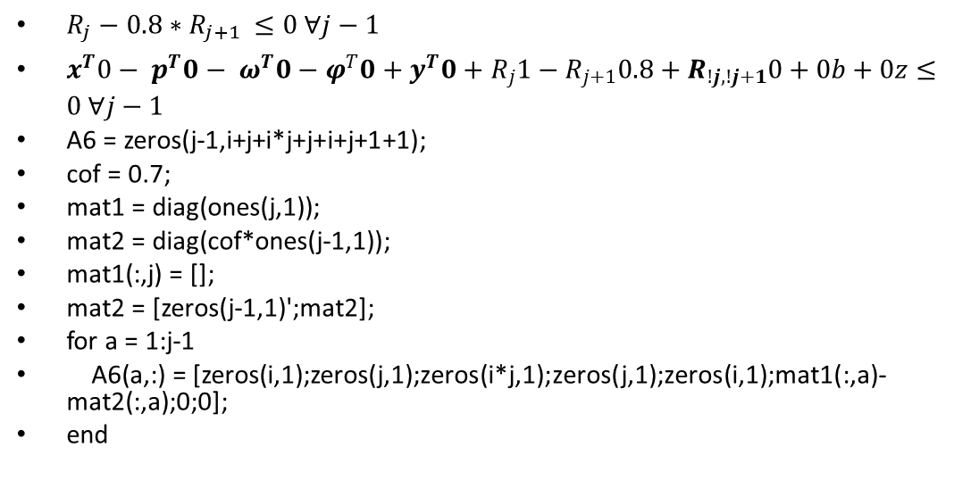
Math programming
$R_{j}−{0.8∗R}_{j+1 }≤0 ∀j−1$
$x^{T}0− p^{T}0− ω^{T}0−φ^{T}0+y^{T}0+R_{j}1−R_{j+1}0.8+R_{!j,!j+1}0+0b+0z≤0 ∀j−1$
A6 = zeros(j-1,i+j+i*j+j+i+j+1+1);
cof = 0.7;
mat1 = diag(ones(j,1));
mat2 = diag(cof*ones(j-1,1));
mat1(:,j) = [];
mat2 = [zeros(j-1,1)';mat2];
for a = 1:j-1
A6(a,:) = [zeros(i,1);zeros(j,1);zeros(i*j,1);zeros(j,1);zeros(i,1);mat1(:,a)-mat2(:,a);0;0];
end

Slide 79
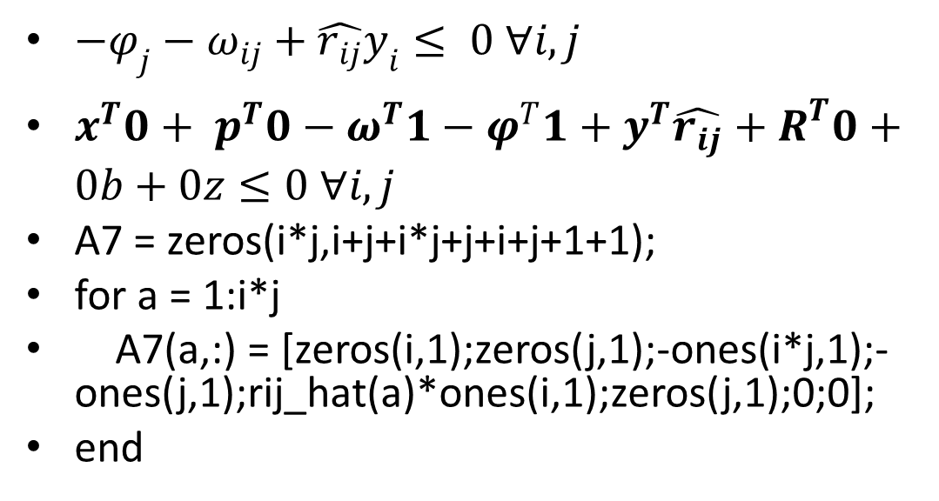
Math programming
$−φ_{j}−ω_{ij}+\hat{r_{ij}}y_{i}≤ 0 ∀i,j$
$x^{T}0+ p^{T}0−ω^{T}1−φ^{T}1+y^{T}\hat{r_{ij}}+R^{T}0+0b+0z≤0 ∀i,j$
A7 = zeros(i*j,i+j+i*j+j+i+j+1+1);
for a = 1:i*j
A7(a,:) = [zeros(i,1);zeros(j,1);-ones(i*j,1);-ones(j,1);rij_hat(a)*ones(i,1);zeros(j,1);0;0];
end

Slide 80
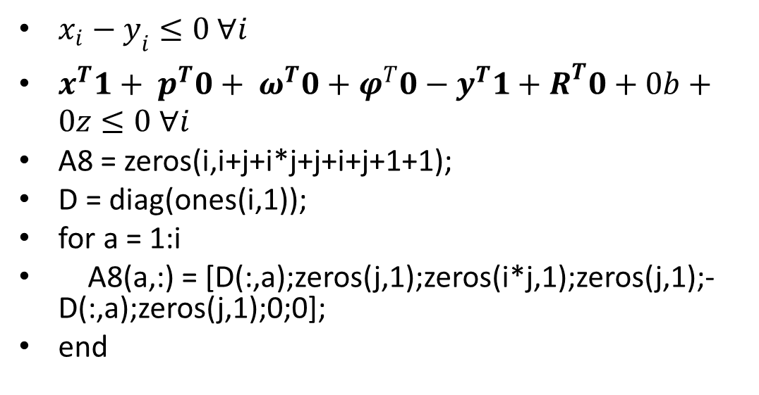
Math programming
$x_{i}−y_{i}≤0 ∀i$
$x^{T}1+ p^{T}0+ ω^{T}0+φ^{T}0−y^{T}1+R^{T}0+0b+0z≤0 ∀i$
A8 = zeros(i,i+j+i*j+j+i+j+1+1);
D = diag(ones(i,1));
for a = 1:i
A8(a,:) = [D(:,a);zeros(j,1);zeros(i*j,1);zeros(j,1);-D(:,a);zeros(j,1);0;0];
end

Slide 81
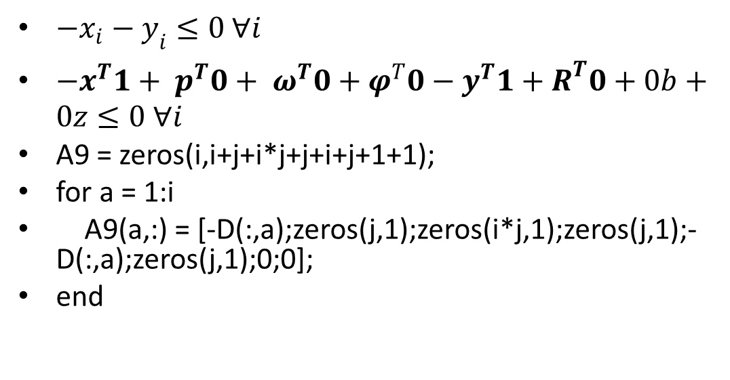
Math programming
$−x_{i}−y_{i}≤0 ∀i$
$−x^{T}1+ p^{T}0+ ω^{T}0+φ^{T}0−y^{T}1+R^{T}0+0b+0z≤0 ∀i$
A9 = zeros(i,i+j+i*j+j+i+j+1+1);
for a = 1:i
A9(a,:) = [-D(:,a);zeros(j,1);zeros(i*j,1);zeros(j,1);-D(:,a);zeros(j,1);0;0];
end

Slide 82
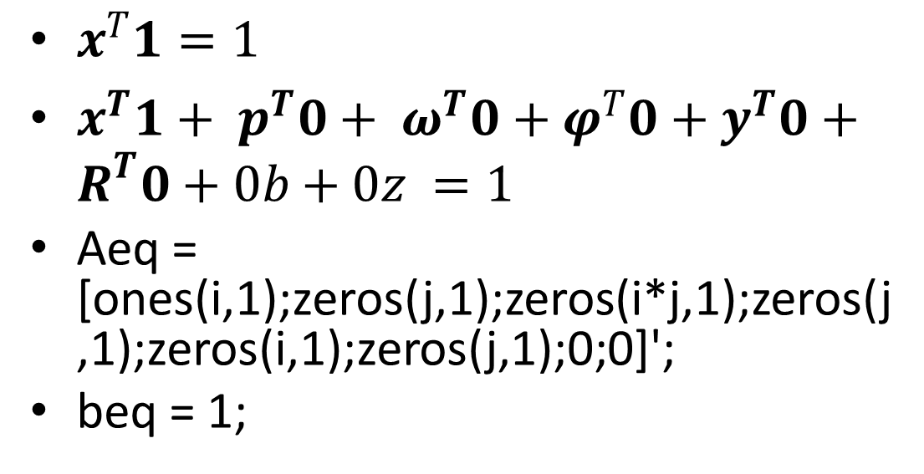
Math programming
$x^{T}1=1$
$x^{T}1+ p^{T}0+ ω^{T}0+φ^{T}0+y^{T}0+R^{T}0+0b+0z =1$
Aeq = [ones(i,1);zeros(j,1);zeros(i*j,1);zeros(j,1);zeros(i,1);zeros(j,1);0;0]';
beq = 1;

Slide 83
Math programming
A = [A1;A2;A3;A4;A5;A6;A7;A8;A9];
b = [0;(K+1)*wAVaR;(K-1)*wAVaR;zeros(j,1);zeros(j-1,1);zeros(j-1,1);zeros(i*j,1);zeros(i,1);zeros(i,1)];

Slide 84
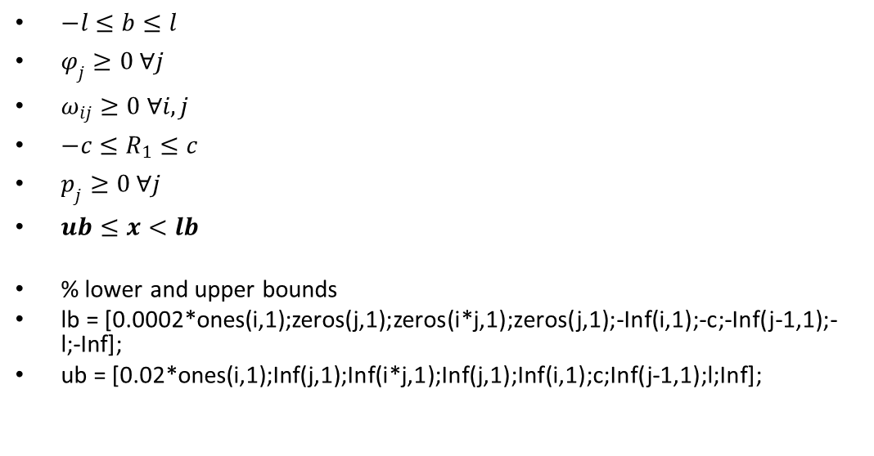
Math programming
$−l≤b≤l$
$φ_{j}≥0 ∀j$
$ω_{ij}≥0 ∀i,j$
$−c≤R_{1}≤c$
$p_{j}≥0 ∀j$
$ub≤x<lb$
% lower and upper bounds
lb = [0.0002*ones(i,1);zeros(j,1);zeros(i*j,1);zeros(j,1);-Inf(i,1);-c;-Inf(j-1,1);-l;-Inf];
ub = [0.02*ones(i,1);Inf(j,1);Inf(i*j,1);Inf(j,1);Inf(i,1);c;Inf(j-1,1);l;Inf];

Slide 85
Math programming
% Solve
options = optimset('LargeScale','off','Simplex','on');
x0 = 0.0002*ones(i+j+i*j+j+i+j+1+1,1);
[x,fval,exitflag,output,lambda] = linprog(f,A,b,Aeq,beq,lb,ub,x0,options);
res = x(1:i,1);

Slide 86
Compute return & risk
% Compute return of portfolio
rp = u'*res;
% Compute tail observations of portfolio
pr = res'*r;
pr = sort(pr,'ascend'); % most negative is at top
len = size(pr);
len = len(2);
lev = round(0.9*t);
prr = pr(:,1:t-lev); % pick tail observation

Slide 87
Compute return & risk
% calculate weights
j= t-lev;
wp = zeros(j,1);
ARA = 1;
for a = 1:j
wp(a,1) = ARA*exp(ARA*(1-((a-1)/j)))/(exp(ARA)-1) - ARA*exp(ARA*(1-a/j))/(exp(ARA)-1);
end
% Compute wAVaR of portfolio
wavarp = prr*wp;

Slide 88
SPDR & SP500?
% daily returns for SPDR and S&P500 for 252 days
rr = zeros(nn,tt);
for a = 1:nn
for b = 1:tt
rr(a,b) = ((pp(a,b) - pp(a,b+1))/pp(a,b));
end
end
% geometrical average daily return
uu = zeros(nn);
for a = 1:nn
uu(a) = (pp(a,1) - pp(a,tt)) / pp(a,tt);
end
uu = prod(uu+1,2).^(1/tt)-1;

Slide 89
SPDR & SP500?
% confidence level
a = 0.9;
level = round((1-a)*tt);
rr = sort(rr,2,'ascend'); % sort such that most negative is at top
rr = rr(:,1:level); % pick observations at tail
% compute weights (highest to lowest)
ww = zeros(level,1);
ARA = 1;
for a = 1:level
ww(a,1) = ARA*exp(ARA*(1-((a-1)/level)))/(exp(ARA)-1) - ARA*exp(ARA*(1-a/level))/(exp(ARA)-1);
end
ww = diag(ww);

Slide 90
SPDR & SP500?
z = rr*ww; %first col = SPDR, second col = SP500
wavar = sum(z,2);
rs = uu(1); %return of SPDR
ri = uu(2); %return of S&P500
wavars = wavar(1); %wAVaR of SPDR
wavari = wavar(2); %wAVaR of S&P500
TRs = abs((wavar(1)-wavar(2))/wavar(2)); %tracking error of SPDR
TRp = abs((wavarp-wavar(2))/wavar(2)); %tracking error of portfolio

Slide 91
Final Data
[rs rp ri wavars wavarp wavari TRs TRp]
Do this for each year (Loop whole script over 10 years -> Out of Memory)

Slide 92
Break down price matrix
2004 1:253
2005 253:505
2006 505:757
2007 757:1009
2009 1009:1261
2010 1513:1765
2011 1765:2017
2012 2017:2269
2013 2269:2521

Slide 93
2004
 | rs | rp | ri | wavars | wavarp | wavari | TRs | TRp
2004 | 0.0007 | 0.0006 | 0.0007 | -0.0148 | -0.0175 | -0.0148 | 0.0049 | 0.1826
 | 0.0007 | 0.0006 | 0.0007 | -0.0148 | -0.0179 | -0.0148 | 0.0049 | 0.2099
 | 0.0007 | 0.0007 | 0.0007 | -0.0148 | -0.0176 | -0.0148 | 0.0049 | 0.1899
 | 0.0007 | 0.0008 | 0.0007 | -0.0148 | -0.0171 | -0.0148 | 0.0049 | 0.1565
 | 0.0007 | 0.0006 | 0.0007 | -0.0148 | -0.018 | -0.0148 | 0.0049 | 0.2214
 | 0.0007 | 0.0006 | 0.0007 | -0.0148 | -0.0186 | -0.0148 | 0.0049 | 0.2562
 | 0.0007 | 0.0005 | 0.0007 | -0.0148 | -0.0183 | -0.0148 | 0.0049 | 0.2365
 | 0.0007 | 0.0005 | 0.0007 | -0.0148 | -0.0172 | -0.0148 | 0.0049 | 0.1637
 | 0.0007 | 0.0006 | 0.0007 | -0.0148 | -0.0169 | -0.0148 | 0.0049 | 0.1464
 | 0.0007 | 0.0007 | 0.0007 | -0.0148 | -0.0175 | -0.0148 | 0.0049 | 0.1862
avg | 0.0007 | 0.00062 | 0.0007 | -0.0148 | -0.01766 | -0.0148 | 0.0049 | 0.19493

Slide 94
2005
 | rs | rp | ri | wavars | wavarp | wavari | TRs | TRp
2005 | 0.0006 | 0.0009 | 0.0005 | -0.0152 | -0.0194 | -0.0154 | 0.0103 | 0.2617
 | 0.0006 | 0.0008 | 0.0005 | -0.0152 | -0.0191 | -0.0154 | 0.0103 | 0.2388
 | 0.0006 | 0.0007 | 0.0005 | -0.0152 | -0.0192 | -0.0154 | 0.0103 | 0.2508
 | 0.0006 | 0.0008 | 0.0005 | -0.0152 | -0.0189 | -0.0154 | 0.0103 | 0.2261
 | 0.0006 | 0.0008 | 0.0005 | -0.0152 | -0.0185 | -0.0154 | 0.0103 | 0.2004
 | 0.0006 | 0.0006 | 0.0005 | -0.0152 | -0.0169 | -0.0154 | 0.0103 | 0.0988
 | 0.0006 | 0.0009 | 0.0005 | -0.0152 | -0.0213 | -0.0154 | 0.0103 | 0.3827
 | 0.0006 | 0.0008 | 0.0005 | -0.0152 | -0.0173 | -0.0154 | 0.0103 | 0.1216
 | 0.0006 | 0.0009 | 0.0005 | -0.0152 | -0.02 | -0.0154 | 0.0103 | 0.2984
 | 0.0006 | 0.0008 | 0.0005 | -0.0152 | -0.0208 | -0.0154 | 0.0103 | 0.3485
avg | 0.0006 | 0.0008 | 0.0005 | -0.0152 | -0.01914 | -0.0154 | 0.0103 | 0.24278

Slide 95
2006
 | rs | rp | ri | wavars | wavarp | wavari | TRs | TRp
2006 | 0.0002 | 0.0001 | 0.0001 | -0.0321 | -0.038 | -0.0324 | 0.0098 | 0.173
 | 0.0002 | 0.0002 | 0.0001 | -0.0321 | -0.0382 | -0.0324 | 0.0098 | 0.1786
 | 0.0002 | 0.0003 | 0.0001 | -0.0321 | -0.0353 | -0.0324 | 0.0098 | 0.0872
 | 0.0002 | 0.0002 | 0.0001 | -0.0321 | -0.037 | -0.0324 | 0.0098 | 0.1417
 | 0.0002 | 0.0004 | 0.0001 | -0.0321 | -0.0385 | -0.0324 | 0.0098 | 0.1856
 | 0.0002 | -0.0001 | 0.0001 | -0.0321 | -0.0376 | -0.0324 | 0.0098 | 0.1585
 | 0.0002 | 0.0003 | 0.0001 | -0.0321 | -0.038 | -0.0324 | 0.0098 | 0.1717
 | 0.0002 | 0.0001 | 0.0001 | -0.0321 | -0.0377 | -0.0324 | 0.0098 | 0.1617
 | 0.0002 | 0.0003 | 0.0001 | -0.0321 | -0.0352 | -0.0324 | 0.0098 | 0.0837
 | 0.0002 | 0 | 0.0001 | -0.0321 | -0.04 | -0.0324 | 0.0098 | 0.2346
avg | 0.0002 | 0.00018 | 0.0001 | -0.0321 | -0.03755 | -0.0324 | 0.0098 | 0.15763

Slide 96
2007
 | rs | rp | ri | wavars | wavarp | wavari | TRs | TRp
2007 | 0.0007 | 0.0009 | 0.0006 | -0.0235 | -0.0278 | -0.0237 | 0.0119 | 0.1687
 | 0.0007 | 0.0009 | 0.0006 | -0.0235 | -0.0269 | -0.0237 | 0.0119 | 0.1337
 | 0.0007 | 0.0008 | 0.0006 | -0.0235 | -0.0256 | -0.0237 | 0.0119 | 0.0771
 | 0.0007 | 0.0009 | 0.0006 | -0.0235 | -0.0303 | -0.0237 | 0.0119 | 0.2761
 | 0.0007 | 0.0008 | 0.0006 | -0.0235 | -0.0285 | -0.0237 | 0.0119 | 0.1989
 | 0.0007 | 0.0008 | 0.0006 | -0.0235 | -0.0277 | -0.0237 | 0.0119 | 0.1671
 | 0.0007 | 0.001 | 0.0006 | -0.0235 | -0.028 | -0.0237 | 0.0119 | 0.1784
 | 0.0007 | 0.0007 | 0.0006 | -0.0235 | -0.0277 | -0.0237 | 0.0119 | 0.1669
 | 0.0007 | 0.0008 | 0.0006 | -0.0235 | -0.0282 | -0.0237 | 0.0119 | 0.1867
 | 0.0007 | 0.0009 | 0.0006 | -0.0235 | -0.0271 | -0.0237 | 0.0119 | 0.1419
avg | 0.0007 | 0.00085 | 0.0006 | -0.0235 | -0.02778 | -0.0237 | 0.0119 | 0.16955

Slide 97
2008
 | rs | rp | ri | wavars | wavarp | wavari | TRs | TRp
2008 | 0.0011 | 0.0017 | 0.001 | -0.0314 | -0.0385 | -0.0325 | 0.0335 | 0.1838
 | 0.0011 | 0.0017 | 0.001 | -0.0314 | -0.0401 | -0.0325 | 0.0335 | 0.2342
 | 0.0011 | 0.0015 | 0.001 | -0.0314 | -0.0378 | -0.0325 | 0.0335 | 0.1621
 | 0.0011 | 0.0017 | 0.001 | -0.0314 | -0.0393 | -0.0325 | 0.0335 | 0.2097
 | 0.0011 | 0.0018 | 0.001 | -0.0314 | -0.0392 | -0.0325 | 0.0335 | 0.2073
 | 0.0011 | 0.0016 | 0.001 | -0.0314 | -0.0443 | -0.0325 | 0.0335 | 0.3621
 | 0.0011 | 0.0016 | 0.001 | -0.0314 | -0.0347 | -0.0325 | 0.0335 | 0.0672
 | 0.0011 | 0.002 | 0.001 | -0.0314 | -0.0489 | -0.0325 | 0.0335 | 0.5039
 | 0.0011 | 0.0018 | 0.001 | -0.0314 | -0.0392 | -0.0325 | 0.0335 | 0.2061
 | 0.0011 | 0.0019 | 0.001 | -0.0314 | -0.0401 | -0.0325 | 0.0335 | 0.2323
avg | 0.0011 | 0.00173 | 0.001 | -0.0314 | -0.04021 | -0.0325 | 0.0335 | 0.23687

Slide 98
2009
 | rs | rp | ri | wavars | wavarp | wavari | TRs | TRp
2009 | -0.0018 | -0.0021 | -0.0019 | -0.0597 | -0.0692 | -0.0602 | 0.0077 | 0.1497
 | -0.0018 | -0.0021 | -0.0019 | -0.0597 | -0.0741 | -0.0602 | 0.0077 | 0.2309
 | -0.0018 | -0.0019 | -0.0019 | -0.0597 | -0.0689 | -0.0602 | 0.0077 | 0.145
 | -0.0018 | -0.0021 | -0.0019 | -0.0597 | -0.0749 | -0.0602 | 0.0077 | 0.2446
 | -0.0018 | -0.0018 | -0.0019 | -0.0597 | -0.0673 | -0.0602 | 0.0077 | 0.1191
 | -0.0018 | -0.0028 | -0.0019 | -0.0597 | -0.0804 | -0.0602 | 0.0077 | 0.3363
 | -0.0018 | -0.0023 | -0.0019 | -0.0597 | -0.0741 | -0.0602 | 0.0077 | 0.2309
 | -0.0018 | -0.0023 | -0.0019 | -0.0597 | -0.0804 | -0.0602 | 0.0077 | 0.3353
 | -0.0018 | -0.0022 | -0.0019 | -0.0597 | -0.0746 | -0.0602 | 0.0077 | 0.2393
 | -0.0018 | -0.0025 | -0.0019 | -0.0597 | -0.0837 | -0.0602 | 0.0077 | 0.3908
avg | -0.0018 | -0.00221 | -0.0019 | -0.0597 | -0.07476 | -0.0602 | 0.0077 | 0.24219

Slide 99
2010
 | rs | rp | ri | wavars | wavarp | wavari | TRs | TRp
2010 | -0.0002 | -0.0008 | -0.0002 | -0.0237 | -0.027 | -0.0242 | 0.0211 | 0.1173
 | -0.0002 | -0.0002 | -0.0002 | -0.0237 | -0.0269 | -0.0242 | 0.0211 | 0.1111
 | -0.0002 | -0.0003 | -0.0002 | -0.0237 | -0.0269 | -0.0242 | 0.0211 | 0.1132
 | -0.0002 | -0.0002 | -0.0002 | -0.0237 | -0.0253 | -0.0242 | 0.0211 | 0.0457
 | -0.0002 | -0.0003 | -0.0002 | -0.0237 | -0.0258 | -0.0242 | 0.0211 | 0.0643
 | -0.0002 | -0.0002 | -0.0002 | -0.0237 | -0.0264 | -0.0242 | 0.0211 | 0.0924
 | -0.0002 | -0.0002 | -0.0002 | -0.0237 | -0.0263 | -0.0242 | 0.0211 | 0.0868
 | -0.0002 | -0.0002 | -0.0002 | -0.0237 | -0.0251 | -0.0242 | 0.0211 | 0.0375
 | -0.0002 | -0.0004 | -0.0002 | -0.0237 | -0.0258 | -0.0242 | 0.0211 | 0.0662
 | -0.0002 | -0.0003 | -0.0002 | -0.0237 | -0.0271 | -0.0242 | 0.0211 | 0.119
avg | -0.0002 | -0.00031 | -0.0002 | -0.0237 | -0.02626 | -0.0242 | 0.0211 | 0.08535

Slide 100
2011
 | rs | rp | ri | wavars | wavarp | wavari | TRs | TRp
2011 | 0.0005 | 0.0005 | 0.0004 | -0.0119 | -0.0152 | -0.0116 | 0.0289 | 0.3098
 | 0.0005 | 0.0004 | 0.0004 | -0.0119 | -0.0157 | -0.0116 | 0.0289 | 0.3536
 | 0.0005 | 0.0006 | 0.0004 | -0.0119 | -0.0162 | -0.0116 | 0.0289 | 0.3959
 | 0.0005 | 0.0003 | 0.0004 | -0.0119 | -0.0156 | -0.0116 | 0.0289 | 0.3429
 | 0.0005 | 0.0005 | 0.0004 | -0.0119 | -0.0145 | -0.0116 | 0.0289 | 0.2513
 | 0.0005 | 0.0005 | 0.0004 | -0.0119 | -0.015 | -0.0116 | 0.0289 | 0.2979
 | 0.0005 | 0.0005 | 0.0004 | -0.0119 | -0.0165 | -0.0116 | 0.0289 | 0.4238
 | 0.0005 | 0.0005 | 0.0004 | -0.0119 | -0.0152 | -0.0116 | 0.0289 | 0.3078
 | 0.0005 | 0.0007 | 0.0004 | -0.0119 | -0.0145 | -0.0116 | 0.0289 | 0.2535
 | 0.0005 | 0.0005 | 0.0004 | -0.0119 | -0.0155 | -0.0116 | 0.0289 | 0.3379
avg | 0.0005 | 0.0005 | 0.0004 | -0.0119 | -0.01539 | -0.0116 | 0.0289 | 0.32744

Slide 101
2012
 | rs | rp | ri | wavars | wavarp | wavari | TRs | TRp
2012 | 0.0004 | 0.0009 | 0.0004 | -0.0127 | -0.0161 | -0.0121 | 0.0504 | 0.3274
 | 0.0004 | 0.0008 | 0.0004 | -0.0127 | -0.0165 | -0.0121 | 0.0504 | 0.3594
 | 0.0004 | 0.001 | 0.0004 | -0.0127 | -0.0166 | -0.0121 | 0.0504 | 0.3708
 | 0.0004 | 0.0006 | 0.0004 | -0.0127 | -0.0137 | -0.0121 | 0.0504 | 0.1253
 | 0.0004 | 0.0008 | 0.0004 | -0.0127 | -0.0165 | -0.0121 | 0.0504 | 0.3638
 | 0.0004 | 0.0006 | 0.0004 | -0.0127 | -0.0152 | -0.0121 | 0.0504 | 0.2505
 | 0.0004 | 0.0007 | 0.0004 | -0.0127 | -0.0159 | -0.0121 | 0.0504 | 0.3094
 | 0.0004 | 0.0008 | 0.0004 | -0.0127 | -0.0166 | -0.0121 | 0.0504 | 0.3666
 | 0.0004 | 0.0008 | 0.0004 | -0.0127 | -0.0152 | -0.0121 | 0.0504 | 0.2523
 | 0.0004 | 0.0011 | 0.0004 | -0.0127 | -0.0162 | -0.0121 | 0.0504 | 0.3386
avg | 0.0004 | 0.00081 | 0.0004 | -0.0127 | -0.01585 | -0.0121 | 0.0504 | 0.30641

Slide 102
2013
 | rs | rp | ri | wavars | wavarp | wavari | TRs | TRp
2013 | 0.0002 | 0.0008 | 0.0001 | -0.0138 | -0.0149 | -0.0132 | 0.0465 | 0.1293
 | 0.0002 | 0.0007 | 0.0001 | -0.0138 | -0.014 | -0.0132 | 0.0465 | 0.0614
 | 0.0002 | 0.0009 | 0.0001 | -0.0138 | -0.0157 | -0.0132 | 0.0465 | 0.191
 | 0.0002 | 0.0009 | 0.0001 | -0.0138 | -0.015 | -0.0132 | 0.0465 | 0.137
 | 0.0002 | 0.0008 | 0.0001 | -0.0138 | -0.0167 | -0.0132 | 0.0465 | 0.2654
 | 0.0002 | 0.0007 | 0.0001 | -0.0138 | -0.0148 | -0.0132 | 0.0465 | 0.1218
 | 0.0002 | 0.0008 | 0.0001 | -0.0138 | -0.0159 | -0.0132 | 0.0465 | 0.204
 | 0.0002 | 0.0008 | 0.0001 | -0.0138 | -0.0158 | -0.0132 | 0.0465 | 0.2002
 | 0.0002 | 0.0008 | 0.0001 | -0.0138 | -0.0145 | -0.0132 | 0.0465 | 0.1026
 | 0.0002 | 0.0009 | 0.0001 | -0.0138 | -0.0148 | -0.0132 | 0.0465 | 0.1255
avg | 0.0002 | 0.00081 | 0.0001 | -0.0138 | -0.01521 | -0.0132 | 0.0465 | 0.15382

Slide 103
Number of observations
What happen if j is increased
More data points at tail of distribution
5 sounds too few
Why can’t increase j?

Slide 104
Memory
Error using vertcat
Out of memory. Type HELP MEMORY for your options.
Error in solve (line 152)
A = [A1;A2;A3;A4;A5;A6;A7;A8;A9];

Slide 105
Conclusion
Invest in SPDR

