Slide 1


Slide 2



data

Slide 3
data
-22.8%
traffic time*
*based on average time

Slide 4
insight
Go home during peak hours,
despite not being in a rush.
-86%

Slide 5

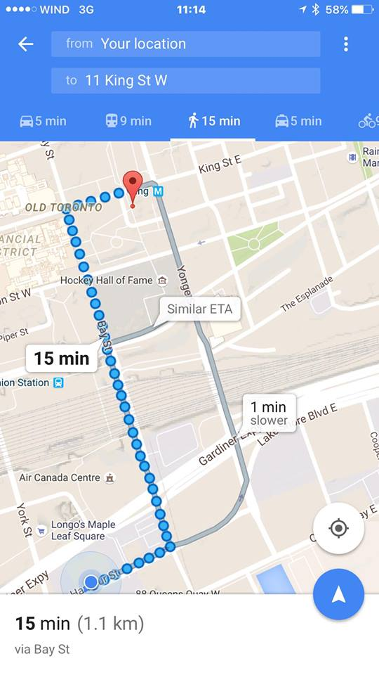

idea
RushHour

Slide 6
demo
19 min
19 min (1.1km)
via Bay Street

Slide 7

demo
19 min
Not in a Rush?
Avoid Traffic
19 min (1.1km)
via Bay Street

Slide 8
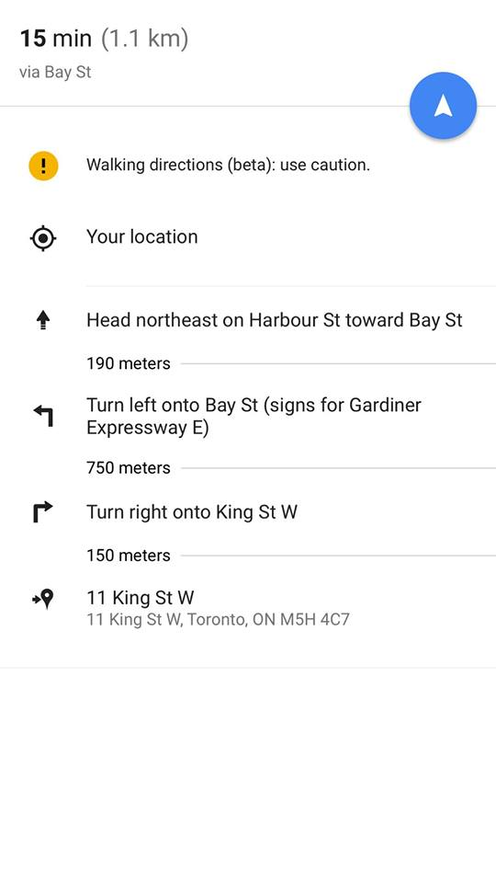
demo
Wait Out Option
via Coffee
Wait out traffic at the coffee house (20 min)

Slide 9
demo
Wait Out Option
via Coffee
Wait out traffic at the coffee house (20 min)
OFFER: X% OFF

Slide 10
demo
RH Points
Traffic Time Saved
10 RH Points to Next Level

Slide 11

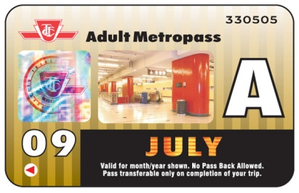

demo
Potential
Redemption
RH Points
Traffic Time Saved
10 RH Points to Next Level

Slide 12

difference
awareness
incentive
less
congestion
Change Human Behavior

Slide 13
incentives
1 options
2 promotions
3 gamification

Slide 14
impact
Less Congestion
Participation
Frequency
41%
74%
x
56%
=

Slide 15

feasibility

Slide 16




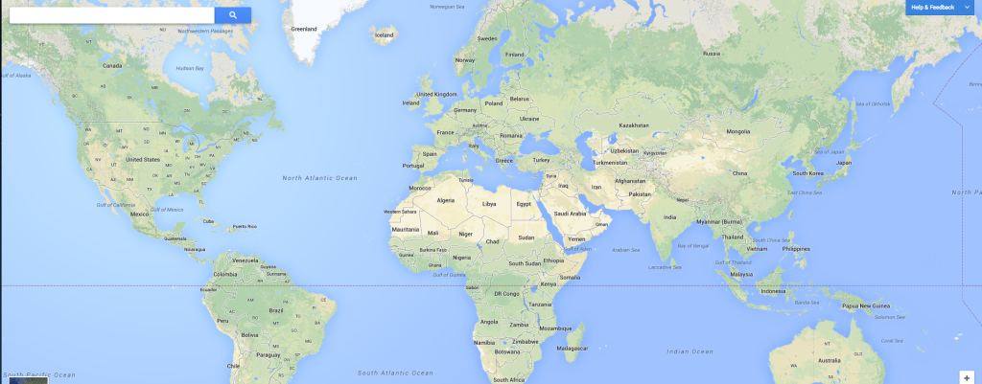
scalability

Slide 17
thank you
RushHour

Slide 18
appendix

Slide 19
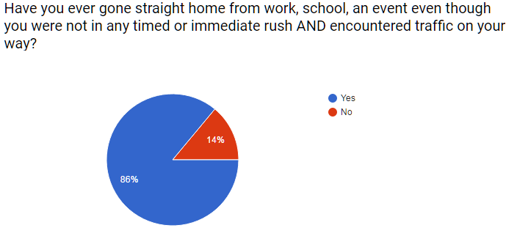
appendix: survey question

Slide 20
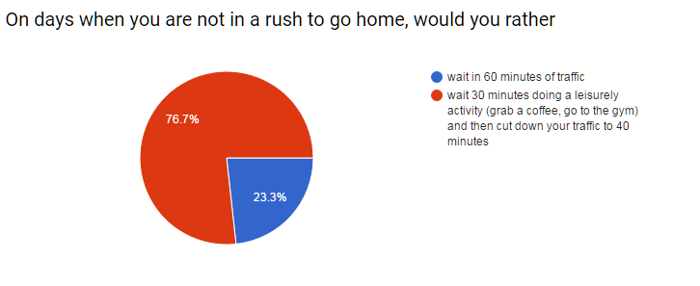
appendix: survey question

Slide 21
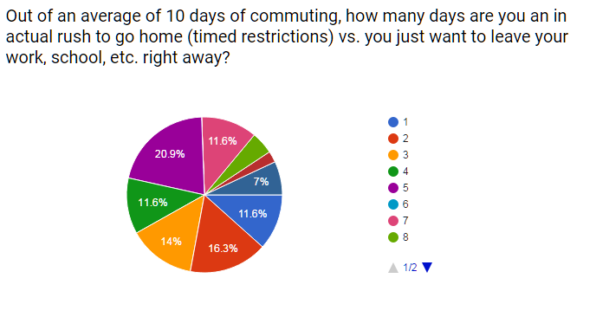
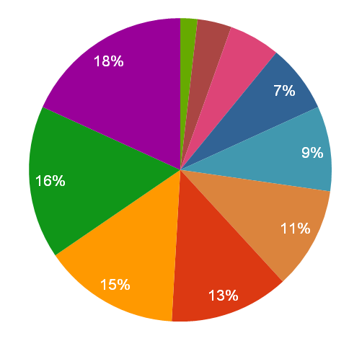
appendix: survey question

Slide 22
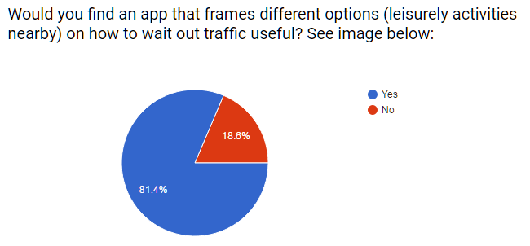
appendix: survey question

Slide 23
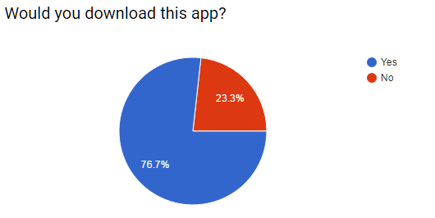
appendix: survey question

Slide 24
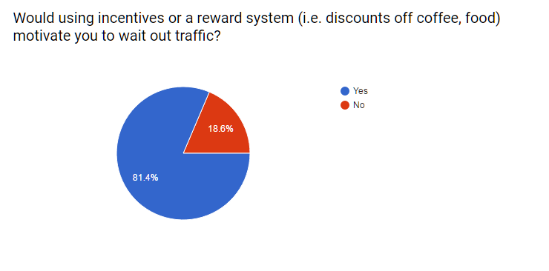
appendix: survey question

Slide 25
appendix: traffic data
(Source: GARDDVBLUETOOTH)
AvgMeasuredTime |  | Time Saved
Top 25% | 88.35872 | 26.10106105
Top 60% | 95.08221 | 19.37756217
Top 100% | 114.4598
 | Count | % of Cars when there is traffic | If we take out X % cars
Top 25% | 4.94426 | 59% | 41%
Top 60% | 7.918938 | 95% | 5%
Top 100% | 8.31931
Methodology: Using Raw Data, we used 1 road example – Start Point G: Endpoint E We then ranked the AVG measured time Broke them in 3 groups – top 25% fastest times (no congestion), top 25 - 60% (somewhat at capacity), and top 60- 100% (slow – congested times) Based on 3 groups, we calculated how many sample counters (cars) are on the road) Assuming Top 60 – 100% is congestion: we looked at how many cars (%) need to be removed to achieve no congestion measured time (top 25%)

Slide 26
appendix: traffic data
(Source: GARDDVBLUETOOTH)
AvgMeasuredTime |  | Time Saved
Top 25% | 88.35872 | 26.10106105
Top 60% | 95.08221 | 19.37756217
Top 100% | 114.4598
 | Count | % of Cars when there is traffic | If we take out X % cars
Top 25% | 4.94426 | 59% | 41%
Top 60% | 7.918938 | 95% | 5%
Top 100% | 8.31931
Conclusion: If we take 41% of the cars off the road we will save commuters 26 minutes off of their commute

Slide 27
appendix: impact calculation
(Source: market research – 33 people)
Methodology Participation = Download App Frequency = Weighted average of 10 days (as a %) Participation x Frequency = Commuters Waiting 76% * 56% = 41%

Slide 28
appendix: team
Joanna Silva
jaygsilva@gmail.com
Allister Geonanga
allister.geonanga@gmail.com
Blair Du
Blair.du@mail.utoronto.ca
Seungmoon Rieh
seungmoon.rieh@mail.utoronto.ca
Chelina Sharma
Chelina.sharma@mail.utoronto.ca

