Slide 1


Slide 2



data

Slide 3
data
-22.8%
traffic time*
*based on average time

Slide 4
insight
Contributed to congestion during peak hours,
despite not being in a rush.
-86%

Slide 5

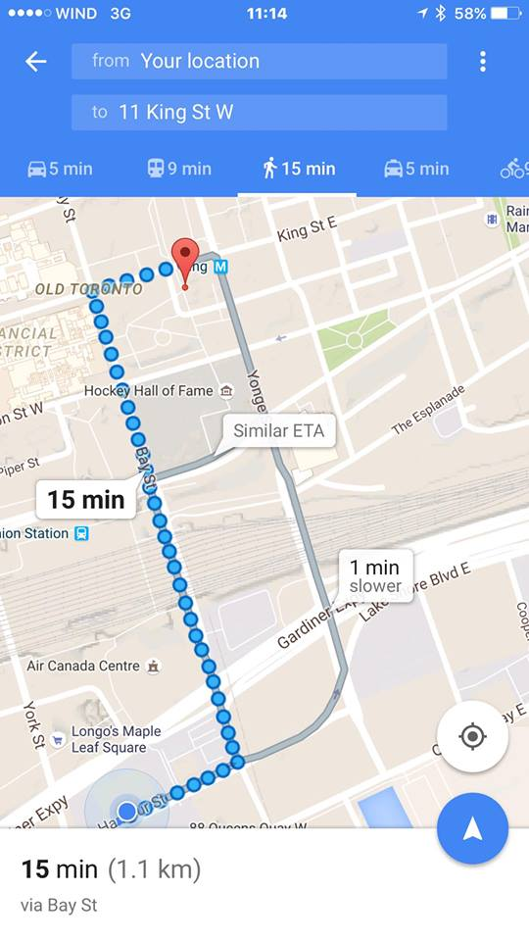

idea
RushHour

Slide 6

demo
19 min
Not in a Rush?
Avoid Traffic
19 min (1.1km)
via Bay Street

Slide 7
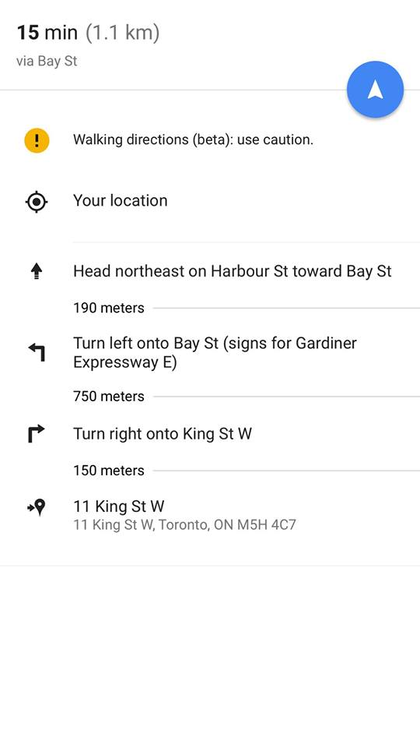
demo
Wait Out Option
via Coffee
Wait out traffic at the coffee house (20 min)
OFFER: X% OFF

Slide 8
demo
RH Points
Traffic Time Saved
10 RH Points to Next Level

Slide 9

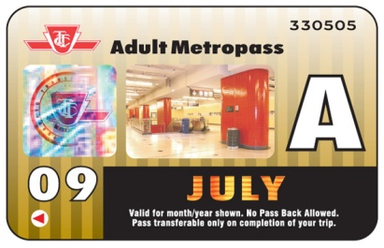

demo
Potential
Redemption
RH Points
Traffic Time Saved
10 RH Points to Next Level

Slide 10

difference
awareness
incentive
less
congestion
Change Human Behavior

Slide 11
incentives
1 options
2 promotions
3 gamification

Slide 12
impact
Less Congestion
Participation
Frequency
41%
74%
x
56%
=

Slide 13

feasibility

Slide 14




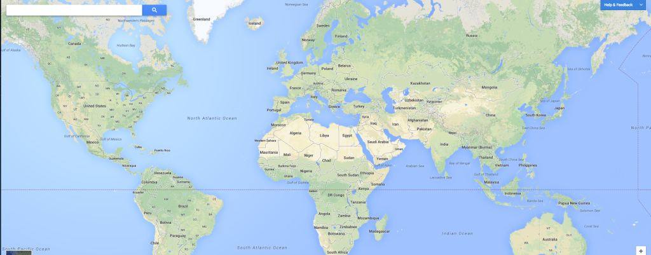
scalability

Slide 15
thank you
RushHour

Slide 16
appendix

Slide 17
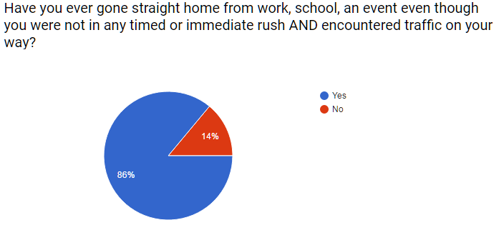
appendix: survey question

Slide 18
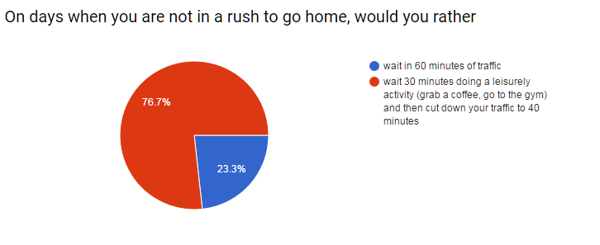
appendix: survey question

Slide 19
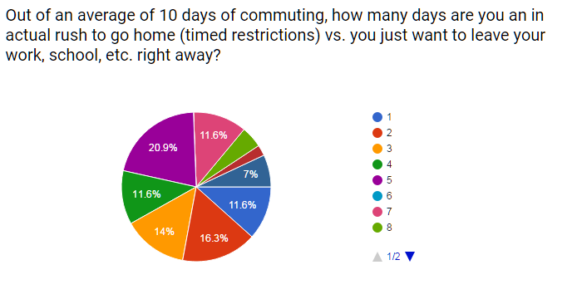
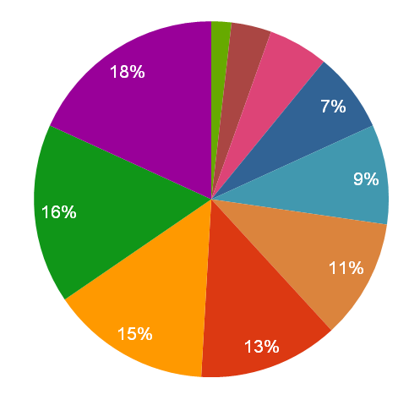
appendix: survey question

Slide 20
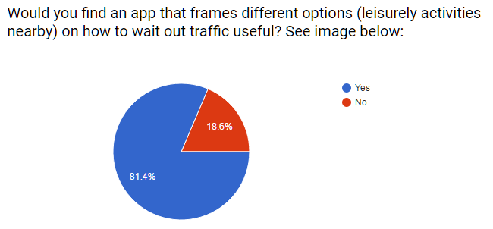
appendix: survey question

Slide 21
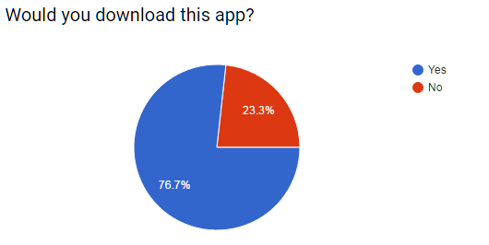
appendix: survey question

Slide 22
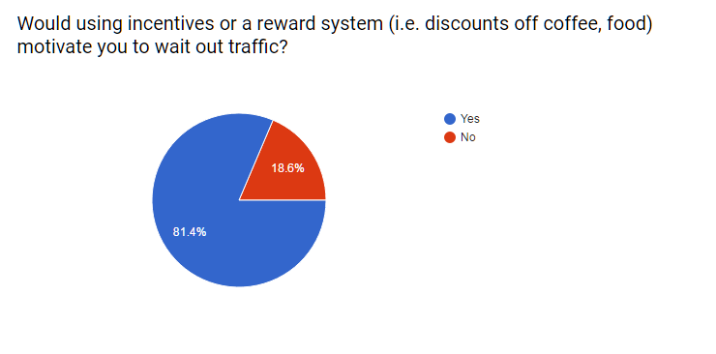
appendix: survey question

Slide 23
appendix: traffic data
(Source: GARDDVBLUETOOTH)
AvgMeasuredTime |  | Time Saved
Top 25% | 88.35872 | 26.10106105
Top 60% | 95.08221 | 19.37756217
Top 100% | 114.4598
 | Count | % of Cars when there is traffic | If we take out X % cars
Top 25% | 4.94426 | 59% | 41%
Top 60% | 7.918938 | 95% | 5%
Top 100% | 8.31931
Methodology: Using Raw Data, we used 1 road example – Start Point G: Endpoint E We then ranked the AVG measured time Broke them in 3 groups – top 25% fastest times (no congestion), top 25 - 60% (somewhat at capacity), and top 60- 100% (slow – congested times) Based on 3 groups, we calculated how many sample counters (cars) are on the road) Assuming Top 60 – 100% is congestion: we looked at how many cars (%) need to be removed to achieve no congestion measured time (top 25%)

Slide 24
appendix: traffic data
(Source: GARDDVBLUETOOTH)
AvgMeasuredTime |  | Time Saved
Top 25% | 88.35872 | 26.10106105
Top 60% | 95.08221 | 19.37756217
Top 100% | 114.4598
 | Count | % of Cars when there is traffic | If we take out X % cars
Top 25% | 4.94426 | 59% | 41%
Top 60% | 7.918938 | 95% | 5%
Top 100% | 8.31931
Conclusion: If we take 41% of the cars off the road we will save commuters 26 minutes off of their commute

Slide 25
appendix: impact calculation
(Source: market research – 33 people)
Methodology Participation = Download App Frequency = Weighted average of 10 days (as a %) Participation x Frequency = Commuters Waiting 76% * 56% = 41%

Slide 26
appendix: team
Joanna Silva
jaygsilva@gmail.com
Allister Geonanga
allister.geonanga@gmail.com
Blair Du
Blair.du@mail.utoronto.ca
Seungmoon Rieh
seungmoon.rieh@mail.utoronto.ca
Chelina Sharma
Chelina.sharma@mail.utoronto.ca

