Slide 1
Treatment of Patients with Advanced
Non-Small Cell Lung Cancers
Gregory J. Riely
2026

Slide 2
Disclosures
MSK receives money for research conducted by me from:
  Novartis
  Pfizer
  Merck
  Mirati
  Roche
  Takeda
  Lilly
  Amgen

Slide 3

Disclosures

Slide 4

Disclosures
The Fellowship Program:
Me:
There are way more than 50 OS/PFS curves in this talk
… I think you can handle it

Slide 5
Agenda
Basic epidemiology
Chemotherapy approach
Incorporation of immune checkpoint inhibitors
Targeted therapy
Thymic tumors

Slide 6
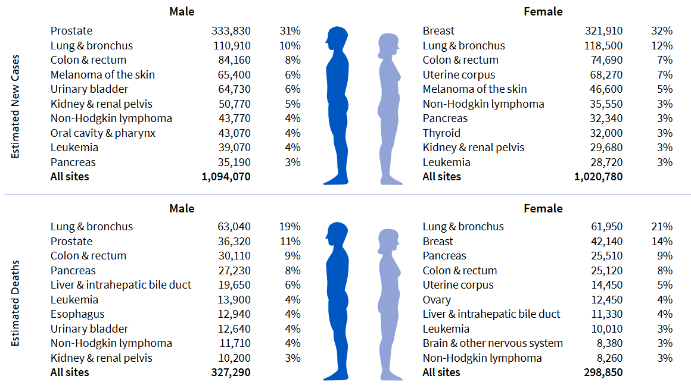
Lung cancer is common, and we aren’t great at curing it
Cancer Facts & Figures 2026, American Cancer Society

Slide 7

> 85% of Lung Cancer Is Caused by
Cigarette Smoking

Slide 8
Lung cancer is not just a disease of smoking
Lung Cancer Deaths
= 124,990 (similar to prostate + breast + colon cancer)
Lung Cancer Deaths in Never Smokers
~ 20,000
> Ovarian Cancer
> Kidney Cancer
> Bladder Cancer
> Gastric Cancer
~ Lymphoma
~ All Leukemias

Slide 9
What are the key things you need to know about a patient’s lung cancer to develop a treatment plan?

Slide 10
What are the key things you need to know about a patient’s lung cancer to develop a treatment plan?
Stage
Sites of disease
Tumor histology
Somatic genomic alterations
PD-L1 status

Slide 11
Overview of NSCLC Staging
Small lung mass
Stage I
>4cm lung mass or hilar nodal involvement
Stage II
>7 cm or mediastinal nodal involvement
Stage III
Curative therapy
Non-Curative therapy
Involvement of
other organs
or contralateral lung
Stage IV
(or Recurrent Disease)

Slide 12
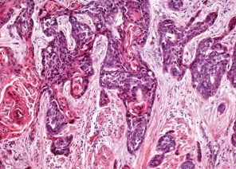
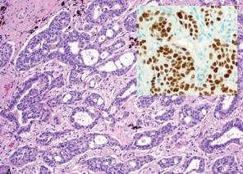
There are two main histologies of NSCLC
Squamous
Other
Adenocarcinoma
~25%
~10%
Squamous Cell Carcinoma
p63 (p40)
Adenocarcinoma
TTF-1, Napsin

Slide 13
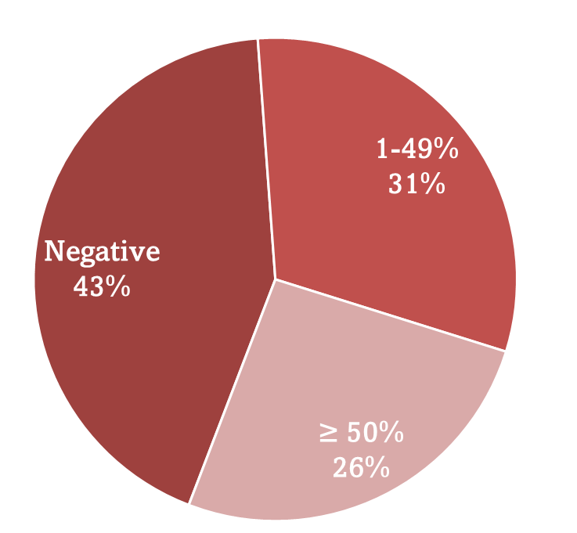
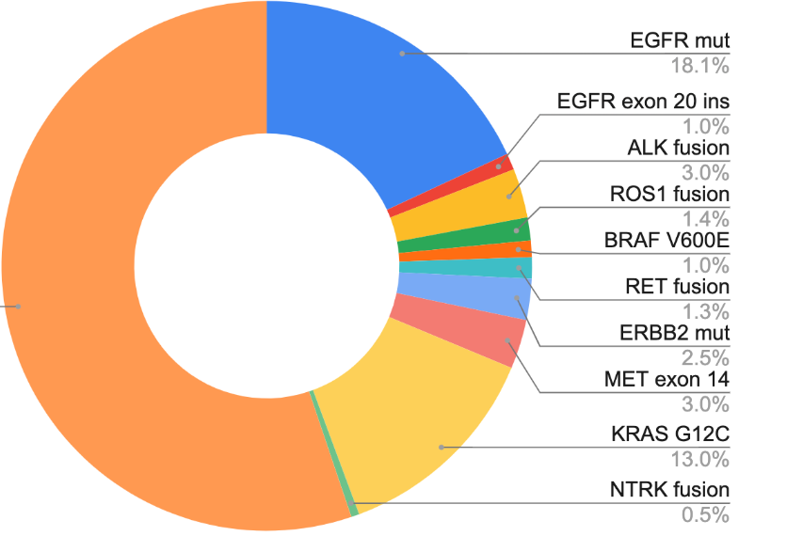
Classification of NSCLC by biomarkers
PD-L1 Tumor Proportion Score
Mutations/Gene Fusions (by NGS)
other
Data from Jee et al, Nature 2024
Data from Choudhury et al, CCR 2023

Slide 14
The Current Approach to First-Line Treatment of Patients with Advanced NSCLC
Stage IV NSCLC
1st line
Mutations/
rearrangement
Histologic Assessment
+
Molecular Analysis
+
PD-L1 Testing
~25%
of patients
PD-L1 <50%
~45%
of patients
PD-L1 ≥50%
~30%
of patients

Slide 15
Immune Checkpoint Inhibitors
Chemotherapy (including VEGF targeting)
Targeted therapy

Slide 16
Immune Checkpoint Inhibitors
Chemotherapy (including VEGF targeting)
Targeted therapy

Slide 17
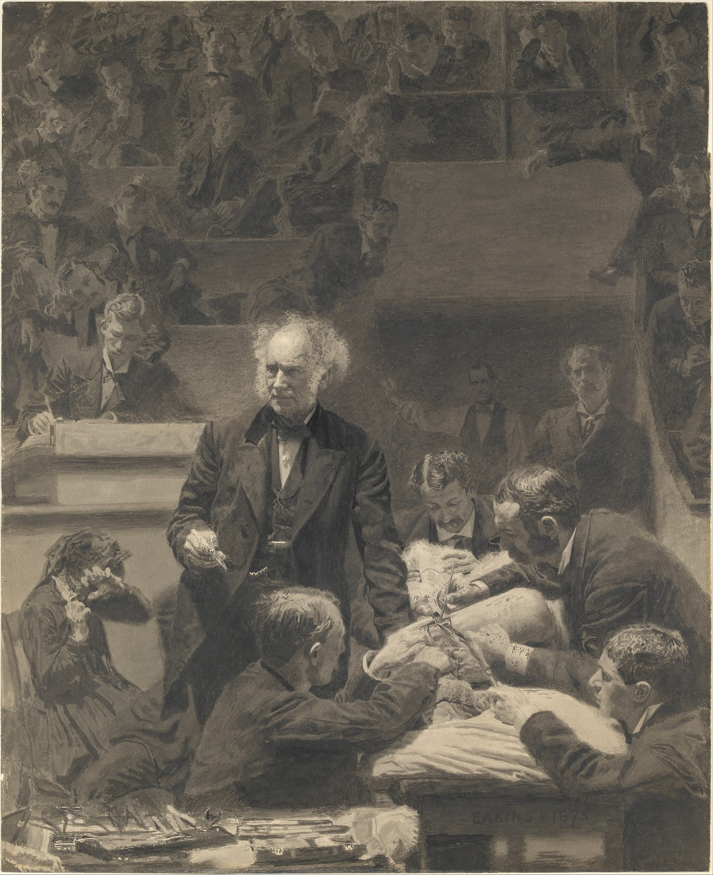
Back in olden times…

Slide 18
How I am going to teach this…
What we learned about chemotherapy
What we learned about immunotherapy
How we learned to combine them

Slide 19

45 year-old person with Stage IV NSCLC
  Adenocarcinoma histology
  No targetable oncogenic driver identified
  No brain metastases
  Good performance status
  PD-L1 negative
  Rheumatoid arthritis requiring steroids, anti-TNF
What is the most appropriate chemotherapy?
  Pembrolizumab
  Cisplatin and docetaxel
  Carboplatin, paclitaxel, and gemcitabine
  Gemcitabine and docetaxel

Slide 20
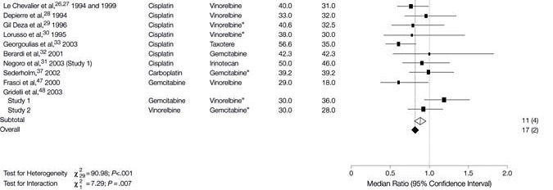
1 vs 2 vs 3 cytotoxic chemotherapies for survival
Delbaldo, C. et al. JAMA 2004;292:470-484.

Slide 21
1 vs 2 vs 3 cytotoxic chemotherapies for survival
2 drugs are better than 1
Delbaldo, C. et al. JAMA 2004;292:470-484.

Slide 22
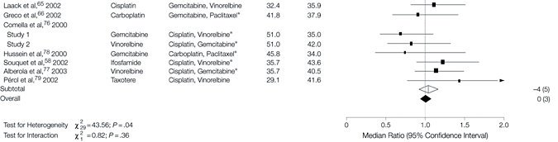
1 vs 2 vs 3 cytotoxic chemotherapies for survival
Delbaldo, C. et al. JAMA 2004;292:470-484.

Slide 23
1 vs 2 vs 3 cytotoxic chemotherapies for survival
For overall survival, 3 cytotoxic drugs are not better than 2
(…it does increase PFS)
Delbaldo, C. et al. JAMA 2004;292:470-484.

Slide 24
Which two drugs are (were) best?

Slide 25
Is there a “best” platinum-based doublet
(in the late 90s)?
Cisplatin + Paclitaxel
  Patients with
  Stage IV or recurrent NSCLC
  No prior chemotherapy
  PS 0-2
Cisplatin + Gemcitabine
Cisplatin + Docetaxel
Carboplatin + Paclitaxel
Schiller JH, et al. N Engl J Med. 2002;346:92-98.

Slide 26
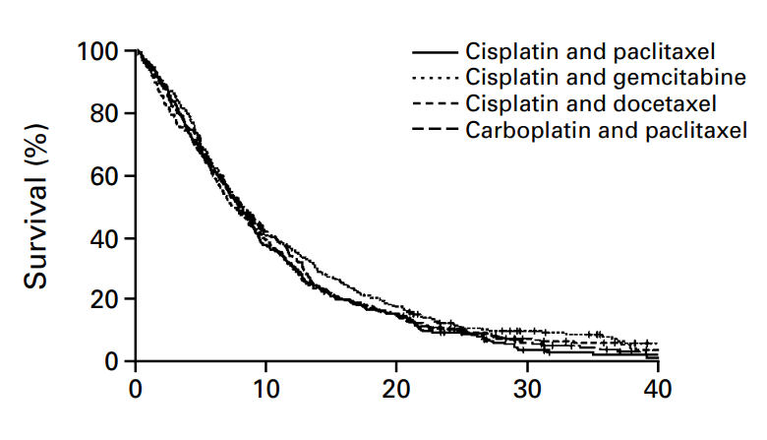
“all platinum doublets are the same”
Schiller JH, et al. N Engl J Med. 2002;346:92-98.

Slide 27
45 year-old person with Stage IV NSCLC
  Adenocarcinoma histology
  No targetable oncogenic driver identified
  No brain metastases
  Good performance status
  PD-L1 negative
  Rheumatoid arthritis requiring steroids, anti-TNF
What is the most appropriate chemotherapy?
  Pembrolizumab
  Cisplatin and docetaxel
  Carboplatin, paclitaxel, and gemcitabine
  Gemcitabine and docetaxel
Best first-line chemo is 2 cytotoxic chemos (not 1, not 3) and the two-drug, platinum-based combinations are all about the same efficacy

Slide 28
55 year-old person with Stage IV NSCLC
  Adenocarcinoma histology
  No targetable oncogenic driver identified
  Asymptomatic
  No brain metastases
  PD-L1 negative
  Rheumatoid arthritis requiring steroids, anti-TNF
What is the right first-line chemotherapy?
  Gemcitabine, cisplatin, and bevacizumab
  Carboplatin, paclitaxel, and bevacizumab
  Docetaxel
  Gemcitabine and vinorelbine

Slide 29
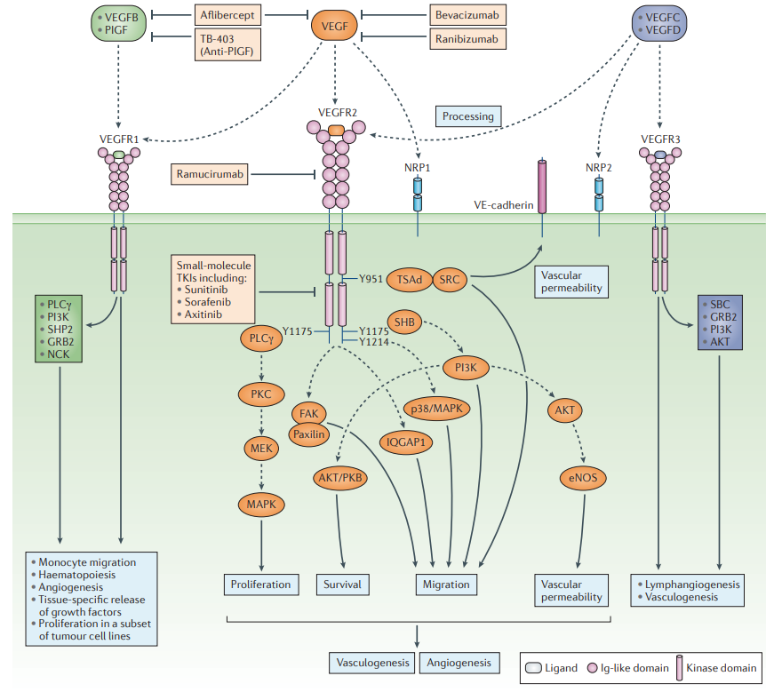
Agents Targeting the VEGF Pathway
Ferrara et al, Nat Rev Drug Disc 2016

Slide 30


Q: Does adding bevacizumab to carboplatin/paclitaxel improve outcomes?
Paclitaxel / Carboplatin
q 3 weeks x 6 cycles
Eligibility:
Metastatic or recurrent NSCLC
No prior chemotherapy
PS 0-1
Non-squamous NSCLC
No Hx of hemoptysis
No CNS metastases
Paclitaxel / Carboplatin
q 3 weeks x 6 cycles
+
Bevacizumab
(15mg/kg q 3 wks) to PD
Sandler et al. N Engl J Med. 2006;355:2542

Slide 31
Why were patients with squamous NSCLC excluded?
In initial randomized phase II trial exploring combination of carboplatin, paclitaxel, and bevacizumab. It enrolled 20% squamous cell.
There were 6 life-threatening bleeds (hemoptysis, hematemesis), 4 were in squamous cell
Subsequent trials explored ways to mitigate risks, but no strategies were effective.
Johnson et al, JCO 2004

Slide 32
NSCLC is now divided into squamous and non-squamous
Other
Adenocarcinoma
Squamous
Non-Squamous
Squamous Cell Carcinoma
p63 (p40)
Adenocarcinoma
TTF-1, Napsin

Slide 33
Q: Does adding bevacizumab to carboplatin/paclitaxel improve outcomes?
Eligibility:
Metastatic or recurrent NSCLC
No prior chemotherapy
PS 0-1
Non-squamous NSCLC
No Hx of hemoptysis
No CNS metastases
Paclitaxel / Carboplatin
q 3 weeks x 6 cycles
Paclitaxel / Carboplatin
q 3 weeks x 6 cycles
+
Bevacizumab
(15mg/kg q 3 wks) to PD
Sandler et al. N Engl J Med. 2006;355:2542

Slide 34
Adding bevacizumab to carboplatin/paclitaxel improves efficacy
Response rate: 15% for carbo/paclitaxel
35% for carbo/paclitaxel + bevacizumab
Progression-Free Survival
Overall Survival
100
Carboplatin/paclitaxel
100
Carboplatin/paclitaxel
Carboplatin/paclitaxel +
bevacizumab
Carboplatin/paclitaxel +
bevacizumab
80
80
P<0.001; HR=0.66
Median PFS: 6.2 months vs.
4.5 months
6-Month PFS: 55% vs. 33%
1-Year PFS: 15% vs. 6%
P=0.003; HR=0.79
Median OS: 12.3 months vs.
10.3 months
1-Year OS: 51% vs. 44%
2-Year OS: 23% vs. 15%
60
Patients Surviving (%)
60
Patients With PFS (%)
40
40
20
20
0
0
0
6
12
18
24
30
36
0
6
12
18
24
30
36
Months
Months
Sandler et al. N Engl J Med. 2006;355:2542

Slide 35
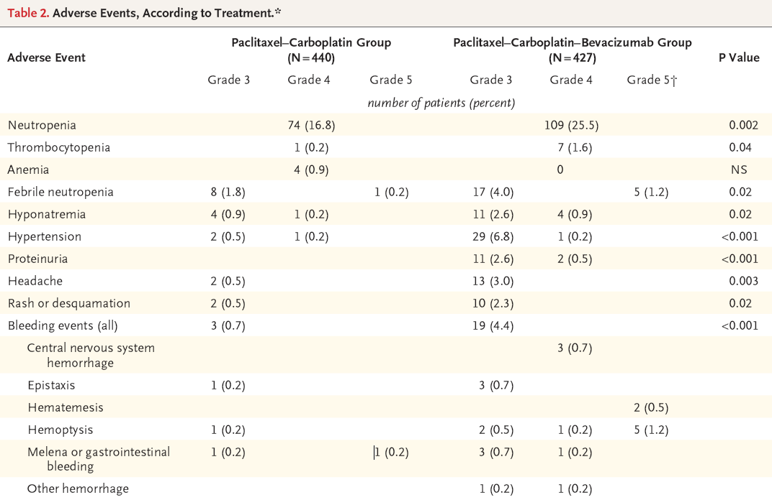
Adding bevacizumab to carboplatin/paclitaxel increases toxicity
Sandler et al, NEJM 2006

Slide 36
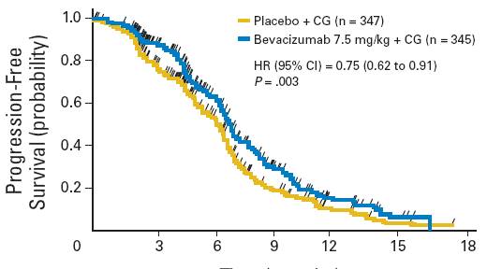
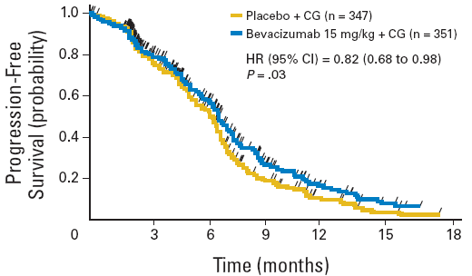
Adding bevacizumab to cisplatin/gemcitabine improves progression free survival
Reck et al, JCO 2009, 27:1227-1234

Slide 37
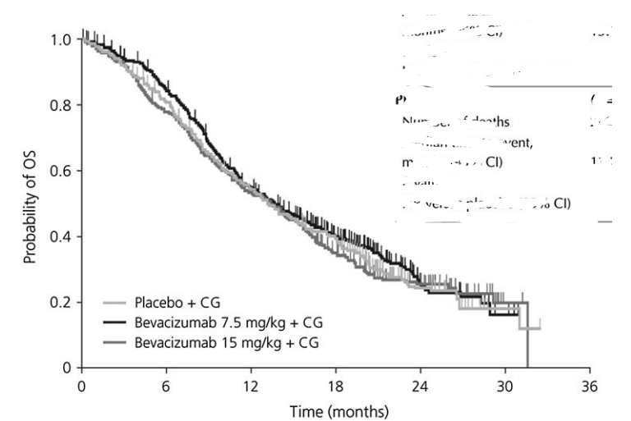
But, adding bevacizumab to cisplatin/gemcitabine does not improve overall survival
 | Placebo + CG | Bev 7.5mg/kg + CG | Bev 15mg/kg + CG
HR (95% CI) |  | 0.93 (0.78–1.11) | 1.03 (0.86–1.23)
p value |  | 0.42 | 0.76
Median OS (months) | 13.1 | 13.6 | 13.4
No Clear Improvement in OS
Reck et al, Annals of Oncology 2010

Slide 38


55 year-old person with Stage IV NSCLC
  Adenocarcinoma histology
  No targetable oncogenic driver identified
  Asymptomatic
  No brain metastases
  PD-L1 negative
  Rheumatoid arthritis requiring steroids, anti-TNF
What is the right first-line chemotherapy?
  Gemcitabine, cisplatin, and bevacizumab
  Carboplatin, paclitaxel, and bevacizumab
  Docetaxel
  Gemcitabine and vinorelbine
Carboplatin, paclitaxel, bevacizumab is primary regimen for use of bevacizumab
(in clinic…we sometimes add it to a number of regimens)

Slide 39
Don’t use bevacizumab:
Squamous histology tumor
  Severe or fatal pulmonary hemorrhage happens in 31% of patients with squamous histology tumor
Patients with more than ½ teaspoon of hemoptysis
Boards tip: the only bevacizumab combinations that will be right have carbo/paclitaxel/bev (+/- atezolizumab)
Lore: “good for CNS…” “good for EGFR mut NSCLC”
Johnson et al, JCO 2004

Slide 40

55 year-old person with Stage IV NSCLC
  Adenocarcinoma histology
  PD-L1 negative and No targetable oncogenes
  No brain metastases
  Good performance status
  Hemoptysis on 3 occasions, total ~ 15 cc blood
  Rheumatoid arthritis requiring steroids, anti-TNF
What is the most appropriate chemotherapy ?
  Cisplatin and gemcitabine
  Cisplatin and pemetrexed
  Carboplatin, paclitaxel, bevacizumab
  Carboplatin, paclitaxel, erlotinib

Slide 41
Q: Is Cisplatin/Pemetrexed non-inferior to Cisplatin/Gemcitabine?
Cisplatin 75 mg/m² day 1 +
Gemcitabine 1250 mg/m² days 1,8
(n=863)
Patients
NSCLC
chemo-naïve
stage IIIb or stage IV
ECOG PS of 0–1
Cisplatin 75 mg/m² day 1 +
Pemetrexed 500 mg/m² day 1
(n=862)
Scagliotti GV, et al. JCO 2008;26:3543-3551.
Notes:
A
Scagliotti G, Parikh P, von Pawel P, et al. Phase III study comparing cisplatin plus gemcitabine with cisplatin plus pemetrexed in chemotherapy-naive patients with advanced-stage non-small-cell lung cancer. J Clin Oncol. 2008;26:3543-3551.
D

Slide 42
Cis/Pem is non-inferior to Cis/Gem in Overall Survival for overall population with NSCLC
1.0
 | Median (months)
Cisplatin/pemetrexed | 10.3 (9.8-11.2)
Cisplatin/gemcitabine | 10.3 (9.6-10.9)
CP vs CG | Adjusted HR (95% CI)
 | 0.94 (0.84-1.05)
0.9
0.8
0.7
0.6
Survival Probability
0.5
0.4
0.3
0.2
0.1
0.0
0
6
12
18
24
30
Survival (months)
*non-inferiority study
Scagliotti GV, et al. JCO 2008;26:3543-3551.
Notes:
Scagliotti G, Parikh P, von Pawel P, et al. Phase III study comparing cisplatin plus gemcitabine with cisplatin plus pemetrexed in chemotherapy-naive patients with advanced-stage non-small-cell lung cancer. J Clin Oncol. 2008;26:3543-3551.

Slide 43
For patients with non-squamous histology, Cis/Pemetrexed is superior to Cis/Gemcitabine
Survival Probability
 | Median
Cisplatin/pemetrexed | 11.8
Cisplatin/gemcitabine | 10.4
CP vs CG | Adjusted HR (95% CI)
 | 0.81 (0.70-0.94)
1.0
0.9
0.8
0.7
0.6
0.5
0.4
0.3
0.2
0.1
0.0
0
6
12
18
24
30
Survival (months)
Scagliotti GV, et al. JCO 2008;26:3543-3551.
Notes:
Scagliotti G, Parikh P, von Pawel P, et al. Phase III study comparing cisplatin plus gemcitabine with cisplatin plus pemetrexed in chemotherapy-naive patients with advanced-stage non-small-cell lung cancer. J Clin Oncol. 2008;26:3543-3551.
The analyses of overall survival by treatment arm for each of 3 histologic groups (large-cell carcinoma, adenocarcinoma, and squamous) demonstrated that cisplatin/pemetrexed in patients with adenocarcinoma and large-cell carcinoma resulted in significantly better survival than cisplatin/gemcitabine (adenocarcinoma: 12.6 vs 10.9 months [P=.03]; large-cell carcinoma: 10.4 vs 6.7 months [P=.03]).
One possible explanation may relate to thymidylate synthase expression levels in NSCLC histologic types. Preclinical date have indicated that overexpression of thymidylate synthase correlates with reduced sensitivity to pemetrexed.

Slide 44
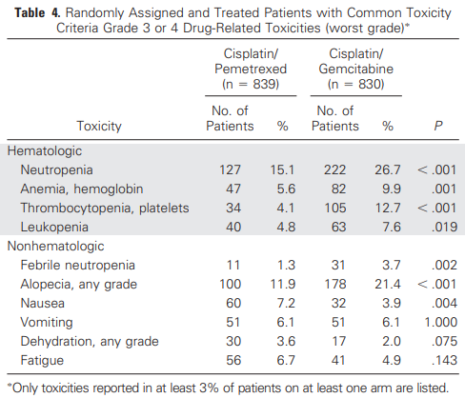
Toxicity of cisplatin/pemetrexed is better than cisplatin/gemcitabine
Scagliotti et al, JCO 2008

Slide 45

55 year-old person with Stage IV NSCLC
  Adenocarcinoma histology
  PD-L1 negative and No targetable oncogenic driver
  No brain metastases
  Good performance status
  Hemoptysis on 3 occasions, total ~ 15 cc blood
  Rheumatoid arthritis requiring steroids, anti-TNF
What is the most appropriate chemotherapy ?
  Cisplatin and gemcitabine
  Cisplatin and pemetrexed
  Carboplatin, paclitaxel, bevacizumab
  Carboplatin, paclitaxel, erlotinib
1. Pemetrexed/cisplatin is better than gemcitabine/cisplatin for non-squamous NSCLC
2. Can’t give bevacizumab if patients have hemoptysis

Slide 46
55 year-old person with Stage IV NSCLC, completes 4 cycles of carboplatin, paclitaxel with stable disease, grade 2 neuropathy, performance status 2
What is the most appropriate next step?
  Continue carboplatin, paclitaxel
  Begin pemetrexed
  Continue paclitaxel until progression
  Discontinue therapy and monitor until progressive disease
  Begin erlotinib

Slide 47

Based on poor quality data, initial platinum-doublet chemotherapy duration is ~ 4 cycles
 | RR | Median PFS/TTP | Median OS
Smith, n=308
MVP x 3 MVP x 6 | 31% 32% | 5 mo 5 mo | 6 mo 7 mo
Socinski, n=230
Carbo/paclitaxel x 4 Carbo/paclitaxel to PD | 22% 24% |  | 6.6 mo 8.5 mo
VonPlessen, n=297
Carbo Vin x 3 Carbo Vin x 6 |  | 4 mo 5.2 mo | 7 mo 8 mo
Widely interpreted to mean that there is little benefit for platinum-based chemotherapy beyond initial 4-6 cycles, prolonged exposure to chemotherapy leads to greater toxicity without additional benefit
Smith et al, JCO 2001; Socinski et al, JCO 2002; von Plessen et al, Br J Cancer 2006

Slide 48
55 year-old person with Stage IV NSCLC, completes 4 cycles of carboplatin, paclitaxel with stable disease, grade 2 neuropathy, performance status 2
What is the most appropriate next step?
  Continue carboplatin, paclitaxel
  Begin pemetrexed
  Continue paclitaxel until progression
  Discontinue therapy and monitor until progressive disease
  Begin erlotinib
4-6 cycles of chemotherapy is
complete initial chemotherapy for Stage IV NSCLC
(there is switch maintenance chemo, but not for PS 2)
For more modern regimens, this translates to including
platinum for the first 4-6 cycles

Slide 49
History lessons in chemotherapy
(or Initial Therapy for Patients Not Appropriate for Immunotherapy)
Summary
Platinum-doublet chemotherapy is the standard
Bevacizumab is contraindicated in patients with squamous histology or hemoptysis
Cisplatin-Pemetrexed is better than Cisplatin-Gemcitabine in patients with “non-squamous”
Discontinuation of platinum after 4-6 cycles of platinum doublet is routine

Slide 50
So, back then…first line treatment
Platinum-doublet chemotherapy (with or without bevacizumab) is standard 1st treatment
For “non-squamous” NSCLC, platinum-pemetrexed common
For squamous NSCLC, platinum-gemcitabine common
Platinum/taxane is used regardless of histology

Slide 51
Immune Checkpoint Inhibitors
Chemotherapy
(including VEGF targeting)
Targeted therapy
“non-squamous”
Cis/carboplatin + pemetrexed
carboplatin + paclitaxel
carboplatin + paclitaxel + bevacizumab
carboplatin + albumin-bound paclitaxel
Squamous
carboplatin + paclitaxel
carboplatin + albumin-bound paclitaxel
Cis/carboplatin + gemcitabine
2nd line chemotherapy
Docetaxel +/- ramucirumab

Slide 52
After first line chemotherapy…

Slide 53
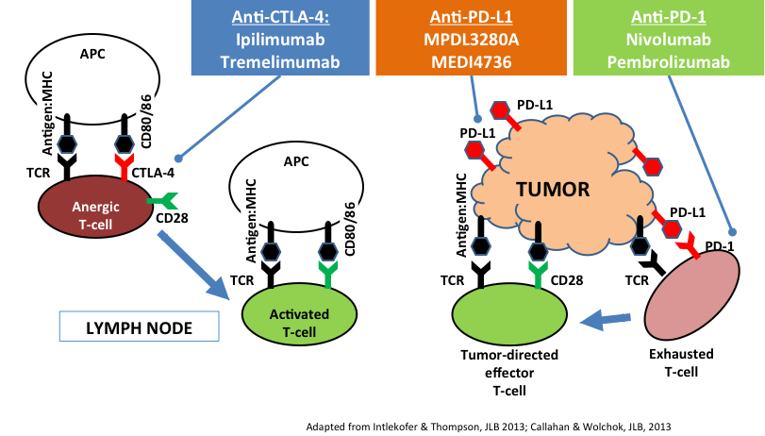
Basics of Immunotherapy
Anti-PD-L1
Atezolizumab
Durvalumab

Slide 54
Cast of Characters
PD-1/PD-L1 antibodies
nivolumab
pembrolizumab
atezolizumab
durvalumab
cemiplimab
avelumab
PD-1/CTLA-4 combinations
nivolumab +
ipilimumab
durvalumab +
tremelimumab

Slide 55
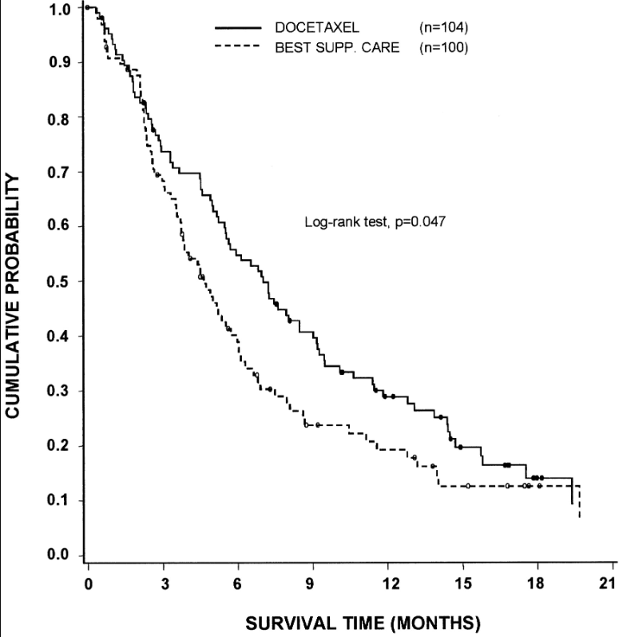
Q: Are anti-PD-(L)1 drugs superior to standard second-line chemotherapy?
RR 7%
mOS – 7 mo vs 4.6 mo
Shepherd et al, JCO 2000

Slide 56
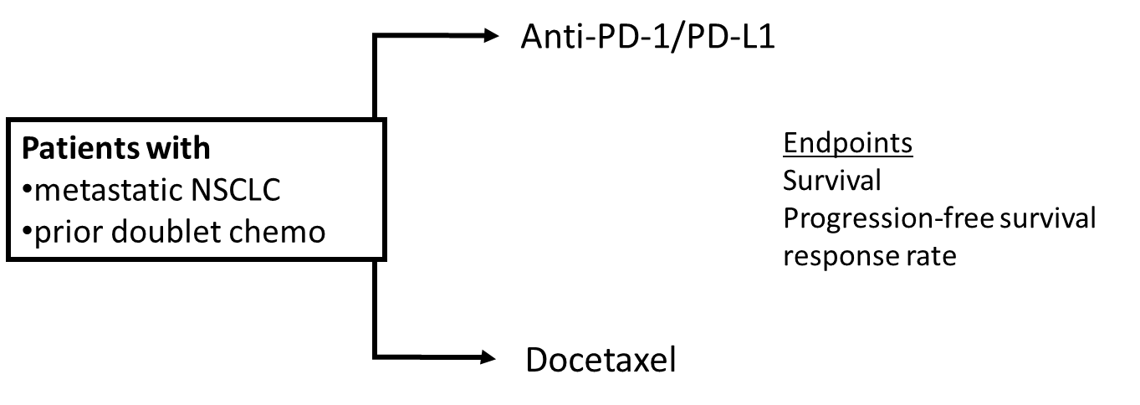
Q: Are anti-PD-(L)1 drugs superior to standard second-line chemotherapy?
RR 7%
mOS – 7 mo vs 4.6 mo
Shepherd et al, JCO 2000

Slide 57
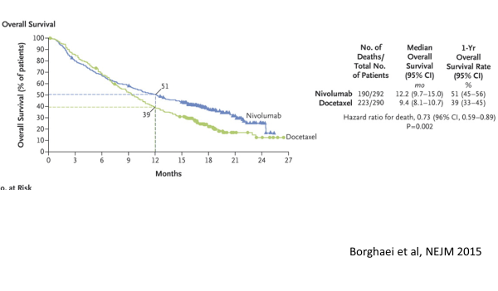
In second line treatment, nivolumab is superior to docetaxel

Slide 58
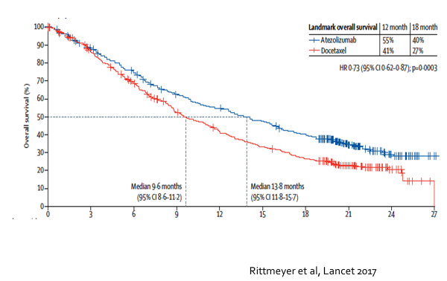
In second line treatment, atezolizumab is superior to docetaxel

Slide 59
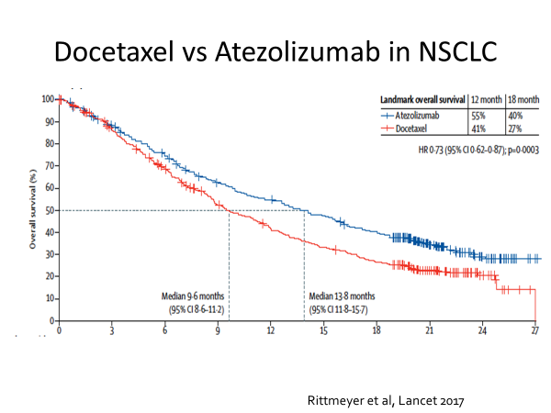
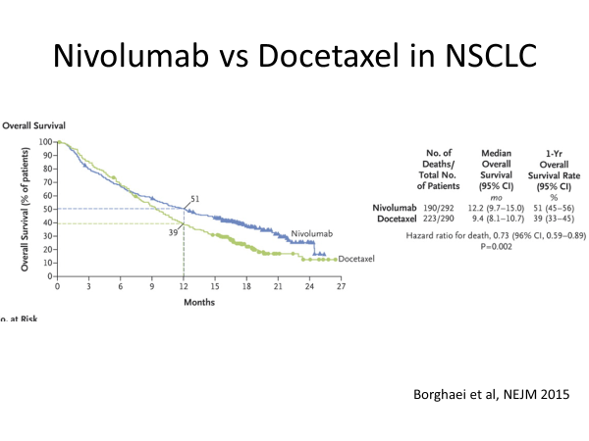
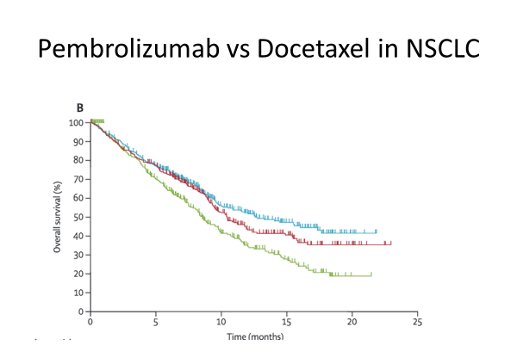
Single-agent anti-PD-1/PD-L1 is better than a lousy chemotherapy
Rittmeyer et al, Lancet 2017; Borghaei et al, NEJM 2015; Herbst et al, Lancet 2016

Slide 60
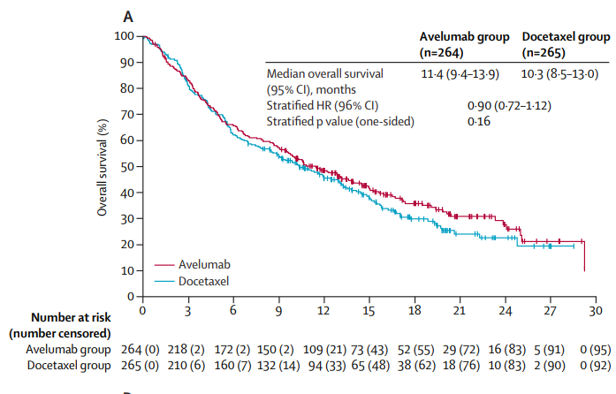
But, it isn’t always superior
(avelumab is not superior to docetaxel)
Barlesi et al, Lancet Onc 2018

Slide 61
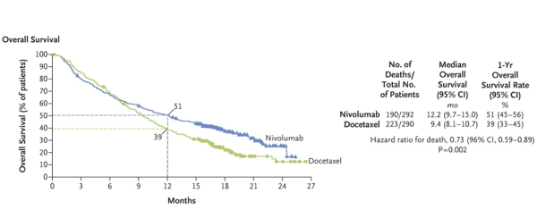
Even when it improves outcomes, can we do better?
The curves are different, but not dramatic. Can we figure out who is getting the most benefit?
Borghaei et al, NEJM 2015

Slide 62
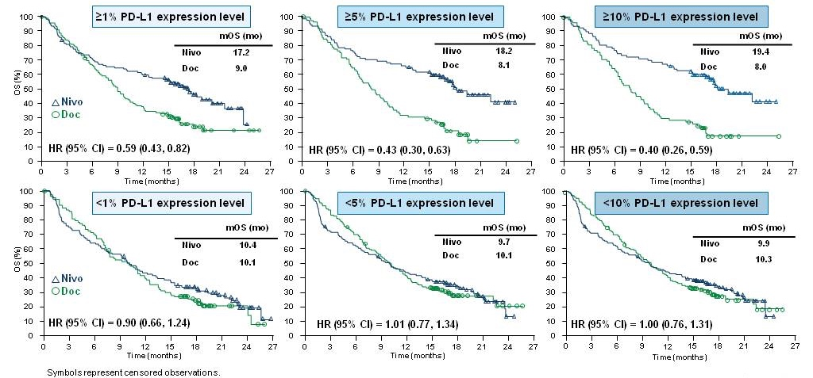
PD-L1 expression predicts better outcomes with nivolumab in non-Squamous Cell Lung Cancer
Paz-Ares et al ASCO 2015

Slide 63
Summary of Immunotherapy after Initial Therapy
As single-agents, atezolizumab, pembrolizumab, and nivolumab were all proven superior to docetaxel for the treatment of patients with NSCLC previously treated with platinum-based therapy (aka “second line”)
PD-L1 is a biomarker (it has limitations and challenges)
Small note: Use of pembrolizumab in “second line” requires evidence of PD-L1 expression

Slide 64
55 year-old person with Stage IV NSCLC
  Adenocarcinoma histology
  PD-L1 negative and No targetable oncogenic driver
  No brain metastases
  Good performance status
What is the most appropriate chemotherapy ?
  Cisplatin and gemcitabine
  Cisplatin and pemetrexed
  Carboplatin, paclitaxel, bevacizumab
  Carboplatin, paclitaxel, erlotinib
  Cisplatin, pemetrexed, pembrolizumab

Slide 65

Often, we aren’t so creative
We know treatment A (platinum doublet) works
We know treatment B (anti-PD-1/PD-L1 antibody) works after treatment A
We should combine A + B!

Slide 66
Q: Does adding pembrolizumab to platinum/pemetrexed in “non-squamous” NSCLC improve outcomes? (Keynote 189)
pembrolizumab + carboplatin/cisplatin + pemetrexed
4 cycles
pembrolizumab + pemetrexed
Recurrent/metastatic nonsquamous NSCLC
no prior chemo
no EGFR+ or ALK+
sample for PD-L1 IHC status
no symptomatic brain metastases
No pneumonitis
R
2:1
carboplatin/cisplatin + pemetrexed
4 cycles
placebo + pemetrexed
Gandhi et al NEJM 2018

Slide 67
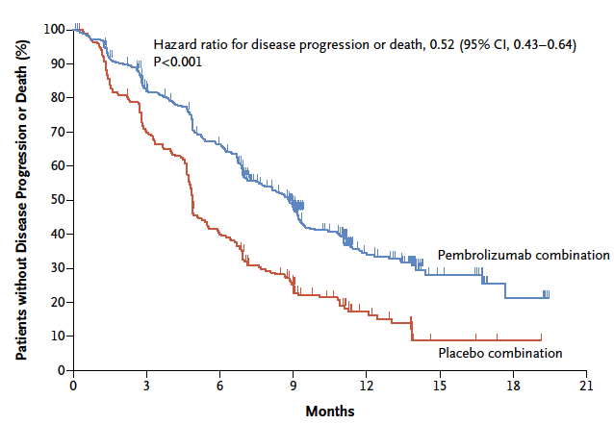
Adding pembrolizumab to chemotherapy in “non-squamous” NSCLC improves PFS
Gandhi et al NEJM 2018

Slide 68
Adding pembrolizumab to chemotherapy in “non-squamous” NSCLC improves PFS
This will be the treatment you see used most:
carboplatin,
pemetrexed,
pembrolizumab
Gandhi et al NEJM 2018

Slide 69
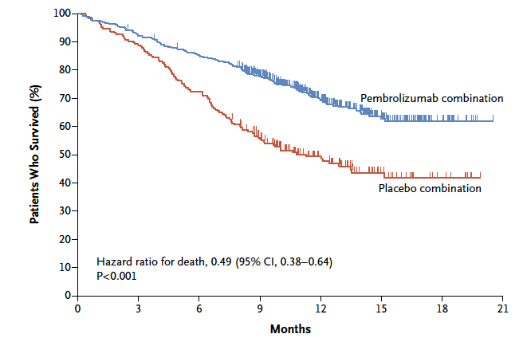
Adding pembrolizumab to chemotherapy in “non-squamous” NSCLC improves overall survival
Gandhi et al NEJM 2018

Slide 70
PD-L1 levels predict greater benefit, but all patients appear to benefit
PD-L1 level | OS HR (95% CI)
All patients | 0.49 (0.38-0.64)
PD-L1 ≥ 50% | 0.42 (0.26-0.68)
PD-L1 1-49% | 0.55 (0.34-0.90)
PD-L1 negative | 0.59 (0.38-0.92)
Gandhi et al NEJM 2018

Slide 71
55 year-old person with Stage IV NSCLC
  Adenocarcinoma histology
  PD-L1 negative and No targetable oncogenic driver
  No brain metastases
  Good performance status
What is the most appropriate chemotherapy ?
  Cisplatin, gemcitabine
  Cisplatin and pemetrexed
  Carboplatin, paclitaxel, bevacizumab
  Carboplatin, paclitaxel, erlotinib
  Cisplatin, pemetrexed, pembrolizumab
Cisplatin, pemetrexed, pembrolizumab is better than cisplatin/pemetrexed (regardless of PD-L1 expression).

Slide 72
55 year-old person with Stage IV NSCLC
  Adenocarcinoma histology
  No targetable oncogenic driver
  No brain metastases
  Good performance status
  Hemoptysis (3 tablespoons)
What is the most appropriate chemotherapy ?
  Cisplatin, gemcitabine
  Carboplatin, paclitaxel, bevacizumab, atezolizumab
  Carboplatin, paclitaxel, bevacizumab
  Carboplatin, paclitaxel, erlotinib
  Cisplatin, pemetrexed, pembrolizumab

Slide 73
Q: Does adding atezolizumab to carboplatin/paclitaxel/bevacizumab improve outcomes in non-squamous NSCLC
Stage IV or
recurrent metastatic nonsquamous NSCLC
Chemotherapy-naiveª
Tumor tissue available for biomarker testing
Any PD-L1 IHC status
N = 1202
Atezolizumab + Carboplatin + Paclitaxel
+ Bevacizumab
4 or 6 cycles
Atezolizumab
+
Bevacizumab
R
1:1:1
Carboplatin + Paclitaxel
+ Bevacizumab
4 or 6 cycles
Bevacizumab
Socinski et al, NEJM 2018

Slide 74
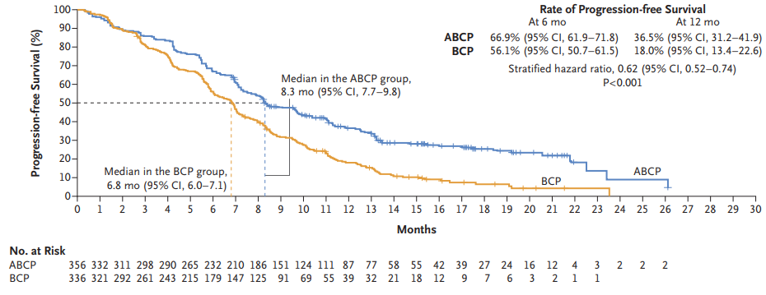
Adding atezolizumab to carboplatin/paclitaxel/bevacizumab improves PFS in non-squamous NSCLC
Socinski et al, NEJM 2018

Slide 75
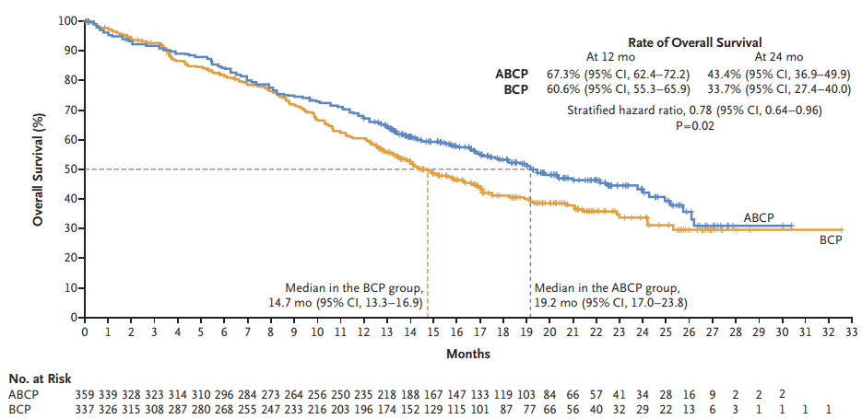
Adding atezolizumab to carboplatin/paclitaxel/bevacizumab improves OS in non-squamous NSCLC
Socinski et al, NEJM 2018

Slide 76
55 year-old person with Stage IV NSCLC
  Adenocarcinoma histology
  No targetable oncogenic driver
  No brain metastases
  Good performance status
  Hemoptysis (3 tablespoons)
What is the most appropriate chemotherapy ?
  Cisplatin, gemcitabine
  Carboplatin, paclitaxel, bevacizumab, atezolizumab
  Carboplatin, paclitaxel, bevacizumab
  Carboplatin, paclitaxel, erlotinib
  Cisplatin, pemetrexed, pembrolizumab
Both chemotherapy + immunotherapy combinations were better than control
Patients with hemoptysis should not receive bevacizumab

Slide 77
55 year-old person with Stage IV NSCLC
  Squamous histology tumor
  Good performance status
  No hemoptysis
  No brain metastases
What is the right first-line chemotherapy?
  Carboplatin, pemetrexed, pembrolizumab
  Carboplatin, paclitaxel, atezolizumab
  Carboplatin, paclitaxel, pembrolizumab
  Cisplatin, gemcitabine

Slide 78
Q: Does adding pembrolizumab to carboplatin and taxane improve outcomes in Squamous NSCLC?
Pembrolizumab +
Carboplatin +
Paclitaxel Q3W
OR
nab-Paclitaxel
for 4 cycles (each 3 wk)
Pembrolizumab
for up to 31 cycles
Key Eligibility Criteria
Untreated stage IV NSCLC with squamous histology
ECOG PS 0 or 1
No symptomatic brain metastases
No pneumonitis requiring systemic steroids
Placebo +
Carboplatin AUC 6 Q3W +
Paclitaxel Q3W
OR nab-Paclitaxel Q1W
for 4 cycles (each 3 wk)
Placebo
for up to 31 cycles
Optional Crossover^{b}
Pembrolizumab
for up to 35 cycles
End points
Primary: PFS (RECIST v1.1, BICR) and OS
Secondary: ORR and DOR (RECIST v1.1, BICR), safety
PD^{b}
Paz-Ares ASCO 2018 Abstract 105

Slide 79
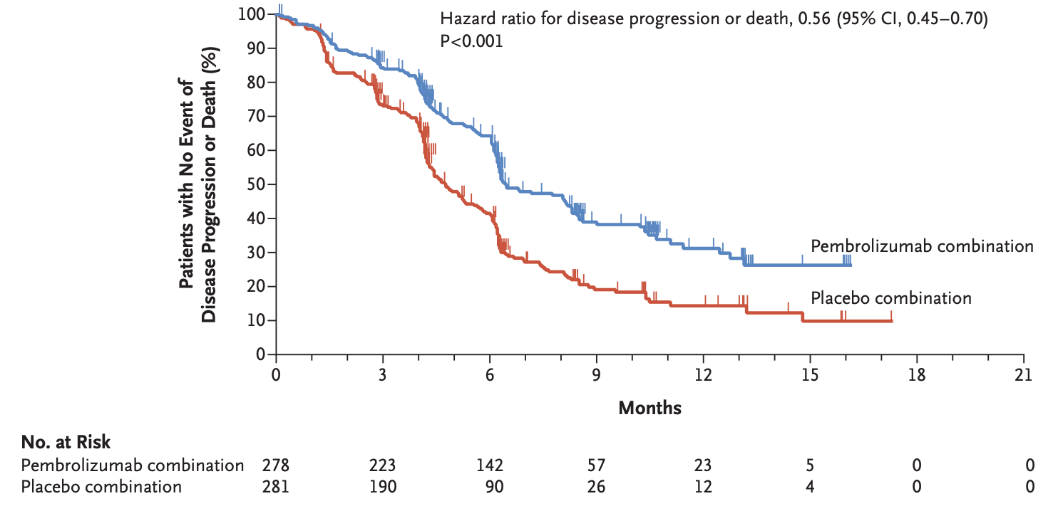
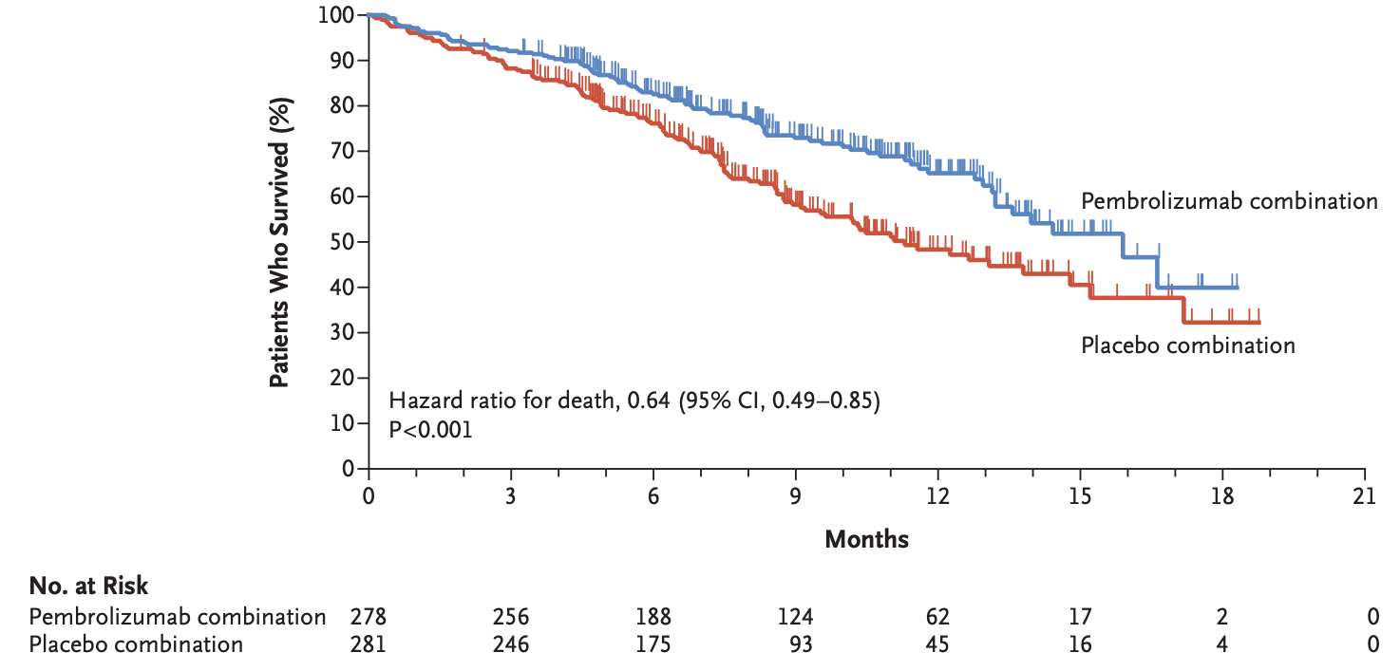
Adding pembrolizumab to carboplatin and taxane improves PFS and OS in Squamous NSCLC
Median (95% CI)
6.4 mo (6.2-8.3)
4.8 mo (4.3-5.7)
Paz-Ares et al, NEJM 2018

Slide 80


55 year-old person with Stage IV NSCLC
  Squamous histology tumor
  Good performance status
  No hemoptysis
  No brain metastases
What is the right first-line chemotherapy?
  Carboplatin, pemetrexed, pembrolizumab
  Carboplatin, paclitaxel, atezolizumab
  Carboplatin, paclitaxel, pembrolizumab
  Cisplatin, gemcitabine
Chemotherapy + pembrolizumab is superior to chemotherapy alone
Pemetrexed is wrong in a patient with squamous cell lung cancer
Atezolizumab combination was not superior to chemotherapy in OS

Slide 81


65 year-old person with Stage IV NSCLC
  Adenocarcinoma histology
  No targetable oncogenic driver identified
  No brain metastases
  Good performance status
  PD-L1 immunohistochemistry positive in 60% of cells
What is the most appropriate initial treatment?
  Cisplatin and docetaxel
  Bevacizumab
  Pembrolizumab
  Cisplatin and pemetrexed
  Nivolumab

Slide 82
Do you need the chemotherapy?

Slide 83
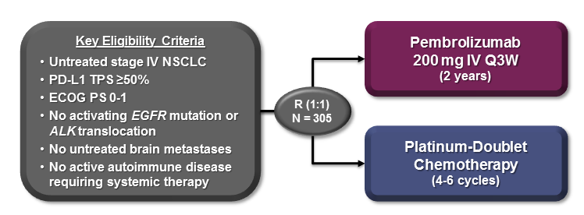
Q: Does substitution of pembrolizumab for chemotherapy improve outcomes in patients whose tumors are PD-L1 ≥ 50%?
(Keynote 024)
Reck et al, ESMO 2016

Slide 84
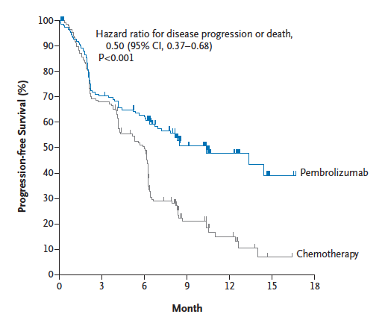
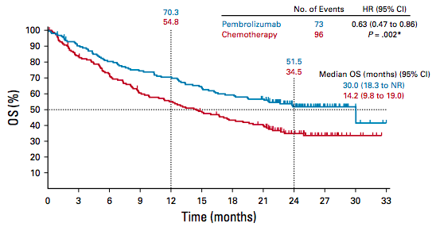
Pembrolizumab is better than chemotherapy for patients whose tumors are PD-L1 ≥ 50% by PFS and OS
Reck et al, NEJM 2016
Reck et al, JCO 2019

Slide 85
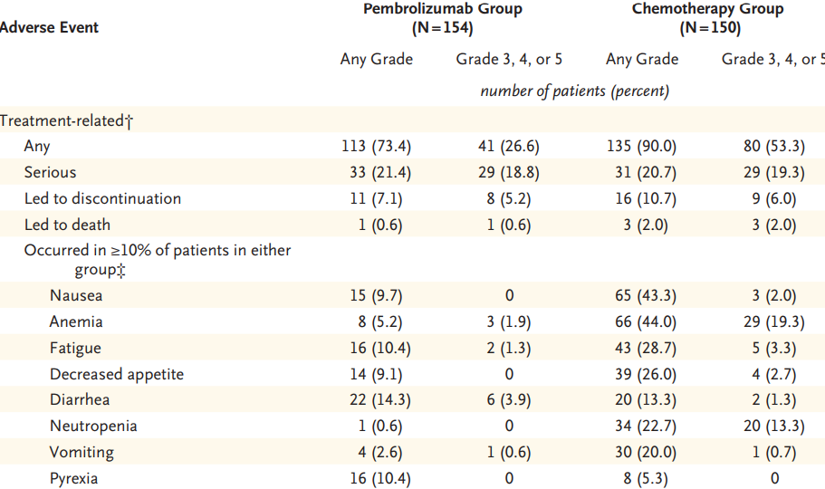




Pembrolizumab is Associated with Fewer Adverse Events than Chemotherapy
Reck et al, NEJM 2016

Slide 86

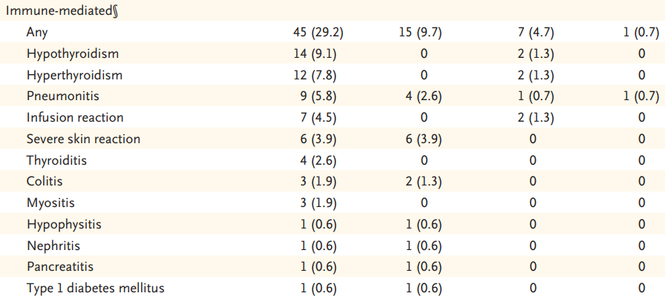



There are Immune-Related Adverse Events
Reck et al, NEJM 2016

Slide 87









65 year-old person with Stage IV NSCLC
  Adenocarcinoma histology
  No targetable oncogenic driver identified
  No brain metastases
  Good performance status
  PD-L1 immunohistochemistry positive in 60% of cells
What is the most appropriate initial treatment?
  Cisplatin and docetaxel
  Bevacizumab
  Pembrolizumab
  Cisplatin and pemetrexed
  Nivolumab
If PD-L1 ≥50%, pembrolizumab is superior to chemotherapy

Slide 88

Open question…
For patients with PD-L1 ≥ 50% which is better?
single-agent checkpoint inhibitor
or
chemotherapy + [ICI]?
No trial data
Symptoms? PD-L1 level (90% vs 50%)?

Slide 89
65 year-old person with Stage IV NSCLC
  Adenocarcinoma histology
  No targetable oncogenic driver identified
  No brain metastases
  Good performance status
  PD-L1 immunohistochemistry positive in 15% of cells
What is the most appropriate initial treatment?
  Pembrolizumab
  Cisplatin and pemetrexed
  Nivolumab
  Carboplatin, pemetrexed, pembrolizumab

Slide 90
Are there other PD-L1 cut points?

Slide 91
Q: Does substitution of pembrolizumab for chemotherapy improve outcomes in patients whose tumors are PD-L1 ≥ 1%
(Keynote 042)
Pembrolizumab
200 mg Q3W
for up to 35 cycles
Key Eligibility Criteria
Untreated locally advanced or metastatic NSCLC of any histology
PD-L1 TPS ≥1%
No sensitizing EGFR or ALK alterations
ECOG PS 0 or 1
No untreated or unstable CNS metastases
No history of pneumonitis that required systemic corticosteroids
N = 637
Carboplatin AUC 5 or 6 Q3W + Paclitaxel 200 mg/m² Q3Wª
OR
Carboplatin AUC 5 or 6 Q3W + Pemetrexed 500 mg/m² Q3Wª
for up to 6 cycles
N = 637
Gilberto Lopes ASCO 2018

Slide 92
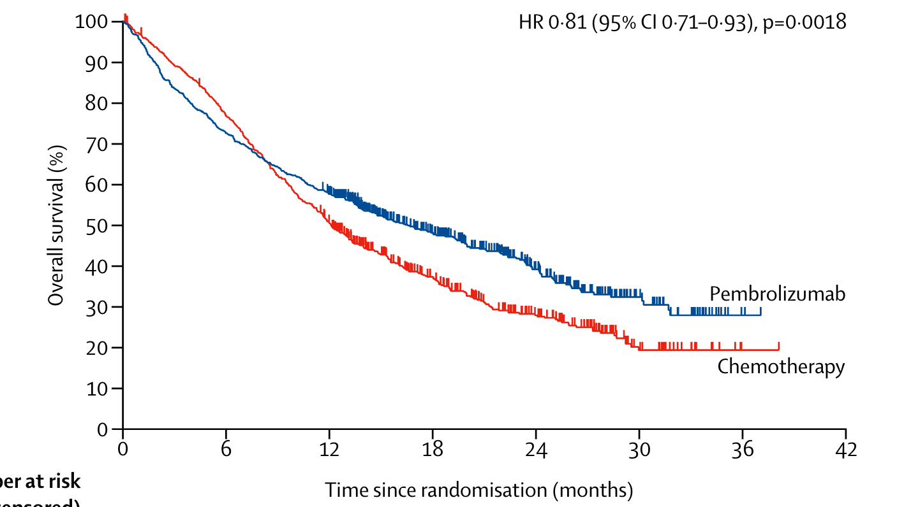
Pembrolizumab is better than chemotherapy for patients whose tumors are PD-L1 ≥ 1%
Mok et al, Lancet 2019

Slide 93


Enrolled in the trial
Overall group, PD-L1 ≥1% n= 1274
That includes:
  People with PD-L1 ≥50%, n=599
  People with PD-L1 1-49%, n=675
And remember…we know that patients with PD-L1 ≥50% benefit (OS HR 0.63 when compared with chemo)
Mok et al, Lancet 2019; Reck et al, NEJM 2016

Slide 94
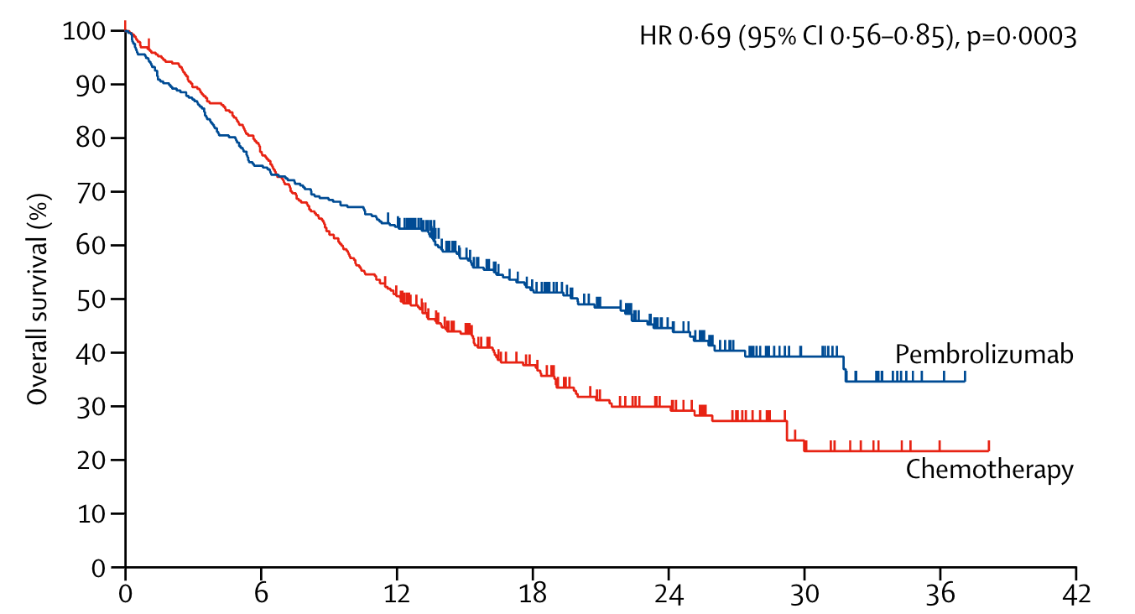
Pembrolizumab is better than chemotherapy for patients whose tumors are PD-L1 ≥ 1%: subset PD-L1 ≥ 50%
Mok et al, Lancet 2019

Slide 95
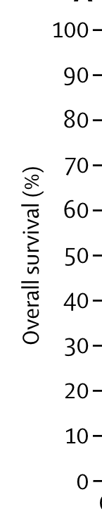
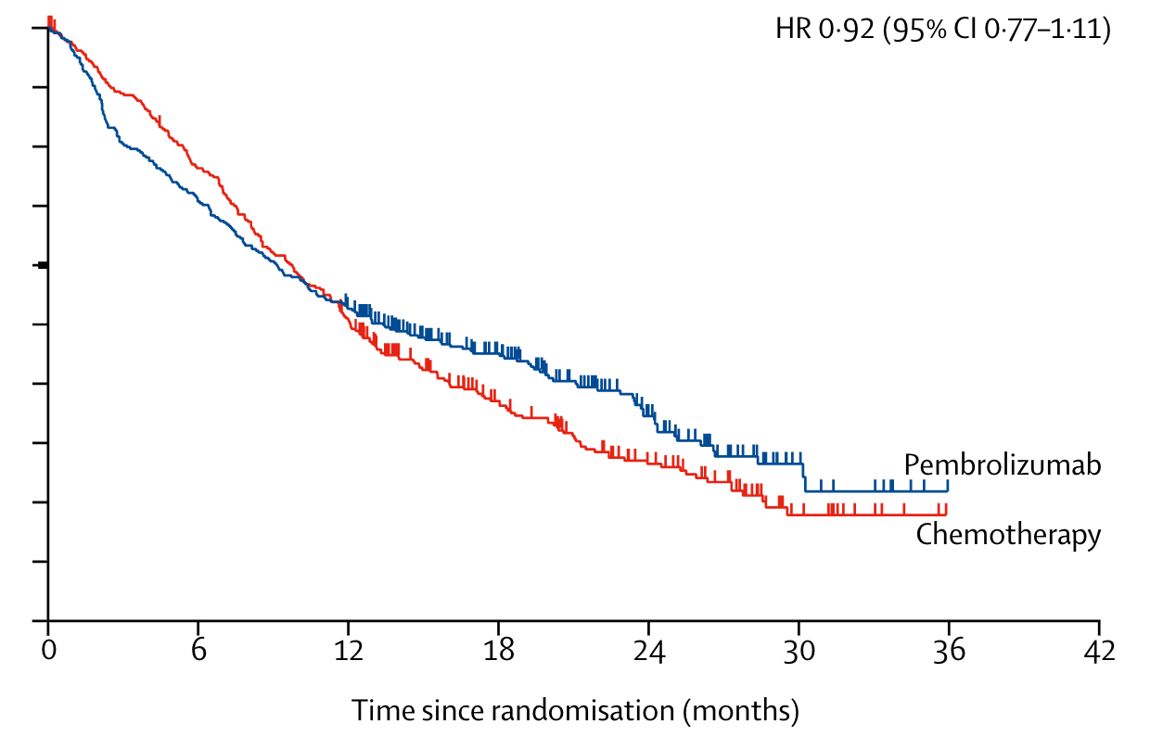
Pembrolizumab is better than chemotherapy for patients whose tumors are PD-L1 ≥ 1%: subset PD-L1 1-49%
Mok et al, Lancet 2019

Slide 96
65 year-old person with Stage IV NSCLC
  Adenocarcinoma histology
  No targetable oncogenic driver identified
  No brain metastases
  Good performance status
  PD-L1 immunohistochemistry positive in 15% of cells
What is the most appropriate initial treatment?
  Pembrolizumab
  Cisplatin and pemetrexed
  Nivolumab
  Carboplatin, pemetrexed, pembrolizumab
If PD-L1 <50%, pembrolizumab was NOT superior to chemotherapy, so most would favor another approach

Slide 97
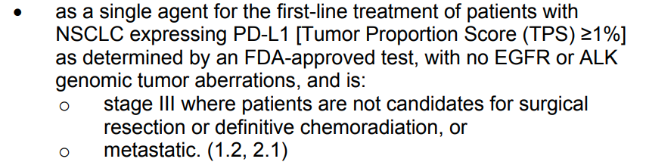
Since overall trial showed improved OS,
FDA has approved for patients with ≥PD-L1 1%
(But not recommended in NCCN guidelines to use single-agent ICI in patients with PD-L1 <50%)
prescribing information

Slide 98
Are all anti-PD-1/PD-L1 drugs the same in the first-line setting?

Slide 99
Q: Is nivolumab better than chemotherapy in NSCLC with PDL1 ≥5%? (Checkmate 026)
Patients with
metastatic NSCLC (EGFR and ALK WT)
PDL1 ≥5% Tumor Cells
no prior chemo
n=541
Nivolumab 3 mg/kg q2 weeks
Investigator’s Choice Platinum Doublet
Endpoints
Primary: Progression-free survival
Response Rate
Overall Survival
Carbone et al, NEJM 2017
Notes:
A
Scagliotti G, Parikh P, von Pawel P, et al. Phase III study comparing cisplatin plus gemcitabine with cisplatin plus pemetrexed in chemotherapy-naive patients with advanced-stage non-small-cell lung cancer. J Clin Oncol. 2008;26:3543-3551.
D

Slide 100
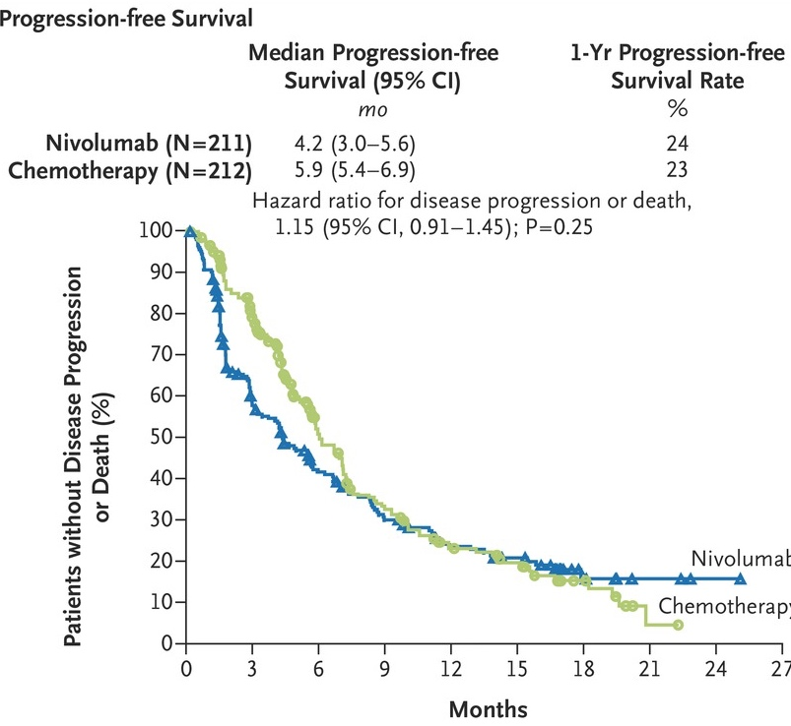
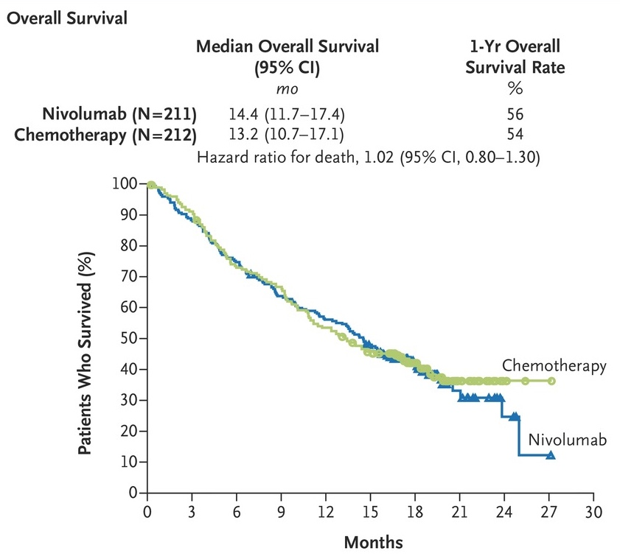
Nivolumab is not better than chemotherapy with PD-L1 ≥ 5%
Carbone DP et al. N Engl J Med 2017
Notes:
Figure 1 Progression-free Survival and Overall Survival among Patients with a Programmed Death Ligand 1 Expression Level of 5% or More. CI denotes confidence interval.

Slide 101
Q: Is atezolizumab better than chemotherapy in patients with high PD-L1 expression
Atezolizumab q 3 weeks
Patients with
metastatic NSCLC (EGFR and ALK WT)
PD-L1 ≥50% Tumor Cells OR 10% of Immune cells (by area)
no prior chemo
Platinum-based chemotherapy
Endpoints
Primary: Progression-free survival
Response Rate
Overall Survival
Herbst et al, NEJM 2020

Slide 102
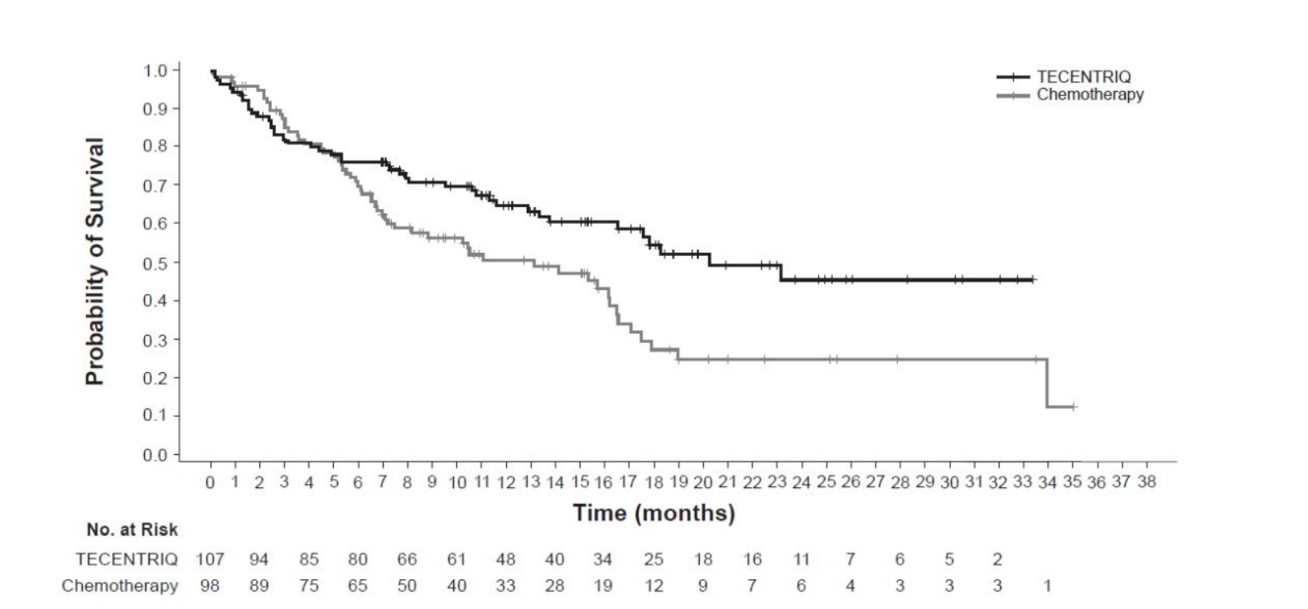
Atezolizumab is better than chemotherapy in patients with high PD-L1 expression
atezolizumab
Median OS – 20 months
HR 0.59 (p=0.01)
Herbst et al, NEJM 2020

Slide 103
Front Line Single-agent anti-PD1/PD-L1
In patients with metastatic NSCLC with high PD-L1,
  Pembrolizumab, cemiplimab (PD-L1 ≥ 50%) and
  atezolizumab (PD-L1 stained ≥ 50% of tumor cells or PD-L1 stained tumor-infiltrating immune cells covering ≥ 10% of the tumor area) are better than chemotherapy
For PD-L1 cutpoints 1-49%, pembrolizumab is not superior to chemotherapy (but is FDA-approved and can be given)
In nivolumab trial in PD-L1 ≥ 5% positive, nivolumab not superior to chemotherapy
In durvalumab trial in PD-L1 ≥ 25% positive, durvalumab not superior to chemotherapy

Slide 104
What about combinations of checkpoint inhibitors?
Anti-PD-L1
Atezolizumab
Durvalumab

Slide 105
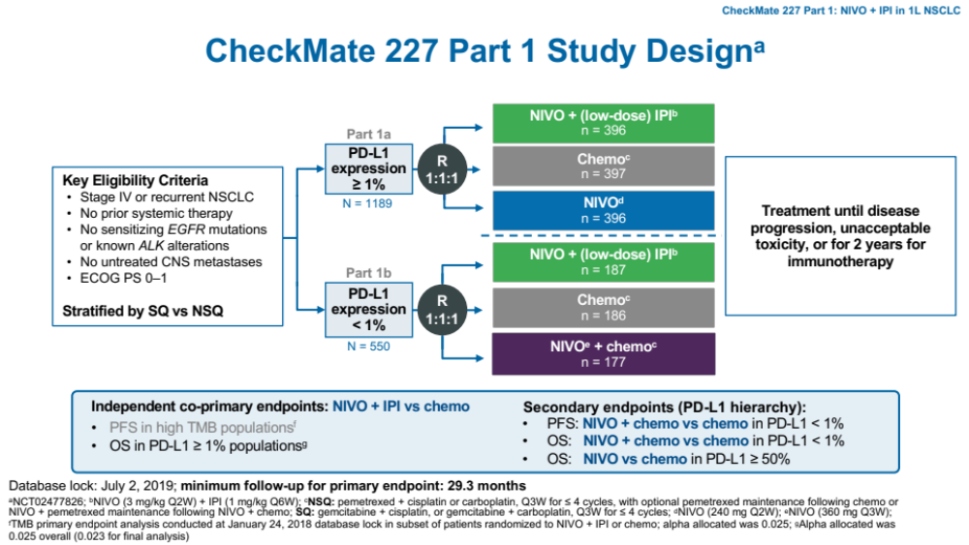
Q: Is combination PD-1 Ab + CTLA4 Ab superior to chemotherapy?
Adapted from Peters et al, ESMO 2019

Slide 106
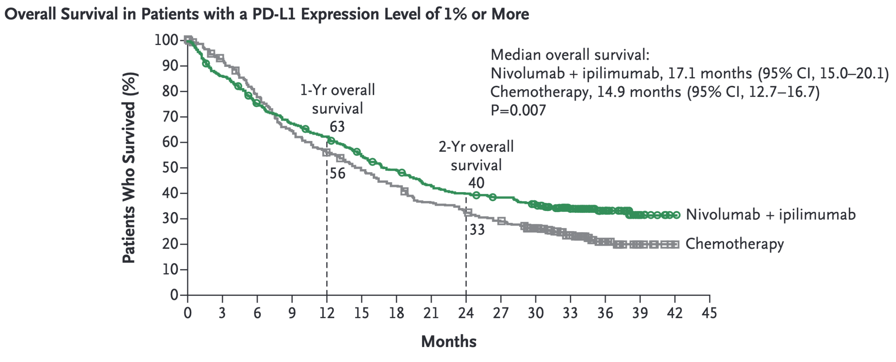
Ipi/Nivo improved OS compared with chemotherapy (w/o IO) in PD-L1 positive
Hellmann et al, NEJM 2019

Slide 107
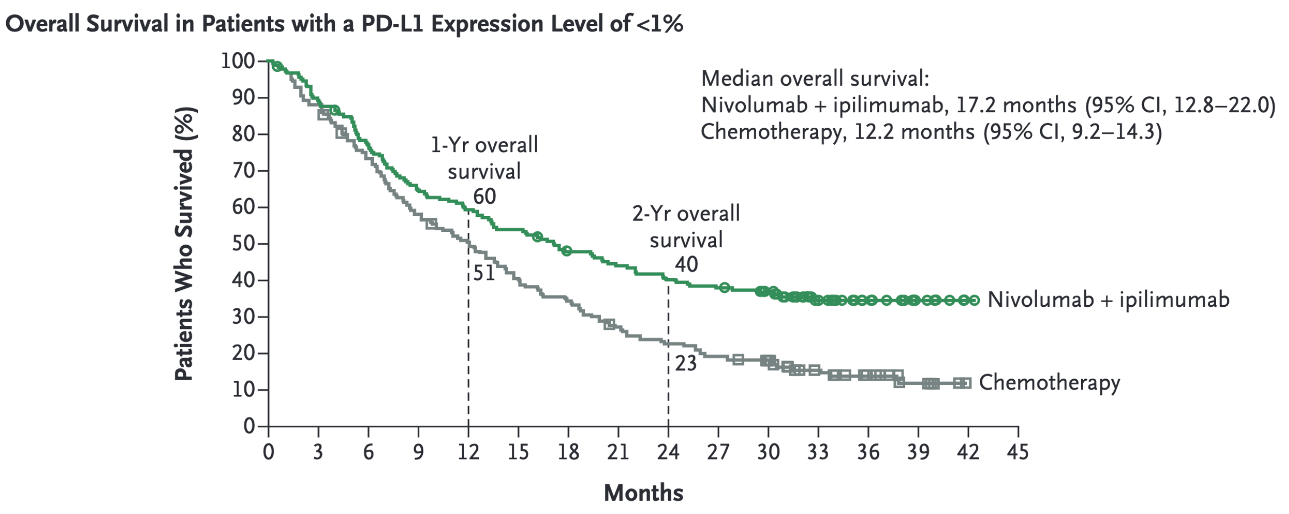
Ipi/Nivo improved OS compared with chemotherapy (w/o IO) in PD-L1 negative
Hellmann et al, NEJM 2019

Slide 108
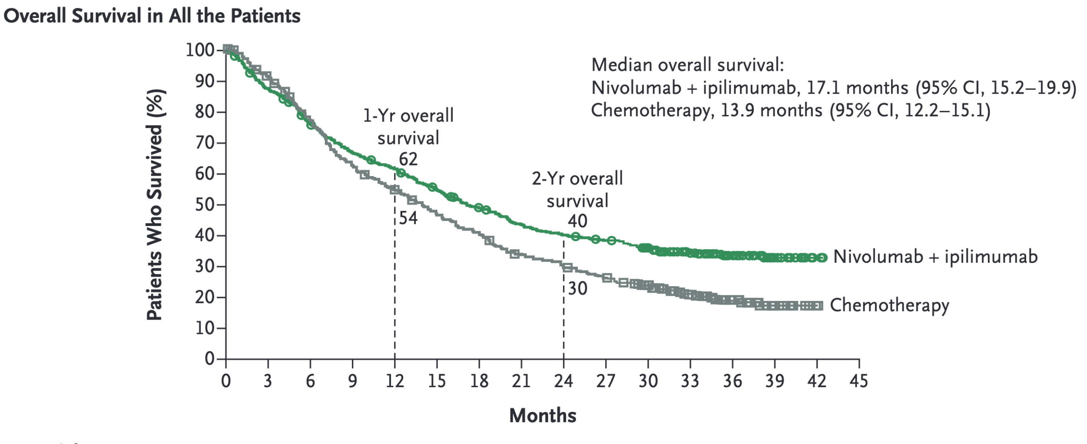
Ipi/Nivo improved OS compared with chemotherapy (w/o IO) regardless of PD-L1 status
Hellmann et al, NEJM 2019

Slide 109
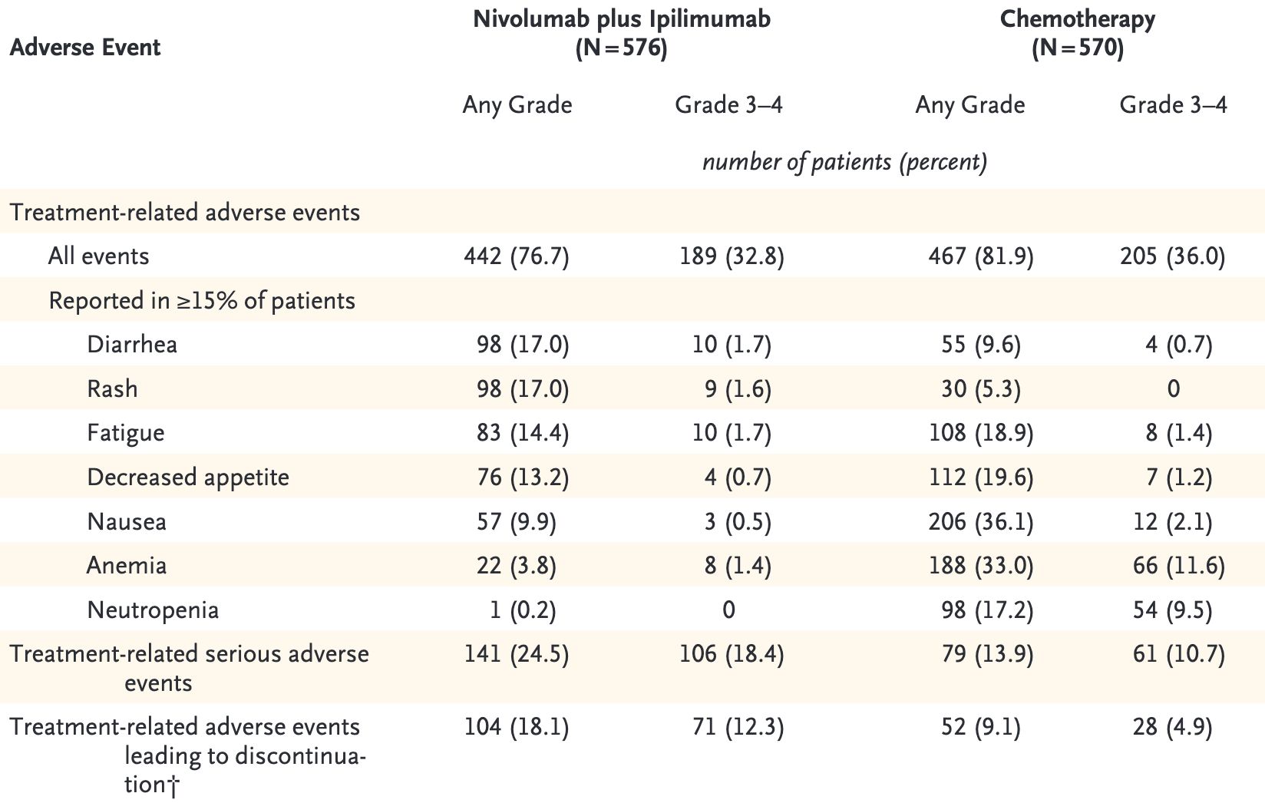
The caveat… less chemo doesn’t mean less tox
Hellmann et al, NEJM 2019

Slide 110


Was CTLA4/PD-L1+chemotherapy better than chemotherapy alone?
Durvalumab and Tremelimumab
But…this is the wrong control arm at this point…need comparison to chemo + anti-PD-(L)1
Johnson et al, JCO 2023

Slide 111
So, our options…
PD-L1
High ( ≥ 50%, TC3/IC3) | Pembrolizumab, atezolizumab, cemiplimab
Low (TPS ≥1%) | pembrolizumab
Any (squamous) | carboplatin, paclitaxel, pembrolizumab ipilimumab/nivolumab carboplatin paclitaxel, ipilimumab/nivolumab platinum-doublet, durvalumab, tremelimumab platinum-doublet, cemiplimab
Any (non-squamous) | carboplatin, pemetrexed, pembrolizumab carboplatin, paclitaxel, bevacizumab, atezolizumab carboplatin, nab-paclitaxel, atezolizumab ipilimumab/nivolumab carboplatin, pemetrexed, ipilimumab/nivolumab platinum-doublet, durvalumab, tremelimumab platinum-doublet, cemiplimab

Slide 112
First line therapy – what do we do in clinic?
(in the absence of a driver oncogene)
PD-L1 (is it <50%?) status and symptoms determines whether patient gets chemotherapy or just pembrolizumab
Histology determines the chemotherapy combination
Histology | Regimen
“Non-Squamous” | Platin/Pemetrexed/Pembrolizumab
Squamous | Carboplatin/Taxane/Pembrolizumab

Slide 113
Immune Checkpoint Inhibitors
Chemotherapy
(including VEGF targeting)
Targeted therapy
PD-1/PD-L1 antibodies
nivolumab
pembrolizumab
atezolizumab
durvalumab
cemiplimab
PD-1/CTLA-4 combinations
nivolumab +
ipilimumab
durvalumab +
tremelimumab
“non-squamous”
Cis/carboplatin + pemetrexed
carboplatin + paclitaxel
carboplatin + paclitaxel + bevacizumab
carboplatin + albumin-bound paclitaxel
Squamous
carboplatin + paclitaxel
carboplatin + albumin-bound paclitaxel
Cis/carboplatin + gemcitabine
2nd line chemotherapy
Docetaxel +/- ramucirumab

Slide 114
72 year old woman presents with a lung mass. Biopsy is done and pathologist says patient has NSCLC. You ask for each of the following except:
Tumor Histology (adenocarcinoma, squamous, etc.)
Tumor mutational burden
EGFR mutational analysis
Tumor Next Generation Sequencing
PD-L1

Slide 115
How do we describe NSCLC?
Other
Adenocarcinoma
Squamous
Non-Squamous
Squamous Cell Carcinoma
p63 (p40)
Adenocarcinoma
TTF-1, Napsin

Slide 116
Classification of NSCLC by biomarkers
PD-L1 Tumor Proportion Score
Mutations/Gene Fusions (by NGS)
other
Data from Jee et al, Nature 2024
Data from Choudhury et al, CCR 2023

Slide 117

Oncogenic Drivers of Lung Cancers
AACR GENIE BPC lung, Choudhury et al, CCR 2023;
Data available at https://genie.cbioportal.org/

Slide 118



Epidermal Growth Factor Receptor
signaling
erlotinib
gefitinib
Pao, W. et al. JCO 23:2556-2568 2005

Slide 119
Q: Is erlotinib (an EGFR TKI) superior to placebo in non-small cell lung cancer
Stage IIIB/IV NSCLC
PS 0–3
1-2 prior therapies
erlotinib + supportive care
placebo + supportive care
Shepherd FA, et al. N Engl J Med. 2005;353:123-132.

Slide 120

Erlotinib is (a little bit) superior to placebo in non-small cell lung cancer
Response Rate 9%
Shepherd et al NEJM 353:123-132

Slide 121


Slide 122


Why are 1 in 10 like this?
Day 1
Day 5

Slide 123
Clinical Factors Associated With Response to EGFR TKI
East Asian
Never Smokers
Tumors with adenocarcinoma histology

Slide 124


Epidermal Growth Factor Receptor

Slide 125



2004
Paez JG, et al. Science. 2004;304(5676):1497-1500.
Lynch TJ, et al. N Engl J Med. 2004;350(21):2129-2139.
Pao W, et al. Proc Natl Acad Sci U S A. 2004;101(36):13306-13311.

Slide 126
Exon 19 Deletions & L858R are Most Common EGFR mutations
Exon 19
Deletions
L858R
Less common mutations:
-G719A/S
-L861
**Exon 20 insertions (Resistant to most EGFR TKI)**

Slide 127




EGFR Tyrosine Kinase Inhibitors
(Erlotinib, Gefitinib, or Afatinib)
improve progression free survival
compared with platinum doublets
in patients with EGFR mutant NSCLC
Maemondo et al NEJM 2010, Mitsudomi et al Lancet Oncol 2010, Rosell et al Lancet Oncol 2012, Sequist et al, JCO 2013

Slide 128

72 year old woman presents with a lung mass. Biopsy is done and pathologist says patient has NSCLC. You ask for each of the following except:
Tumor Histology (adenocarcinoma, squamous, etc.)
Tumor mutational burden
EGFR mutational analysis
Tumor Next Generation Sequencing
PD-L1
Testing for all of the above is important, except for tumor mutational burden

Slide 129
What drives acquired resistance to EGFR TKI
Median 10.8 vs 5.4 months, HR 0.30,
Maemondo et al, NEJM 2010

Slide 130
What causes resistance?
Diagnosed with EGFR mutant NSCLC
erlotinib
Development of Clinical Resistance to EGFR TKI
Biopsy to understand mechanism of resistance

Slide 131

Mechanisms of Acquired Resistance to EGFR Tyrosine Kinase Inhibitors
Yu et al, CCR 2013

Slide 132
Third Generation EGFR TKI (osimertinib)
Developed to target mutant EGFR, particularly EGFR T790M, and spare normal EGFR
Oral, irreversible, with a distinct profile from gefitinib, erlotinib, afatinib, and dacomitinib
Notable toxicities: rash, interstitial lung disease

Slide 133


Clinically targeting EGFR mutant NSCLC
 | Drug | EGFR L858R | EGFR Exon 19 del | EGFR | EGFR T790M | HER2
1st gen | gefitinib | + | + | + | - | -
 | erlotinib | + | + | + | - | -
2nd gen | afatinib dacomitinib | + + | + + | + + | - - | + +
3rd gen | Osimertinib | + | + | - | + | -
 | Lazertinib | + | + | - | + | -

Slide 134

Osimertinib in Patients With Acquired Resistance to EGFR TKI and EGFR T790M
Response Rate = 61%

Slide 135
Way back then…
Diagnosis
9-11 months
Median PFS
1st Gen
~10 months
Median PFS
3rd Gen

Slide 136

Drug A works
Drug B (with same mechanism of action) works after drug A stops working
Maybe we should try giving drug B first?

Slide 137
How should we treat EGFR mutant patients?
Diagnosis
9-11 months
Median PFS
1st Gen
~10 months
Median PFS
3rd Gen
Diagnosis
?
Start with 3rd Gen ?

Slide 138

Q: Is Osimertinib superior to gefitinib/erlotinib as initial therapy for patients with EGFR mutant lung cancer (FLAURA)?
Primary endpoint: PFS
Secondary endpoints: response rate, duration of response, disease control rate, depth of response, overall survival, patient reported outcomes, safety
Soria et al, NEJM 2017

Slide 139


Osimertinib is superior to first generation EGFR TKI as initial treatment for NSCLC: Progression-Free Survival
Soria et al, NEJM 2017

Slide 140
Osimertinib is superior to first generation EGFR TKI as initial treatment for NSCLC Overall Survival
Ramalingam et al, ESMO 2019/NEJM 2020

Slide 141
So, single-agent osimertinib (EGFR TKI) gives
~ 3 year median OS…it’s the standard.
Can we improve outcomes ?

Slide 142

How do we improve on TKI for EGFR mut lung cancer?
Add
Chemotherapy
Dual EGFR inhibition
Platinum + Pemetrexed
+
osimertinib
amivantamab
+
lazertinib
3rd generation
EGFR TKI
Antibody
IV
Planchard et al, NEJM 2023; Cho et al, NEJM 2024
Gonzalvez et al, Cancer Discov 2021; adapted from Guo et al, Touch Reviews 2021

Slide 143
Q: Does adding chemotherapy to osimertinib improve outcomes?
osimertinib
Patients with
metastatic NSCLC
EGFR Exon 19 del or EGFR L858R
no prior chemo
n=557
osimertinib
+ pemetrexed/platin
q 3 weeks
Primary Endpoint: PFS
Janne et al WCLC 2023

Slide 144

Adding chemotherapy to osimertinib improves PFS
Planchard et al NEJM 2023

Slide 145

Adding chemotherapy to osimertinib increases toxicity
 | Osimertinib | Osimertinib +chemo
Grade 3 or higher | 27% | 64%
SAE | 19% | 38%
Death | 1 patient | 5 patients
Planchard et al, NEJM 2023

Slide 146



Adding chemotherapy to osimertinib improves OS
Jänne et al, NEJM 2025

Slide 147
How do we improve on TKI for EGFR mut lung cancer?
Add
Chemotherapy
Dual EGFR inhibition
Platinum + Pemetrexed
+
osimertinib
amivantamab
+
lazertinib
3rd generation
EGFR TKI
Antibody
IV
Gonzalvez et al, Cancer Discov 2021; adapted from Guo et al, Touch Reviews 2021

Slide 148

Q: Can dual EGFR blockade + MET inhibition delay resistance as initial therapy for patients with EGFR mutant NSCLC?
Cho et al, Future Oncol 2022

Slide 149

amivantamab+lazertinib improves PFS compared with osimertinib
AMI/LAZER
Cho et al, NEJM 2024

Slide 150

amivantamab+lazertinib increases toxicity when compared with osimertinib
AMI/LAZER
 | Osimertinib | Amivantamab + Lazertinib
Grade 3 or higher | 43% | 75%
SAE | 33% | 49%
Death | 7% | 8%
Cho et al, NEJM 2024

Slide 151


amivantamab+lazertinib improves OS compared with osimertinib
Yang et al, NEJM 2025

Slide 152
Metastatic EGFR mutant (exon 19 del/L858R) NSCLC
EGFR mutations occur in ~20% of patients with lung adenocarcinoma
EGFR mutations are more common in never/light smokers BUT CAN OCCUR IN ANYONE
First line treatment with EGFR TKI is superior to chemotherapy
Osimertinib is superior to erlotinib/gefitinib as first line therapy
Adding chemotherapy to osimertinib OR combining an EGFR-MET bispecific antibody to EGFR TKI improves PFS and OS
In general, we recommend osimertinib+chemotherapy based on similar overall efficacy and sense of less toxicity

Slide 153
What about immunotherapy in patients with EGFR mutations?

Slide 154

Nivolumab in Non-Squamous Cell Lung Cancer
Paz-Ares et al ASCO 2015

Slide 155

PFS of Pembrolizumab vs Docetaxel in NSCLC subsets
Herbst et al, Lancet 2016

Slide 156

7 patients with PD-L1 >50%
11 patients enrolled
10 patients with EGFR mutation
0% Response Rate
0/10
3 patients with PD-L1
1-49%
Lisberg et al, JTO 2018

Slide 157
Summary of Immunotherapy in EGFR mutant NSCLC
probably doesn’t work by itself (RR <5%)
Combinations not promising (either ↥ toxicity, or no benefit)
Most front-line IO trials (single-agent pembro, IO + chemo) excluded patients with EGFR or ALK
We think that these principles apply to patients with the other oncogenic drivers (except KRAS and maybe BRAF)

Slide 158
Oncogenic Drivers of Lung Cancers
AACR GENIE BPC lung, Choudhury et al, CCR 2023;
Data available at https://genie.cbioportal.org/

Slide 159


ALK Rearrangements in NSCLC

Slide 160

Tumor Responses to First-generation ALK inhibitor Crizotinib for Patients with ALK-positive NSCLC
Kwak EL et al. N Engl J Med 2010;363:1693-1703

Slide 161

Crizotinib Treatment Leads to improved PFS compared to Cisplatin/Pemetrexed in ALK+ NSCLC First Line
Solomon et al, NEJM 2014

Slide 162
70 year old man with metastatic ALK positive lung adenocarcinoma involving lung and liver.
What is the best initial therapy?
Carboplatin, pemetrexed
Ceritinib
Alectinib
Ramucirumab

Slide 163

Historical Approach to Patients with ALK+ NSCLC
Newer ALK Inhibitors
Ceritinib
Alectinib
Brigatinib
Crizotinib

Slide 164
How should we treat Patients with ALK positive NSCLC
Diagnosis
11 months
Median PFS
Crizotinib
~7-10 months or more
Median PFS
Ceritinib or
Alectinib or
Brigatinib

Slide 165
How should we treat Patients with ALK positive NSCLC
Diagnosis
11 months
Median PFS
Crizotinib
~7-10 months or more
Median PFS
Ceritinib or
Alectinib or
Brigatinib
Diagnosis
Start with next gen TKI

Slide 166
Q: is a newer ALK inhibitor better than crizotinib in ALK+ NSCLC
Key Entry Criteria
Stage IIIB/IV or recurrent ALK-positive NSCLC
ALK positive
ECOG PS 0-2
Brain metastases allowed
no prior therapy
Newer ALK inhibitor
Endpoints
Primary
- PFS
Secondary
- ORR
- OS
R
1:1
Crizotinib 250 mg BID PO

Slide 167

Alectinib improves PFS compared with Crizotinib as 1st line ALK inhibitor
Peters et al, NEJM 2017

Slide 168

Alectinib improves rate of CNS progression compared with Crizotinib
Peters et al, NEJM 2017

Slide 169
Comparing newer ALK inhibitors in ALK+ NSCLC
 | RR (vs crizotinib) | 12 month PFS (vs crizotinib) | PFS HR
Alectinib | 83% vs 76% | 68% vs 49% | 0.47
Brigatinib | 71% vs 60% | 67% vs 43% | 0.49
Lorlatinib | 76% vs 58% | 78% vs 39% | 0.28
Ensartinib | 74% vs 67% | NR | 0.51
Peters et al, NEJM 2017; Camidge et al, NEJM 2018; Shaw et al, NEJM 2020; Horn et al, JAMA Oncol 2021

Slide 170

Lorlatinib leads to longer PFS compared with crizotinib
Shaw et al, Ann Oncol 2026

Slide 171
70 year old man with metastatic ALK positive lung adenocarcinoma involving lung and liver.
What is the best initial therapy?
Carboplatin, pemetrexed
Ceritinib
Alectinib or Brigatinib or Lorlatinib*
Ramucirumab
2nd or 3rd generation ALK inhibitors are superior to crizotinib, but we mostly use lorlatinib now

Slide 172
ALK Summary
Occurs in ~5% of patients with NSCLC
More likely in younger, never smokers
Can be identified by FISH, IHC, NGS, or ACCESS
Initial therapy: alectinib or brigatinib or ensartinib or lorlatinib

Slide 173
Oncogenic Drivers of Lung Cancers
AACR GENIE BPC lung, Choudhury et al, CCR 2023;
Data available at https://genie.cbioportal.org/

Slide 174
How do oncogenic drivers work?
Genomic alteration | Example
Mutation that activates enzyme | EGFR, HER2 (mutation), BRAF
Gene fusion that leads to over-expression (e.g. low/no normal expression in a particular tissue) | ALK RET ROS1 NTRK
Mutations that lead to protein stabilization/overexpression | MET exon 14
Mutation that inactivates an enzyme (leading to activation of a pathway) | KRAS G12

Slide 175



What does targeted therapy look like?
Single-agent, small molecule, targeted therapy
  kinase inhibitor that targets wild-type protein (e.g ALK)
  mutation-specific kinase inhibitor (e.g. EGFR)
Combination small molecule targeted therapy (BRAF/MEK)
Antibody to appropriate target (amivantamab – EGFR exon 20)
Antibody drug conjugate (ERBB2)
Chemotherapy + targeted therapy (chemo + EGFR TKI)

Slide 176

BRAF mutant NSCLC
1-2% of NSCLC
More common in current/former cigarette smokers
V600E mutations <50% of mutations
Non-V600E often lower activity, not likely to respond to BRAF inhibitors
Litvak, Journal of Thoracic Oncology 2014

Slide 177


Single-agent BRAF inhibitors in Patients with BRAF V600E NSCLC
vemurafenib
dabrafenib
Response Rate = 42%
Overall Response Rate – 33%
median PFS < 6 months
Hyman et al, NEJM 2015
Planchard et al, Lanc Onc 2016

Slide 178

Perhaps dual-targeting of BRAF and MEK will improve outcomes
Subbiah et al, Trends in Cancer 2020

Slide 179


Dual BRAF/MEK inhibition in BRAF V600E mutant NSCLC
Response Rate 63%
median PFS 9 months
Response rate 75% (95% CI: 62-85)
dabrafenib/trametinib
encorafenib/binimetinib
Planchard et al, Lanc Onc 2016, Riely et al JCO 2023

Slide 180
Oncogenic Drivers of Lung Cancers
AACR GENIE BPC lung, Choudhury et al, CCR 2023;
Data available at https://genie.cbioportal.org/

Slide 181


Trastuzumab Deruxtecan in Patients with
Her2 Mutated NSCLC
Response Rate 55%
Li et al, NEJM 2022

Slide 182



Zongertinib with efficacy in ERBB2 (HER2) mutant NSCLC
Heymach et al, NEJM 2025

Slide 183
Oncogenic Drivers of Lung Cancers
AACR GENIE BPC lung, Choudhury et al, CCR 2023;
Data available at https://genie.cbioportal.org/

Slide 184


Single-agent amivantamab in patients with EGFR exon 20 insertion NSCLC
Single-agent data led to FDA accelerated approval
Park et al, JCO 2021/prescribing information

Slide 185

Amivantamab + Chemotherapy improves PFS compared with Chemotherapy alone
Chemotherapy + Amivantamab
Stage IV or recurrent NSCLC
EGFR Exon 20 insertion
no prior therapy
Chemotherapy
Zhou et al, NEJM 2023

Slide 186
Oncogenic Drivers of Lung Cancers
AACR GENIE BPC lung, Choudhury et al, CCR 2023;
Data available at https://genie.cbioportal.org/

Slide 187
65 year old woman with metastatic NSCLC
PD-L1 negative
KRAS G12C mutation
No brain metastases
Progresses on first-line carboplatin, pemetrexed, pembrolizumab
What is best choice for next-line systemic therapy?
Afatinib
Carboplatin/paclitaxel
Adagrasib
Cemiplimab
Docetaxel

Slide 188

KRAS mutant NSCLC
~25% of Patients with NSCLC have KRAS mutations
The most common KRAS mutation in NSCLC is G12C
Arbour et al, CCR 2017

Slide 189



The New Hope – Direct RAS inhibitors
Nature 2013
Angewandte Chemie International Edition 2013
Cell 2018

Slide 190




Skoulidis et al, NEJM 2021

Slide 191




Jänne PA et al. N Engl J Med 2022;387(2):120-31.

Slide 192

Q: Does sotorasib improve outcomes in KRAS G12C mutant NSCLC, compared with docetaxel?
Johnson et al, ESMO 2022

Slide 193

Sotorasib Improves Progression-Free Survival
(compared with docetaxel)
de Langen et al, Lancet 2023

Slide 194

Adagrasib Improves Progression-Free Survival
(compared with docetaxel)

Slide 195

Sotorasib does not Improve Overall Survival
(compared with docetaxel)
de Langen et al, Lancet 2023

Slide 196

65 year old woman with metastatic NSCLC
PD-L1 negative
KRAS G12C mutation
No brain metastases
Progresses on first-line carboplatin, pemetrexed, pembrolizumab
What is best choice for next-line systemic therapy?
Afatinib
Carboplatin/paclitaxel
Adagrasib or Sotorasib
Cemiplimab
Docetaxel
RAS Targeted therapy is superior to docetaxel in PFS and toxicity

Slide 197
Target | Available |  |  | Most common 1st in clinic
EGFR (Exon 19 del, L858R, G719, L861) | gefitinib afatinib Dacomitinib Amivantamab +lazertinib | erlotinib osimertinib erlotinib + ramucirumab osimertinib + chemotherapy | Erlotinib Osimertinib Erlotinib + Ramucirumab | Osimertinib + chemotherapy
EGFR (exon 20) | Amivantamab +/- chemotherapy, (sunvozertinib) |  |  | Amivantamab +/- chemotherapy
ALK fusions | crizotinib alectinib | ceritinib brigatinib lorlatinib | Ceritinib Brigatinib lorlatinib | alectinib or lorlatinib
BRAF V600E | dabrafenib +trametinib encorafenib + binimetinib |  |  | encorafenib + binimetinib
ROS1 fusions | crizotinib ceritinib zidesamtinib |  | entrectinib repotrectinib taletrectinib | taletrectinib
NTRK fusions | larotrectinib, entrectinib |  |  | larotrectinib, entrectinib
RET fusions | selpercatinib, pralsetinib |  |  | selpercatinib
MET exon 14 | capmatinib, tepotinib |  |  | tepotinib
ERBB2 (HER2) mut | trastuzumab deruxtecan*, zongertinib, sevabertinib |  |  | zongertinib
NRG1 fusions | zenocutuzumab |  |  | zenocutuzumab
KRAS G12C | adagrasib*, sotorasib* |  |  | adagrasib*
*second-line approvals

Slide 198
Molecularly Targeted Therapy of NSCLC
EGFR is the paradigm of an oncogene-addicted lung cancer.
Molecular analysis has defined mechanisms of sensitivity and resistance for patients with EGFR mutant NSCLC. Drugs targeting molecular defined pathways of resistance are available.
Multiple targetable oncogene-driven cancers exist, including EGFR, ALK, BRAF V600E, RET, Met Exon 14 splice site mutations, ROS1, KRAS G12C, ERBB2

Slide 199
Immune Checkpoint Inhibitors
Chemotherapy
(including VEGF targeting)
Targeted therapy
PD-1/PD-L1 antibodies
nivolumab
pembrolizumab
atezolizumab
durvalumab
cemiplimab
PD-1/CTLA-4 combinations
nivolumab +
ipilimumab
durvalumab +
tremelimumab
“non-squamous”
Cis/carboplatin + pemetrexed
carboplatin + paclitaxel
carboplatin + paclitaxel + bevacizumab
carboplatin + albumin-bound paclitaxel
Squamous
carboplatin + paclitaxel
carboplatin + albumin-bound paclitaxel
Cis/carboplatin + gemcitabine
2nd line chemotherapy
docetaxel +/- ramucirumab
gefitinib, erlotinib
afatinib, dacomitinib
osimertinib, lazertinib
amivantamab, sunvozertinib
crizotinib, ceritinib
alectinib, brigatinib
ensartinib, lorlatinib
dabrafenib +trametinib
encorafenib + binimetinib
entrectinib, zidesamtinib
repotrectinib, taletrectinib
larotrectinib, entrectinib
selpercatinib, pralsetinib
capmatinib, tepotinib
trastuzumab deruxtecan, zongertinib, sevabertinib
adagrasib, sotorasib
zenocotuzumab
Antibody Drug Conjugates

Slide 200

What about HER2 overexpression?
ERBB2 (HER2) mutation
HER2 overexpression
Li et al, JTO 2015,
Hirsch et al, Molecular and Cellular Pathology 2002

Slide 201

Same tool…different target
FDA approval for trastuzumab deruxtecan:
adult patients with unresectable or metastatic non-small cell lung cancer (NSCLC) whose tumors have activating HER2 (ERBB2) mutations, as detected by an FDA approved test, and who have received a prior systemic therapy.* (1.3)
adult patients with unresectable or metastatic HER2-positive (IHC 3+) solid tumors who have received prior systemic treatment and have no satisfactory alternative treatment options.* (1.5)
Fam-trastuzumab deruxtecan, prescribing information

Slide 202



Trastuzumab Deruxtecan in patients with HER2 overexpression
Smit et al, Lancet Onc 2024
Fam-trastuzumab-deruxtecan, prescribing information

Slide 203


Telisotuzumab vedotin a MET-targeted ADC
Approval: high c-Met protein overexpression [≥50% of tumor cells with strong (3+) staining]
Camidge et al, JCO 2024

Slide 204
Immune Checkpoint Inhibitors
Chemotherapy
(including VEGF targeting)
Targeted therapy
PD-1/PD-L1 antibodies
nivolumab
pembrolizumab
atezolizumab
durvalumab
cemiplimab
PD-1/CTLA-4 combinations
nivolumab +
ipilimumab
durvalumab +
tremelimumab
“non-squamous”
Cis/carboplatin + pemetrexed
carboplatin + paclitaxel
carboplatin + paclitaxel + bevacizumab
carboplatin + albumin-bound paclitaxel
Squamous
carboplatin + paclitaxel
carboplatin + albumin-bound paclitaxel
Cis/carboplatin + gemcitabine
2nd line chemotherapy
docetaxel +/- ramucirumab
gefitinib, erlotinib
afatinib, dacomitinib
osimertinib, lazertinib
amivantamab, sunvozertinib
crizotinib, ceritinib
alectinib, brigatinib
ensartinib, lorlatinib
dabrafenib +trametinib
encorafenib + binimetinib
entrectinib, zidesamtinib
repotrectinib, taletrectinib
larotrectinib, entrectinib
selpercatinib, pralsetinib
capmatinib, tepotinib
trastuzumab deruxtecan, zongertinib, sevabertinib
adagrasib, sotorasib
zenocotuzumab
Antibody Drug Conjugates
Trastuzumab deruxtecan
Telisotuzumab vedotin
Datopotamab deruxtecan

Slide 205
The Current Approach to Treatment of Patients with Advanced NSCLC
Chemotherapy +
Immunotherapy
or
Ipilimumab/nivolumab
Targeted Therapy
Histologic Assessment
+
Molecular Analysis
+
PD-L1 Testing
PD-L1 <50%
“First-line” Mutation/
rearrangement
PD-L1 ≥50%
  EGFR
  ALK
  ROS1
  BRAF
  ERBB2
  MET exon 14
  RET
  NTRK
  Docetaxel +/- Ramucirumab
  Unless subsequent therapy targets
  KRAS G12C
  HER2 overexpression
  MET overexpression
ICI
or
Chemotherapy + ICI

Slide 206
How we do biomarker testing at MSK
(now…most of the time)
On all lung cancers, there is IHC for PD-L1, c-MET, HER2 protein expression
On all lung adenocarcinomas, there is a small panel fusion (ALK, RET, ROS1, NTRK, Met Ex 14) and NGS (MSK-REACT: EGFR, ALK, KRAS, MET, BRAF, ERBB2, NRAS, TP53) for rapid results
Testing for other genes is by MSK-IMPACT, which happens automatically, if genomic DNA control is available
If no driver, then do MSK-Target Exome RNAseq
Plasma NGS (MSK-ACCESS or Guardant 360) when tumor tissue is unavailable

Slide 207



Slide 208
64 year-old presents with dyspnea, found to have a large left-sided pleural effusion. Large volume thoracentesis improves symptoms. Cytology from pleural effusion shows adenocarcinoma, TTF-1 positive, PD-L1 negative, no targetable oncogenes.
What is the most appropriate next step?
  Carboplatin/pemetrexed/pembrolizumab
  Referral to thoracic surgery
  Pembrolizumab
  Chest radiotherapy

Slide 209

Systemic Therapy Response Rates are Low
…in PD-L1 high patients getting pembrolizumab, RR is just 45%
Reck et al, NEJM 2016

Slide 210
Key Concept When Thinking About
Initial Chemotherapy of NSCLC
Likelihood of benefit from most therapies is relatively low, so if there are sites of impending doom, consider managing with other modalities
Cord compression
Brain metastases >1cm
Malignant pleural effusion

Slide 211
64 year-old presents with dyspnea, found to have a large left-sided pleural effusion. Large volume thoracentesis improves symptoms. Cytology from pleural effusion shows adenocarcinoma, TTF-1 positive, PD-L1 negative, no targetable oncogenes.
What is the most appropriate next step?
  Carboplatin/pemetrexed/pembrolizumab
  Referral to thoracic surgery
  Pembrolizumab
  Chest radiotherapy
We recommend definitive management of malignant pleural effusion prior to initiation of systemic therapy

Slide 212
Performance Status
ECOG Performance Status
0 | Fully active, able to carry on all pre-disease performance without restriction
1 | Restricted in physically strenuous activity but ambulatory and able to carry out work of a light or sedentary nature, e.g., light house work, office work
2 | Ambulatory and capable of all selfcare but unable to carry out any work activities. Up and about more than 50% of waking hours
3 | Capable of only limited selfcare, confined to bed or chair more than 50% of waking hours
4 | Completely disabled. Cannot carry on any selfcare. Totally confined to bed or chair
Oken, M.M., Creech, R.H., Tormey, D.C., Horton, J., Davis, T.E., McFadden, E.T., Carbone, P.P.: Toxicity And Response Criteria Of The Eastern Cooperative Oncology Group. Am J Clin Oncol 5:649-655, 1982.
NCCN guidelines:
Unfit of any age (performance status 3-4) do not benefit from cytotoxic treatment.
(Data are mixed on benefit from immunotherapy)

Slide 213

46.8%
ever received systemic therapy
Looked at SEER and Medicare data from 2006-2021
US patients 65 and older
>250,000 patients with metastatic NSCLC
Fox et al, JAMA Onc 2026

Slide 214
The End of nsclc

Slide 215
Thymic Tumors

Slide 216

Thymic Tumors
Thymic tumors (thymoma, thymic carcinoma) are the most common tumor of the anterior mediastinum
Thought to derive from thymic epithelial cells
No known risk factors, though may be more common in people from Asia and African Americans

Slide 217

Thymic tumors rise in frequency with age, but are uncommon
Hsu et al, PLoS One 2019

Slide 218
Thymic tumors
WHO Pathology Classification
Type | Description | Epithelial Atypia | Predominant Cell Type
A | Spindle Cell | None | Epithelial
AB | Mixed Thymoma | None | Distinct epithelial-rich and lymphoid cell-rich areas
B1 | Lymphocyte rich | None | Mixed
B2 | Cortical thymoma | Mild-moderate | Increasing epithelial component
B3 | “well-differentiated thymic carcinoma” | Increasing epithelial atypia | Predominantly epithelial, few lymphocytes
Thymic Carcinoma |  | Overtly malignant | Epithelial
These are widely discussed, may be prognostic, but don’t generally factor into decision-making
WHO Classification of Thoracic Tumours, 5th ed, 2021

Slide 219
Pathology of Thymic Tumors…simpler
Thymoma
Thymic Carcinoma
“bland” without atypia
“organotypic”
Usually encapsulated
“overt cytologic atypia”
Squamous is most common histology
Usually express CD5
Frequently express CD117 (c-KIT)
c-KIT occasionally mutated

Slide 220

Incidence of recurrence by stage (AJCC TNM)
Note the x-axis. Recurrence can happen late.
Ruffini et al JTO 2023

Slide 221

Thymic tumor staging
Detterbeck et al, JTO 2014

Slide 222

Thymic tumor staging –
Stage IVa is much more common than IVb
Detterbeck et al, JTO 2014

Slide 223
Thymoma / Thymic Carcinoma Treatment
Referral to a specialized center
Surgery, if possible—the best predictor of outcome is whether the patient has a complete surgical resection
Sometimes we do neoadjuvant therapy (but there is no clear consensus when this should be done)

Slide 224

After Surgery …what next?
NCCN Guidelines 2025

Slide 225
After Surgery …what next?
We generally recommend postoperative radiation for patients with positive margins and/or stage III disease.
There are no randomized data to define the role of post-operative radiation.
NCCN Guidelines 2025

Slide 226
After Surgery …what next?
We generally recommend surveillance scans annually (or semiannually) for many years (5-10+) since:
tumors are slow-growing and can recur many years later, and
local recurrences (usually in the pleura) can be managed with surgery with long-term disease-free intervals
NCCN Guidelines 2025

Slide 227

Chemotherapy for Recurrent/Advanced Thymic Tumors
There is no comparative data for chemotherapy regimens
For thymoma, doxorubicin-based regimens are preferred, RR ≥ 50%
For thymic carcinoma, platinum/taxane combinations, RR ≥ 25%
NCCN Guidelines 2025

Slide 228

Later-line therapy for thymic tumors
There is no comparative data.
Notable, board-prep notes:
Octreotide is a well-tolerated, sometimes effective treatment that can be given in patients with avid disease
Don’t give checkpoint inhibitors to patients with thymoma. They already have a high risk for autoimmune problems and there are many reported cases of fulminant autoimmune problems
In patients with thymic carcinoma who get checkpoint inhibitors, there is a higher rate of myositis, including myocarditis than with other diseases, but it’s reasonably tolerated and has efficacy.
NCCN Guidelines 2025

Slide 229
Paraneoplastic Syndromes
Thymoma
Thymic Carcinoma
Neurologic:
  Myasthenia gravis (10%/30-40%)
    Anti-AChR Ab
  Neuromyotonia +/- encephalitis (multiple, irregular contractions of the long muscles, cramping, weakness, pruritus, hyperhidrosis, insomnia, and delirium) aka Isaacs / Morvan syndrome
    Anti-VGKC ab, Anti-Caspr2 ab
Hematologic:
  Pure red cell aplasia (<10%)
  Hypogammaglobulinemia (6-10%)
rare
Thompson et al, JTO 2007

Slide 230
Thymic Tumors Conclusions
The most common tumor of the anterior mediastinum
Uncommon tumor occurring in <2000 people per year in the US
Treatment is surgery if possible
Thymoma is associated with paraneoplastic syndromes, the most common is myasthenia gravis, but notable other ones include pure red cell aplasia

