Slide 1
AbracadaBRAF:
Treatment of BRAF Mutated Lung Cancer
Gregory J. Riely
Ning Zhao and Ge Li Chair in Lung Cancer Research
Memorial Sloan Kettering Cancer Center
New York, New York

Slide 2
Disclosures
MSKCC receives or has received research funding for my work from:
Mirati
Lilly
Takeda
Merck
Roche
Pfizer
Novartis
Amgen

Slide 3
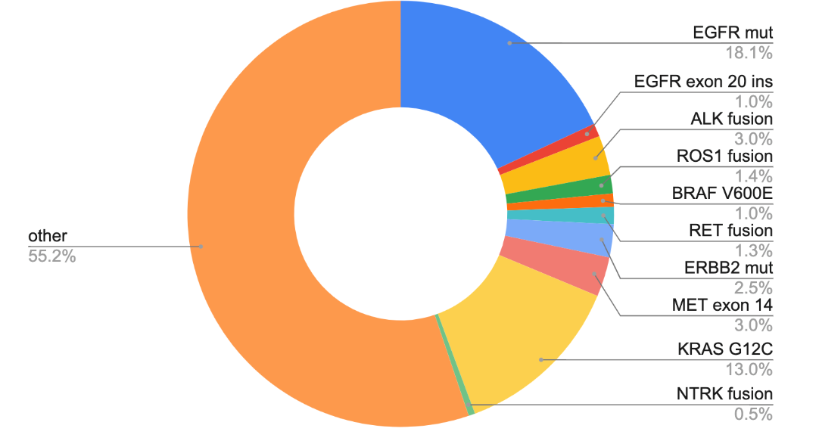
Lung cancer molecular subtypes with indicated agents
AACR GENIE BPC lung, genie.cbioportal.org
Notes:
NCCN Clin Info MH 3/28/23: this repeats slides 10, 18, 51

Slide 4
When were BRAF mutations first described in NSCLC?
1984
2002
2004
2007

Slide 5
Oncogenic drivers first described in NSCLC
1984
2002
2004
2007
KRAS

Slide 6
Oncogenic drivers first described in NSCLC
1984
2002
2004
2007
KRAS
ALK

Slide 7
Oncogenic drivers first described in NSCLC
1984
2002
2004
2007
KRAS
BRAF
EGFR
ALK

Slide 8
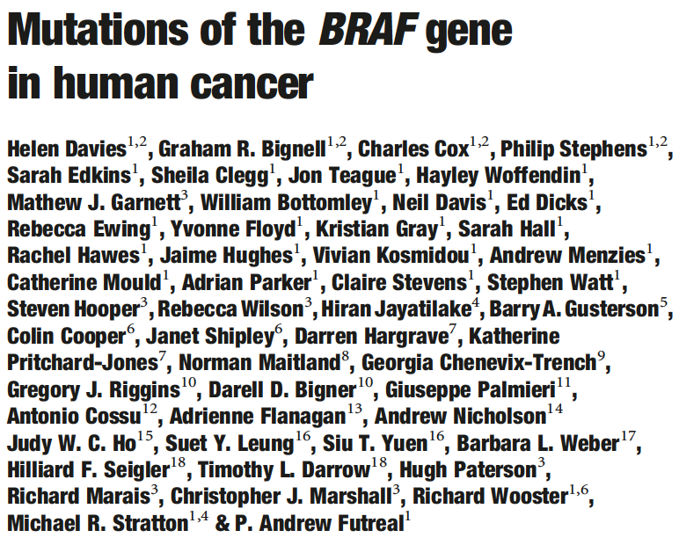
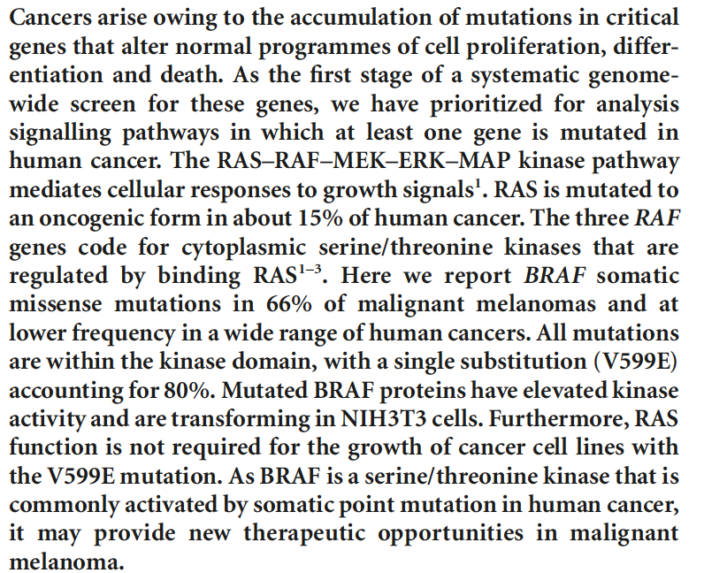
2002 – First description of BRAF mutations as oncogenic

Slide 9
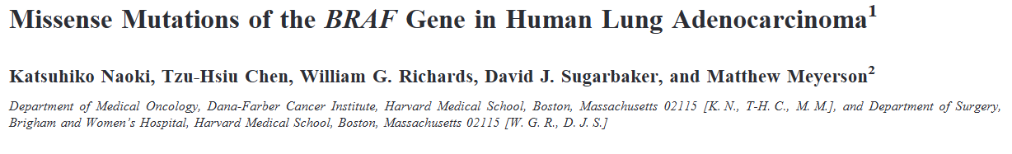
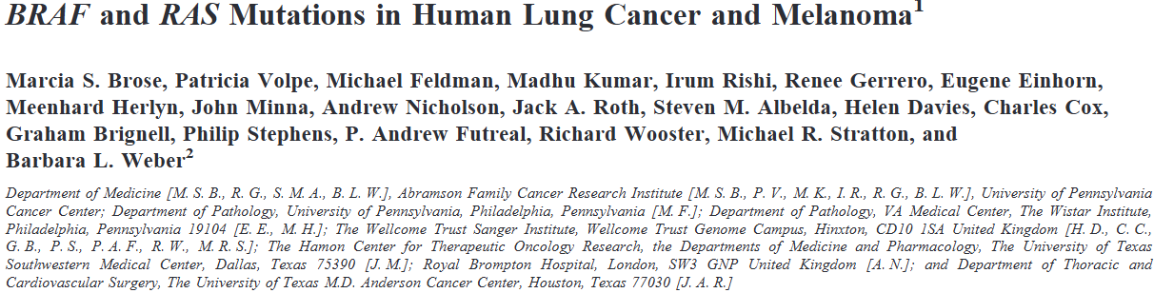
In 2002 – BRAF mutations in NSCLC…but trials came much later

Slide 10
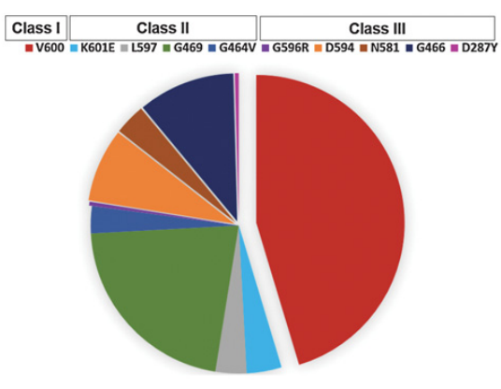
There are many types of BRAF mutations
 | Category | examples
Class 1 | Ras independent, signal as active monomers | V600
Class 2 | Ras independent, constitutively active dimers | K601, L597, G469, G464, fusions
Class 3 | Ras dependent, impaired/dead kinase activity | D287, V459, G466, S467, D594
Yao et al, Nature 2017, Dagogo-Jack et al, Clin Cancer Res 2019

Slide 11
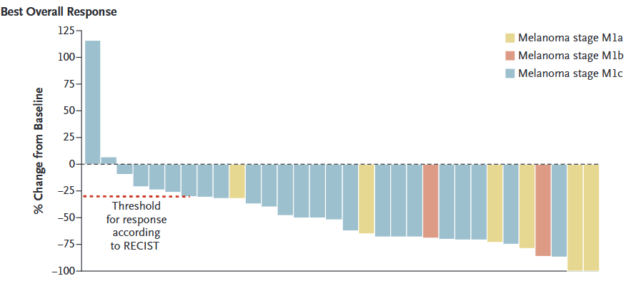
Targeting BRAF V600E first demonstrated in patients with melanoma
Flaherty et al, NEJM 2010

Slide 12
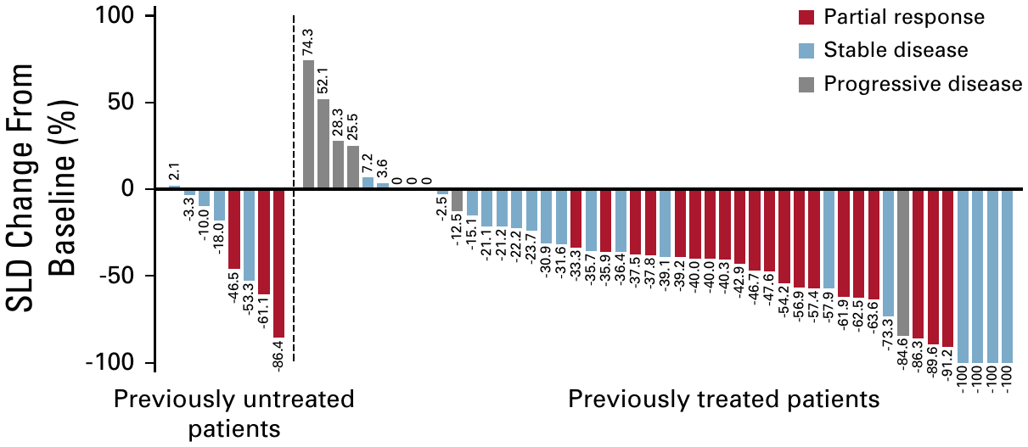
Vemurafenib in BRAF V600 NSCLC
VE-BASKET NSCLC cohort, n = 62
ORR 37% (95% CI 25-50%). Untreated 38% (3/8), pretreated 37% (20/54)
Subbiah et al, JCO Precis Oncol 2019

Slide 13
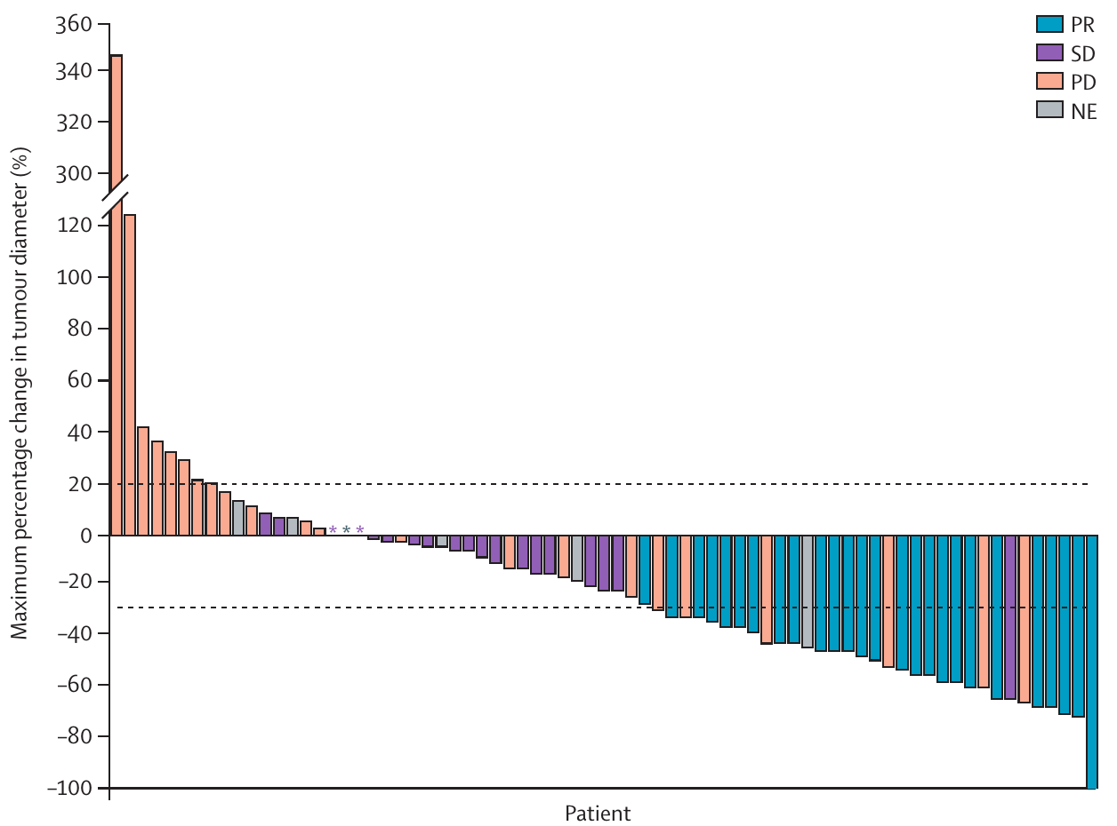
Dabrafenib in BRAF V600E NSCLC
Previously treated cohort, n = 78
ORR 33%
(95% CI 23-45%)
Untreated: 4 /6 responded
Planchard et al, Lancet Oncol 2016

Slide 14
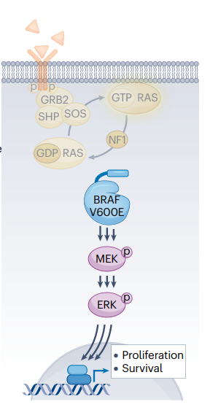
Would it be better to target BRAF by inhibiting both BRAF and MEK?
Inhibiting BRAF
Inhibiting MEK
Hanrahan et al, Nat Rev Clin Oncol 2024

Slide 15
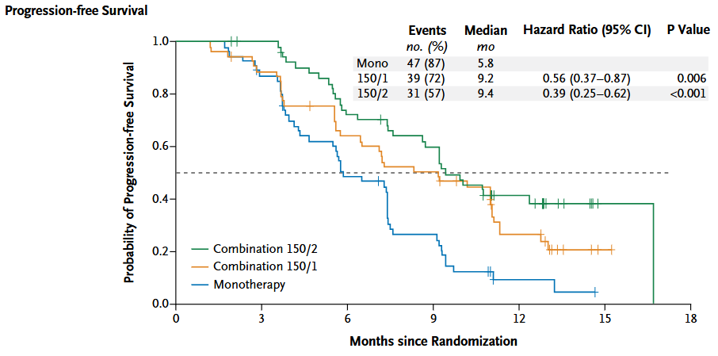
In melanoma, combined BRAF and MEK inhibition is better than BRAF inhibition alone
Flaherty et al, NEJM 2012

Slide 16
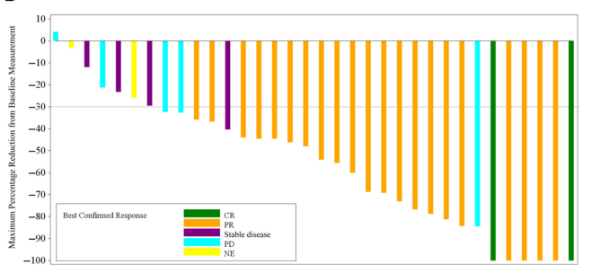
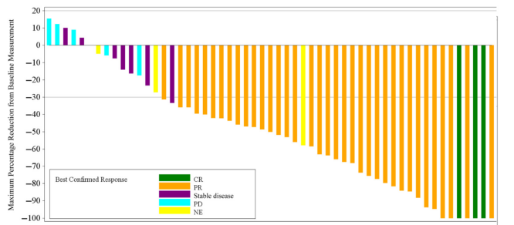
Dabrafenib (BRAF inhibitor) + Trametinib (MEK inhibitor) have efficacy in patients with metastatic BRAF V600E NSCLC
Treatment naïve
Previously treated
Response Rate 68%
Response Rate 64%
Planchard et al, JTO 2021

Slide 17
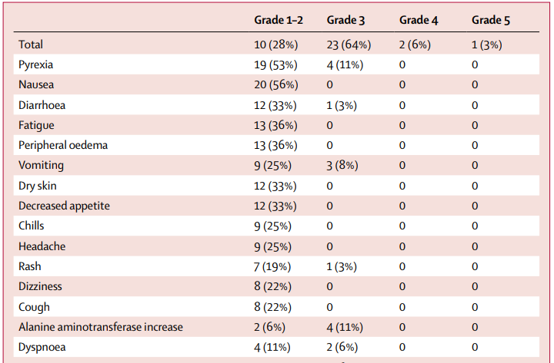
Dabrafenib (BRAF inhibitor) + Trametinib (MEK inhibitor) toxicities include pyrexia, nausea, diarrhea
Modified from Planchard et al, Lancet Oncol 2017

Slide 18
Encorafenib + Binimetinib in BRAF V600E-mutant metastatic NSCLC: A single-arm, open-label, multicenter, phase 2 study
Key eligibility criteria
BRAF V600E–mutant metastatic NSCLC
ECOG performance status 0 or 1
No EGFR mutation, ALK fusion, or ROS1 rearrangement
No more than 1 prior line of treatment in the advanced setting
No prior treatment with BRAF or MEK inhibitor
No symptomatic brain metastases
Encorafenib:
450 mg QD
Binimetinib:
45 mg BID
28-day cycles
Treat until progression or unacceptable toxicity
Treatment naïve
n=59
Patients enrolled
Previously treated
n=39
Primary endpoint
ORR by lRR
Secondary endpoints
ORR by investigator
DOR, DCR, PFS, and TTR (all by lRR and investigator)
OS
Safety
Exploratory endpoints
Biomarker and pharmacokinetic analyses
Riely et al, ASCO 2023 (Abstract 9018)
NCT03915951

Slide 19
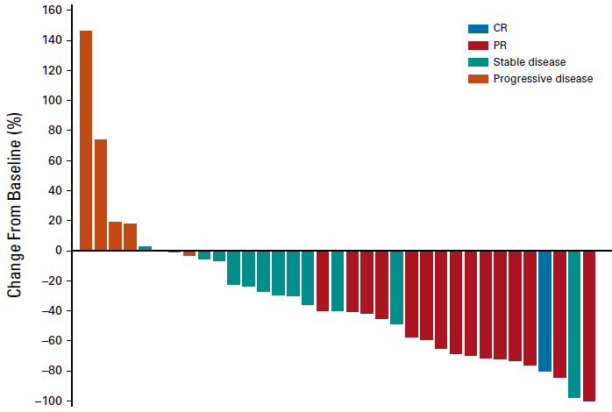
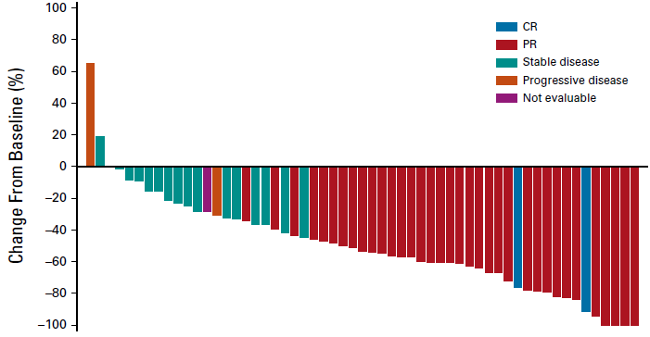
Encorafenib plus binimetinib has efficacy in patients with BRAF V600E-mutant metastatic NSCLC
Treatment naïve (n=57)
Previously treated (n=35)
Response rate 75% (95% CI: 62-85)
Response rate 46% (95% CI: 30-63)
Median Duration of Response 40 months
Median Duration of Response17 months
Riely et al, JCO 2023, ESMO 2024

Slide 20
Encorafenib + Binimetinib
Updated Progression-free survival
Treatment naive (n=59)
Previously treated (n=39)
100
No. of PFS events, n (%) | 28 (47)
Median duration of follow-up for PFS (95% CI), months | 33.3 (30.4, 41.3)
Median PFS (95% CI), months | 30.2 (15.7, NE)
100
No. of PFS events, n (%) | 20 (51)
Median duration of follow-up for PFS (95% CI), months | 14.0 (11.3, 44.2)
Median PFS (95% CI), months | 9.3 (6.2, 24.8)
90
90
80
80
70
68%
70
60
56%
60
Progression-free survival, %
Progression-free survival, %
48%
50
43%
50
40
40
33%
30
30
27%
20
20
10
10
0
0
0
59
4
45
8
36
12
30
16
28
20
23
24
22
28
20
32
16
36
10
40
10
44
7
48
4
52
3
56
0
0
39
4
24
8
16
12
12
16
7
20
6
24
5
28
4
32
4
36
4
40
4
44
3
48
0
52
0
56
0
No. at risk
Treatment naive
Months
No. at risk
Previously treated
Months
Riely et al, JTO 2025

Slide 21
Encorafenib + Binimetinib toxicities include nausea, diarrhea, but pyrexia is much less common
most common TRAEs (≥15%) by treatment line
Treatment naive (n=59)
Previously treated (n=39)
Nausea
59%
41%
Diarrhea
41%
49%
All treatment-related events of pyrexia were grade 1 or 2
Fatigue
31%
33%
Vomiting
31%
28%
 | Grade 1 | Grade 2
Treatment naive | 10% | 2%
Previously treated | 3% | 0%
Vision blurred
20%
15%
ALT increased
19%
5%
AST increased
19%
5%
Anemia
17%
18%
Grade 1
Constipation
15%
13%
Grade 2
Pruritus
10%
15%
Grade 3/4
Asthenia
5%
18%
60
Riely et al, JTO 2025
40
20
0
20
40
60
Patients, %

Slide 22
For patients with metastatic BRAF V600E:
Standard initial therapy is with combination of BRAF and MEK inhibitors
BRAF inhibitor
Dabrafenib
Encorafenib
+
OR
+
MEK inhibitor
Trametinib
Binimetinib
Note: no randomized data comparing to each other or with immunotherapy +/- chemotherapy

Slide 23
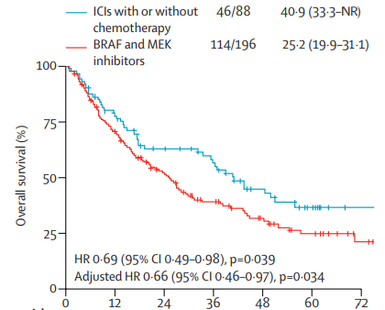
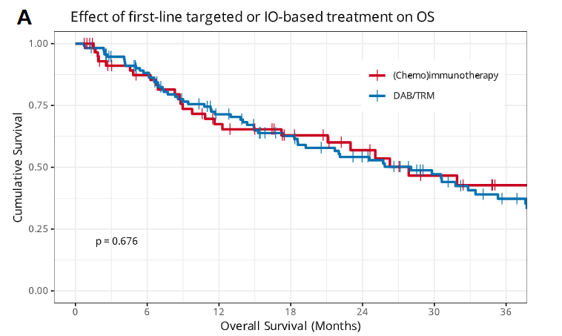
In retrospective data, some controversy about best 1st line approach

Slide 24
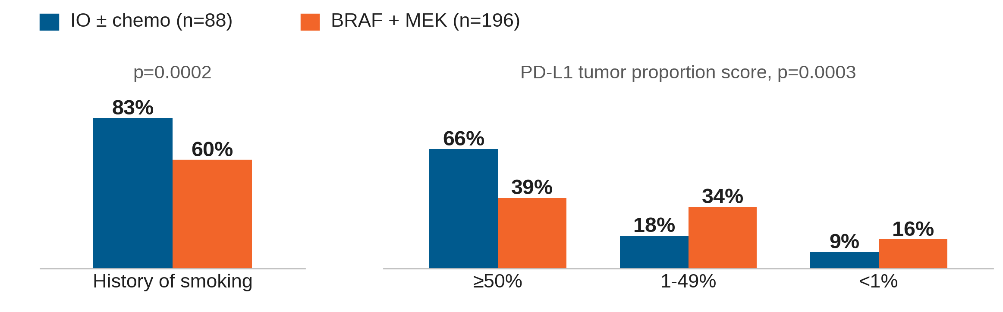
There were baseline imbalances that associated with different treatments
FRONT-BRAF, IO ± chemotherapy (n=88) vs BRAF + MEK inhibitors (n=196)
IO group had more smokers and higher PD-L1 expression
Di Federico et al, Lancet Oncol 2025

Slide 25
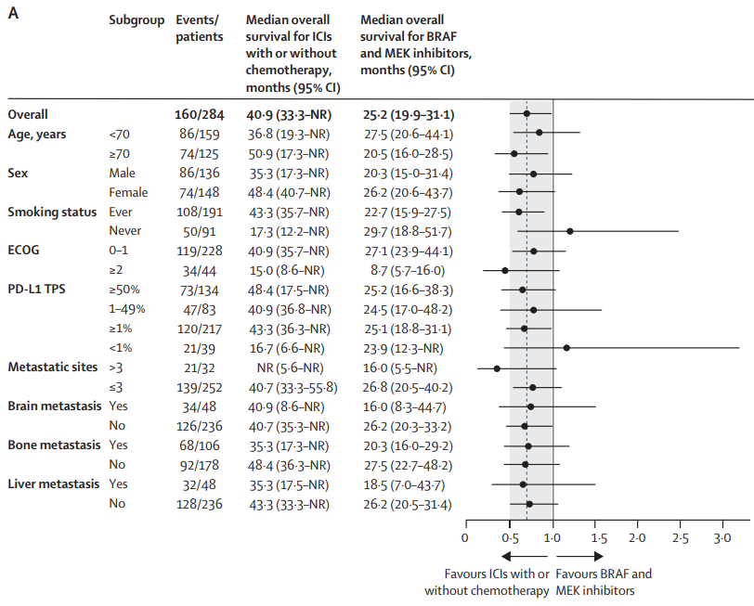
In never smokers, PD-L1 negative, targeted therapy seems more effective

Slide 26
There are many types of BRAF mutations
 | Category | examples
Class 1 | Ras independent, signal as active monomers | V600
Class 2 | Ras independent, constitutively active dimers | K601, L597, G469, G464, fusions
Class 3 | Ras dependent, impaired/dead kinase activity | D287, V459, G466, S467, D594
Yao et al, Nature 2017, Dagogo-Jack et al, Clin Cancer Res 2019

Slide 27
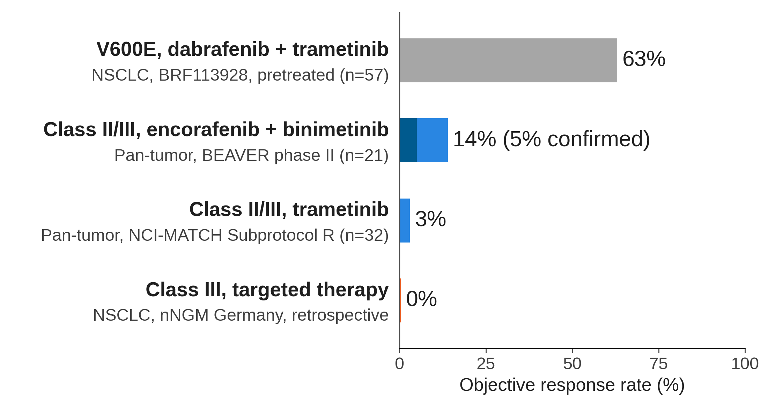
Clinical Experience with MAPK Inhibition in Class II/III BRAF Mutations
Objective response rate
Response rates of 0% to 14% in class II/III, compared with 63% for V600E
Planchard et al, Lancet Oncol 2016; Rose et al, medRxiv 2024; Johnson et al, Clin Cancer Res 2020; Kropf-Sanchen et al, ESMO Open 2025

Slide 28
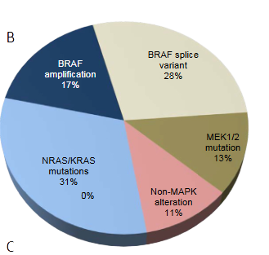
What are mechanisms of resistance to RAF/MEK inhibition?
(data from melanoma)

Slide 29
New Drugs for BRAF-Mutant Cancers
Approach | Agents | Rationale
Paradox-breaker RAF | Plixorafenib (FORE8394) | Monomers and dimers, no MEKi.
RAF dimer inhibitors ± MEK | Claturafenib (PF-07799933) + polfurmetinib Brimarafenib (BGB-3245) + mirdametinib | brain-penetrant, pan-mutant BRAF, spares WT ERK.
Pan-RAF inhibitors ± MEK | Exarafenib (KIN-2787) + binimetinib Naporafenib + trametinib Belvarafenib + cobimetinib S241656 (BDTX-4933) | Class II/III and RAS-driven dimers
More potent MEK partner | Tunlametinib (HL-085) + vemurafenib | V600 NSCLC, ORR 60.6%, mPFS 10.5 months
Upstream feedback blockade | SHP2 inhibitors RAS(ON) inhibitors | Blocks ERK reactivation.
No published efficacy data yet in BRAF-mutant NSCLC for most
Spira et al, JCO Oncol Adv 2026, Schram et al, AACR 2023, de Braud et al, JCO 2023, Shi et al, Exp Hematol Oncol 2024, NCT05786924

Slide 30
Conclusions
BRAF V600E mutations (class I) define a subset of NSCLC that responds to combined BRAF and MEK inhibition.
Dabrafenib + trametinib or encorafenib + binimetinib are both standard options. In treatment-naive patients, encorafenib + binimetinib gave an ORR of 75% and a median PFS of 30.2 months.
Toxicity profiles differ for targeted therapies. Pyrexia is the main issue with dabrafenib + trametinib, while GI toxicity is more common with encorafenib + binimetinib.
In absence of randomized data, retrospective data favor targeted therapy in never smokers and in PD-L1 negative tumors. Others may benefit from IO+/- chemotherapy
Class 2 and 3 BRAF mutations and acquired resistance are a challenge. New RAF inhibitors are in early trials.

