Slide 1


Project 1
Cataschevastica
An Online Transaction Processing Database
TEAM 6
Members: Dimitris Ropoutis, Marios Rapanakis, Milan Tsompanoglou, Panagiotis Koutridis, Sotirios Theodoropoulos
May 2024

Slide 2


TEAM 6
Project Overview
Project goal: Establish a comprehensive database system for Cataschevastica to manage suppliers, materials, products, customers, production teams, logistic partners and orders.
Data model : Relational database model with interlinked tables for efficient data retrieval and manipulation.
Functionality : The database allows for order processing, production tracking, inventory management and customer relationship management.

Slide 3
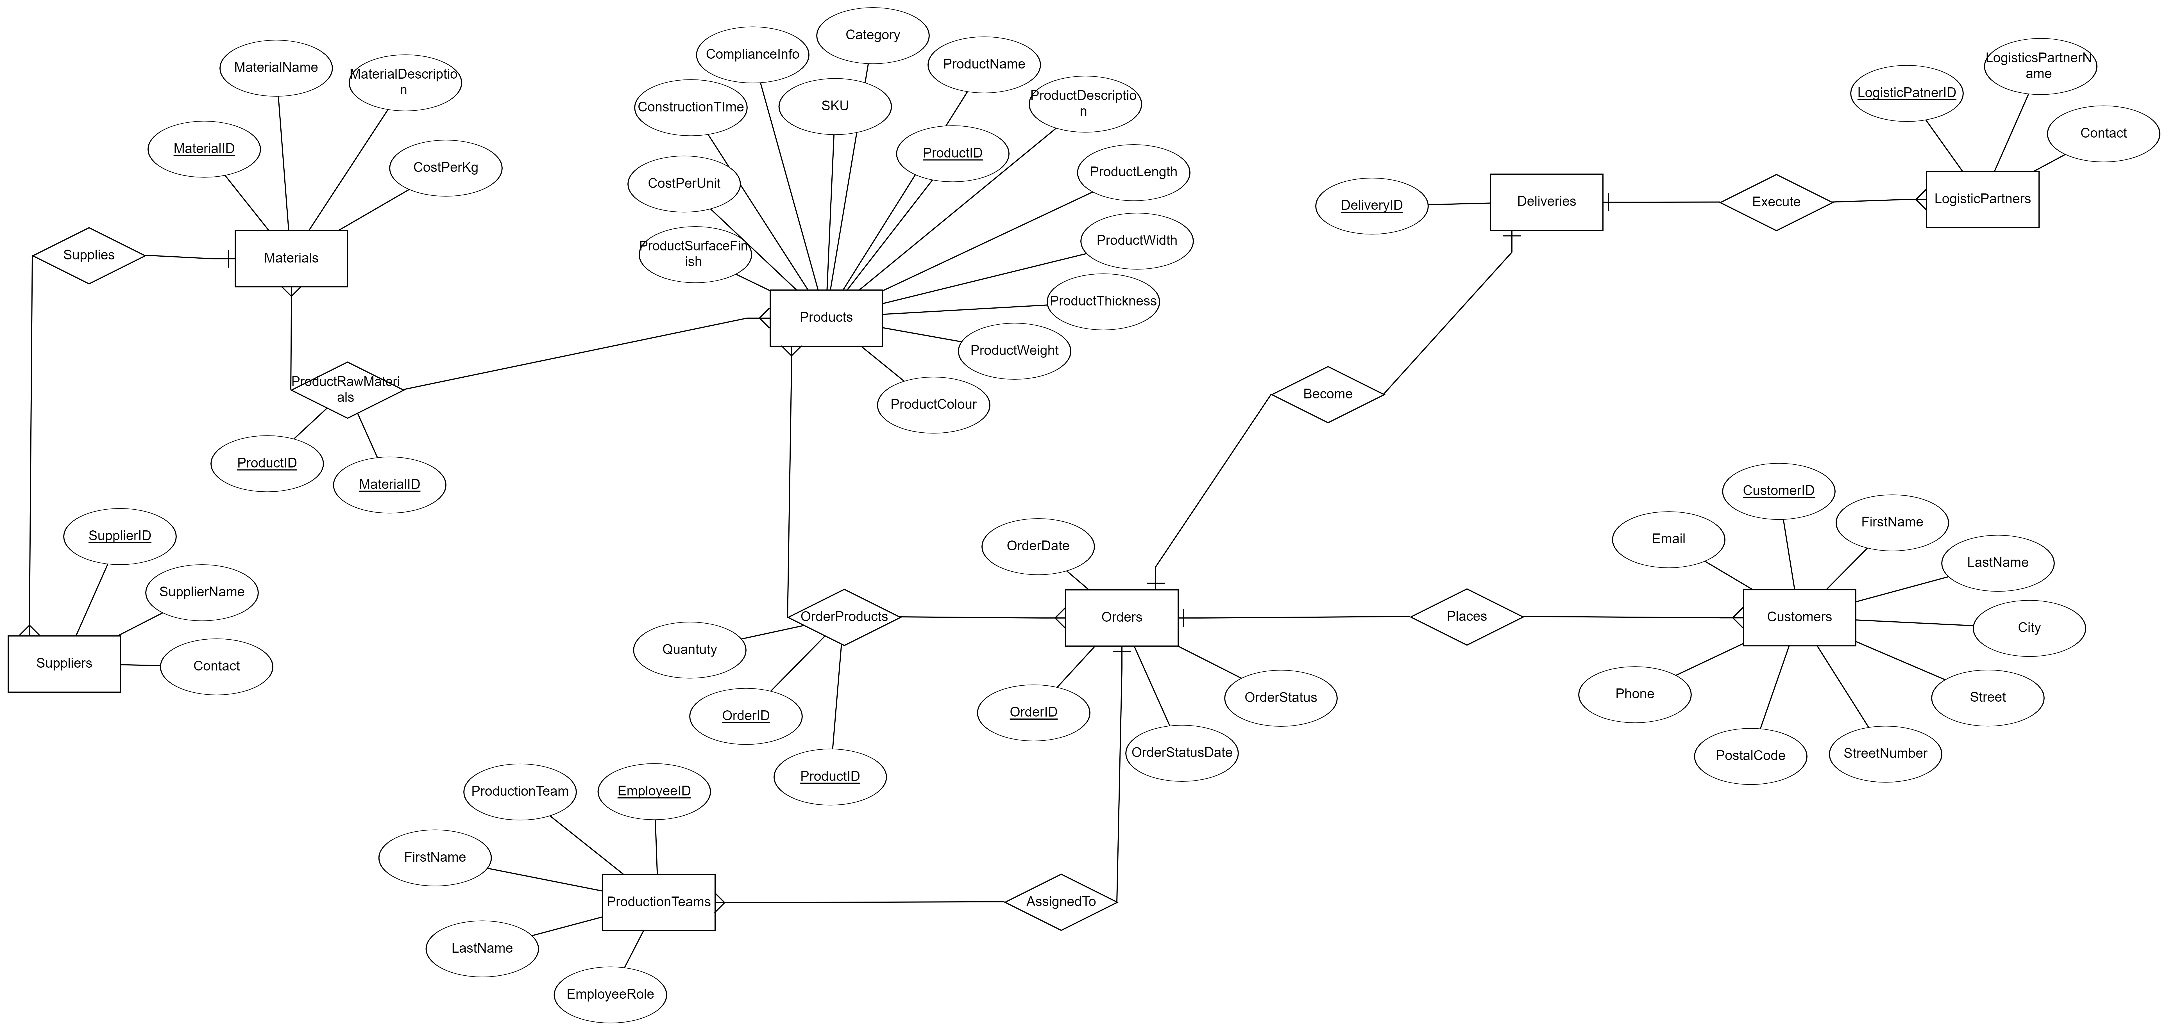
TEAM 6
ENTITY RELATIONSHIP DIAGRAM

Slide 4
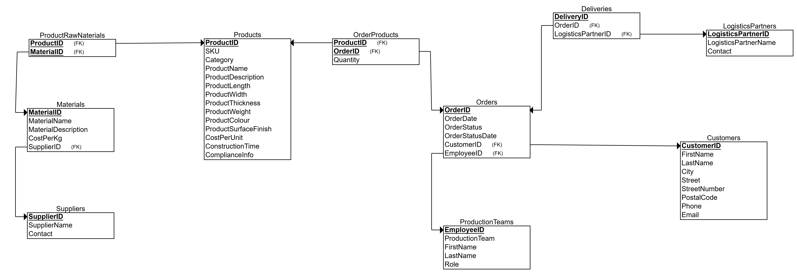
TEAM 6
Cataschevastica OLTP Database Project
Relational Diagram

Slide 5
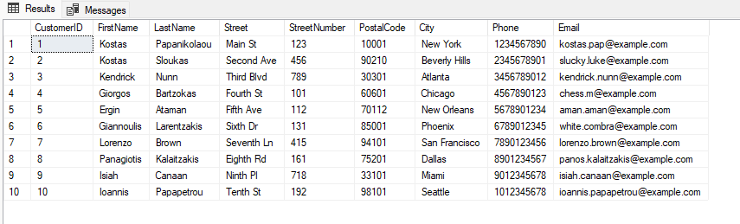
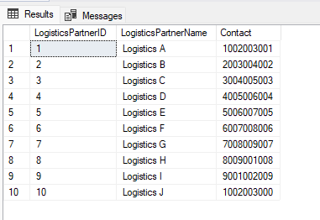
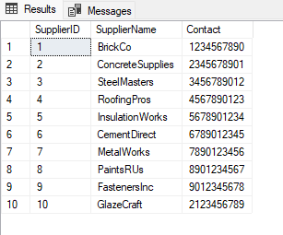
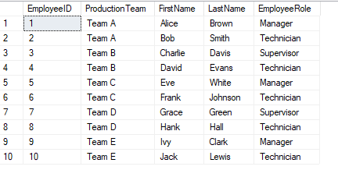
TEAM 6
Entities Description
Customers
LogisticsPartners
Suppliers
ProductionTeams

Slide 6
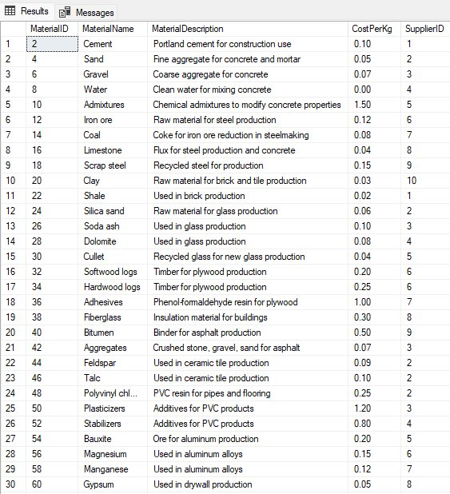
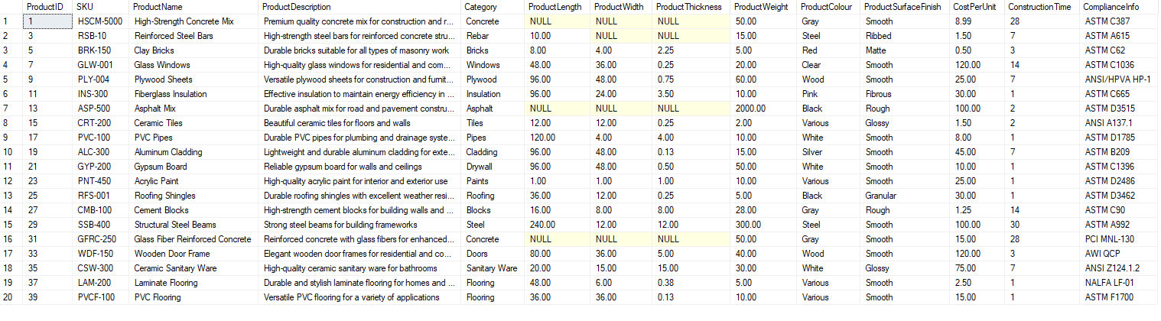
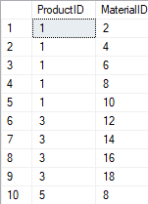
TEAM 6
Materials
Products
ProductRawMaterials

Slide 7
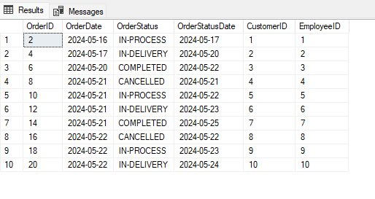
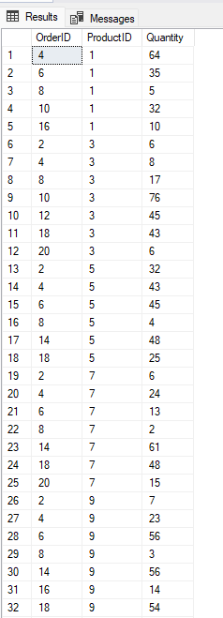
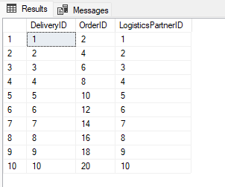
TEAM 6
Orders
OrderProducts
Deliveries
Products

Slide 8
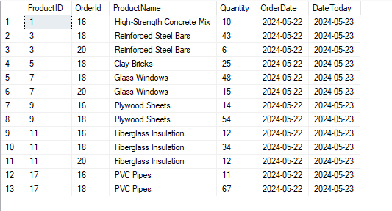
TEAM 6
QUERIES
-- a. List of all products ordered yesterday
SELECT p.ProductID,o.OrderId, p.ProductName, op.Quantity, o.OrderDate, CAST(GETDATE() AS DATE) as DateToday
FROM Orders o
JOIN OrderProducts op ON o.OrderID = op.OrderID
JOIN Products p ON op.ProductID = p.ProductID
WHERE o.OrderDate = DATEADD(DAY, -1, CAST(GETDATE() AS DATE));

Slide 9
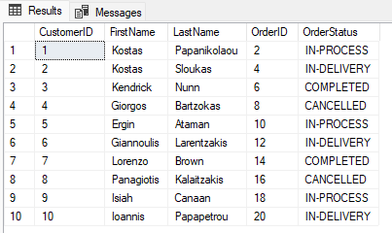
TEAM 6
QUERIES
-- b. List of all finished orders ready to deliver
SELECT o.OrderID, o.OrderDate, o.OrderStatus, o.OrderStatusDate, c.FirstName, c.LastName,c.City,c.Street,c.StreetNumber,c.PostalCode,c.Phone,c.Email
FROM Orders o
JOIN Customers c ON o.CustomerID = c.CustomerID
WHERE o.OrderStatus = 'IN-DELIVERY';
--c. List of all orders per customer, completed, pending, cancelled
SELECT c.CustomerID, c.FirstName, c.LastName, o.OrderID ,o.OrderStatus
FROM Orders o
JOIN Customers c ON c.CustomerID = o.CustomerID
ORDER BY c.CustomerID, o.OrderStatus;

Slide 10
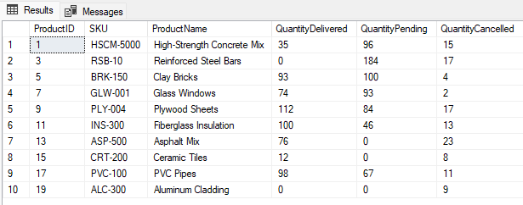
TEAM 6
QUERIES
--d. List of all products with quantities, ordered and delivered, ordered and pending, cancelled
SELECT p.ProductID, p.SKU,p.ProductName, SUM(CASE WHEN o.OrderStatus = 'COMPLETED' THEN op.Quantity ELSE 0 END) AS QuantityDelivered, SUM(CASE WHEN o.OrderStatus IN ('IN-PROCESS', 'IN-DELIVERY') THEN op.Quantity ELSE 0 END) AS QuantityPending,
SUM(CASE WHEN o.OrderStatus = 'CANCELLED' THEN op.Quantity ELSE 0 END) AS QuantityCancelled FROM Products p JOIN OrderProducts op ON p.ProductID = op.ProductID JOIN Orders o ON op.OrderID = o.OrderID GROUP BY p.ProductID, p.ProductName,p.SKU;

Slide 11
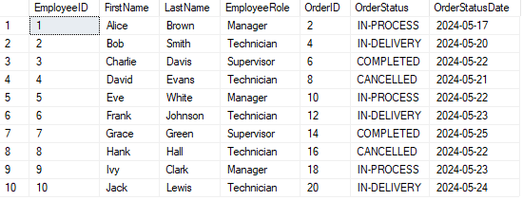
TEAM 6
QUERIES
--e. List of orders per production team employee, completed, pending, cancelled
SELECT pt.EmployeeID, pt.FirstName, pt.LastName, pt.EmployeeRole, o.OrderID, o.OrderStatus, o.OrderStatusDate FROM ProductionTeams pt JOIN Orders o ON pt.EmployeeID = o.EmployeeID ORDER BY pt.EmployeeID, o.OrderStatus,o.OrderStatusDate;

Slide 12
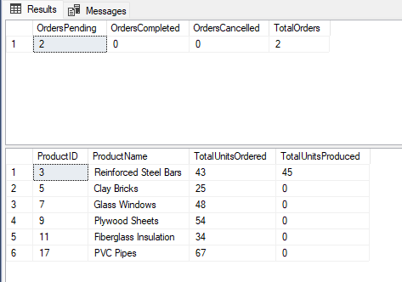
TEAM 6
QUERIES
--f. Daily order and production report
DECLARE @ReportDate DATE
SET @ReportDate= GETDATE()
SELECT
COUNT(CASE WHEN (o.OrderStatus = 'IN-PROCESS' OR o.OrderStatus = 'IN-DELIVERY') THEN 1 END) AS OrdersPending,
COUNT(CASE WHEN o.OrderStatus = 'COMPLETED' THEN 1 END) AS OrdersCompleted,
COUNT(CASE WHEN o.OrderStatus = 'CANCELLED' THEN 1 END) AS OrdersCancelled,
COUNT(*) AS TotalOrders
FROM Orders o
WHERE o.OrderStatusDate = @ReportDate;
SELECT p.ProductID, p.ProductName AS ProductName,
SUM(CASE WHEN (o.OrderStatus='IN-PROCESS' AND o.OrderStatusDate = @ReportDate) THEN oi.Quantity ELSE 0 END) AS TotalUnitsOrdered,
SUM(CASE WHEN (o.OrderStatus = 'IN-DELIVERY' AND o.OrderStatusDate = @ReportDate) THEN oi.Quantity ELSE 0 END) AS TotalUnitsProduced
FROM Orders o
JOIN OrderProducts oi ON o.OrderID = oi.OrderID
JOIN Products p ON oi.ProductID = p.ProductID
WHERE OrderStatusDate = @ReportDate
GROUP BY p.ProductID, p.ProductName;

Slide 13
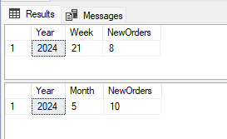
TEAM 6
QUERIES
-- g. List of new orders per week
SELECT YEAR(o.OrderDate) AS Year, DATEPART(WEEK, o.OrderDate) AS Week, COUNT(*) AS NewOrders FROM Orders o WHERE DATEPART(WEEK, o.OrderDate) = DATEPART(WEEK,CAST(GETDATE() AS DATE)) GROUP BY YEAR(o.OrderDate), DATEPART(WEEK, o.OrderDate) ORDER BY Year, Week;
-- List of new orders per month
SELECT YEAR(o.OrderDate) AS Year, DATEPART(MONTH, o.OrderDate) AS Month, COUNT(*) AS NewOrders FROM Orders o WHERE DATEPART(MONTH, o.OrderDate) = DATEPART(MONTH,CAST(GETDATE() AS DATE)) GROUP BY YEAR(o.OrderDate), DATEPART(MONTH, o.OrderDate) ORDER BY Year, Month;

Slide 14
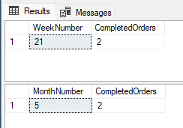
TEAM 6
QUERIES
-- h. List of completed orders per week
SELECT DATEPART(WEEK, o.OrderStatusDate) AS WeekNumber, COUNT(o.OrderID) AS CompletedOrders
FROM Orders o
WHERE o.OrderStatus = 'COMPLETED' AND YEAR(o.OrderStatusDate) = YEAR(GETDATE())
GROUP BY DATEPART(WEEK, o.OrderStatusDate);
-- List of completed orders per month
SELECT DATEPART(MONTH, o.OrderStatusDate) AS MonthNumber, COUNT(o.OrderID) AS CompletedOrders
FROM Orders o
WHERE o.OrderStatus = 'COMPLETED' AND YEAR(o.OrderStatusDate) = YEAR(GETDATE())
GROUP BY DATEPART(MONTH, o.OrderStatusDate);

Slide 15
TEAM 6
COMMAND STATEMENTS
-- 1.Command to create an order
INSERT INTO Orders (OrderDate, OrderStatus, OrderStatusDate, CustomerID, EmployeeID)
VALUES ('2024-05-20', 'IN-PROCESS', '2024-05-20', 1, 1);
-- 2.Command to finalize production
UPDATE Orders
SET OrderStatus = 'IN-DELIVERY', OrderStatusDate = CAST(GETDATE() AS DATE)
WHERE OrderID = 12;
-- 3.Command to finalize an order and delivery
UPDATE Orders
SET OrderStatus = 'COMPLETED', OrderStatusDate = CAST(GETDATE() AS DATE)
WHERE OrderID = 12;
INSERT INTO Deliveries ( OrderID, LogisticsPartnerID)
VALUES (12, 1);

Slide 16
TEAM 6
Conclusion
Summary:
Successfully designed and implemented an OLTP database for Cataschevastica.
Ensured data consistency and efficiency through normalization.
Achievements:
Completed ERD and relational schema.
Populated database with realistic sample data.
Developed and tested complex query statements and commands.
Lessons Learned:
Importance of detailed requirement analysis.
Challenges in database normalization and optimization.
Value of comprehensive testing and validation.

