Slide 1
AI AGENT OLYMPICS SUBMISSION
Blitz TraceGrid
Trace target
Visual AI Runtime Intelligence for software systems
selected node
INPUT
We convert repositories into graph-grounded execution stories, then use specialized agents to explain structure, security risk, and root-cause evidence.
v
Replay path
causal steps
FLOW
STATIC CAUSAL RECONSTRUCTION
AGENTIC INVESTIGATION
VULTR DEPLOYED
v
AI verdict
1
4
0
root cause
OUTPUT
autonomous investigation button
graph-grounded reasoning agents
GPU management required
AI Agent Olympics Hackathon | Milan AI Week 2026
01

Slide 2
THE ENTERPRISE PROBLEM
AI can generate code. Teams still cannot see behavior.
The next bottleneck is not writing more software. It is understanding what user actions, API calls, and agent workflows actually cause.
Fragmented evidence
Opaque AI work
Security blind spots
Demo vs diligence
Logs, traces, source files, and agent outputs live in different places. The story of execution is scattered.
AI agents call tools and APIs, but teams struggle to inspect why one action caused another.
Attack surfaces hide in flow boundaries: auth, API routes, sessions, database lookups, and external calls.
A graph can impress judges, but it only survives diligence if every explanation is grounded in evidence.
TraceGrid's answer: reconstruct execution as a visible causal system, then let agents explain the graph instead of hallucinating around it.
AI Agent Olympics Hackathon | Milan AI Week 2026
02

Slide 3
WHAT TRACEGRID IS
A causal intelligence layer between code and human judgment.
TraceGrid turns source structure into a graph, selects a replayable path, and makes agents reason from that same evidence.
PIPELINE
Repository
AST-lite
Causal graph
Trace slice
Agents
>
>
>
>
GitHub/local
IN
Python + TS/JS
EVIDENCE
nodes + edges
MODEL
bounded context
FOCUS
verdict + story
AI
Current milestone: graph-grounded static causal reconstruction. Roadmap: runtime instrumentation and deterministic replay.
AI Agent Olympics Hackathon | Milan AI Week 2026
03

Slide 4
DEMO FLOW
The demo is staged around one mental conclusion: software becomes watchable.
JUDGED SEQUENCE
Analyze repo
>
Pick target
>
Replay path
>
Agent verdict
full graph reveal
1
click or type
2
ordered steps
3
root cause
4
Trace slice: visible connected context around the selected node
Primary replay path: the step-by-step route selected for animation and explanation
This prevents the graph from becoming noise. The user sees both broad context and a clean execution story.
AI Agent Olympics Hackathon | Milan AI Week 2026
04

Slide 5
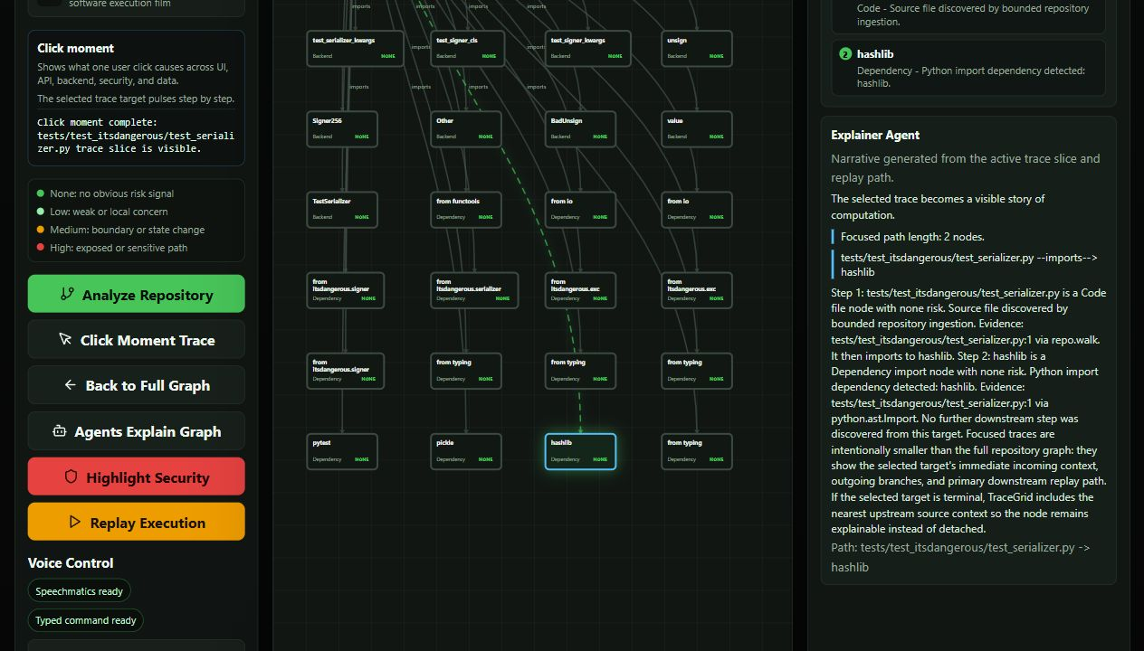
PRODUCT PROOF
The interface turns graph complexity into a guided investigation.
The user can analyze a repository, focus a trace target, inspect risk reasoning, run agents, and replay the selected path.
AI Agent Olympics Hackathon | Milan AI Week 2026
05

Slide 6
AUTONOMOUS WORKFLOW
Run AI Investigation is the hackathon memory anchor.
One button turns a repository map into a graph-grounded investigation verdict.
AUTONOMOUS STEPS
Analyze
>
Score
>
Trace
>
Reason
>
Verdict
graph
1
risk + centrality
2
graph
3
4 agents
4
graph
5
Root Cause
Attack Surface
Replay Path
Recommended Fix
Confidence
Why this target was selected and what graph evidence supports it.
What exposed, sensitive, or boundary-crossing risk exists in the slice.
The exact primary route selected for animation and explanation.
Next control to validate: auth, telemetry, data-flow, runtime tracing.
Graph-grounded, not guessed.
AI Agent Olympics Hackathon | Milan AI Week 2026
06

Slide 7
SECURITY VALUE
Security becomes visible when risk is placed inside the execution path.
TraceGrid shows where trust boundaries, auth checks, API routes, sessions, and database access appear in the causal flow.
Click
>
API route
>
Auth middleware
>
DB query
UI
NONE
public boundary
HIGH
policy
HIGH
identity data
HIGH
For developers
For security teams
For AI governance
See what one feature actually touches before changing it.
Find attack surfaces as flow positions, not disconnected alerts.
Audit agent/tool behavior through grounded evidence and replay.
AI Agent Olympics Hackathon | Milan AI Week 2026
07

Slide 8
HACKATHON ALIGNMENT
Direct fit for AI Agent Olympics: enterprise agents with real deployment.
The event asks for autonomous agents, agentic workflows, enterprise utility, production-style web apps, and partner technology use.
Vultr
Featherless
Speechmatics
Enterprise utility
Production-style web app deployment on a VM with Docker, Nginx, FastAPI, and Next.js.
OpenAI-compatible inference for specialized reasoning agents when a key is configured.
Realtime speech-to-text path plus typed voice mode for reliable judged demos.
Developer, security, incident response, and AI-governance teams need execution clarity.
Recommended submission categories
Intelligent Reasoning | Agentic Workflows | Enterprise Utility | Collaborative Systems | Multimodal Intelligence
AI Agent Olympics Hackathon | Milan AI Week 2026
08

Slide 9
CREDIBLE ROADMAP
The credibility move: be honest about static today, runtime tomorrow.
This prevents overclaiming while making the technical direction stronger.
Now
Next
Defensible future
Static causal reconstruction from AST-lite evidence, GitHub ingestion, trace target slicing, replay path selection, graph-grounded agents, typed voice, Docker/Vultr deployment.
Runtime event capture through browser instrumentation, OpenTelemetry spans, backend hooks, and policy-aware trace correlation.
Deterministic replay, attack propagation reconstruction, AI agent audit trails, data-flow and taint analysis, SOC/DFIR integration.
Do not sell this as another code graph engine. Sell it as causal intelligence for autonomous systems.
AI Agent Olympics Hackathon | Milan AI Week 2026
09

Slide 10
CLOSE
TraceGrid does not just analyze code.
It reconstructs how software behaves.
Visibly. Causally. Reproducibly.
FIRST SHOCK: GRAPH REVEAL
MIDDLE AHA: TRACE TARGET
FINAL SHIFT: SOFTWARE IS WATCHABLE
Blitz TraceGrid is the explainability layer for autonomous software execution.
AI Agent Olympics Hackathon | Milan AI Week 2026
10

