Slide 1
R Markdown Output
Last run on: 2021-07-10 06:12:28

Slide 2
Overview
This document has code embedded throughout. In the next section we will create a visualization using the already loaded dataset eth_data:
datatable(eth_data)

Slide 3
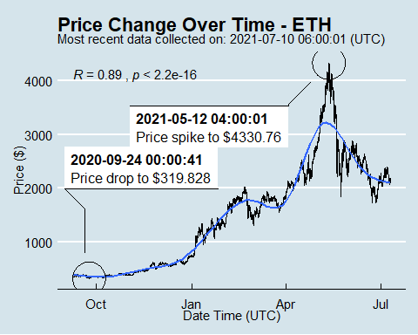
Price Chart - Ethereum

Slide 4
Python Code Example
import pandas as pd # Create the Python object from R df = r.cryptodata # Show the new Python dataframe df
## pair symbol ask_1_price date_time_utc ## 0 ETHUSD ETH 2114.555 2021-07-10 06:00:01 ## 1 BTCUSD BTC 33653.860 2021-07-10 06:00:00 ## 2 BTCUSD BTC 33651.580 2021-07-10 05:00:01 ## 3 ETHUSD ETH 2107.891 2021-07-10 05:00:01 ## 4 ETHUSD ETH 2132.825 2021-07-10 04:00:01 ## ... ... ... ... ... ## 15101 BTCUSD BTC 11372.920 2020-08-12 00:03:55 ## 15102 BTCUSD BTC 11868.320 2020-08-11 03:03:52 ## 15103 BTCUSD BTC 11900.900 2020-08-11 02:03:53 ## 15104 BTCUSD BTC 11863.170 2020-08-11 01:03:53 ## 15105 BTCUSD BTC 11906.130 2020-08-11 00:03:49 ## ## [15106 rows x 4 columns]

Slide 5
One more Python example
The code below creates a new column price_percentile that specifies if the price for the row was in the upper or lower 50th percentile of prices (BTC should be upper and ETH lower):
import numpy as np # Create a new column based on the ask_1_price value: df['price_percentile'] = np.where(df['ask_1_price'] > np.percentile(df['ask_1_price'], 50), 'upper 50th percentile of prices', 'lower 50th percentile of prices') # Show modified dataframe: df[['symbol', 'ask_1_price', 'price_percentile']]
## symbol ask_1_price price_percentile ## 0 ETH 2114.555 lower 50th percentile of prices ## 1 BTC 33653.860 upper 50th percentile of prices ## 2 BTC 33651.580 upper 50th percentile of prices ## 3 ETH 2107.891 lower 50th percentile of prices ## 4 ETH 2132.825 lower 50th percentile of prices ## ... ... ... ... ## 15101 BTC 11372.920 upper 50th percentile of prices ## 15102 BTC 11868.320 upper 50th percentile of prices ## 15103 BTC 11900.900 upper 50th percentile of prices ## 15104 BTC 11863.170 upper 50th percentile of prices ## 15105 BTC 11906.130 upper 50th percentile of prices ## ## [15106 rows x 3 columns]

