Slide 1
R Markdown Output
Last run on: 2021-01-08 06:37:52

Slide 2
Overview
This document has code embedded throughout. In the next section we will create a visualization using the already loaded dataset eth_data:
datatable(eth_data)

Slide 3
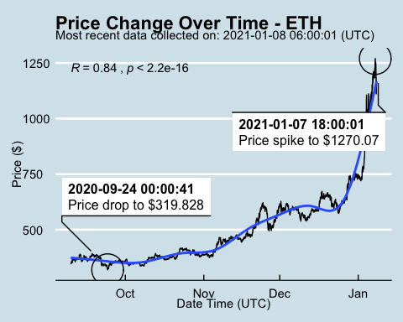
Price Chart - Ethereum

Slide 4
Python Code Example
import pandas as pd # Create the Python object from R df = r.cryptodata # Show the new Python dataframe df

Slide 5
One more Python example
The code below creates a new column price_percentile that specifies if the price for the row was in the upper or lower 50th percentile of prices (BTC should be upper and ETH lower):
import numpy as np # Create a new column based on the ask_1_price value: df['price_percentile'] = np.where(df['ask_1_price'] > np.percentile(df['ask_1_price'], 50), 'upper 50th percentile of prices', 'lower 50th percentile of prices') # Show modified dataframe: df[['symbol', 'ask_1_price', 'price_percentile']]

