Slide 1
R Markdown Output
Last run on: 2021-07-11 06:13:59

Slide 2
Overview
This document has code embedded throughout. In the next section we will create a visualization using the already loaded dataset eth_data:
datatable(eth_data)

Slide 3
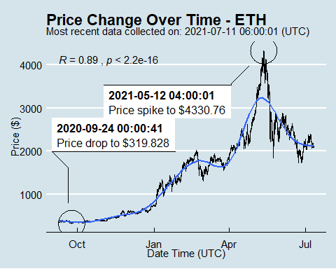
Price Chart - Ethereum

Slide 4
Python Code Example
import pandas as pd # Create the Python object from R df = r.cryptodata # Show the new Python dataframe df
## pair symbol ask_1_price date_time_utc ## 0 ETHUSD ETH 2099.617 2021-07-11 06:00:01 ## 1 BTCUSD BTC 33579.600 2021-07-11 06:00:00 ## 2 ETHUSD ETH 2094.423 2021-07-11 05:00:01 ## 3 BTCUSD BTC 33463.920 2021-07-11 05:00:00 ## 4 ETHUSD ETH 2091.950 2021-07-11 04:00:01 ## ... ... ... ... ... ## 15125 BTCUSD BTC 11573.270 2020-08-13 00:03:52 ## 15126 BTCUSD BTC 11266.550 2020-08-12 03:03:52 ## 15127 BTCUSD BTC 11331.140 2020-08-12 02:03:56 ## 15128 BTCUSD BTC 11346.560 2020-08-12 01:03:56 ## 15129 BTCUSD BTC 11372.920 2020-08-12 00:03:55 ## ## [15130 rows x 4 columns]

Slide 5
One more Python example
The code below creates a new column price_percentile that specifies if the price for the row was in the upper or lower 50th percentile of prices (BTC should be upper and ETH lower):
import numpy as np # Create a new column based on the ask_1_price value: df['price_percentile'] = np.where(df['ask_1_price'] > np.percentile(df['ask_1_price'], 50), 'upper 50th percentile of prices', 'lower 50th percentile of prices') # Show modified dataframe: df[['symbol', 'ask_1_price', 'price_percentile']]
## symbol ask_1_price price_percentile ## 0 ETH 2099.617 lower 50th percentile of prices ## 1 BTC 33579.600 upper 50th percentile of prices ## 2 ETH 2094.423 lower 50th percentile of prices ## 3 BTC 33463.920 upper 50th percentile of prices ## 4 ETH 2091.950 lower 50th percentile of prices ## ... ... ... ... ## 15125 BTC 11573.270 upper 50th percentile of prices ## 15126 BTC 11266.550 upper 50th percentile of prices ## 15127 BTC 11331.140 upper 50th percentile of prices ## 15128 BTC 11346.560 upper 50th percentile of prices ## 15129 BTC 11372.920 upper 50th percentile of prices ## ## [15130 rows x 3 columns]

