Slide 1
R Markdown Output
Last run on: 2021-07-13 06:12:10

Slide 2
Overview
This document has code embedded throughout. In the next section we will create a visualization using the already loaded dataset eth_data:
datatable(eth_data)

Slide 3
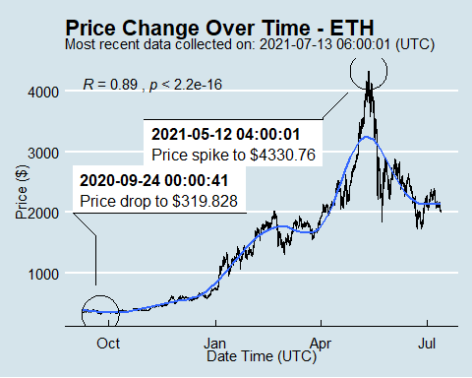
Price Chart - Ethereum

Slide 4
Python Code Example
import pandas as pd # Create the Python object from R df = r.cryptodata # Show the new Python dataframe df
## pair symbol ask_1_price date_time_utc ## 0 ETHUSD ETH 1982.230 2021-07-13 06:00:01 ## 1 BTCUSD BTC 32825.540 2021-07-13 06:00:00 ## 2 ETHUSD ETH 2024.858 2021-07-13 05:00:01 ## 3 BTCUSD BTC 33140.010 2021-07-13 05:00:00 ## 4 ETHUSD ETH 2030.624 2021-07-13 04:00:01 ## ... ... ... ... ... ## 15172 BTCUSD BTC 11747.010 2020-08-14 04:03:56 ## 15173 BTCUSD BTC 11722.060 2020-08-14 03:03:55 ## 15174 BTCUSD BTC 11761.120 2020-08-14 02:04:04 ## 15175 BTCUSD BTC 11719.280 2020-08-14 01:03:54 ## 15176 BTCUSD BTC 11827.080 2020-08-14 00:03:56 ## ## [15177 rows x 4 columns]

Slide 5
One more Python example
The code below creates a new column price_percentile that specifies if the price for the row was in the upper or lower 50th percentile of prices (BTC should be upper and ETH lower):
import numpy as np # Create a new column based on the ask_1_price value: df['price_percentile'] = np.where(df['ask_1_price'] > np.percentile(df['ask_1_price'], 50), 'upper 50th percentile of prices', 'lower 50th percentile of prices') # Show modified dataframe: df[['symbol', 'ask_1_price', 'price_percentile']]
## symbol ask_1_price price_percentile ## 0 ETH 1982.230 lower 50th percentile of prices ## 1 BTC 32825.540 upper 50th percentile of prices ## 2 ETH 2024.858 lower 50th percentile of prices ## 3 BTC 33140.010 upper 50th percentile of prices ## 4 ETH 2030.624 lower 50th percentile of prices ## ... ... ... ... ## 15172 BTC 11747.010 upper 50th percentile of prices ## 15173 BTC 11722.060 upper 50th percentile of prices ## 15174 BTC 11761.120 upper 50th percentile of prices ## 15175 BTC 11719.280 upper 50th percentile of prices ## 15176 BTC 11827.080 upper 50th percentile of prices ## ## [15177 rows x 3 columns]

