Slide 1
R Markdown Output
Last run on: 2021-07-12 06:12:08

Slide 2
Overview
This document has code embedded throughout. In the next section we will create a visualization using the already loaded dataset eth_data:
datatable(eth_data)

Slide 3
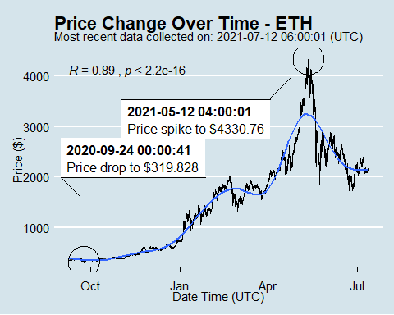
Price Chart - Ethereum

Slide 4
Python Code Example
import pandas as pd # Create the Python object from R df = r.cryptodata # Show the new Python dataframe df
## pair symbol ask_1_price date_time_utc ## 0 ETHUSD ETH 2151.045 2021-07-12 06:00:01 ## 1 BTCUSD BTC 34344.240 2021-07-12 06:00:00 ## 2 ETHUSD ETH 2149.095 2021-07-12 05:00:01 ## 3 BTCUSD BTC 34301.190 2021-07-12 05:00:00 ## 4 ETHUSD ETH 2164.946 2021-07-12 04:00:01 ## ... ... ... ... ... ## 15149 BTCUSD BTC 11827.080 2020-08-14 00:03:56 ## 15150 BTCUSD BTC 11551.860 2020-08-13 03:03:54 ## 15151 BTCUSD BTC 11605.670 2020-08-13 02:04:01 ## 15152 BTCUSD BTC 11633.600 2020-08-13 01:03:53 ## 15153 BTCUSD BTC 11573.270 2020-08-13 00:03:52 ## ## [15154 rows x 4 columns]

Slide 5
One more Python example
The code below creates a new column price_percentile that specifies if the price for the row was in the upper or lower 50th percentile of prices (BTC should be upper and ETH lower):
import numpy as np # Create a new column based on the ask_1_price value: df['price_percentile'] = np.where(df['ask_1_price'] > np.percentile(df['ask_1_price'], 50), 'upper 50th percentile of prices', 'lower 50th percentile of prices') # Show modified dataframe: df[['symbol', 'ask_1_price', 'price_percentile']]
## symbol ask_1_price price_percentile ## 0 ETH 2151.045 lower 50th percentile of prices ## 1 BTC 34344.240 upper 50th percentile of prices ## 2 ETH 2149.095 lower 50th percentile of prices ## 3 BTC 34301.190 upper 50th percentile of prices ## 4 ETH 2164.946 lower 50th percentile of prices ## ... ... ... ... ## 15149 BTC 11827.080 upper 50th percentile of prices ## 15150 BTC 11551.860 upper 50th percentile of prices ## 15151 BTC 11605.670 upper 50th percentile of prices ## 15152 BTC 11633.600 upper 50th percentile of prices ## 15153 BTC 11573.270 upper 50th percentile of prices ## ## [15154 rows x 3 columns]

