Slide 1
Example Presentation

Slide 2
Overview
This document has code embedded throughout. In the next section we will create a visualization using the already loaded dataset eth_data:
datatable(eth_data)

Slide 3
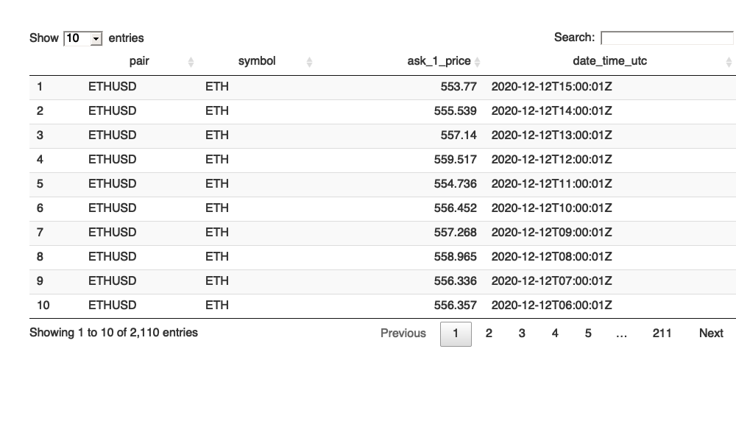

Slide 4
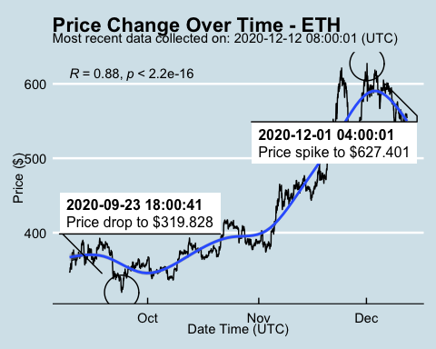
Price Chart

Slide 5
Python Code Example
import pandas as pd # Create the Python object from R df = r.cryptodata # Show the new Python dataframe df
## pair symbol ask_1_price date_time_utc ## 0 BTCUSD BTC 18371.130 2020-12-12 15:00:01 ## 1 ETHUSD ETH 553.770 2020-12-12 15:00:01 ## 2 ETHUSD ETH 555.539 2020-12-12 14:00:01 ## 3 BTCUSD BTC 18400.890 2020-12-12 14:00:00 ## 4 ETHUSD ETH 557.140 2020-12-12 13:00:01 ## ... ... ... ... ... ## 5091 BTCUSD BTC 11972.900 2020-08-10 06:03:50 ## 5092 BTCUSD BTC 11985.890 2020-08-10 05:03:48 ## 5093 BTCUSD BTC 11997.470 2020-08-10 04:32:55 ## 5094 BTCUSD BTC 10686.880 NaT ## 5095 ETHUSD ETH 357.844 NaT ## ## [5096 rows x 4 columns]

Slide 6
One more Python example
Press on w on your keyboard to make the presentation wider. Press f to fullscreen.
import numpy as np # Create a new field based on the ask_1_price value: df['price_percentile'] = np.where(df['ask_1_price'] > np.percentile(df['ask_1_price'], 50), 'upper 50th percentile of prices', 'lower 50th percentile of prices') # Show modified dataframe: df[['symbol', 'ask_1_price', 'price_percentile']]
## symbol ask_1_price price_percentile ## 0 BTC 18371.130 upper 50th percentile of prices ## 1 ETH 553.770 lower 50th percentile of prices ## 2 ETH 555.539 lower 50th percentile of prices ## 3 BTC 18400.890 upper 50th percentile of prices ## 4 ETH 557.140 lower 50th percentile of prices ## ... ... ... ... ## 5091 BTC 11972.900 upper 50th percentile of prices ## 5092 BTC 11985.890 upper 50th percentile of prices ## 5093 BTC 11997.470 upper 50th percentile of prices ## 5094 BTC 10686.880 upper 50th percentile of prices ## 5095 ETH 357.844 lower 50th percentile of prices ## ## [5096 rows x 3 columns]

Slide 7
Back to Gallery
knitr::include_url("https://r-markdown-gallery.org")

Slide 8


