Slide 1
R Markdown Output
Last run on: 2024-09-08 06:28:00

Slide 2
Overview
This document has code embedded throughout. In the next section we will create a visualization using the already loaded dataset eth_data:
datatable(eth_data)

Slide 3
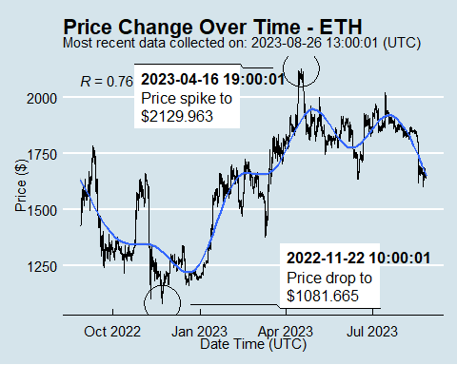
Price Chart - Ethereum

Slide 4
Python Code Example
removed for now because of package install automation issues

