Slide 1
R Markdown Output
Last run on: 2021-07-16 06:14:48

Slide 2
Overview
This document has code embedded throughout. In the next section we will create a visualization using the already loaded dataset eth_data:
datatable(eth_data)

Slide 3
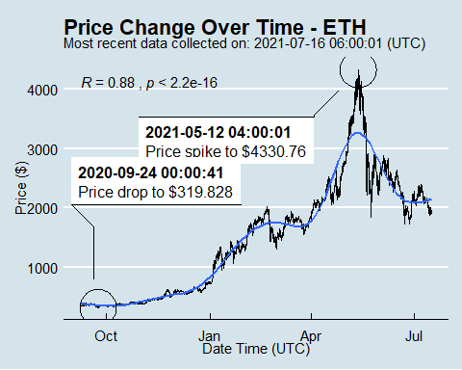
Price Chart - Ethereum

Slide 4
Python Code Example
import pandas as pd # Create the Python object from R df = r.cryptodata # Show the new Python dataframe df
## pair symbol ask_1_price date_time_utc ## 0 ETHUSD ETH 1928.872 2021-07-16 06:00:01 ## 1 BTCUSD BTC 31804.460 2021-07-16 06:00:00 ## 2 ETHUSD ETH 1947.025 2021-07-16 05:00:01 ## 3 BTCUSD BTC 31916.240 2021-07-16 05:00:00 ## 4 ETHUSD ETH 1949.451 2021-07-16 04:00:01 ## ... ... ... ... ... ## 15244 BTCUSD BTC 11844.000 2020-08-17 04:03:55 ## 15245 BTCUSD BTC 11855.070 2020-08-17 03:03:54 ## 15246 BTCUSD BTC 11838.670 2020-08-17 02:04:02 ## 15247 BTCUSD BTC 11825.050 2020-08-17 01:03:53 ## 15248 BTCUSD BTC 11925.450 2020-08-17 00:03:56 ## ## [15249 rows x 4 columns]

Slide 5
One more Python example
The code below creates a new column price_percentile that specifies if the price for the row was in the upper or lower 50th percentile of prices (BTC should be upper and ETH lower):
import numpy as np # Create a new column based on the ask_1_price value: df['price_percentile'] = np.where(df['ask_1_price'] > np.percentile(df['ask_1_price'], 50), 'upper 50th percentile of prices', 'lower 50th percentile of prices') # Show modified dataframe: df[['symbol', 'ask_1_price', 'price_percentile']]
## symbol ask_1_price price_percentile ## 0 ETH 1928.872 lower 50th percentile of prices ## 1 BTC 31804.460 upper 50th percentile of prices ## 2 ETH 1947.025 lower 50th percentile of prices ## 3 BTC 31916.240 upper 50th percentile of prices ## 4 ETH 1949.451 lower 50th percentile of prices ## ... ... ... ... ## 15244 BTC 11844.000 upper 50th percentile of prices ## 15245 BTC 11855.070 upper 50th percentile of prices ## 15246 BTC 11838.670 upper 50th percentile of prices ## 15247 BTC 11825.050 upper 50th percentile of prices ## 15248 BTC 11925.450 upper 50th percentile of prices ## ## [15249 rows x 3 columns]

