Slide 1
R Markdown Output

Slide 2
Overview
This document has code embedded throughout. In the next section we will create a visualization using the already loaded dataset eth_data:
datatable(eth_data)

Slide 3
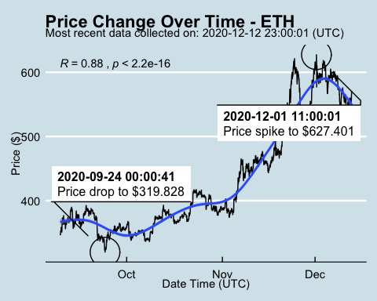
Price Chart - Ethereum

Slide 4
Python Code Example
import pandas as pd # Create the Python object from R df = r.cryptodata # Show the new Python dataframe df
## pair symbol ask_1_price date_time_utc ## 0 ETHUSD ETH 570.892 2020-12-12 23:00:01 ## 1 BTCUSD BTC 18870.440 2020-12-12 23:00:00 ## 2 ETHUSD ETH 570.047 2020-12-12 22:00:01 ## 3 BTCUSD BTC 18792.170 2020-12-12 22:00:00 ## 4 ETHUSD ETH 567.440 2020-12-12 21:00:01 ## ... ... ... ... ... ## 5107 BTCUSD BTC 11972.900 2020-08-10 06:03:50 ## 5108 BTCUSD BTC 11985.890 2020-08-10 05:03:48 ## 5109 BTCUSD BTC 11997.470 2020-08-10 04:32:55 ## 5110 BTCUSD BTC 10686.880 NaT ## 5111 ETHUSD ETH 357.844 NaT ## ## [5112 rows x 4 columns]

Slide 5
One more Python example
The code below creates a new column price_percentile that specifies if the price for the row was in the upper or lower 50th percentile of prices (BTC should be upper and ETH lower):
import numpy as np # Create a new column based on the ask_1_price value: df['price_percentile'] = np.where(df['ask_1_price'] > np.percentile(df['ask_1_price'], 50), 'upper 50th percentile of prices', 'lower 50th percentile of prices') # Show modified dataframe: df[['symbol', 'ask_1_price', 'price_percentile']]
## symbol ask_1_price price_percentile ## 0 ETH 570.892 lower 50th percentile of prices ## 1 BTC 18870.440 upper 50th percentile of prices ## 2 ETH 570.047 lower 50th percentile of prices ## 3 BTC 18792.170 upper 50th percentile of prices ## 4 ETH 567.440 lower 50th percentile of prices ## ... ... ... ... ## 5107 BTC 11972.900 upper 50th percentile of prices ## 5108 BTC 11985.890 upper 50th percentile of prices ## 5109 BTC 11997.470 upper 50th percentile of prices ## 5110 BTC 10686.880 upper 50th percentile of prices ## 5111 ETH 357.844 lower 50th percentile of prices ## ## [5112 rows x 3 columns]

Slide 6
Back to Gallery
include_url("https://r-markdown-gallery.org")

