Slide 1
R Markdown Output
Last run on: 2021-07-09 06:12:08

Slide 2
Overview
This document has code embedded throughout. In the next section we will create a visualization using the already loaded dataset eth_data:
datatable(eth_data)

Slide 3
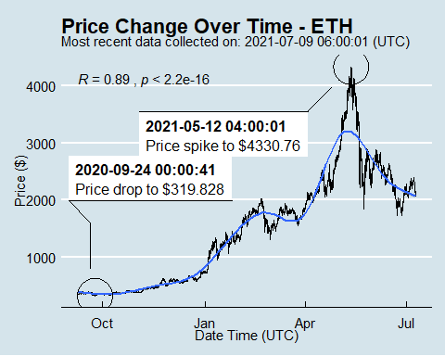
Price Chart - Ethereum

Slide 4
Python Code Example
import pandas as pd # Create the Python object from R df = r.cryptodata # Show the new Python dataframe df
## pair symbol ask_1_price date_time_utc ## 0 BTCUSD BTC 32974.920 2021-07-09 06:00:01 ## 1 ETHUSD ETH 2137.489 2021-07-09 06:00:01 ## 2 BTCUSD BTC 33020.580 2021-07-09 05:00:01 ## 3 ETHUSD ETH 2140.297 2021-07-09 05:00:01 ## 4 ETHUSD ETH 2120.626 2021-07-09 04:00:01 ## ... ... ... ... ... ## 15077 BTCUSD BTC 11906.130 2020-08-11 00:03:49 ## 15078 BTCUSD BTC 11993.880 2020-08-10 07:03:48 ## 15079 BTCUSD BTC 11972.900 2020-08-10 06:03:50 ## 15080 BTCUSD BTC 11985.890 2020-08-10 05:03:48 ## 15081 BTCUSD BTC 11997.470 2020-08-10 04:32:55 ## ## [15082 rows x 4 columns]

Slide 5
One more Python example
The code below creates a new column price_percentile that specifies if the price for the row was in the upper or lower 50th percentile of prices (BTC should be upper and ETH lower):
import numpy as np # Create a new column based on the ask_1_price value: df['price_percentile'] = np.where(df['ask_1_price'] > np.percentile(df['ask_1_price'], 50), 'upper 50th percentile of prices', 'lower 50th percentile of prices') # Show modified dataframe: df[['symbol', 'ask_1_price', 'price_percentile']]
## symbol ask_1_price price_percentile ## 0 BTC 32974.920 upper 50th percentile of prices ## 1 ETH 2137.489 lower 50th percentile of prices ## 2 BTC 33020.580 upper 50th percentile of prices ## 3 ETH 2140.297 lower 50th percentile of prices ## 4 ETH 2120.626 lower 50th percentile of prices ## ... ... ... ... ## 15077 BTC 11906.130 upper 50th percentile of prices ## 15078 BTC 11993.880 upper 50th percentile of prices ## 15079 BTC 11972.900 upper 50th percentile of prices ## 15080 BTC 11985.890 upper 50th percentile of prices ## 15081 BTC 11997.470 upper 50th percentile of prices ## ## [15082 rows x 3 columns]

