Slide 1
R Markdown Output

Slide 2
Overview
This document has code embedded throughout. In the next section we will create a visualization using the already loaded dataset eth_data:
datatable(eth_data)

Slide 3
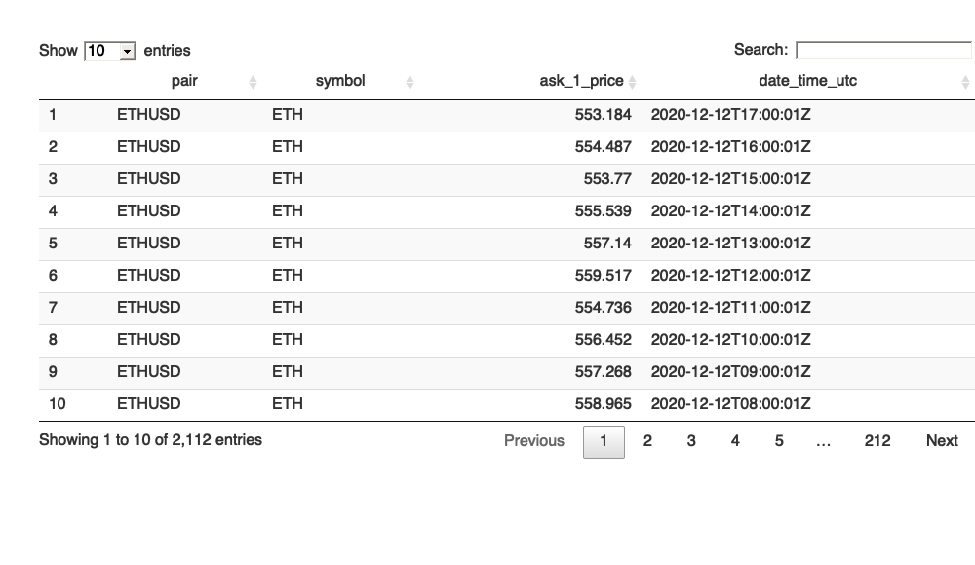

Slide 4
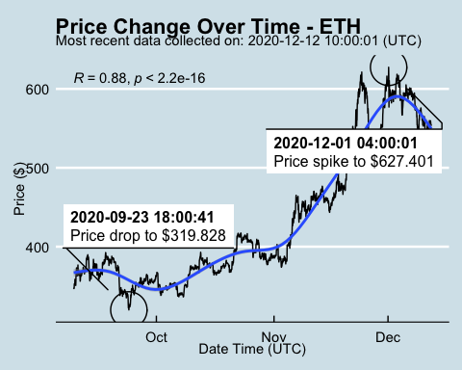
Price Chart - Ethereum

Slide 5
Python Code Example
import pandas as pd # Create the Python object from R df = r.cryptodata # Show the new Python dataframe df
## pair symbol ask_1_price date_time_utc ## 0 ETHUSD ETH 553.184 2020-12-12 17:00:01 ## 1 BTCUSD BTC 18394.400 2020-12-12 17:00:00 ## 2 BTCUSD BTC 18402.110 2020-12-12 16:00:01 ## 3 ETHUSD ETH 554.487 2020-12-12 16:00:01 ## 4 BTCUSD BTC 18371.130 2020-12-12 15:00:01 ## ... ... ... ... ... ## 5095 BTCUSD BTC 11972.900 2020-08-10 06:03:50 ## 5096 BTCUSD BTC 11985.890 2020-08-10 05:03:48 ## 5097 BTCUSD BTC 11997.470 2020-08-10 04:32:55 ## 5098 BTCUSD BTC 10686.880 NaT ## 5099 ETHUSD ETH 357.844 NaT ## ## [5100 rows x 4 columns]

Slide 6
One more Python example
The code below creates a new column price_percentile that specifies if the price for the row was in the upper or lower 50th percentile of prices (BTC should be upper and ETH lower):
import numpy as np # Create a new column based on the ask_1_price value: df['price_percentile'] = np.where(df['ask_1_price'] > np.percentile(df['ask_1_price'], 50), 'upper 50th percentile of prices', 'lower 50th percentile of prices') # Show modified dataframe: df[['symbol', 'ask_1_price', 'price_percentile']]
## symbol ask_1_price price_percentile ## 0 ETH 553.184 lower 50th percentile of prices ## 1 BTC 18394.400 upper 50th percentile of prices ## 2 BTC 18402.110 upper 50th percentile of prices ## 3 ETH 554.487 lower 50th percentile of prices ## 4 BTC 18371.130 upper 50th percentile of prices ## ... ... ... ... ## 5095 BTC 11972.900 upper 50th percentile of prices ## 5096 BTC 11985.890 upper 50th percentile of prices ## 5097 BTC 11997.470 upper 50th percentile of prices ## 5098 BTC 10686.880 upper 50th percentile of prices ## 5099 ETH 357.844 lower 50th percentile of prices ## ## [5100 rows x 3 columns]

Slide 7
Back to Gallery
include_url("https://r-markdown-gallery.org")

Slide 8
