Slide 1
R Markdown Output
Last run on: 2021-07-15 06:12:11

Slide 2
Overview
This document has code embedded throughout. In the next section we will create a visualization using the already loaded dataset eth_data:
datatable(eth_data)

Slide 3
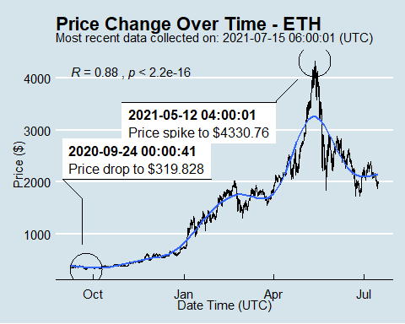
Price Chart - Ethereum

Slide 4
Python Code Example
import pandas as pd # Create the Python object from R df = r.cryptodata # Show the new Python dataframe df
## pair symbol ask_1_price date_time_utc ## 0 ETHUSD ETH 1964.267 2021-07-15 06:00:01 ## 1 BTCUSD BTC 32583.050 2021-07-15 06:00:00 ## 2 BTCUSD BTC 32673.000 2021-07-15 05:00:01 ## 3 ETHUSD ETH 1973.606 2021-07-15 05:00:01 ## 4 BTCUSD BTC 32651.650 2021-07-15 04:00:01 ## ... ... ... ... ... ## 15220 BTCUSD BTC 11921.180 2020-08-16 04:03:55 ## 15221 BTCUSD BTC 11877.910 2020-08-16 03:03:52 ## 15222 BTCUSD BTC 11875.600 2020-08-16 02:04:00 ## 15223 BTCUSD BTC 11822.170 2020-08-16 01:04:00 ## 15224 BTCUSD BTC 11860.060 2020-08-16 00:03:57 ## ## [15225 rows x 4 columns]

Slide 5
One more Python example
The code below creates a new column price_percentile that specifies if the price for the row was in the upper or lower 50th percentile of prices (BTC should be upper and ETH lower):
import numpy as np # Create a new column based on the ask_1_price value: df['price_percentile'] = np.where(df['ask_1_price'] > np.percentile(df['ask_1_price'], 50), 'upper 50th percentile of prices', 'lower 50th percentile of prices') # Show modified dataframe: df[['symbol', 'ask_1_price', 'price_percentile']]
## symbol ask_1_price price_percentile ## 0 ETH 1964.267 lower 50th percentile of prices ## 1 BTC 32583.050 upper 50th percentile of prices ## 2 BTC 32673.000 upper 50th percentile of prices ## 3 ETH 1973.606 lower 50th percentile of prices ## 4 BTC 32651.650 upper 50th percentile of prices ## ... ... ... ... ## 15220 BTC 11921.180 upper 50th percentile of prices ## 15221 BTC 11877.910 upper 50th percentile of prices ## 15222 BTC 11875.600 upper 50th percentile of prices ## 15223 BTC 11822.170 upper 50th percentile of prices ## 15224 BTC 11860.060 upper 50th percentile of prices ## ## [15225 rows x 3 columns]

