Slide 1
Example Presentation

Slide 2
Overview
This document has code embedded throughout. In the next section we will create a visualization using the already loaded dataset cryptodata:
library(DT) datatable(eth_data, rownames = FALSE)

Slide 3
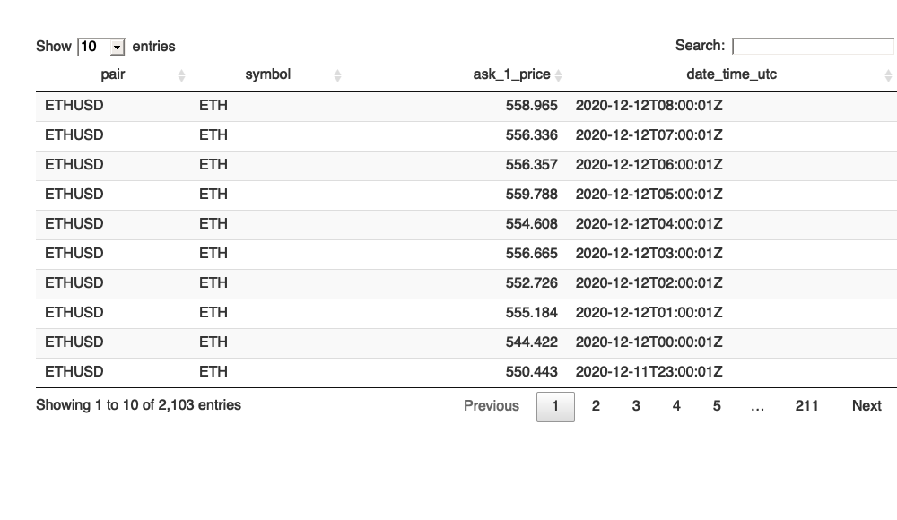

Slide 4
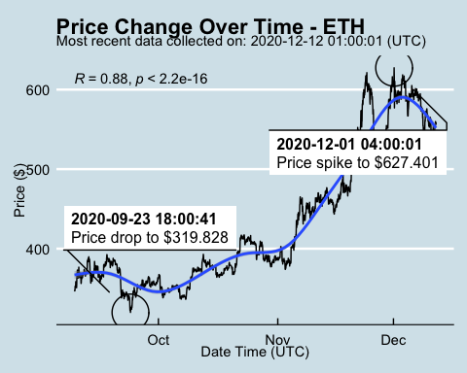
Price Chart

Slide 5
Python Code Example
import pandas as pd # Create the Python object from R df = r.cryptodata # Show the new Python dataframe df
## pair symbol ask_1_price date_time_utc ## 0 BTCUSD BTC 18037.560 2020-12-12 00:00:00 ## 1 ETHUSD ETH 544.422 2020-12-12 00:00:01 ## 2 BTCUSD BTC 18338.710 2020-12-12 01:00:00 ## 3 ETHUSD ETH 555.184 2020-12-12 01:00:01 ## 4 BTCUSD BTC 18283.790 2020-12-12 02:00:00 ## ... ... ... ... ... ## 5077 BTCUSD BTC 11847.080 2020-08-10 21:03:49 ## 5078 BTCUSD BTC 11819.920 2020-08-10 22:03:49 ## 5079 BTCUSD BTC 11804.900 2020-08-10 23:03:54 ## 5080 BTCUSD BTC 10686.880 NaT ## 5081 ETHUSD ETH 357.844 NaT ## ## [5082 rows x 4 columns]

Slide 6
One more Python example
Press on w on your keyboard to make the presentation wider. Press f to fullscreen.
import numpy as np # Create a new field based on the ask_1_price value: df['price_percentile'] = np.where(df['ask_1_price'] > np.percentile(df['ask_1_price'], 50), 'upper 50th percentile of prices', 'lower 50th percentile of prices') # Show modified dataframe: df[['symbol', 'ask_1_price', 'price_percentile']]
## symbol ask_1_price price_percentile ## 0 BTC 18037.560 upper 50th percentile of prices ## 1 ETH 544.422 lower 50th percentile of prices ## 2 BTC 18338.710 upper 50th percentile of prices ## 3 ETH 555.184 lower 50th percentile of prices ## 4 BTC 18283.790 upper 50th percentile of prices ## ... ... ... ... ## 5077 BTC 11847.080 upper 50th percentile of prices ## 5078 BTC 11819.920 upper 50th percentile of prices ## 5079 BTC 11804.900 upper 50th percentile of prices ## 5080 BTC 10686.880 upper 50th percentile of prices ## 5081 ETH 357.844 lower 50th percentile of prices ## ## [5082 rows x 3 columns]

Slide 7
Back to Gallery
knitr::include_url("https://r-markdown-gallery.org")

Slide 8
