Slide 1
Digital Naturalization for the Elderly with Linux
Brian Whetten, Founder of The Riesling Computer Company

Slide 2
(Alt. Title) GNU for Grandma
Brian Whetten, Founder of The Riesling Computer Company

Slide 3
Thank you to Linux Fest Northwest

Slide 4
Thank you to the Document Foundation for Libre Office
(Love you guys)

Slide 5
Please reserve your questions until the end. I’ve made sure that we have enough time.
Please make sure it’s a question (on topic to the presentation) and also not a comment.
I’m here for the rest of the conference and in Bellingham tomorrow, please come find me if you’d like to have a discussion outside this session.
Please silence your cell phones.

Slide 6
Not just for the Cloud and Servers
But for the Elderly too. Let’s use it to blur generational lines.

Slide 7

Why use a computer?

Slide 8
Why don’t they?
Demographics

Slide 9
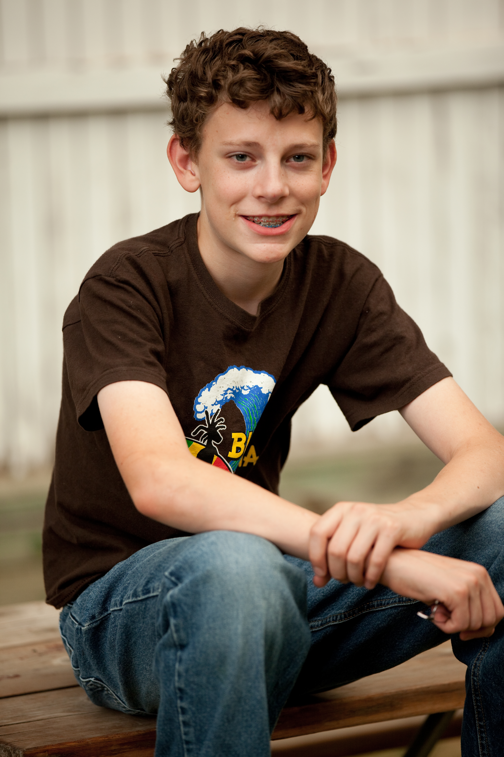
Young Brian

Slide 10
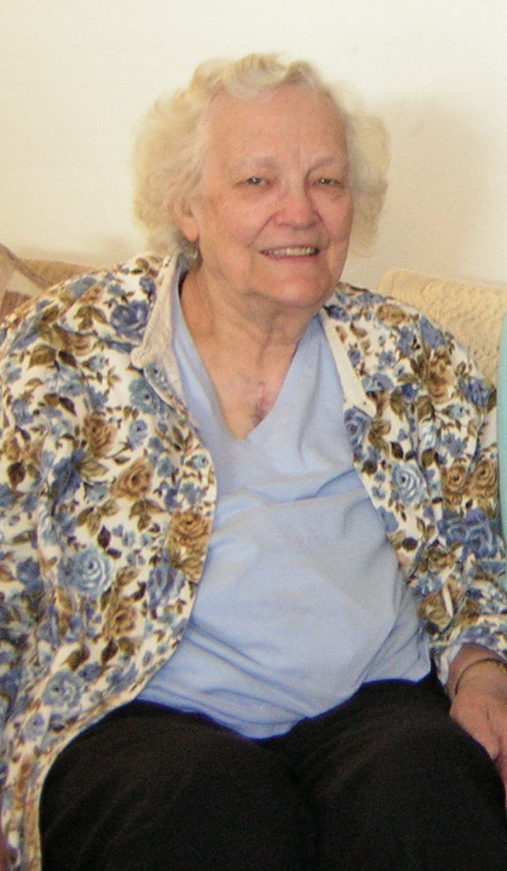
Grandma Jones and Geneology

Slide 11
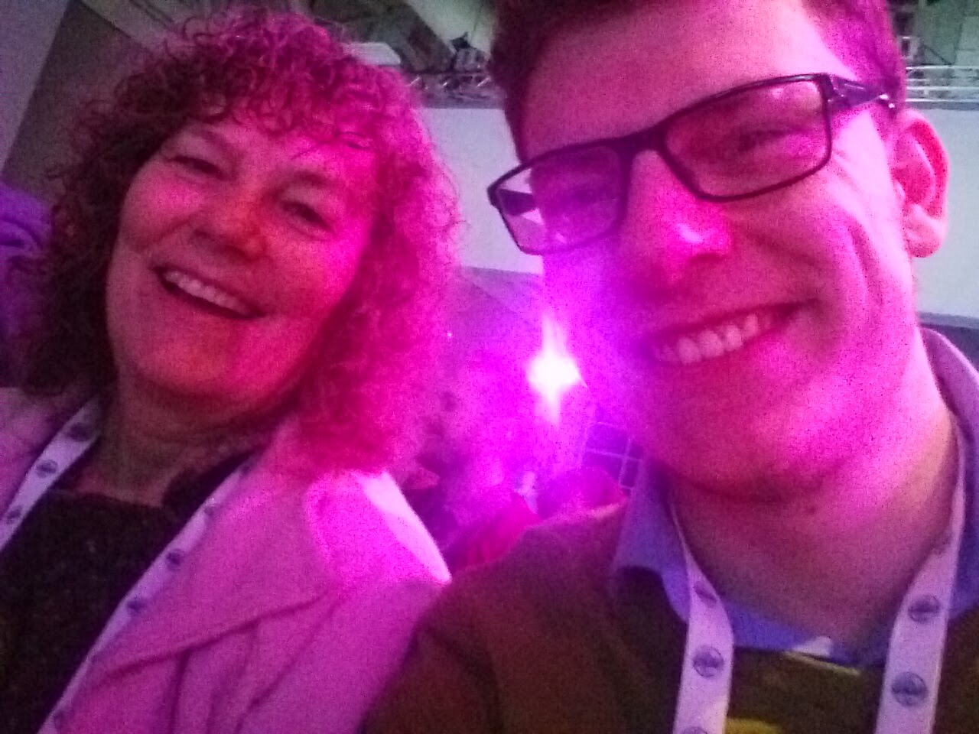
My True Inspiration

Slide 12
Terminology
Digital Natives
Digital Immigrants (Naturalization)

Slide 13
Riesling Computer Company
Enabling Autonomy through GNU/Linux

Slide 14
Get better with age.

Slide 15
Why GNU/Linux specifically?
It’s my home.
I know how to fix it.
I believe strongly in it.

Slide 16
Aligned consumer values
Many people (not just the Elderly) appreciate stable products that can be repaired or modified by the consumer.

Slide 17

How on earth will I ever have a better campaign than this?

Slide 18

DRM and the proprietary

Slide 19
Money
The root of all things evil
-or-
American

Slide 20
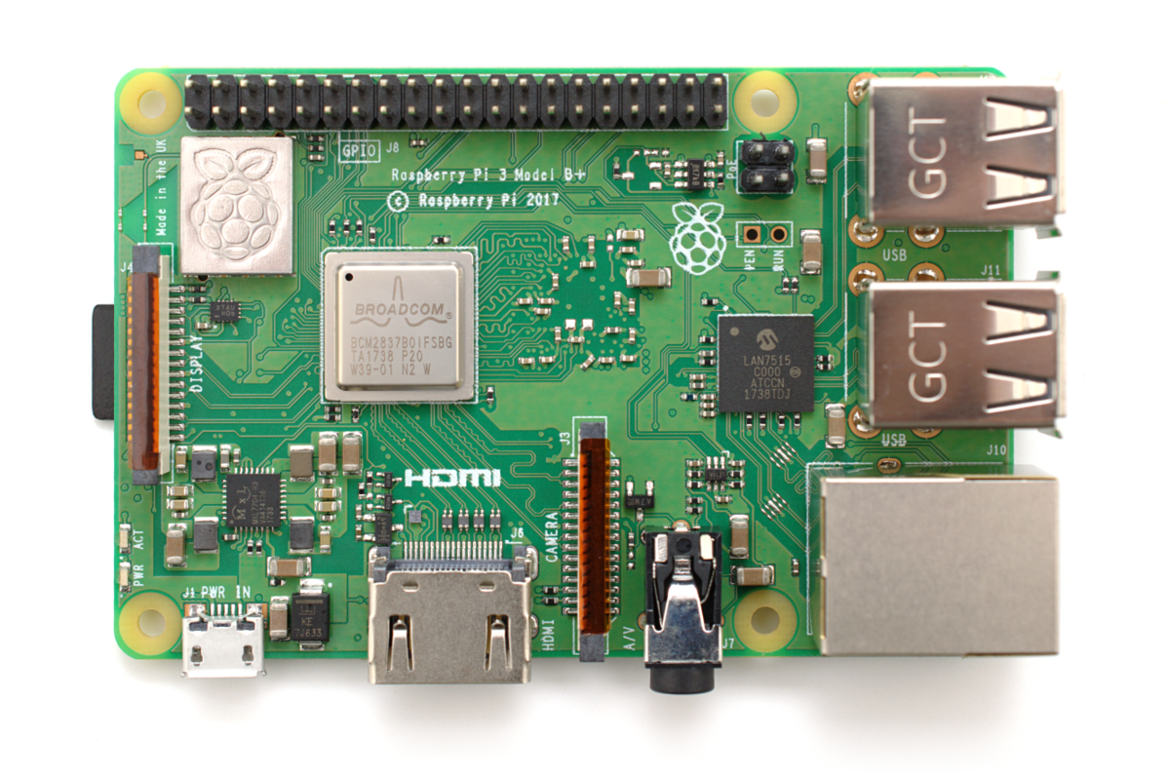
Lower cost hardware
By Gareth Halfacree from Bradford, UK - Raspberry Pi 3 B+, CC BY-SA 2.0, https://commons.wikimedia.org/w/index.php?curid=67384207

Slide 21
Data Security and Privacy
Self-aware PEBKAC and ID10 errors

Slide 22
Resistance to change
It creates beautiful things:
Like XFCE, LXDE, Cinnamon, and Mate.

Slide 23
Let’s talk about our make file:
How can we bring someone up to speed on all of computing in a reasonable amount of time?

Slide 24
I declare a flame war (select a distro)!
Can you fix when it breaks?
Are there regular security updates?
Will the interface change with an update?

Slide 25
Flavors to go for:
OpenSUSE Leap, Fedora/CentOS, Debian Stable/Ubuntu LTS.

Slide 26
Things I (personally) would avoid:
OpenSUSE tumbleweed, Arch/Antergos/Manjaro, Gentoo, type distros (remember this is for Grandma/Grandpa)

Slide 27
Choose what will work for you
I am not you. You get to decide, but I hope you draw from my mistakes.

Slide 28
Teaching Methods
Tried and tested in the field.
(written in Python and Bash if you prefer that over prose)

Slide 29
Center around self sufficiency
When are we going to be able to hand over the reigns completely?
root@localhost:~$ adduser grandpa sudo
foo@localhost:~$ echo remember autonomy

Slide 30
Never take away the mouse
Unless you’re fixing a setting
Or something in the command line
Give them a chance to learn and memorize
def support(onsite, broken):
if broken==False:
print("Never take away the mouse or keyboard.")
elif broken==True:
print("Fix it in the command line quickly.")
else:
print("You shouldn’t end up here, but it’s correct syntax.")

Slide 31
Repeat, repeat, repeat
How do you effectively learn a language?
from tech import technique
knowledge=False
def try():
technique
while knowledge==False:
try

Slide 32
Encourage Note Taking
Make sure they have resources they understand, and help retention.
foo@localhost:~$ git init notes

Slide 33
Spend as little time talking as possible
Most of the learning comes in doing, not listening.
talking=False
listening=True
question=False
if question==True:
talking=True
else:
talking=False
listening=True

Slide 34
Patience, young grasshopper
Make sure that you have time to spend with who you’re supporting when you make it there.
import time
teaching=True
while teaching==True:
time.sleep(1)
#i would love a better code analogy

Slide 35
Apples to Penguins
Clarity. Pass it on.
#checking to see if the python analogies got at least a chuckle
audience_laughing = False
brian_happy = False
if audience_laughing == True:
brian_happy = True
elif audience_laughing == False:
brian_happy = True
#can’t get me down
else:
assert brian_happy
print(“How did we get here?”)

Slide 36

Ye Olde Technologies

Slide 37
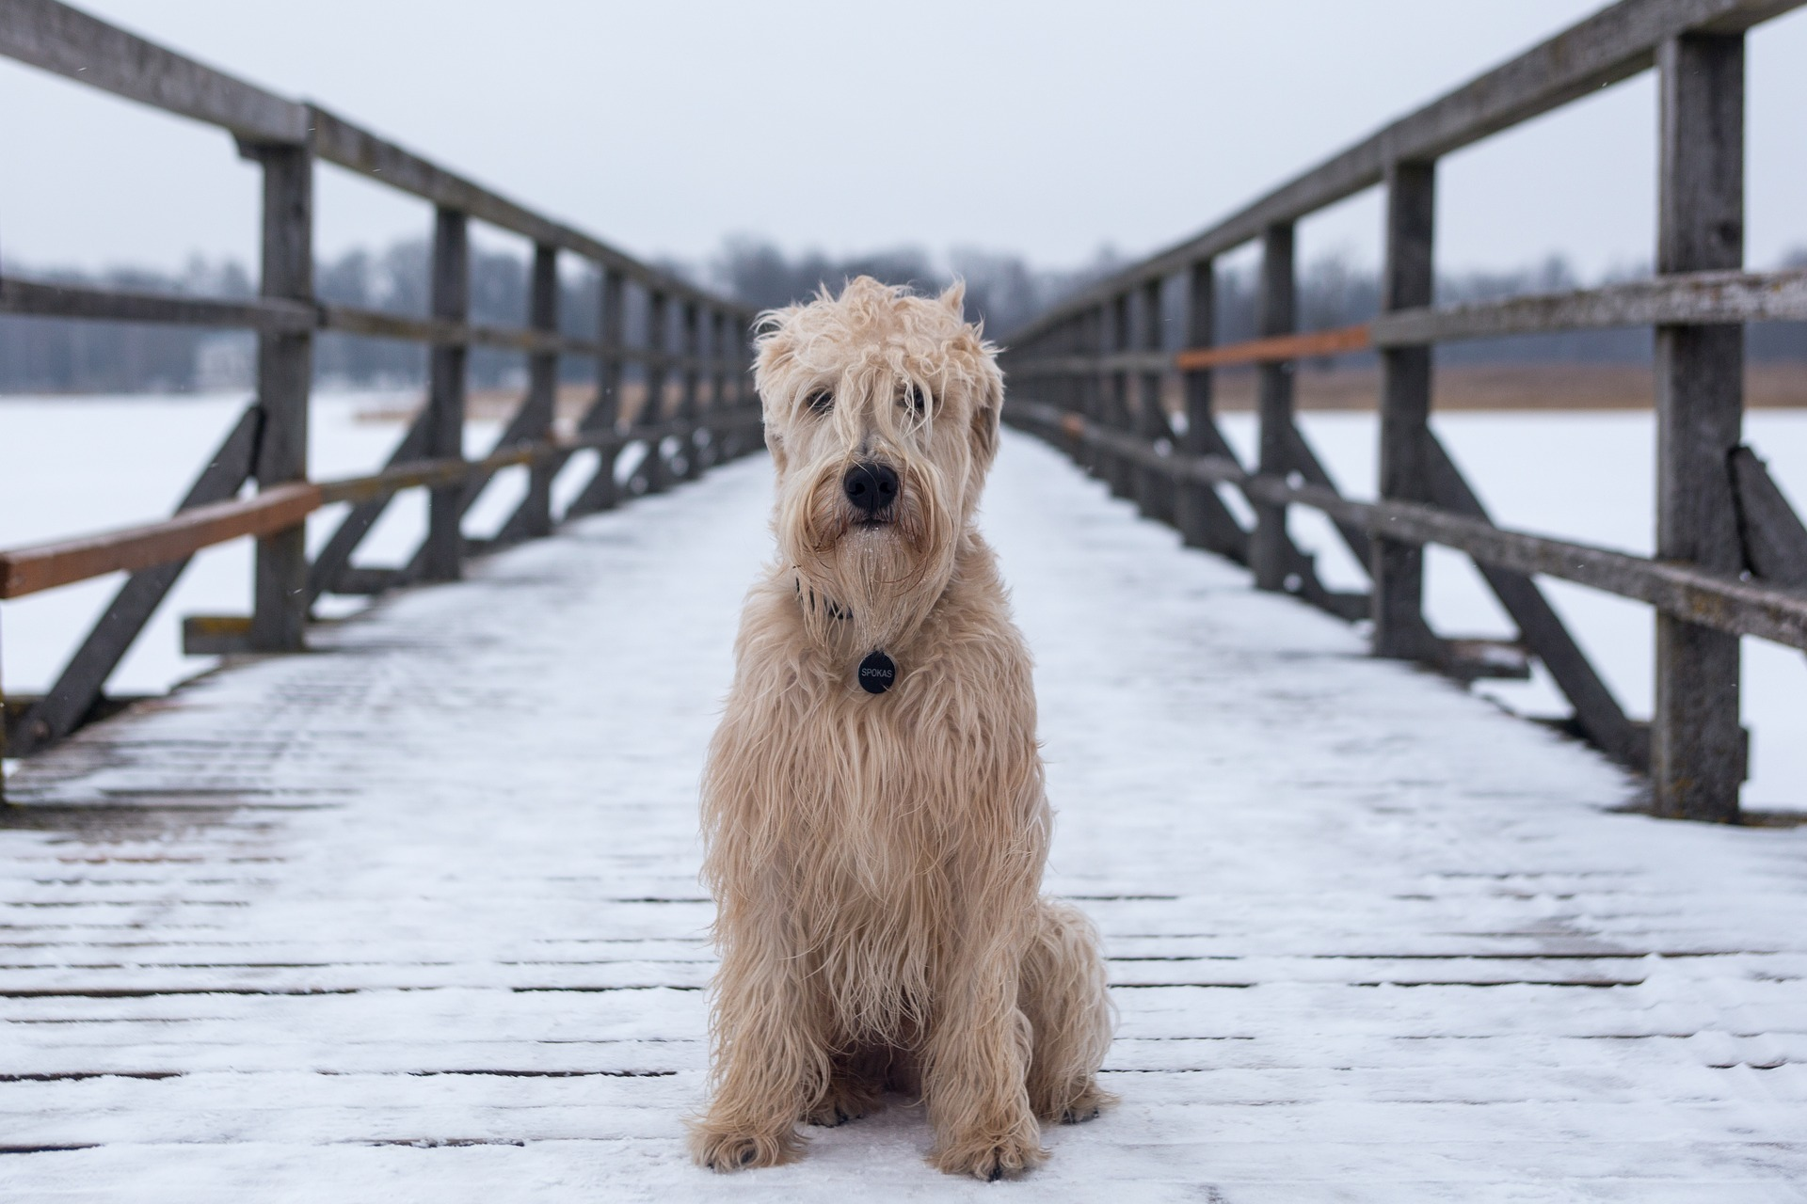
How do we fight Abandonment?
Favorite Pixabay image for “alone”

Slide 38
http://gameaccessabilityguidelines.com
Mouse drivers to help with tremors
Gnome/plasma/whatever else themes
Bigger fonts
Source Sans Pro

Slide 39
Big Picture Goals for the company
How cool will the technology of the future be?
Source Sans Pro
You bet yourself I want to be there.

Slide 40
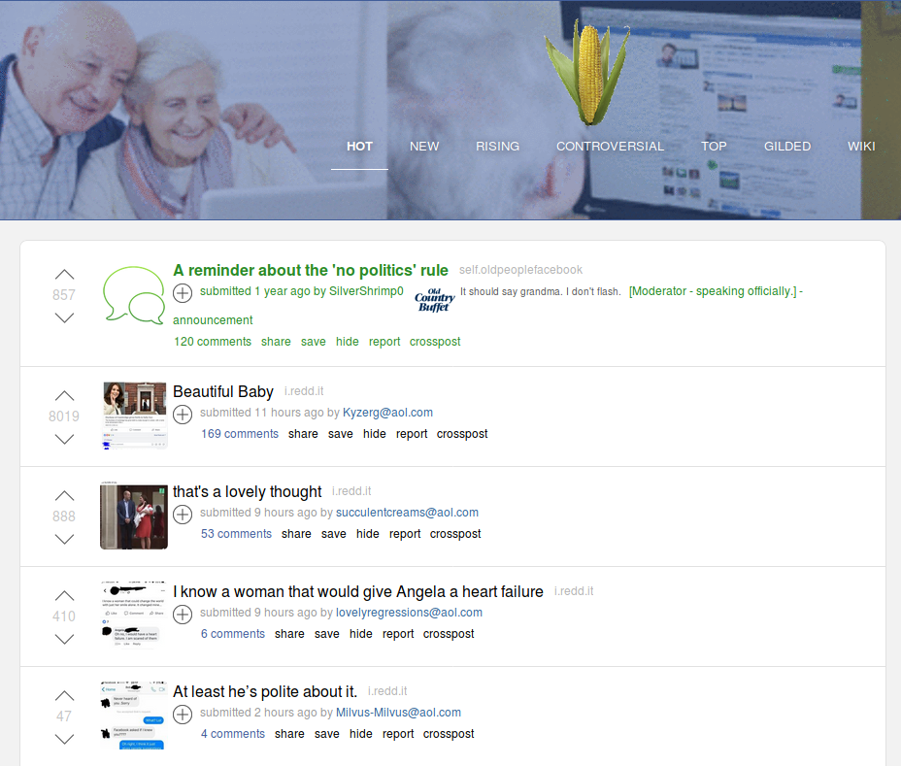
r/OldPeopleFacebook

Slide 41
In Summation
“With great knowledge comes great responsibility to share it.”

