Slide 1
Go Programming
London, 10-13 July 2019

Slide 2
About the Trainer
Radu Ioan Fericean
radu@fericean.ro
https://github.com/rif
Used a lot of programming languages, early Go adopter
https://github.com/cgrates

Slide 3
Housekeeping
9:30 First session
10:45 Break
11:00 Second session
12:45 Break
13:30 Third session
15:15 Break
15:30 Fourth session
17:00 End of the day

Slide 4

Environment
Compiler + tools
Editor/IDE
Source code
Binaries
Analysis and compression
Deploy and System services

Slide 5
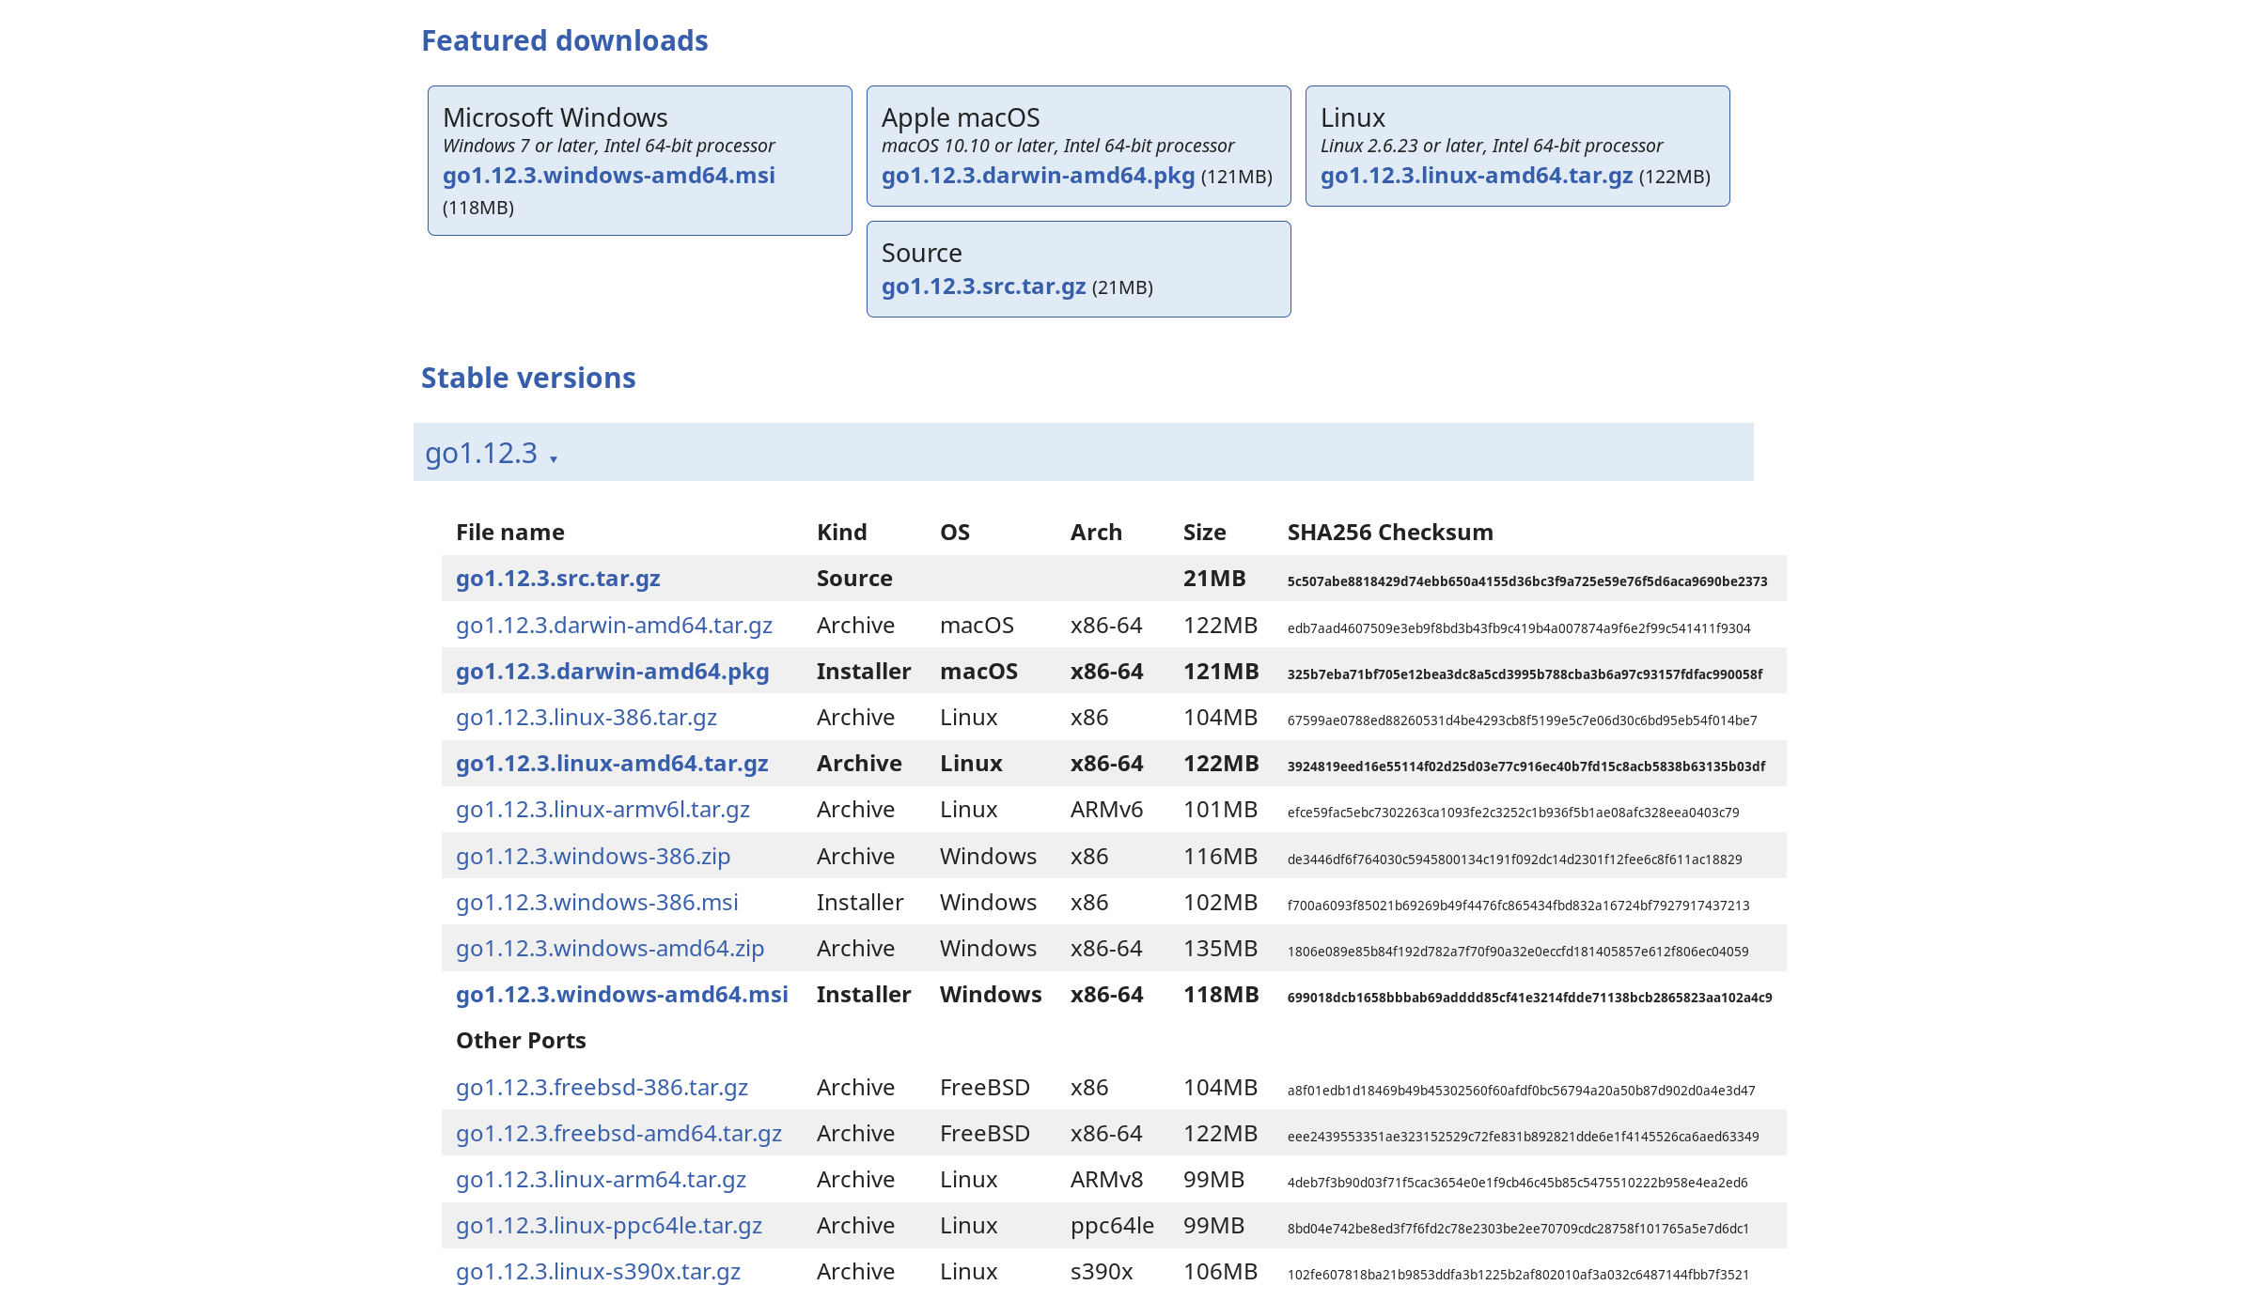
Compiler + tools
System packages
Snaps
https://golang.org/dl/
docker

Slide 6
Official tools
go get/build/install/run/test
gofmt -s -w / goimports
go vet
go doc / godoc
go tool pprof
golang.org/x/tools/… (goimports, guru)
https://github.com/golang/go/wiki/gopls

Slide 7
Third party tools
github.com/stamblerre/gocode (nsf/gocode)
github.com/rogpeppe/godef
github.com/derekparker/delve
github.com/goreleaser/goreleaser
https://github.com/avelino/awesome-go

Slide 8
Pacakges and documentation
https://godoc.org/
https://go-search.org
https://www.alexedwards.net/blog/an-overview-of-go-tooling

Slide 9
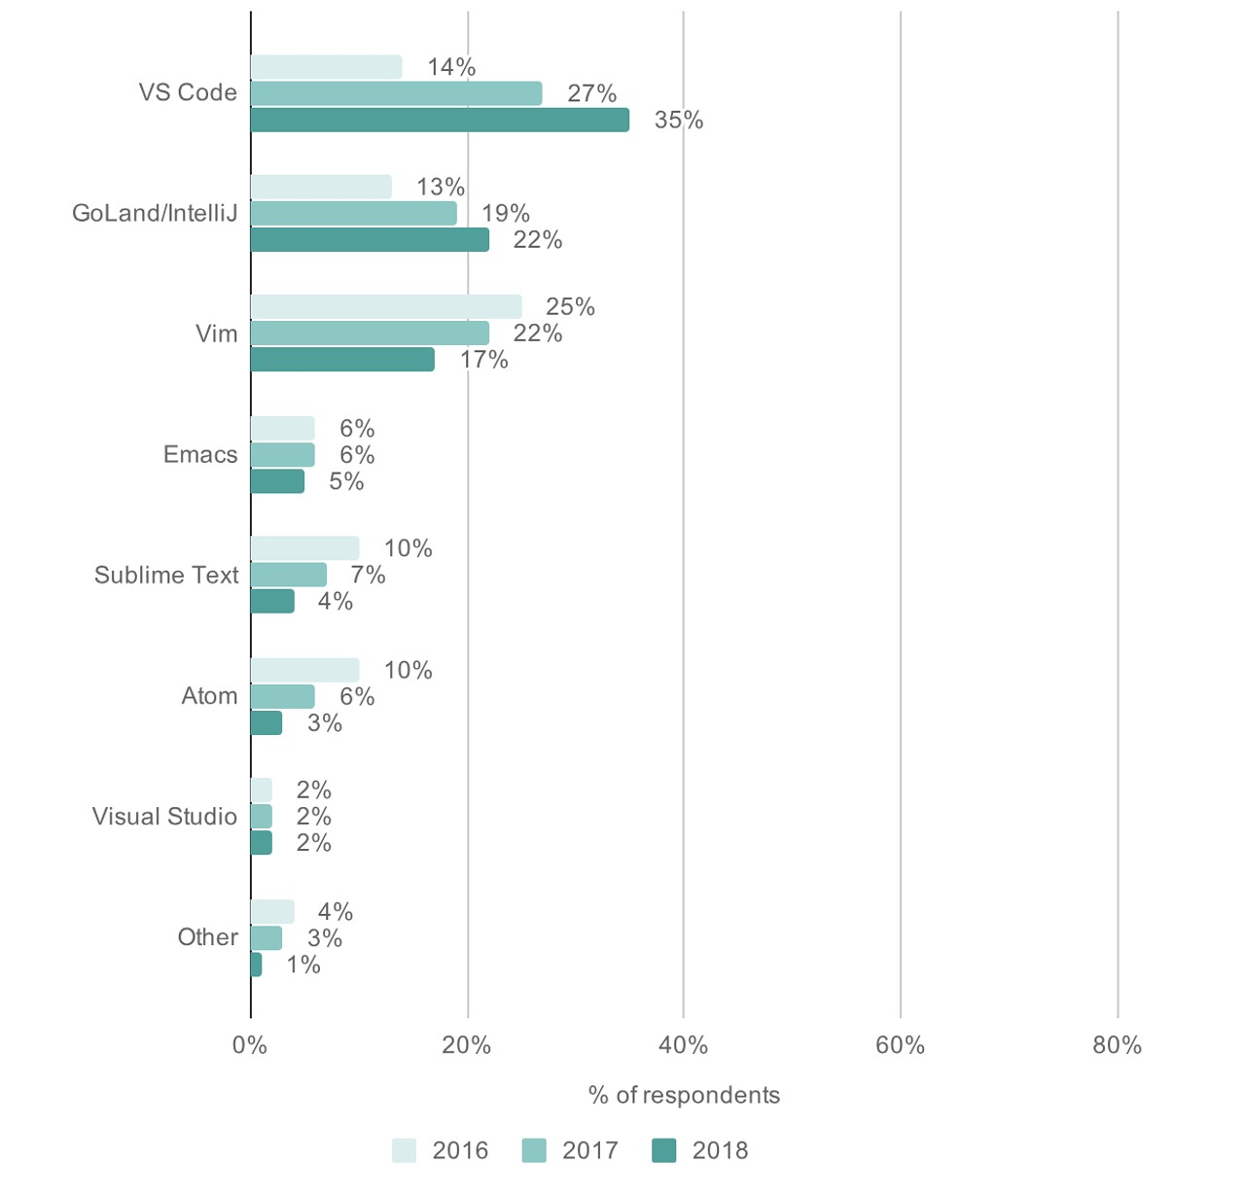
Editor/IDE

Slide 10
https://code.visualstudio.com/docs/languages/go

Slide 11
VSCodium
https://github.com/VSCodium/vscodium
https://code.visualstudio.com/docs/languages/go

Slide 12
Hello World
https://golang.org/doc/
https://tour.golang.org
https://golang.org/doc/code.html
https://golang.org/doc/effective_go.html
https://golang.org/pkg/
https://golang.org/doc/faq
https://play.golang.org/
https://gobyexample.com/

Slide 13
Go Syntax: Packages
By convention, the package name is the same as the last element of the import path.
Import by full path (not relative)
Exported names start with a capital letter
import (
"fmt"
"github.com/rs/zerolog"
)

Slide 14
Go Syntax: Functions
func add(x, y int) int {}
Multiple results
Named returns provide naked return
First-class value that can be allocated and passed around like any other (can even be a type)
Main does not return anything, use os.Exit
Use … for variadic functions

Slide 15
Go Syntax: Variables
Use var or := shorthand
Inferred types
Go is statically/strongly typed whereas python is dynamically/strongly typed and js is dynamically/weakly typed
Multiple initializations c, python, java := true, false, "no!"
Type conversions float64(i)

Slide 16
Go Syntax: Loops
Just for
No parenthesis
Emulate while with for sum < 100 {…
Run Infinite for {}
Spoiler:
  for i,v := range for slices and maps

Slide 17

C's while is spelled for in Go

Slide 18
Go Syntax: if
Does not require parentheses ( ) but braces { } are required (yes, even for a single statement)
If with a short statement
  if v := math.Pow(x, n); v < lim {…
Very useful for err and ok checks

Slide 19
Go Syntax: switch
No break necessary
Value can be string or other types
Simple initialization like if: switch os := runtime.GOOS; os {
Evaluate cases from top to bottom, stopping when a case succeeds.
Switch without a condition is the same as switch true useful instead long if-then-else chains
Cases can be presented in comma-separated lists
  case ' ', '?', '&', '=', '#', '+', '%':

Slide 20
Go Syntax: defer
A defer statement defers the execution of a function until the surrounding function returns.
The deferred call's arguments are evaluated immediately, but the function call is not executed until the surrounding function returns.
Deferred function calls are pushed onto a stack. When a function returns, its deferred calls are executed in last-in-first-out order.

Slide 21
Go Syntax: pointers
Like C we use * and &
Zero value is nil (not null)
Unlike C, Go has no pointer arithmetic
Important for types usage
I use pointers in 99% of cases
Unlike in C, it's perfectly OK to return the address of a local variable

Slide 22
Go Syntax: structs
Go does not have class keyword
A struct is a collection of fields
Struct fields are accessed using a dot
Struct pointers can be created with new or &
Always use name for fields in struct literals
Struct size is the collection of field sizes

Slide 23
Go Syntax: arrays
var a [10]int declares a variable a as an array of ten integers
Cannot be resized
Almost never used as there are slices that provide a convenient way of working with arrays.
Slice is a reference to an array and it’s zero value is nil
a := [...]{1, 2, 3}

Slide 24
Go Syntax: slices
A slice is a dynamically-sized, flexible view into the elements of an array
A slice does not store any data, it just describes a section of an underlying array
a := []int{2, 3, 5, 7, 11, 13} creates the array and the slices that references it
var a [10]int these slice expressions are equivalent: a[0:10], a[:10], a[0:], a[:]

Slide 25
Slice length and capacity
The length of a slice is the number of elements it contains.
The capacity of a slice is the number of elements in the underlying array, counting from the first element in the slice.
s := make([]int, size, cap)

Slide 26
Creating empty slices
built-in make function;
a := make([]int, 5) // len(a)=5
b := make([]int, 0, 5) // len(b)=0, cap(b)=5
b = b[:cap(b)] // len(b)=5, cap(b)=5
b = b[1:] // len(b)=4, cap(b)=4

Slide 27
More on slices
Use append/copy to add/copy elements to a slice
Use range to iterate the elements of a slice
When ranging over a slice, two values are returned for each iteration. The first is the index, and the second is a copy of the element at that index.
You can skip the index or value by assigning to _.
If you only want the index, you can omit the second variable.
https://github.com/golang/go/wiki/SliceTricks

Slide 28
Go Syntax: maps
A map maps keys to values.
The zero value of a map is nil. A nil map has no keys, nor can keys be added.
The make function returns a map of the given type, initialized and ready for use.
Map literals are like struct literals, but the keys are required.
If the top-level type is just a type name, you can omit it from the elements of the literal.

Slide 29
Using maps
Iterate the elements using range
delete(m, key) // safe even if key is not present
elem, ok = m[key]
If key is not in the map, then elem is the zero value for the map's element type

Slide 30
Go Syntax: methods
You can define methods on types
A method is just a function with a receiver argument (like python)
You can declare methods with pointer receivers
Pointer receivers are more common than value receivers
In general, all methods on a given type should have either value or pointer receivers, but not a mixture of both

Slide 31
Go Syntax: interfaces
An interface type is defined as a set of method signatures
An interface type is defined as a set of method signatures.
A type implements an interface by implementing its methods. There is no explicit declaration of intent, no "implements" keyword
An empty interface may hold values of any type

Slide 32
Go Syntax: type assertions
A type assertion provides access to an interface value's underlying concrete value
t := i.(T) or t, ok := i.(T)
Note the similarity between this syntax and that of reading from a map
A type switch is a construct that permits several type assertions in series

Slide 33
Go Syntax: errors
The error type is a built-in interface
Functions often return an error value, and calling code should handle errors by testing whether the error equals nil

Slide 34
Go Syntax: goroutines
A goroutine is a lightweight thread managed by the Go runtime
go f(x, y, z) starts a new goroutine running function f
The evaluation of f, x, y, and z happens in the current goroutine and the execution of f happens in the new goroutine
Goroutines run in the same address space, so access to shared memory must be synchronized

Slide 35
Go Syntax: channels
Channels are a typed conduit through which you can send and receive values with the channel operator, ←
(The data flows in the direction of the arrow.)
Like maps and slices, channels must be created before use: ch := make(chan int)
ch <- v // Send v to channel ch.
v := <-ch // Receive from ch, and
// assign value to v.

Slide 36
Buffered Channels
Channels can be buffered. Provide the buffer length as the second argument to make to initialize a buffered channel:
ch := make(chan int, 100)
Sends to a buffered channel block only when the buffer is full. Receives block when the buffer is empty

Slide 37
Channels range and close
A sender can close a channel to indicate that no more values will be sent. Receivers can test whether a channel has been closed by assigning a second parameter to the receive expression: v, ok := <-ch
ok is false if there are no more values to receive and the channel is closed.
The loop for i := range c receives values from the channel repeatedly until it is closed.
Note: Only the sender should close a channel, never the receiver. Sending on a closed channel will cause a panic.
Another note: Channels aren't like files; you don't usually need to close them. Closing is only necessary when the receiver must be told there are no more values coming, such as to terminate a range loop.

Slide 38
Channels select
The select statement lets a goroutine wait on multiple communication operations
A select blocks until one of its cases can run, then it executes that case. It chooses one at random if multiple are ready.
The default case in a select is run if no other case is ready
Use a default case to try a send or receive without blocking

Slide 39
Handling timeouts
select {
case res := <-c1:
fmt.Println(res)
case <-time.After(1 * time.Second):
fmt.Println("timeout")
}

Slide 40
Go Syntax: sync.Mutex
Go's standard library provides mutual exclusion with sync.Mutex and its two methods:
  Lock
  Unlock

Slide 41
Modules
GOPATH vs modules
https://blog.golang.org/using-go-modules
https://youtu.be/H_4eRD8aegk
https://youtu.be/aeF3l-zmPsY
https://github.com/rogpeppe/gohack

Slide 42
CLI arguments
Use flag package instead of os.Args
var ip = flag.Int("flagname", 1234, "help message for flagname")
flag.Parse()
flag.Narg(), flag.Arg(i), flag.Args()
os.Args is find too but without flags support

Slide 43
Garbage collector
https://blog.twitch.tv/go-memory-ballast-how-i-learnt-to-stop-worrying-and-love-the-heap-26c2462549a2
https://blog.learngoprogramming.com/a-visual-guide-to-golang-memory-allocator-from-ground-up-e132258453ed

Slide 44
Tips to help GC
Don’t produce garbage
https://blog.golang.org/profiling-go-programs (2011)
Use sync.Pool (improvements coming)
https://github.com/allegro/bigcache
https://github.com/coocood/freecache
https://blog.dgraph.io/post/caching-in-go/

Slide 45
Reading and writing files
os.Open → os.File
ioutil.ReadFile: read entire file at once
bufio.Reader: buffered reader efficient and many features
bufio.Scanner: parses bytes, runes, words, lines
compress.* → wrappers to read/write compressed files
encoding.* → wrappers for different formats: cvs, xml, binary, gob, base64, etc.

Slide 46
HTTP Server
package main
import (
"fmt"
"net/http"
)
func main() {
http.HandleFunc("/", func (w http.ResponseWriter, r *http.Request) {
fmt.Fprintf(w, "Welcome to my website!")
})
fs := http.FileServer(http.Dir("static/"))
http.Handle("/static/", http.StripPrefix("/static/", fs))
log.Fatal(http.ListenAndServe(":8080", nil))
}

Slide 47
HTTP Client
resp, err := http.Get("http://example.com/")
resp, err := http.Post("http://example.com/upload", "image/jpeg", &buf)
resp, err := http.PostForm("http://example.com/form",
url.Values{"key": {"Value"}, "id": {"123"}})
var netClient = &http.Client{Timeout: time.Second * 10}
response, _ := netClient.Get(url)

