Slide 1
● CSE440 — INTELLIGENT SYSTEMS ●
Autonomous Self-Driving Car
with Deep Q-Learning (DQN)
A Pygame-based 2D racing simulation where a Deep Q-Network agent learns
to navigate racetracks, avoid obstacles, and complete laps from scratch.
Rifa
Abir
Istiaque
Miel
Python 3.13
PyTorch
Pygame 2.6
Double DQN
NumPy
Course Project | Brac University | 2026

Slide 2
PROBLEM STATEMENT
What Problem Are We Solving?
🎯 Autonomous Navigation
🚧 Obstacle Avoidance
🧠 Learning from Reward
How can a vehicle learn to navigate an unknown track without any hardcoded rules or human input?
How can the car detect & respond to both static track walls and dynamic moving traffic vehicles?
Can a neural network learn an optimal driving policy using only numerical reward signals?
Our Approach:
Apply Deep Q-Network (DQN) Reinforcement Learning — the same algorithm that mastered Atari games — to train a car agent that drives itself around a racetrack with zero human-provided rules.

Slide 3
SYSTEM ARCHITECTURE
How the System Works
🎮 Game Engine
🧠 DQN Agent
⚙️ Config & Utils
🖥️ Modes
game/
ai/
main.py
→ 2D Physics & Kinematics
→ MLP Q-Network (6→64→64→4)
→ Central config.py
→ Pygame Interactive GUI
→ Track Generation (3 Levels)
→ Experience Replay Buffer
→ Reward shaping
→ Headless Training Loop
→ Raycasting Sensors
→ Double-DQN Loss
→ Training hyperparams
→ Evaluation / Testing
→ Pygame Rendering & HUD
→ ε-Greedy Exploration
→ Metric logging & plots
→ Live In-Game Training
→ Traffic Cars & Collision
→ Target Network Sync
→ Reproducible seeding
→ Manual Player Drive
main.py gui
→ Interactive Pygame window
main.py train
→ Headless training
main.py evaluate
→ Run pretrained model
main.py describe
→ Print config JSON

Slide 4
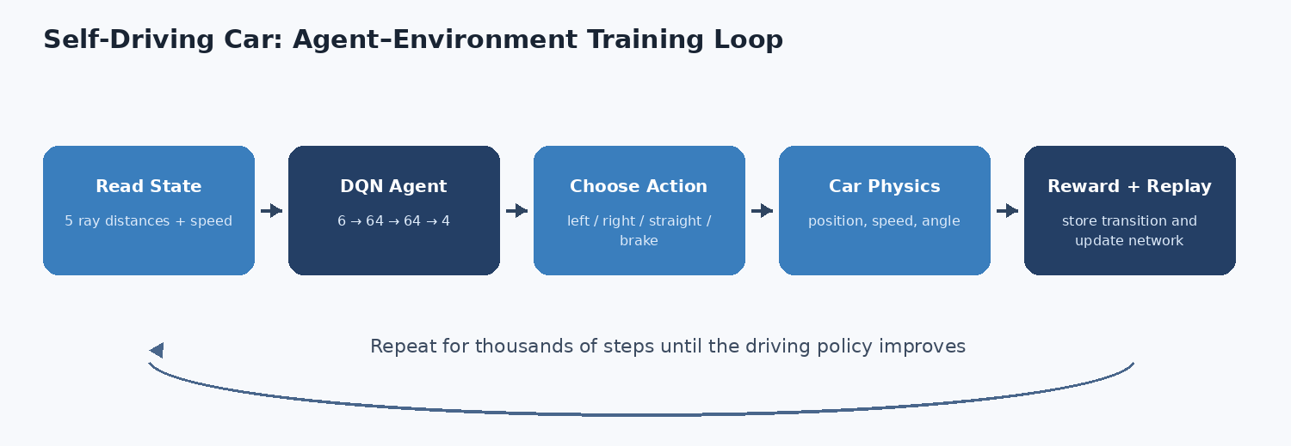
SYSTEM ARCHITECTURE
Agent-Environment Training Loop
Read State
DQN Agent
Choose Action
Car Physics
Reward + Replay
5 ray distances + speed
Q-Network 6 -> 64 -> 64 -> 4
left / right / straight / brake
position, speed, angle
store transition & update net
Repeat for thousands of steps until the driving policy converges

Slide 5
PERCEPTION SYSTEM
Sensors & State Representation
🔦 Raycasting Lidar — 5 Sensors
📐 State Vector: 6 Dimensions
Five rays cast from the car's front bumper at fixed angles.
Each returns a normalized distance to the nearest wall or traffic car.
state = [
d_-90°, # left wall distance ∈ [0, 1]
−90°
Left side sensor
d_-45°, # front-left dist ∈ [0, 1]
−45°
Front-left diagonal
d_0°, # forward dist ∈ [0, 1]
0°
Forward sensor (main)
d_+45°, # front-right dist ∈ [0, 1]
d_+90°, # right wall dist ∈ [0, 1]
+45°
Front-right diagonal
v/v_max # normalized speed ∈ [0, 1]
+90°
Right side sensor
]
speed
Normalized car speed v / v_max
⚡ Sensors also detect moving traffic cars (proximity < 23px triggers hit)

Slide 6
RL ALGORITHM
Deep Q-Network (Double DQN)
Input
6
Hidden
64 (ReLU)
Hidden
64 (ReLU)
Output
4 Actions
💾 Hyperparameters
→
→
→
Learning Rate
1 × 10⁻³
Discount γ
0.99
Batch Size
64
Replay Buffer
50,000
⚡ Double-DQN Update Rule
Target Sync
Every 600 steps
Gradient Clip
10.0
a* = argmax_a Q_policy(s', a)
ε Start → End
1.0 → 0.05
y = r + γ · Q_target(s', a*)
ε Decay Steps
45,000
𝓛 = ( Q_policy(s, a) − y )²
Hidden Size
64 neurons
Optimizer
Adam
🎲 ε-Greedy: 1.0 (ep 0) → 0.50 (ep ~150) → 0.05 (ep ~350+)

Slide 7
AGENT DESIGN
Actions & Reward Function
🕹️ Action Space — 4 Discrete Actions
🏆 Reward Function
A[0]
A[1]
Event
Reward
⬅ Turn Left
➡ Turn Right
🟢 Forward driving (per speed ratio)
+1.0 / step
A[2]
A[3]
🏁 Checkpoint progress
+20.0
⬆ Straight
🛑 Brake
🎉 Full lap completed
+100.0
💥 Wall / traffic collision
−100.0
⬅️ Driving backwards
−10.0
🚗 Vehicle Physics
Max Speed:
7.0 px/frame
Acceleration:
0.20 px/f²
😴 Standing still / stuck
−2.0 / step
Brake Power:
0.34
Friction:
0.035/frame
🔄 Rapid L↔R oscillation chatter
−0.25
Steer Rate:
4.2°/frame
Max Steps:
1,800

Slide 8
TRACK DESIGN
3 Procedurally Generated Racetracks
🟢 Easy Track
🟡 Medium Track
🔴 Hard Track
Oval Ellipse
Wavy Ellipse
Complex Curve
Simple oval — wide road (116 px),
constant-radius turns.
Perfect for initial learning.
Deformed ellipse with harmonic
radial variations — sinusoidal
curves challenge smooth steering.
Biaxial radial distortions — narrow
road (84 px), twisty circuit.
Demands precise timing.
Centerline: 500 × 320 px
Road width: 98 px | Radial mod: 10%
Road width: 84 px | Dual-axis mod
🗺️ Track Asset Generation Pipeline:
Spline Centerline
→ Boundaries
→ Grass (PIL)
→ Asphalt + Curbs
→ Checkerboard Start
→ Dashed Line
→ PNG + Mask + JSON ✓

Slide 9
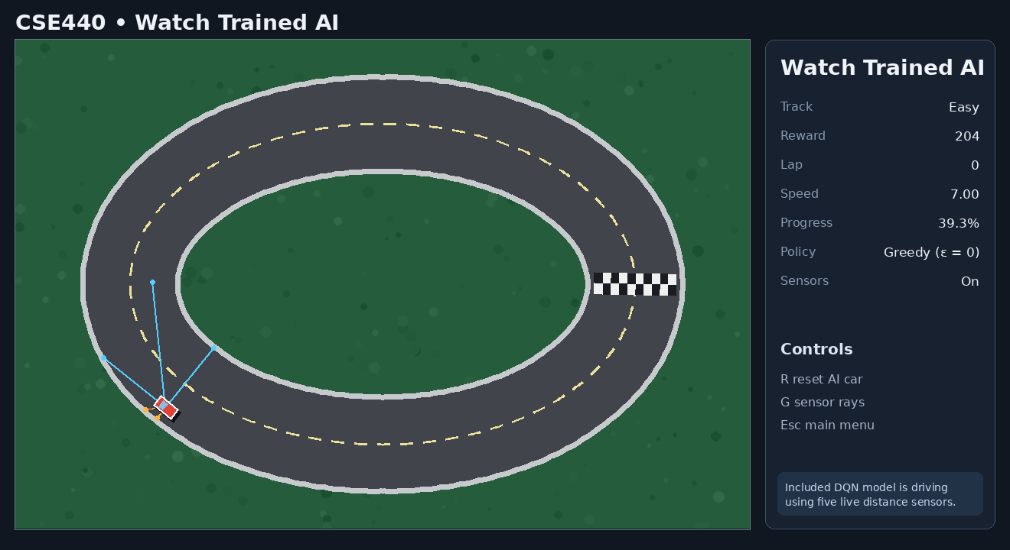
LIVE DEMO
The Game in Action
🎮 Interactive Modes
🕹️ Manual Drive
Arrow key control of the car
🤖 Watch Trained AI
Greedy ε = 0 policy, no exploration
📈 Train AI (Live)
Observe the car learn in real-time
📊 Evaluate AI
Benchmark statistics & metrics
⚙️ Settings
Change track layout & car colour
🚦 Traffic: 3 cars at 2.0 px/frame — sensors detect them within 23 px
Pretrained DQN agent — Easy track, sensors visible (blue rays), reward = 204

Slide 10
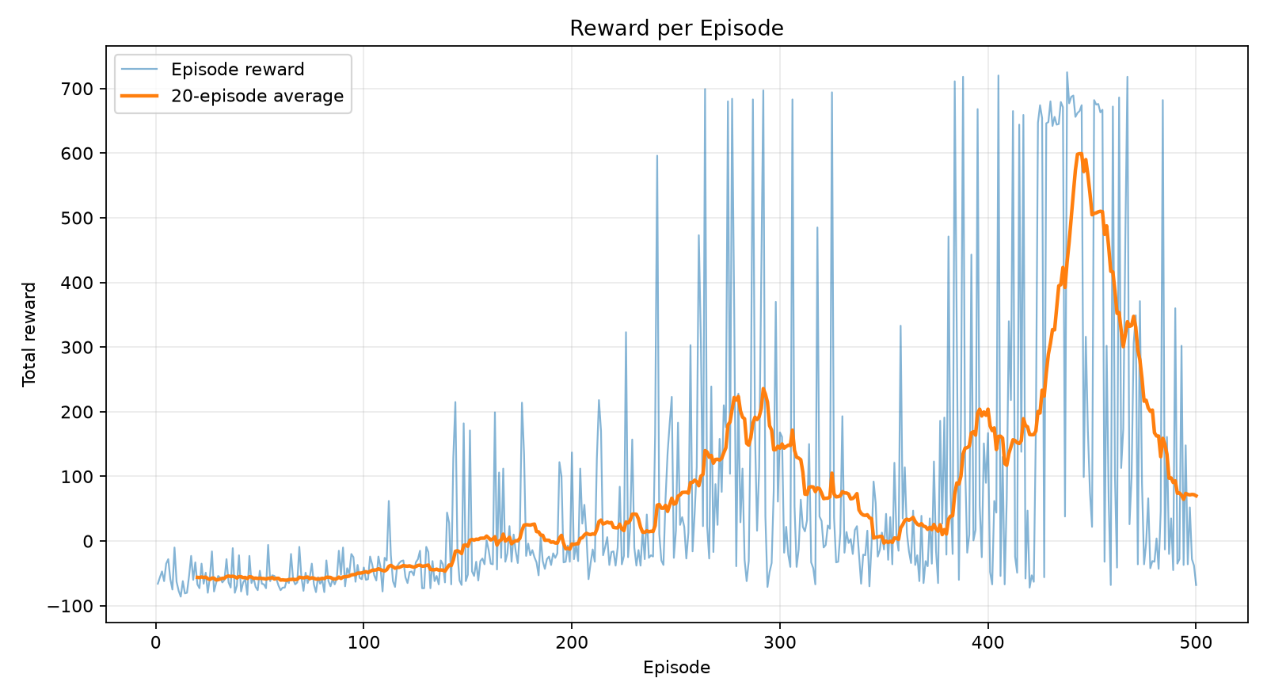
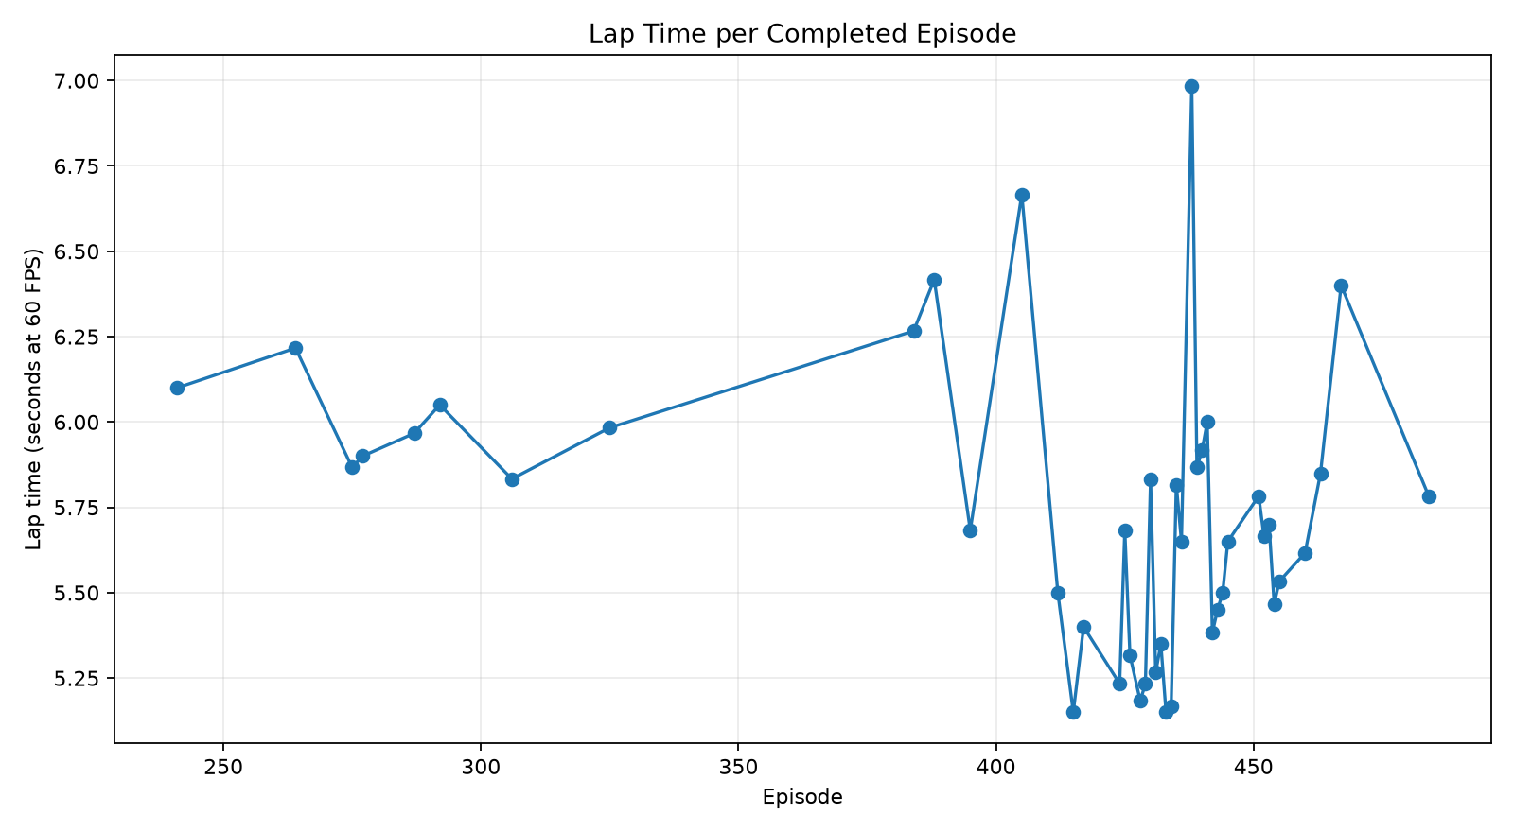
EXPERIMENTAL RESULTS
Training Performance & Results
Reward per Episode — agent clearly improves from episode ~200 onwards
Lap Time — converging from ~6.2 s toward ~5.2 s optimal
500+
Training Episodes
~5.2 s
Best Lap Time
700+
Peak Episode Reward
3
Difficulty Levels

Slide 11
SUMMARY
Conclusions & Future Work
✅ What We Achieved
✓ DQN agent successfully learns autonomous lap completion
✓ Real-time traffic avoidance with dynamic sensor detection
✓ 3 track difficulty levels with procedural generation
✓ Full Pygame interactive GUI with 4 operating modes
✓ Modular testable Python codebase (12 test modules)
✓ Pre-trained models for Easy, Medium & Hard tracks
✓ Comprehensive documentation & academic report
Repository
🔮 Future Improvements
github.com/rifa0118/CSE440-project-self-driving-car-game
→ Prioritized Experience Replay (PER) • Dueling DQN
→ PPO / A2C continuous action space
PyTorch 2.2
Pygame 2.6
Python 3.13
Double DQN
→ Multi-agent competitive racing • Visual pixel input
Thank You! -- Questions welcome.

