Slide 1
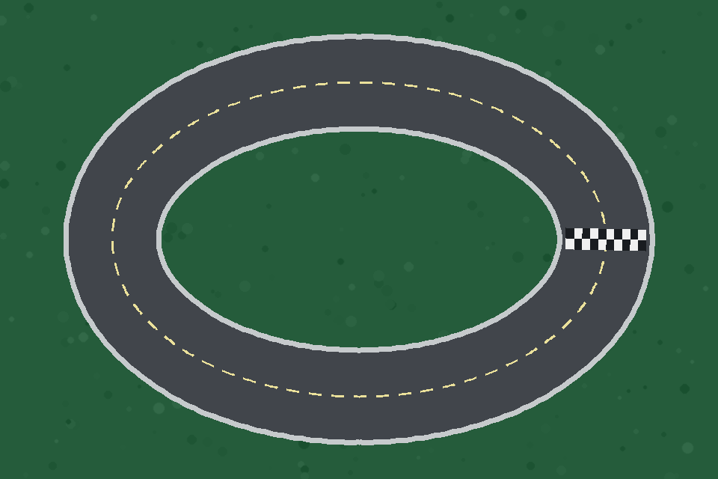
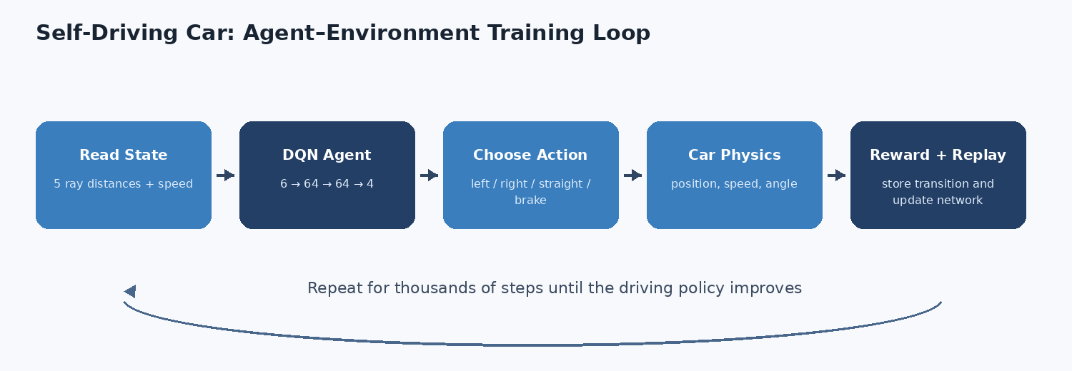
SELF-DRIVING CAR RACING GAME
Deep Q-Network Reinforcement Learning
CSE440 - Introduction to Artificial Intelligence
Add team names and IDs

Slide 2
Project Idea and Scope
A focused AI demonstration that runs on a normal laptop
Agent
Environment
One AI-controlled car learns a policy from reward, not a scripted route.
2D tracks, simple physics, image-mask collision, checkpoints, and laps.
Observation
Learning
Five distance rays plus speed create a compact six-value state.
DQN, replay memory, target network, and epsilon-greedy exploration.
CSE440 | Self-Driving Car Racing Game
2

Slide 3
Agent-Environment Training Loop
Observe, act, reward, replay, update, repeat
State
Action
Learning
5 distances + speed
left / right / straight / brake
reward -> replay -> DQN update
CSE440 | Self-Driving Car Racing Game
3

Slide 4
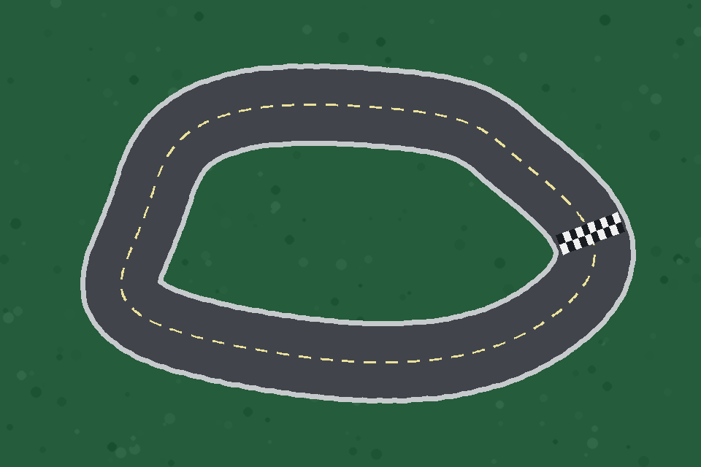
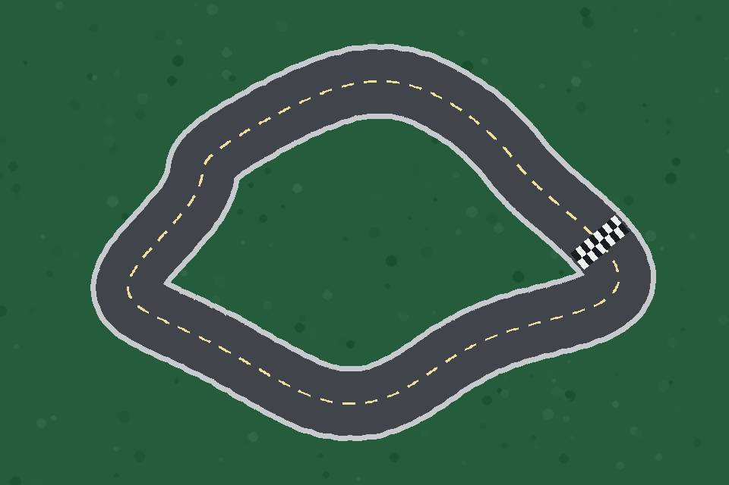
Game Environment
Image-based tracks and intentionally simple vehicle physics
Easy
Medium
Hard
White road / black wall mask for collision and sensors
Nine car-body probe points
720 ordered centerline points and 12 checkpoints
Position, speed, heading, steering, acceleration, braking, friction
CSE440 | Self-Driving Car Racing Game
4

Slide 5
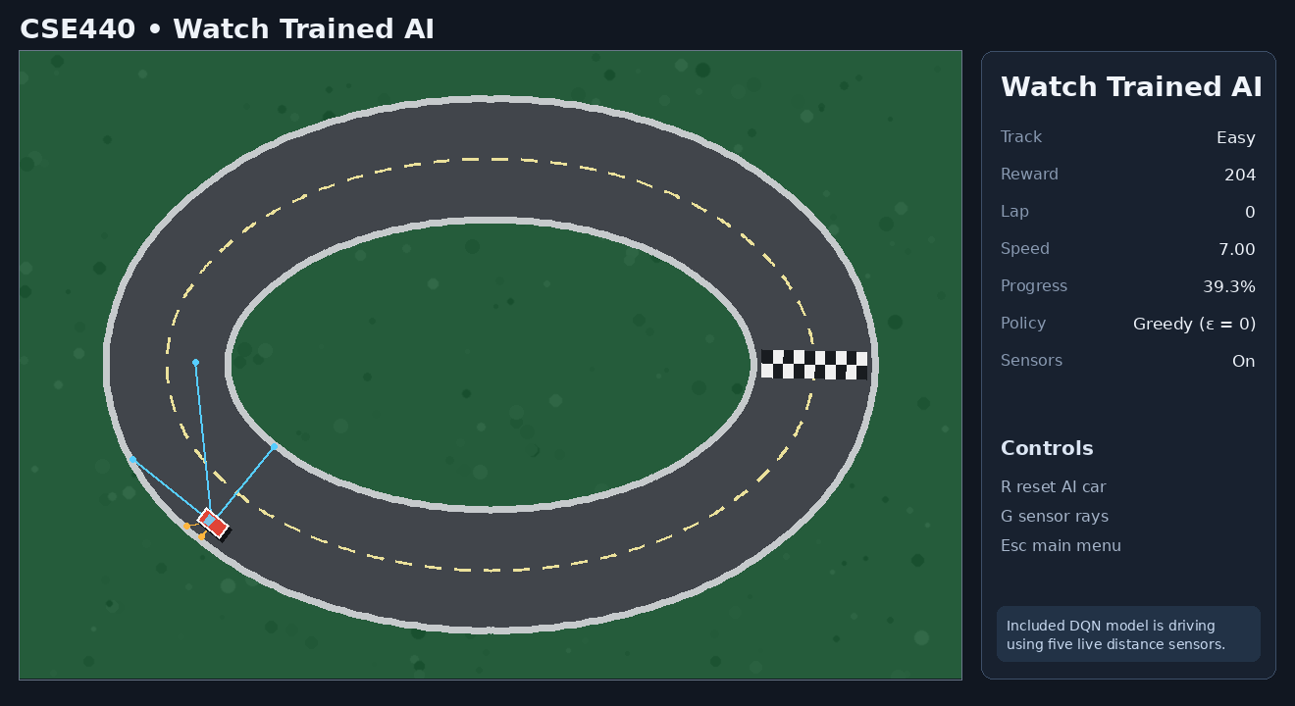
State Representation
The neural network receives six normalized values
Five ray angles
-90°, -45°, 0°, +45°, +90°
Normalization
distance / maximum range speed / maximum speed
State vector
[left, front_left, front, front_right, right, speed]
Small, interpretable, and CPU-friendly
CSE440 | Self-Driving Car Racing Game
5

Slide 6
Actions and Reward Engineering
DQN fits the four-action discrete control problem
0
Turn left
1
Turn right
2
Go straight
3
Brake
Driving forward
Checkpoint
+1
+20
Lap complete
Collision
+100
-100
Driving backwards
Standing still
-10
-2
Good rewards matter more than an unnecessarily complicated network.
CSE440 | Self-Driving Car Racing Game
6

Slide 7
Deep Q-Network
A compact 6 -> 64 -> 64 -> 4 policy network
Input
Hidden
Hidden
Output
6 values
64 ReLU
64 ReLU
4 Q-values
Experience replay: random mini-batches from stored transitions
Target network: slower-moving Bellman target
Double DQN target selection by default
Huber loss + Adam + gradient clipping
Gamma = 0.99; epsilon 1.00 -> 0.05
CSE440 | Self-Driving Car Racing Game
7

Slide 8
Training and Model Lifecycle
Live controls for demonstration; headless mode for speed
Live training
Controls
Headless CLI
Episode, reward, speed, epsilon, loss, sensors
Start, pause, continue, speed up, save
Faster CPU training without rendering
Best checkpoint
Latest checkpoint
Results
Highest completed/reward score
Resume optimizer and training state
CSV, JSON, reward, lap, collision graphs
Training behavior includes random exploration; evaluation uses epsilon = 0.
300 Easy episodes
CPU only
Seed/config saved
20 automated tests
CSE440 | Self-Driving Car Racing Game
8

Slide 9
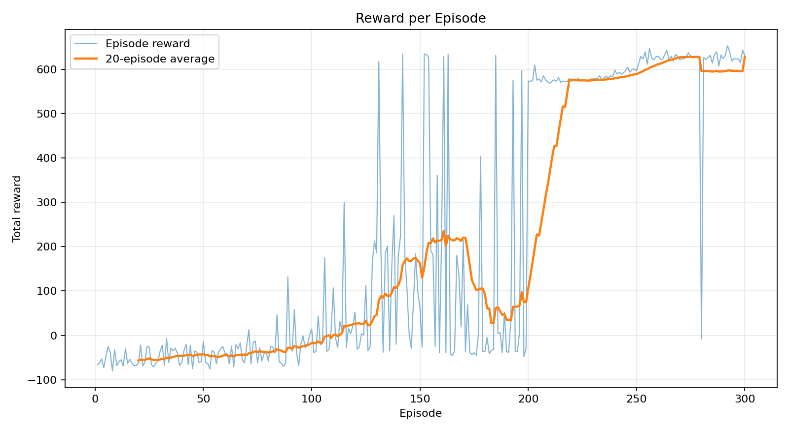
Training Results
The reward trend becomes strongly positive as laps are learned
300
training episodes
110
exploratory lap completions
614.7
final-50 mean reward
653.0
best exploratory reward
Noise remains because epsilon-greedy training intentionally keeps exploring.
CSE440 | Self-Driving Car Racing Game
9

Slide 10
Greedy Evaluation
Standard start position, epsilon = 0, 20 episodes per track
Easy
Medium
Hard
20 / 20
20 / 20
20 / 20
completed laps
completed laps
completed laps
0 collisions
0 collisions
0 collisions
Reward 631.0
Reward 576.0
Reward 593.0
295 mean lap steps
241 mean lap steps
259 mean lap steps
All three packaged best checkpoints reached 100% success with zero collisions in deterministic standard-start evaluation. Medium and Hard use curriculum continuation; arbitrary-start and unseen-track generalization are not claimed.
CSE440 | Self-Driving Car Racing Game
10

Slide 11
Complete Pygame Application
Manual drive, live training, model playback, evaluation, and settings
Selectable track difficulty
Red / blue / green car
Live sensor rays
Pause / continue / save
Best/latest model loading
Automatic evaluation JSON
Same core environment in every mode
CSE440 | Self-Driving Car Racing Game
11

Slide 12
Reliability, Limitations, and Future Work
Measured claims and clear project boundaries
Reliability
Limitations
Future work
20 automated tests Atomic checkpoint writes Raw CSV and JSON Saved seed/configuration Included model lap test
Fixed evaluation start Medium/Hard use curriculum continuation Simple educational physics No temporal memory Not real vehicle control
From-scratch vs curriculum benchmarks Randomized starts Curriculum comparison PPO comparison Obstacles or camera input
CSE440 | Self-Driving Car Racing Game
12

Slide 13
CONCLUSION
A complete, explainable, CPU-friendly reinforcement-learning project
Full state -> action -> reward -> replay -> update pipeline
Validated checkpoints complete Easy, Medium, and Hard from their standard starts
Interactive Pygame app plus headless training/evaluation
Models, raw results, graphs, documentation, and tests included
Questions?
Add presenter names and IDs

