Slide 1
TEXT EXTRACTION FROM IMAGE AND CONVERTING IT INTO SPEECH
GROUP 11
N.V. Vaishnavi
V. Tejkiran
V. Sai Rathan
N. Srilekha
Syed Jahangir

Slide 2
Introduction
Text acquisition, recognition and speech conversion using character recognition approach and text to speech synthesizer (TTS) by MATLAB.
The main objective of our project is to extract horizontally aligned text of various font styles including hand written from images.
Our project electronically converts hand written or printed text into machine encoded text from a scanned document or a photo.

Slide 3
FLOWCHART (describing various stages of process)

Slide 4
Choose an image as input
Conversion to Grayscale
Binarization of image
Matching characters in template
Character Extraction
Line Extraction
Framing the sentence
Spell check
(improveme-nt)
Text to Speech
Speech Output

Slide 5
STEPS INVOLVED IN OUR METHODOLOGY
Browse for an input image and load it into MATLAB through User Interface.
Firstly convert the image from RGB to Grayscale, then by using an appropriate global image threshold value we binarize the image into black and white.
Now since the first and last occurrence of 1s along the rows and columns enclose the text to be extracted we clip the outer unwanted image.

Slide 6
Now by summing up each row’s values in the previously obtained image matrix we extract each line of text by cutting the image if the sum is equal to 0.
Now by applying the similar logic along columns each line thus obtained is split into characters. Meanwhile, we also calculate the average space between two characters so that the word separation becomes easier.
After the character is split, it will be compared to every character in our dataset until a match of >95% is obtained. If not, the most accurate match is identified. The characters thus obtained are appended into a list finally forming a sentence.

Slide 7
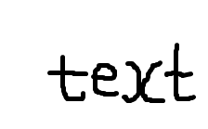
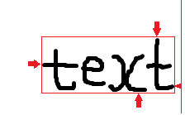

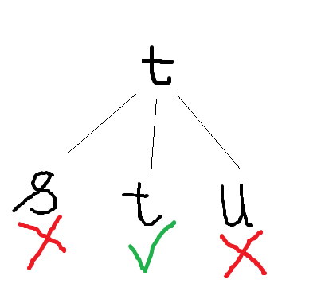
The spelling of each word of the sentence is then checked and the sentence thus formed is converted to speech using TTS of MATLAB.

Slide 8
APPLICATIONS
When this application is developed with an increase in efficiency, it will have the potential to replace Braille for the visually challenged.
When integrated with proper hardware, it can be used in cars/vehicles to notice traffic signs and street names and alert the driver.

Slide 9
THANK YOU

