Slide 1
Kubernetes at a Glance
INTEGRATION TEAM · LEARNING SESSION
What it is, the problems it solves, how it works, a real example — and why we are learning it.
Notes:
Open with a question: if our payment callback server crashes at 3 a.m. today, what happens? Who notices, and how long until it is fixed? Today we will see how Kubernetes handles that on its own. 8 slides, 10–12 minutes.

Slide 2





What is Kubernetes?
Kubernetes (K8s) is an open-source container orchestrator — it lets you use many servers as if they were one big computer. You say what to run; Kubernetes decides where and how to run it.
Runs
Watches
Self-heals
Scales
Decides which container goes on which server
Checks all the time that every container is healthy
Restarts crashes; moves work off a dead server
Adds copies when load rises, removes them when it drops
Desired state
Reconciliation
Actual state
Written in YAML: "3 api Pods"
Compares the two, all the time
2 running → it creates 1 more
What it is not: it does not build your code, back up your database, or act as a PaaS — it runs and manages containers.
Notes:
Give the definition, then the four jobs. The bottom row is the core idea: you write what you want (desired state), and Kubernetes keeps comparing it with what is actually running (actual state) and fixes any difference on its own — this is called reconciliation. Analogy: set an AC thermostat to 24°C and it keeps measuring and cooling the room by itself. History: inspired by Google's internal systems, open-sourced in 2014, now run under the CNCF, and offered as a managed service by every major cloud — AWS (EKS), Google (GKE), Azure (AKS).

Slide 3
The problems Kubernetes solves
Running one app on one server is easy. The trouble starts with many apps, many servers, and something breaking at 3 a.m.
Situation | Without Kubernetes | With Kubernetes
App crashes | Someone sees an alert, restarts by hand | Restarts itself — self-healing
A server dies | Every app on that server goes down | New copies start on another server
Traffic spikes | Add servers and copies by hand | Adds copies itself — autoscaling
New version deploy | Stop, then start — downtime in between | Swaps copies one by one — rolling update
Bug in new version | Find the old build and redeploy | One command to rollback
Notes:
The first three rows matter most for our payment callbacks. Ask the room: which of these has already happened to us? Each row is a manual job today that Kubernetes does automatically.

Slide 4
Kubernetes in 8 words
Container
Image
Node
Cluster
An app packed with everything it needs, running isolated
The container's template — build once, run many times
One machine (server or VM) where containers run
The control plane (the brain) plus all the nodes
subtrack-api:1.0
worker-1
kind-subtrack-lab
Node.js API
Pod
Deployment
Service
Namespace
The smallest unit — a wrapper around containers, with its own IP
"Keep N copies running; change versions safely"
A stable name and address, even as Pods change
Separate rooms inside one cluster — dev and prod apart
replicas: 3
http://api
subtrack-dev
one copy of api
Plus two tools: YAML — the file where you write what you want · kubectl — the command you use to talk to the cluster
Notes:
Go small to big: a container runs inside a Pod → Pods run on nodes → nodes together make a cluster. A Deployment decides how many Pods; a Service gives them one stable address. The bottom line reminds everyone that all of this is written in YAML and sent with kubectl.

Slide 5

You send YAML; the cluster does the rest
01
02
03
04
05
06
kubectl apply
API server
Controllers
Scheduler
kubelet
Pod Ready
Sends the YAML to the cluster
Validates it, stores it in etcd
See 3 Pods are needed, create them
Picks a node for each Pod
Pulls the image, runs the container
The Service now sends it traffic
Reconciling never stops after the deploy
Container crashes → the kubelet restarts it
A Pod disappears → a controller creates a new one
A node dies → Pods move to another node within minutes
Notes:
One line per step. The key point: you only do step 1; the other five are done automatically by different parts of the cluster. Later, a user's request goes through the Service to any healthy Pod — the user never needs to know which node a Pod is on. Finish by asking: what happens if a worker node dies? (third box at the bottom)

Slide 6
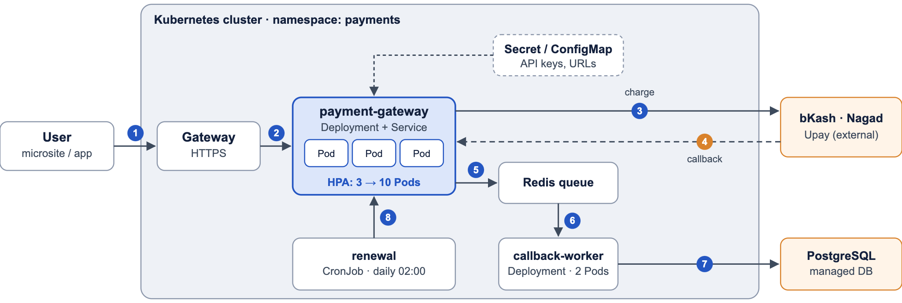
Real-world example: subscription payments
1 user subscribes → 2 Gateway (HTTPS) → 3 payment-gateway sends the charge → 4 callback comes back → 5 queued → 6 worker picks it up → 7 writes to the DB · 8 nightly renewal CronJob. Orange = outside the cluster.
Notes:
This is a sample architecture — not our actual system, but close to the kind of work we do. Walk through what Kubernetes does at each part: payment-gateway runs 3 Pods; if one crashes, the other two keep serving and Kubernetes starts a new one (self-healing). During a campaign, the HPA grows it from 3 to 10 Pods (autoscaling). New versions roll out one Pod at a time, so no callback is lost (rolling update). API keys live in a Secret, not in code. Renewals run as a CronJob. The database and payment providers sit outside the cluster — keeping the DB on a managed service is the safer choice.

Slide 7
When to use it — and when not to
A good fit
The cost (trade-offs)
Skip it when
Many services
Traffic that rises and falls
Downtime is not acceptable
Frequent releases
A long learning curve
Lots of YAML, silent bugs
Running a cluster is a job itself
Harder to debug
1–2 small apps, steady traffic
No one can run a cluster
Only a database — use a managed DB
"Everyone uses it" — not a reason
Notes:
Be honest: Kubernetes is not the answer to everything. For a small app it is heavy and adds cost. The rule: have the problem first, then adopt Kubernetes. The next slide shows why our work really does have that problem.

Slide 8




Why we are learning Kubernetes
Money work can't go down
Many products, one gateway
Payment callbacks and webhooks — no request can be lost, even during a deploy
Each service deploys and scales on its own, and finds the others by name
Owning our own apps
Industry standard
Even if someone else runs the cluster, the YAML, health checks and debugging are ours
The same thing on every major cloud — learn it once, use it everywhere
The plan
14 phases, 1 hour a day, about 11–12 months · local lab cluster already set up · next: Linux and command-line basics
Notes:
Last slide. Tie each of the four reasons to our own work. Stress the third: even when a platform team runs the cluster, if we can't read our app's YAML, probes and resources, or understand problems like CrashLoopBackOff, we can't fix our own app. Then share the plan and take questions: which of our services would be the best first candidate for Kubernetes, and why?

