Slide 1
Design of a 4-bit Computer in VerilogHDL
Video Link: https://web.microsoftstream.com/video/dbf29407-a455-41e4-a275-d2d4b0443ec8?list=studio
With a fixed instruction set
Prepared By:
Shafin Bin Hamid
ID: 1606008

Slide 2
Outline
A Progressive Route (From SAP-1 to My own design)
Unique Features of the Design
Demonstration using a sample testbench program

Slide 3
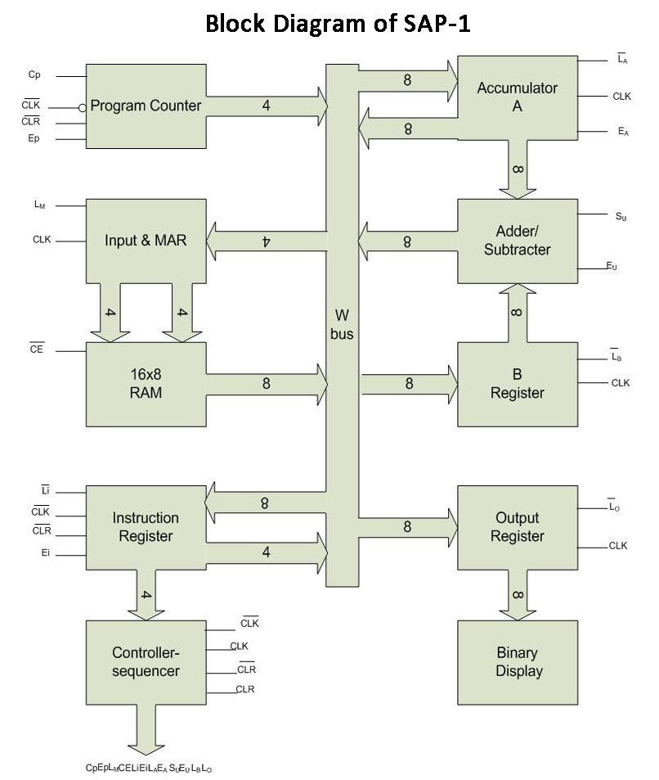
A progressive route(From SAP-1 to my own design)
Build a SAP-1 from scratch
Gradually add parts to it for handing more complex instructions
Temporary Register
Flags
Register

Slide 4
A progressive route(From SAP-1 to my own design)
Program Counter Testbench
Testbench
RAM Testbench
MAR Testbench

Slide 5
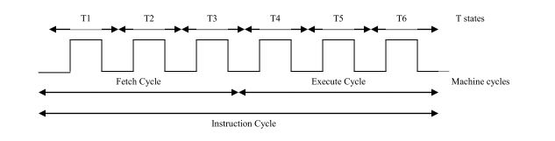
A progressive route(From SAP-1 to my own design)
Need to make all the modules work synchronously
So everything happens as and when they are required to do so
Build a Control Sequencer to generate control signals for synchronization
Control Sequencer is the brain of the computer because it controls which modules are active/inactive
The operation based on the control signal happens on the next posedge
Control signals are generated at the negedge

Slide 6
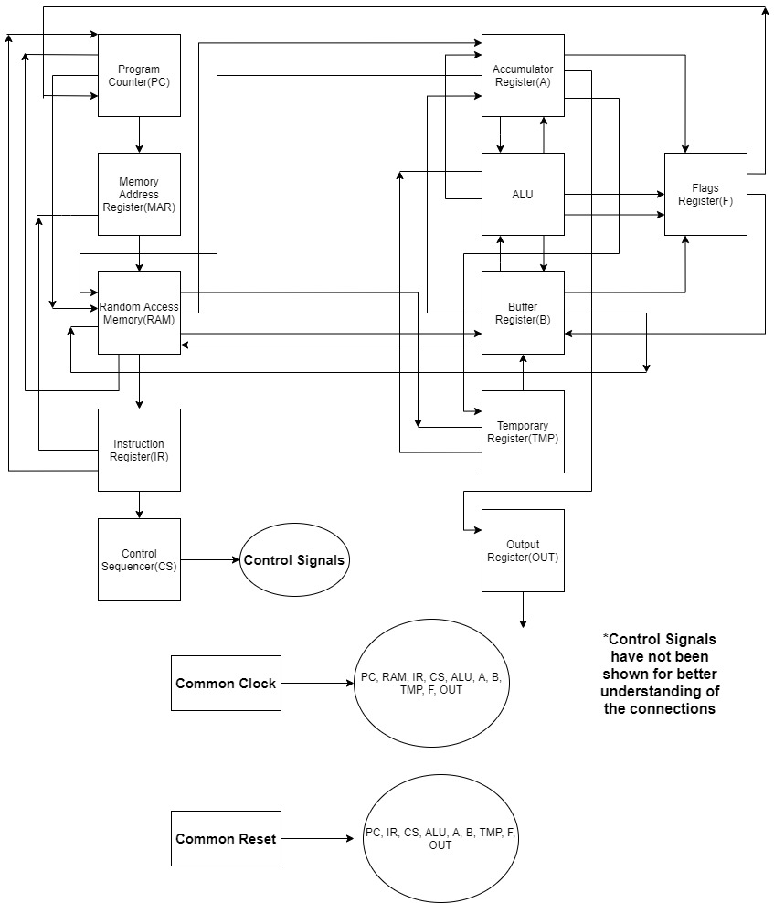
Final Design
RAM Size is 16 * 8
First 9 locations contain instructions
Next 5 locations are for storing data
Last 2 locations are stack memory
Instruction length is 8 bits
Data length is 4 bits
For data, first 4 bits are set to zero
First 4 bits of instruction are opcode, second 4 bits are operand
For instructions that do not have a valid operand, last 4 bits are set to zero
All ALU operations are done with 4-bit registers

Slide 7
Unique Features of the Design
No common ‘Write BUS’
Communications between different modules are established through separate buses
There is one bus connecting PC to MAR and there is another bus connecting IR to MAR etc
No unwanted overwrites
Increased reliability
Easy to understand for one-way bus communication
Synchronous operation

Slide 8
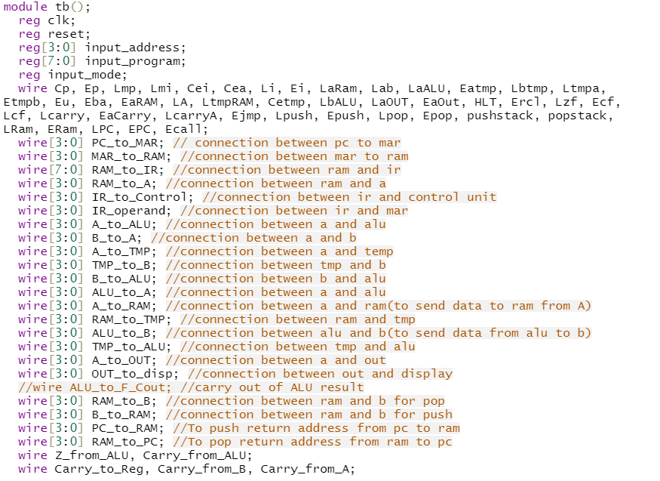
Demonstration of the Computer
A sample testbench code
Common clock and reset
Declaration of all the control signals along with the buses between different modules

Slide 9
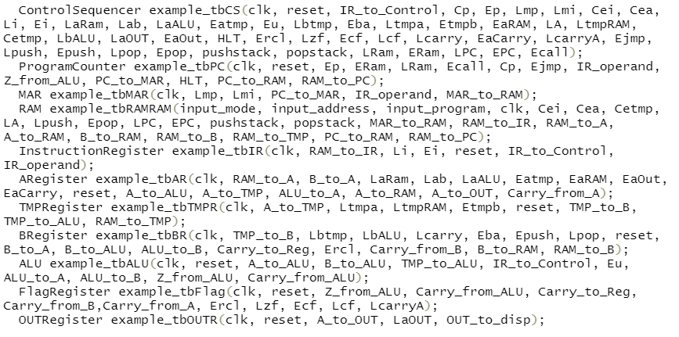
Demonstration of the Computer
A sample testbench program
Instantiation of all modules

Slide 10
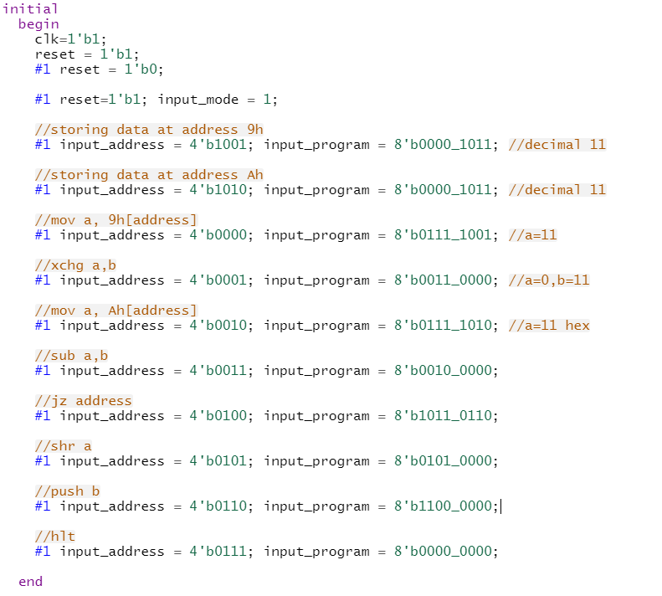
Demonstration of the Computer
A sample testbench program
MOV A,9h ;move RAM[9] to A
XCHG A,B ;swap A and B
MOV A, Ah ;move RAM[10] to A
SUB A,B ;subtract B from A and store result in A
JZ 6h ;if ALU result is zero, jump to address 6
SHR A ;shift logical right A by one bit
PUSH B ;Push B to stack
HLT ;halt program execution
Data at RAM index 9 = Bh/11d
Data at RAM index 10 = Bh/11d

Slide 11
Demonstration of the Computer
RAM Index | RAM Content at Index
0 | 0111_1001
1 | 0011_0000
2 | 0111_1010
3 | 0010_0000
4 | 1011_0110
5 | 1100_0000
6 | 0101_0000
7 | 0000_0000
Assembly Code
Conversion to machine code and mapping
MOV A,9h ;move RAM[9] to A
XCHG A,B ;swap A and B
MOV A, Ah ;move RAM[10] to A
SUB A,B ;subtract B from A and store result in A
JZ 6h ;if ALU result is zero, jump to address 6
SHR A ;shift logical right A by one bit
PUSH B ;Push B to stack
HLT ;halt program execution
Data Segment
RAM Index | RAM Content at Index
14 | Stack index 1
15 | Stack index 2
RAM Index | RAM Content at Index
9 | 0000_1011
10 | 0000_1011

Slide 12
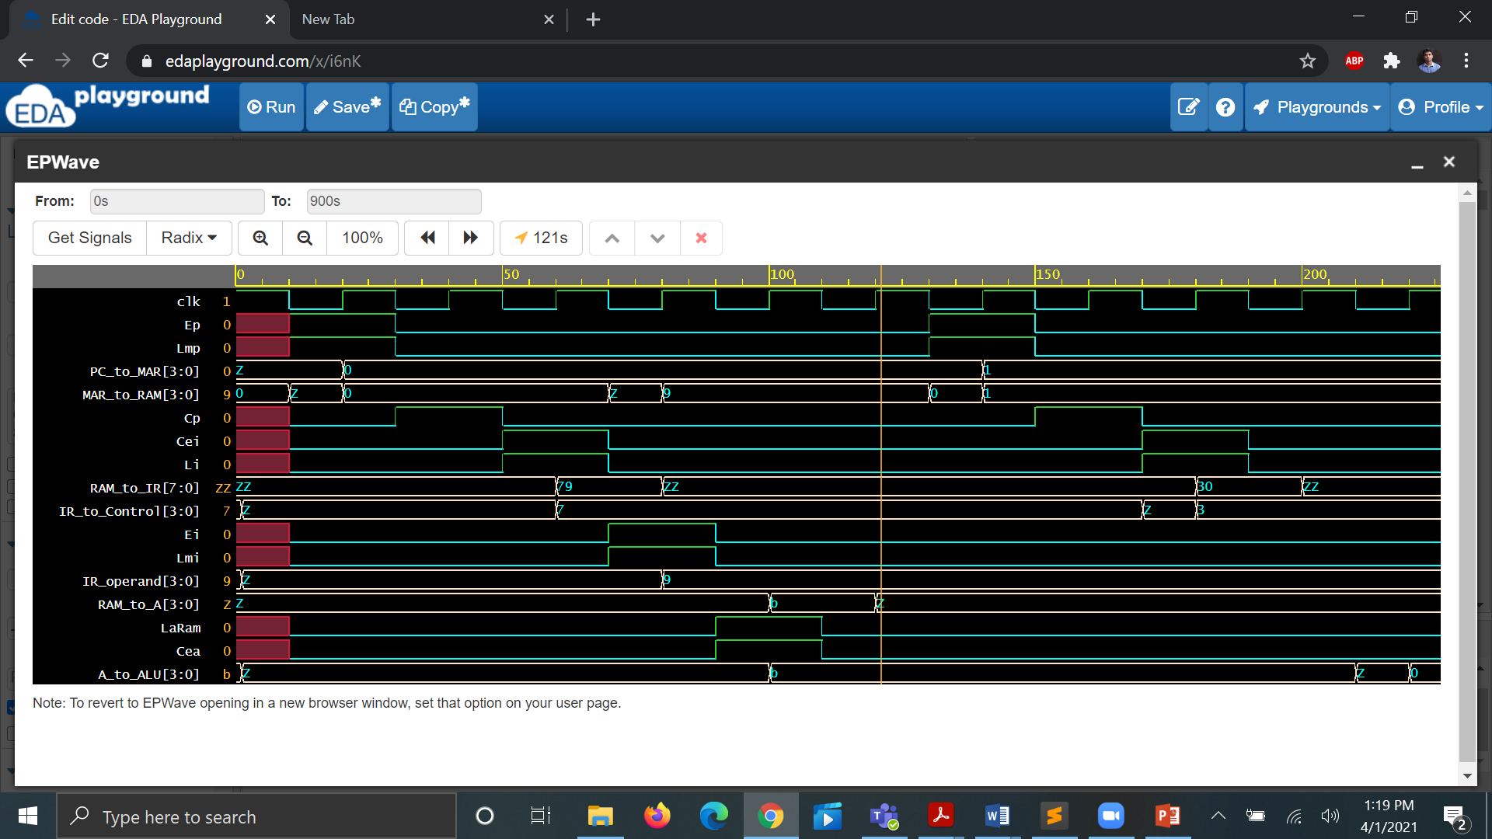
Demonstration of the Computer
MOV A, 9h
Control signal generation occurs at negedge clock
Generation of control signals resemble ring counter
Data transfer occurs at next posedge clock
A=11 at the end of first instruction cycle

Slide 13
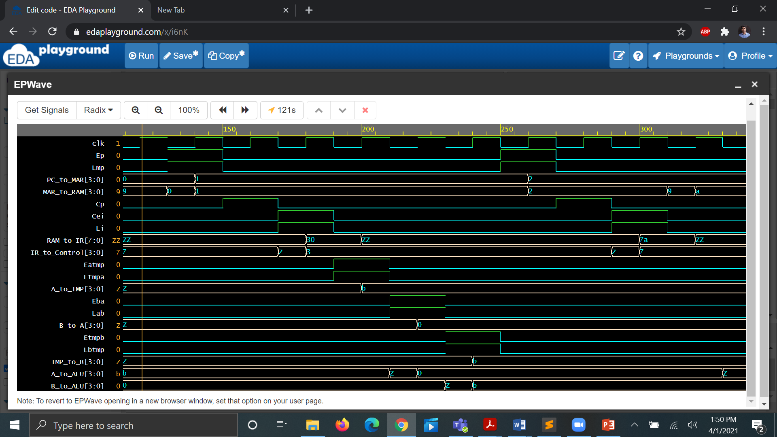
Demonstration of the Computer
XCHG A,B
After xchg, A=0h, B=bh
Initially, A=bh, B=0h

Slide 14
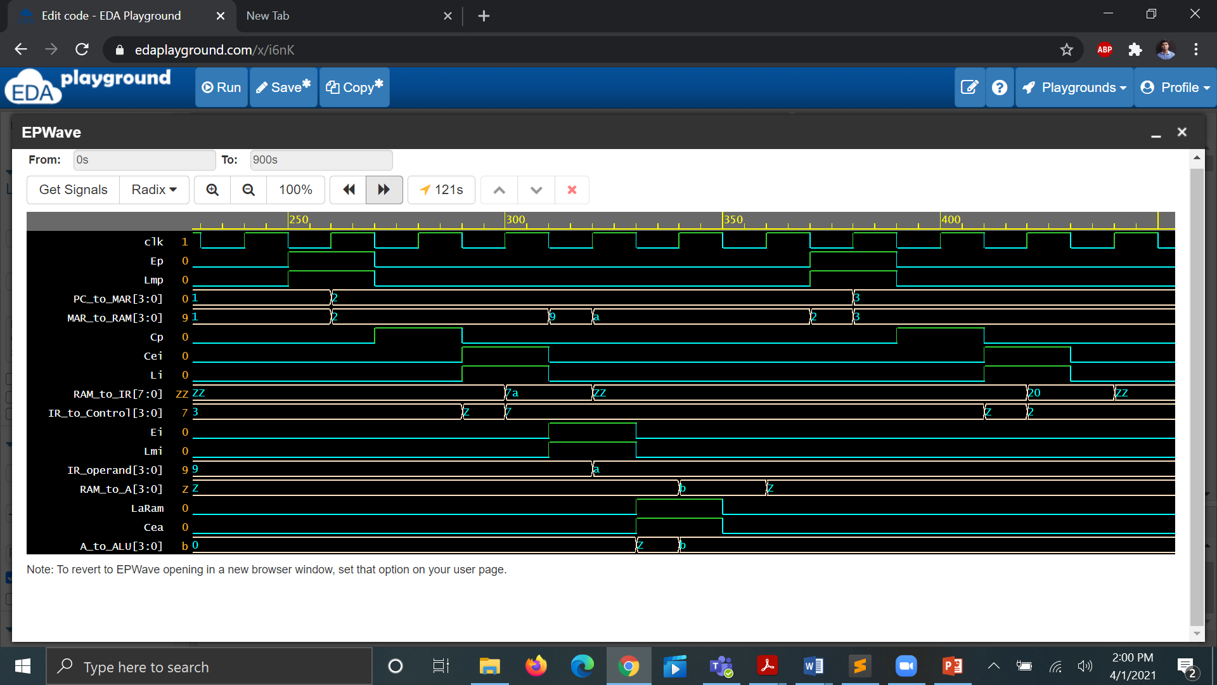
Demonstration of the Computer
MOV A, Ah
At the end, A=bh

Slide 15
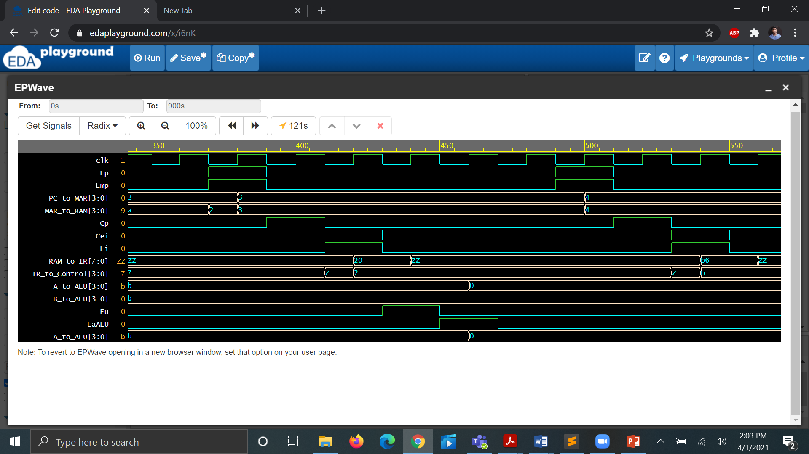
Demonstration of the Computer
SUB A, B
ALU Computes A-B
Initially, A=bh, B=bh
A=0h

Slide 16
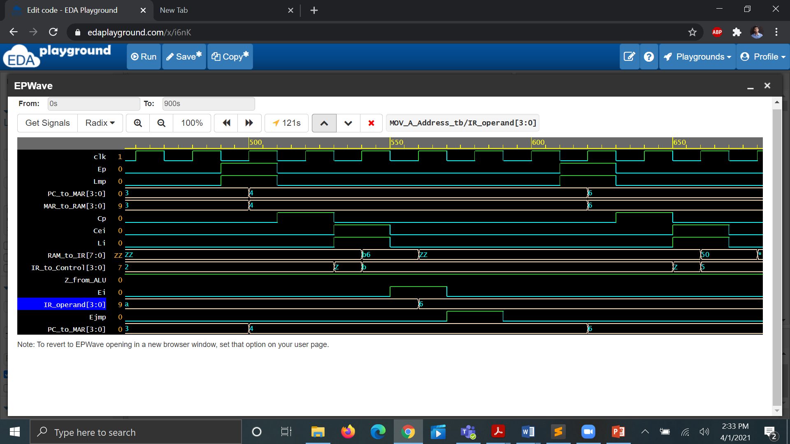
Demonstration of the Computer
JZ 6h
Zero Flag = 1
Address Field = 6
PC jumps to 6

Slide 17
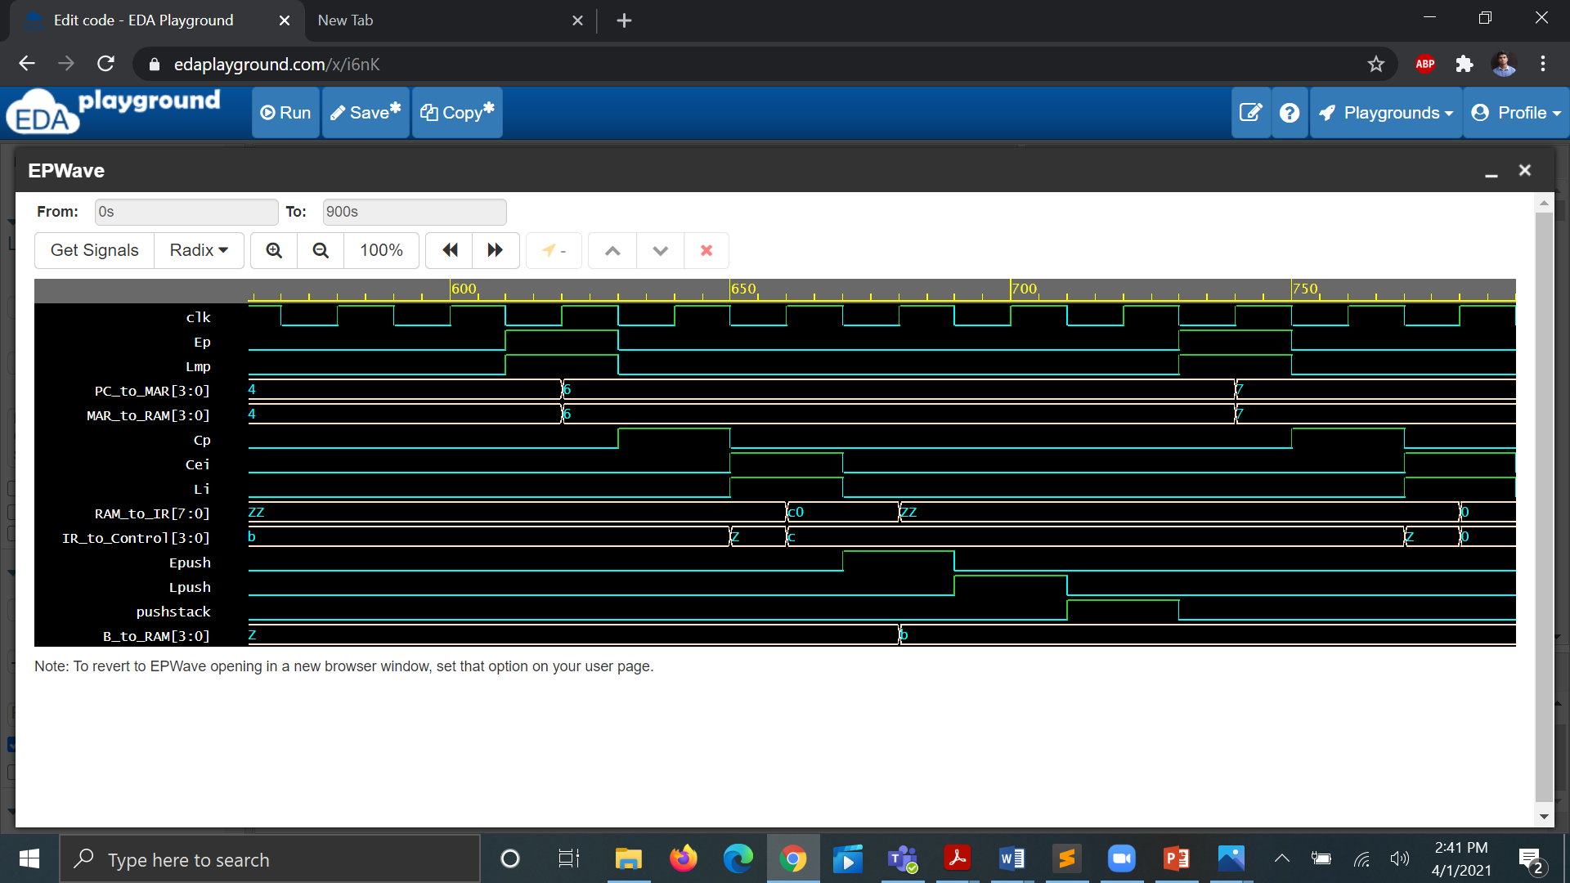
Demonstration of the Computer
PUSH B
SP is decremented
B sends data to stack
Stack stores that data

Slide 18
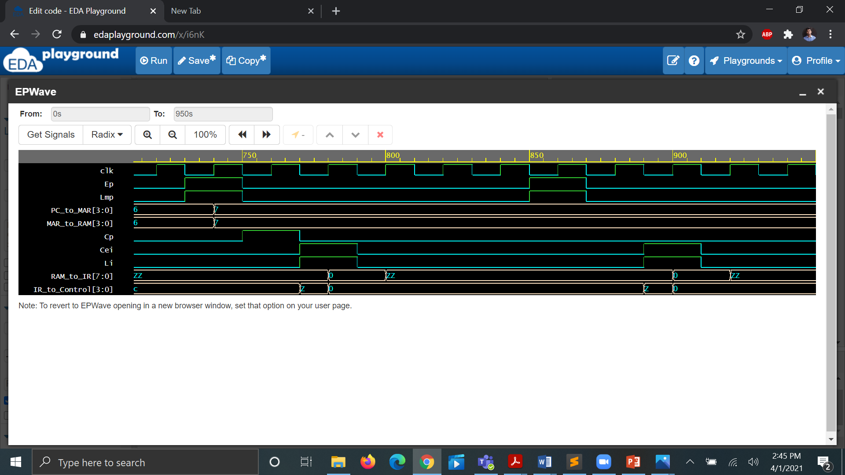
Demonstration of the Computer
HLT
RAM keeps fetching the same instruction
Program counter value is indefinitely set to 7.

Slide 19


