Slide 1

Comparative Analysis On Research Papers
Presented by:
Farhana Akter Suci (B190305001)
Rifah Sajida Deya (B190305004)
Guided by :
Md. Aminul Islam, Ph.D.
Associate Professor
Department of Computer Science and Engineering
Jagannath University, Dhaka
15th January, 2025

Slide 2
Explainable Artificial Intelligence of Multi-Level Stacking Ensemble for Detection of Alzheimer’s Disease Based on Particle Swarm Optimization and the Sub-Scores of Cognitive Biomarkers
Authors :
Abdulaziz Almohimeed , Sherif Mostafa ,
Redhwan M. A. Saad, Nora Mahmoud El-rashidy ,
Sarah Farrag, Abdelkareem Gaballah ,
Mohamed Abd Elaziz , Shaker El-sappagh ,
and Hager Saleh

Slide 3
Table of contents
01
02
07
04
Problem Statement
05
Result Analysis
Objectives
06
Visual Comparison
03
Introduction
Conclusion
Materials & Methods

Slide 4
Problem Statement:
Existing machine learning techniques for Alzheimer’s disease (AD) detection often rely on single-modal data, limiting their ability to fully capture the complexity of AD progression. These approaches lack robust feature selection and interpretability, which hinders their effectiveness in leveraging diverse cognitive biomarkers for accurate and early-stage diagnosis.

Slide 5
Objectives:
Enhance early Alzheimer’s disease detection
Optimize feature selection with Particle Swarm Optimization
Integrate heterogeneous modalities efficiently
Advance interpretability in AI diagnostics
Demonstrate superior performance of multi-level stacking

Slide 6
Introduction
Alzheimer's Disease (AD) is a leading cause of dementia, marked by progressive memory loss and cognitive decline, affecting over 50 million people globally—a number projected to triple by 2050. Mild Cognitive Impairment (MCI), a precursor to AD, presents an opportunity for early intervention, as approximately 10-15% of MCI patients transition to AD annually. Despite the lack of a cure, early detection and intervention can significantly reduce AD progression.

Slide 7
Introduction (cont..)
Limitations of Previous Studies ( Research Gap)
Most studies relied on single-modal data or summary scores.
Few integrated cost-effective cognitive sub-scores for AD detection.
Explainability of black-box models remains under explored.

Slide 8
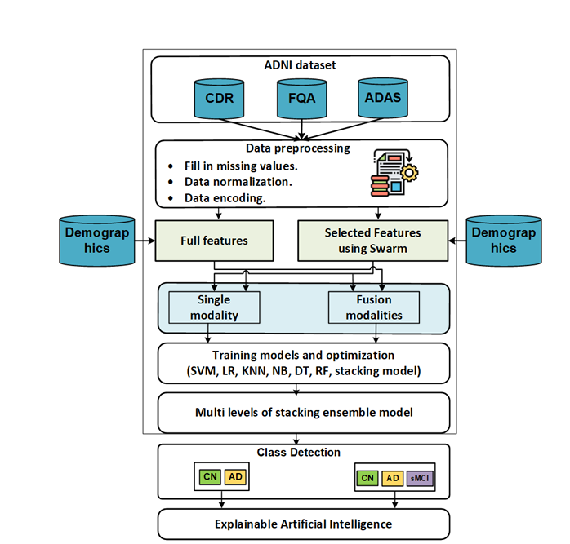
The Proposed Framework:
Figure 1.1 : The Proposed Framework

Slide 9
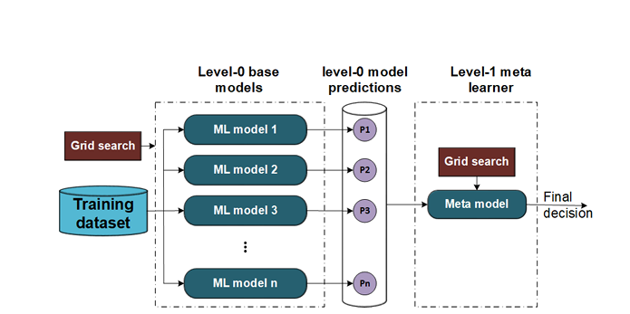
Materials & Methods (cont..) :
Single Level Stacking Ensemble
Figure 1.2 : Single Level Stacking Ensemble

Slide 10
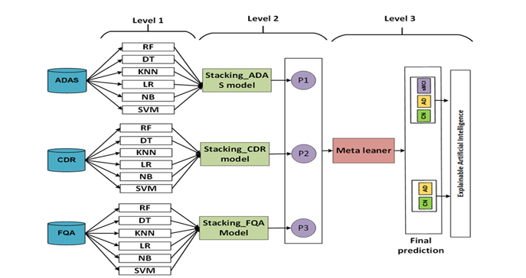
Materials & Methods (cont..) :
Multi-level stacking ensemble model Development
Figure 1.3 : Multi-level stacking ensemble model development

Slide 11
Materials & Methods (cont..):
Particle Swarm Optimization ( PSO )
Algorithm
Input: N: sample size
p:problem dimension
M:Maximum iterations
LS:the lower bound of the search space
US:the upper bound of the search space
Output: S_{best} :the best solution
1 Start
2 Initialize the search process randomly.
.

Slide 12
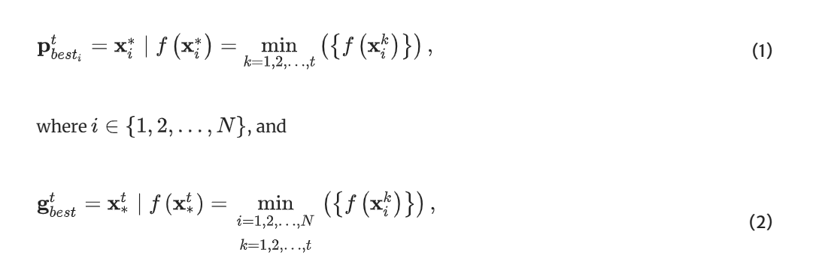
Materials & Methods (cont..) :
Particle Swarm Optimization ( PSO )
3. for i←1 to N do
4 . v_{i}⁰← random volicty vector [LS∪US]^{p}
5. x_{i}⁰←random position [LS∪US]^{p}
p_{best}⁰←x_{i}⁰
End for
8. Apply eqn(2) to get g_{best}⁰
9. m←1
.

Slide 13
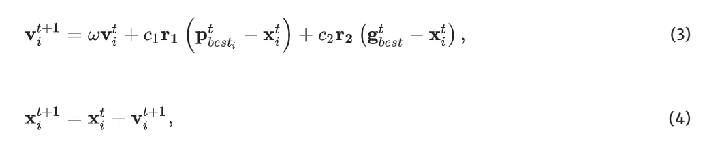
Materials & Methods (cont..) :
Particle Swarm Optimization ( PSO )
9. While m ≤ M do
10. For i=1 to N do
11. r¹ r²←are two independent vectors that
generated randomly [0.1]^{D}
12. Apply eqn(3)
13. Apply eqn(4)

Slide 14
Materials & Methods (cont..) :
Particle Swarm Optimization ( PSO )
Apply eqn(2) to get the best solution
m←m+1
16. If f(x^{t}_{i})<f(x^{t-1}_{best}) then
( x^{t}_{best_i} )←f(x^{t}_{best_i})
End if
End for
.

Slide 15
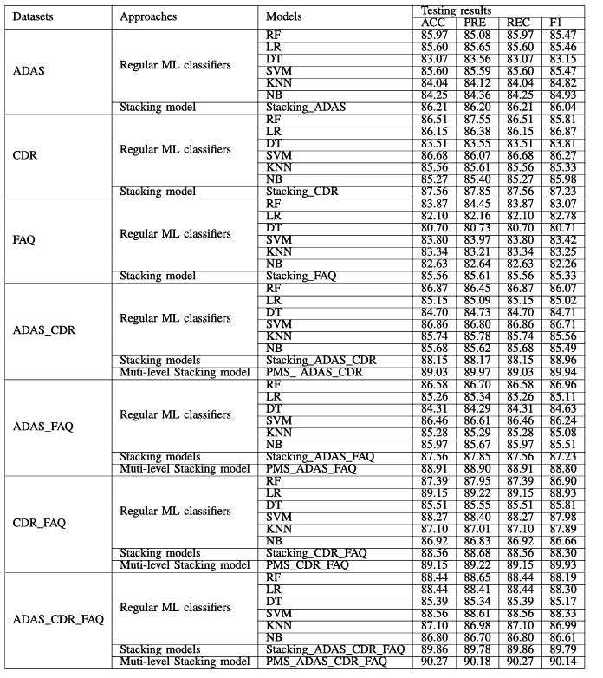
Results and Analysis

Slide 16
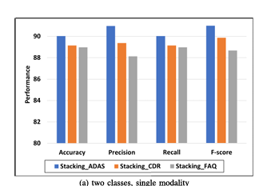
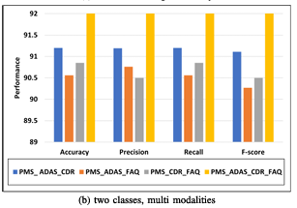
Visual Comparison:
The results of two classes AD and CN The best models for each modality
Figure 1.4 : The best models for each modality with two classes and selected features

Slide 17
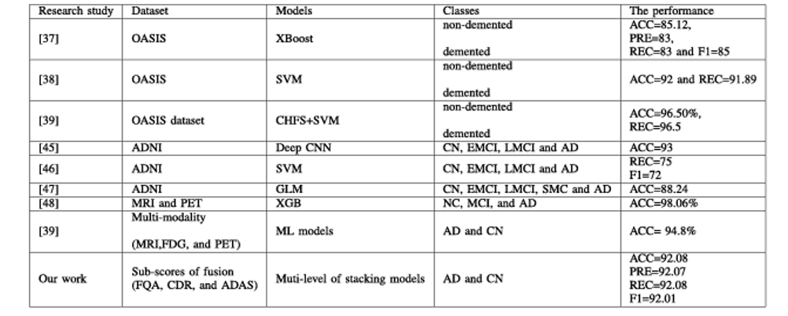
Comparison (Previous studies):

Slide 18
SHAP Analysis
SHAP (SHapley Additive exPlanations) values are a way to explain the output of any machine learning model.
Model Interpretation
Used to make the machine learning model more interpretable. Designed to enhance understanding of how the machine learning model operates.

Slide 19
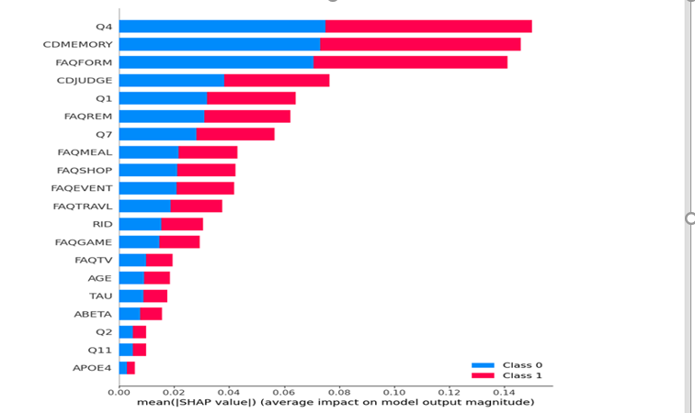
SHAP Analysis (Cont..):
.
Figure 1.5 : Summary plot for two class problems (0=AD, 1=CN).

Slide 20
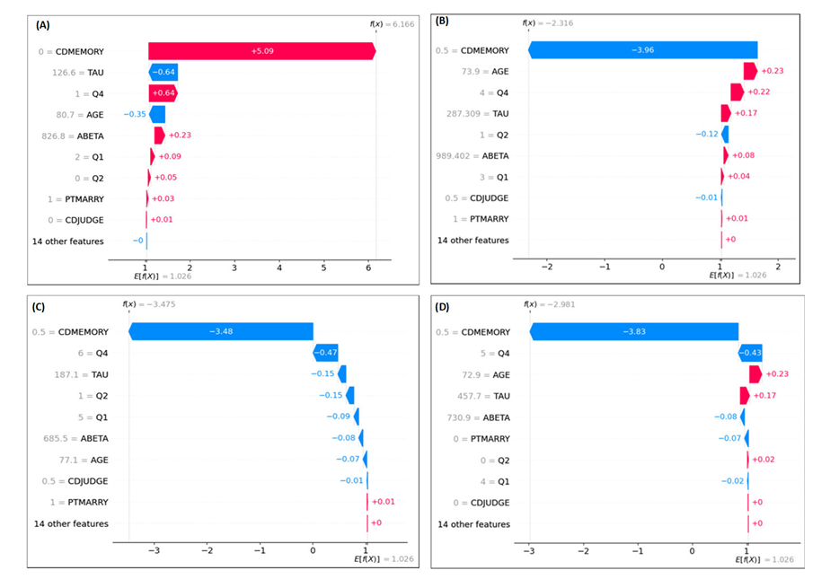
SHAP Analysis (Cont..):
.
Figure 1.6 : Waterfall for three classes problem.

Slide 21
Conclusion:
A new multi-level stacking model has been proposed to predict Alzheimer's Disease (AD) with higher accuracy.
The study addresses classification problems with two classes (AD, CN) and three classes (AD, CN, sMCI).
The proposed multi-level stacking model outperformed single-level stacking and classical ML models, achieving the highest performance with selected features for both two-class (accuracy = 92.08%) and three-class (accuracy = 90.03%) problems.
Multi-modalities demonstrated superior results compared to single modalities.

Slide 22
Ensemble learning using traditional machine learning and deep neural network for diagnosis of Alzheimer’s disease
Authors:
Dong Nguyen,
Hoang Nguyen,
Hong Ong,
Hoang Le
Huong Ha, and
Hoan Thanh Ngo

Slide 23
Table of contents
01
02
04
01
05
Result Analysis
Problem Statement
02
06
Visual Comparison
Objectives
03
03
Introduction
07
Limitations
04
08
Proposed Methodology
Conclusion
23

Slide 24
Problem Statement:
Alzheimer is a progressive neurodegenerative disorder and there is still no cure of this disease. But it’s effects can be delayed if it can be detected early
To detect Alzheimer’s disease early, there are many methods but some methods focus on textual data, some focus on image data, while both type of these data hold significant importance

Slide 25
Objectives:
To include both textual data and image data
To make an efficient methodology with combination of both Machine learning and Deep learning which can detect Alzheimer early
Increase model accuracy using K-fold cross validation

Slide 26
Introduction:
Overview of Alzheimer's Disease (AD):
Progressive neurodegenerative condition
Primarily affects cognitive and memory functions in the elderly
Most cases of this disease are observed in people aging 65 and above
It is observed that people with higher education are at less risk
Early detection is crucial for:
Delaying mental health effects
Improving patient quality of life

Slide 27
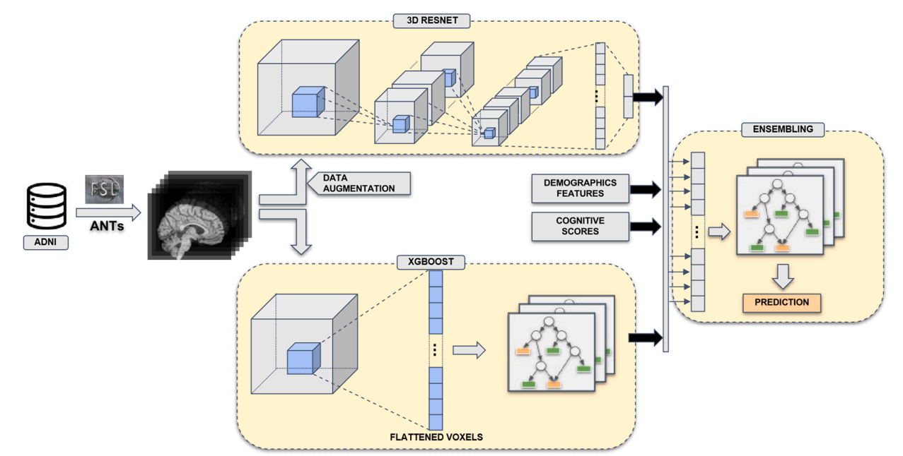
Proposed Methodology:
Figure: . Overview of the classification framework proposed by authors

Slide 28
Proposed Methodology (cont..):
Data Source: The ADNI database is used as the source of required data
Pre-processing methods:
The images are preprocessed using
ANTs (Advanced Normalization Tools) and
FSL (FMRIB Software Library).

Slide 29
Proposed Methodology (cont..):
Data Augmentation: The preprocessed images undergo data augmentation to increase the dataset's variability.
The operations are-
Geometric Transformations: Here images go through rotation, transformation and flipping process
Color Transformations: In this step, the contrast, brightness and saturations are changed of the image
Noise Addition: Here Gaussian Noise and Salt-and-Pepper Noise are used

Slide 30
Proposed Methodology (cont..):
Along with base models 4 Ensemble techniques are used here. Base models are shown in the table:
Model/Technique | Description | Classification Method
3D-ResNet | 3D Residual Network | 3D- ResNet
XGB-HC | XGBoost model on hippocampus regions | XGBoost
XGB | XGBoost model on complete image | XGBoost
RTE-XGB | XGBoost model with input dimension reduction | RTE XGBoost

Slide 31
Proposed Methodology (cont..):
4 Ensemble techniques are shown in the table:
Model/Technique | Description | Classification Method
ENS-1 | Ensemble model of all XGBoost models (XGB, XGB-HC , RTE-XGB) | XGBoost
ENS-2 | ENS-1 + 3D-ResNet | XGBoost
ENS-3 | ENS-2 + demographics features (age, gender) | XGBoost
ENS-ALL | ENS-3 + cognitive scores | XGBoost

Slide 32
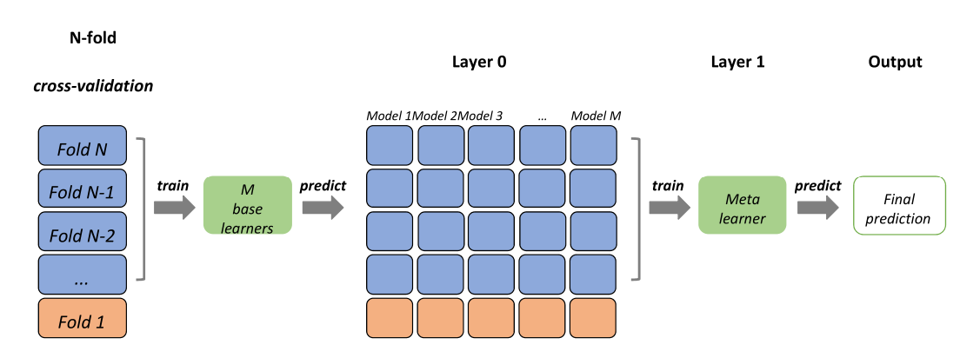
Proposed Methodology (cont..):
5-fold cross-validation is used here-
During Training and Model Selection
After Training (but before final prediction)
Figure: A visual representation of N-fold cross validation in Stacked Ensemble Learning

Slide 33
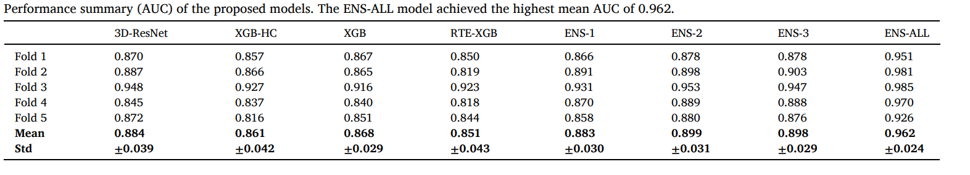
Result analysis:
The performance summery clearly shows ENS-ALL provides the best result

Slide 34
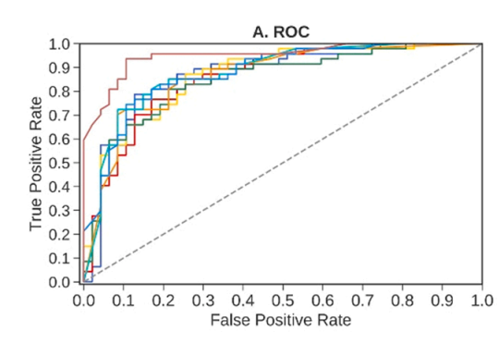
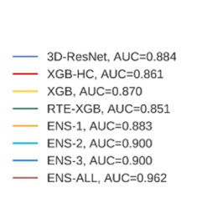
Visual Comparison:
Here is the ROC curve, that visually represents True Positive Rate and False Positive Rate
Figure: ROC curve

Slide 35
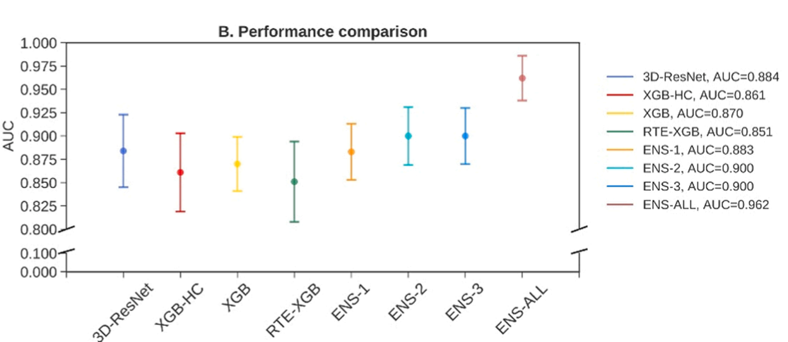
Visual Comparison (cont..):
The performance comparison plot represents the accuracy of different models
Figure: Performance Comparison

Slide 36
Limitations:
fMRI and PET and other biomarkers are not used in this paper
Here authors only worked to detect AD. Detection of MCI can be added
Transfer learning may also be applied to further reduce overfitting caused by the limited training data

Slide 37
Conclusion:
In the paper, authors tried to provide an enhance methodology with combination of machine learning and deep learning
Authors worked with both textual and image data
The final model ENS-ALL acquired highest accuracy with almost 96.2% mean AUC

Slide 38
Summery:
The first paper proposes Multi-Level Stacking Ensemble for Detection of Alzheimer’s Disease and application of SHAP Analysis in this field
The second paper has used multiple Machine learning models and one deep learning model. The ensemble approach is used here to combine the models and get better accuracy.

Slide 39


