Slide 1

Ensemble Learning Using Traditional Machine Learning And Deep Neural Network For Diagnosis Of Alzheimer’s Disease
Authors
Dong Nguyen, Hoang Nguyen, Hong Ong, Hoang Le, Huong Ha, Nguyen Thanh Duc & Hoan Thanh Ngo

Slide 2
Outlines
Problem Statement
Objectives
Introduction
Proposed Framework
Methodes & Models
Result Analysis
Discussion
Conclusion

Slide 3
Problem Statement
There is still no cure for Alzheimer’s disease, but its effects can be delayed if detected early
Traditional diagnostic methods are expensive, time-consuming, and inaccessible to many
To detect Alzheimer’s disease early, various research works are conducted but some of those focus on textual data, while others focus on image data while both types of data hold significant importance

Slide 4
Objectives
Include both textual data and image data
Develop an efficient methodology combining both Machine Learning and Deep Learning techniques to enable early detection of Alzheimer’s disease
Enhance model accuracy by implementing K-fold cross-validation

Slide 5
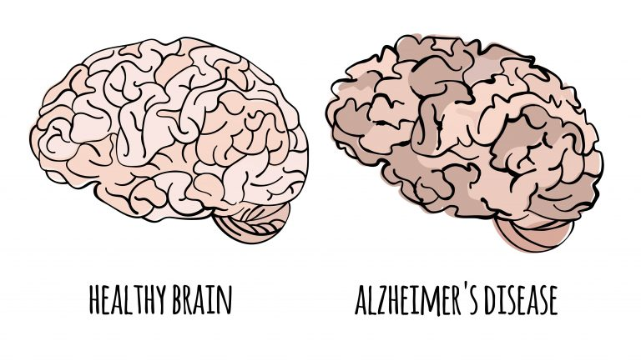
Introduction
Alzheimer's Disease (AD) is a progressive neurodegenerative condition
Primarily affects cognitive and memory functions in the elderly
Most cases of this disease are observed in people aging 65 and above
It is observed that people with higher education are at less risk

Slide 6
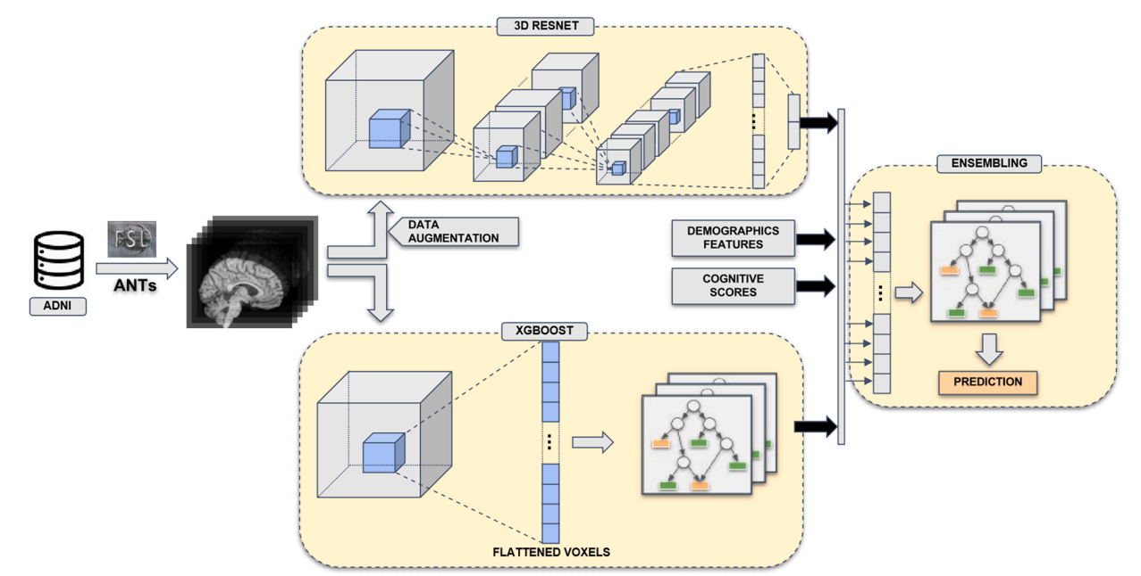
Proposed Framework
Overview of the classification framework proposed by the authors-
Figure 2.1: Proposed Framework

Slide 7
Methods & Models
Data Collection:
The authors collected of datasets from ADNI
Data Preprocessing:
Voxel-Based Morphometry (VBM): For analysis of volumetric pixel, authors used FSL (FMRIB Software Library)
Data Normalization: Data is normalized using ANTs (Advanced Normalization Tools)
Data Augmentation:
Geometric Transformations: Here images go through rotation, transformation and flipping process
Color Transformations: In this step, the contrast, brightness and saturations are changed of the image

Slide 8
Methods & Models (cont..)
Along with base models 4 Ensemble techniques are used here. Base models are shown in the table:
Model/ Technique | Description | Classification Method
3D-ResNet | 3D Residual Network | 3D-ResNet
XGB-HC | XGBoost model on hippocampus regions | XGBoost
XGB | XGBoost model on complete image | XGBoost
RTE-XGB | XGBoost model with input dimension reduction | RTE XGBoost
Table 2.1: The used base models

Slide 9
Ensemble Method
The 4 Ensemble technique are shown here:
XGB-HC
XGB
RTE-XGB
+
ENS-1
Prediction
3D ResNet
+
ENS-2
Prediction
Demographic features
+
ENS-3
Prediction
Cognitive scores
+
ENS-ALL
Prediction
Figure 2.2: The proposed Ensemble Method

Slide 10
Validation
K-fold cross validation is used in this paper. Overview of K-Fold Cross-Validation:
K-fold Cross Validation (CV) involves splitting the dataset into K equally sized folds. The model is trained on K-1 folds and tested on the remaining fold
This process is repeated K times, each time with a different fold as the test set, ensuring all data points are used for both training and testing
For better accuracy five-fold cross validation is used in the proposed model
The dataset is divided into 5 equal parts (folds), with each fold used once as a test set while the remaining 4 folds are used for training
This ensures that every sample in the dataset is used for both training and testing, reducing bias

Slide 11
Results Analysis
Each of the 4 base models and 4 ensemble methods and evaluated with AUC (Area Under Curve) score
3D-ResNet
Mean of five-folds AUC score: 0.884
XGB-HC
Mean of five-folds AUC score: 0.861
XGB
Mean of five-folds AUC score: 0.868
RTE-XGB
Mean of five-folds AUC score: 0.851
ENS-1
Mean of five-folds AUC score: 0.883
ENS-2
Mean of five-folds AUC score: 0.899
ENS-3
Mean of five-folds AUC score: 0.898
ENS-ALL
Mean of five-folds AUC score: 0.962

Slide 12
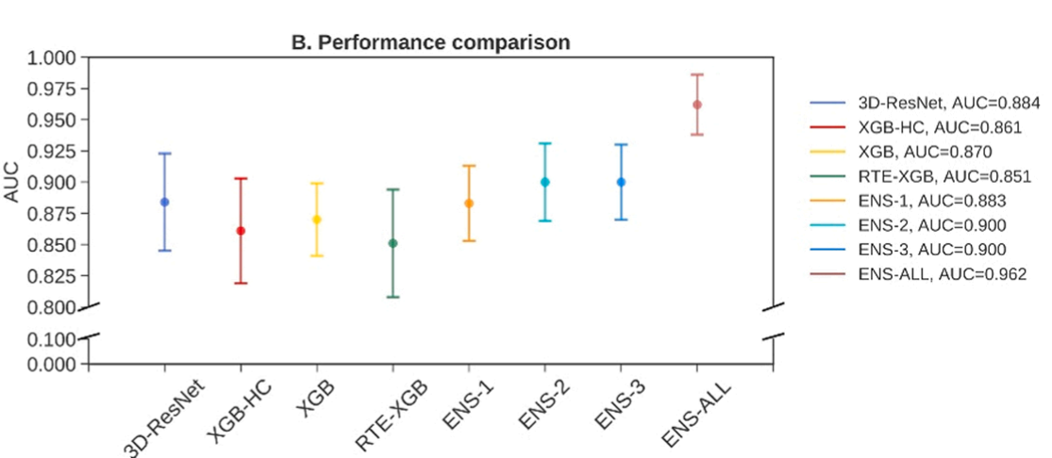
Results Analysis (cont..)
Here the AUC score is visualized through the plot
Figure 2.3: Performance Comparison

Slide 13
Discussion
So, after the result analysis it can be stated that, all the methods performed well, but the ENS-ALL has performed best
Strengths:
Included both textual and image data
Combination of both ML and DL has boosted the accuracy
Limitations:
fMRI and PET and other biomarkers are not used
Detection of MCI can be added

Slide 14
Conclusion
In the paper, authors tried to provide an enhance methodology with combination of machine learning and deep learning
Authors worked with both textual and image data
The final model ENS-ALL acquired highest accuracy with almost 96.2% mean AUC
For further research work, transfer learning can be added

Slide 15


