Slide 1

Comparative Analysis On Research Papers
Presented by:
Binary_Girls
Farhana Akter Suci (B190305001)
Rifah Sajida Deya (B190305004)
Presented to:
Md. Aminul Islam, Ph.D.
Associate Professor
Department of Computer Science and Engineering
Jagannath University, Dhaka
15th January, 2025

Slide 2
Summery
The first paper proposes Multi-Level Stacking Ensemble for Detection of Alzheimer’s Disease and application of SHAP Analysis in this field
The second paper is actually a review paper of almost 47 authentic papers. It introduces a new approach to research and provides a summary of all the completed research methodologies proposed so far in the detection of Alzheimer’s Disease.

Slide 3
Explainable Artificial Intelligence of Multi-Level Stacking Ensemble for Detection of Alzheimer’s Disease Based on Particle Swarm Optimization and the Sub-Scores of Cognitive Biomarkers
Authors :
Abdulaziz Almohimeed , Sherif Mostafa ,
Redhwan M. A. Saad, Nora Mahmoud El-rashidy ,
Sarah Farrag, Abdelkareem Gaballah ,
Mohamed Abd Elaziz , Shaker El-sappagh ,
and Hager Saleh

Slide 4
Table of contents
01
02
07
04
Problem Statement
05
Result Analysis
Objectives
06
Visual Comparison
03
Introduction
Conclusion
Materials & Methods

Slide 5
Problem Statement:
Existing machine learning techniques for Alzheimer’s disease (AD) detection often rely on single-modal data, limiting their ability to fully capture the complexity of AD progression. These approaches lack robust feature selection and interpretability, which hinders their effectiveness in leveraging diverse cognitive biomarkers for accurate and early-stage diagnosis.

Slide 6
Objectives:
Enhance early Alzheimer’s disease detection
Optimize feature selection with Particle Swarm Optimization
Integrate heterogeneous modalities efficiently
Advance interpretability in AI diagnostics
Demonstrate superior performance of multi-level stacking

Slide 7
Introduction
Alzheimer's Disease (AD) is a leading cause of dementia, marked by progressive memory loss and cognitive decline, affecting over 50 million people globally—a number projected to triple by 2050. Mild Cognitive Impairment (MCI), a precursor to AD, presents an opportunity for early intervention, as approximately 10-15% of MCI patients transition to AD annually. Despite the lack of a cure, early detection and intervention can significantly reduce AD progression.

Slide 8
Introduction
Limitations of Previous Studies ( Research Gap)
Most studies relied on single-modal data or summary scores.
Few integrated cost-effective cognitive sub-scores for AD detection.
Explainability of black-box models remains under explored.

Slide 9
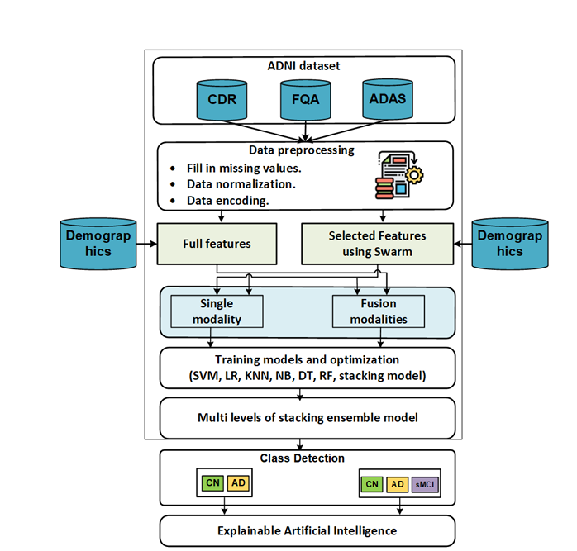
The Proposed Framework:
Figure : The Proposed Framework

Slide 10
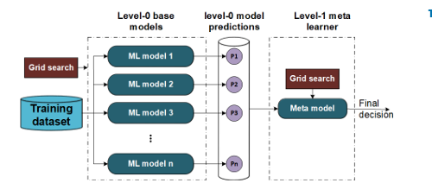
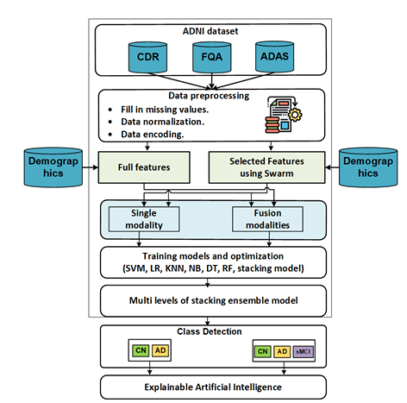
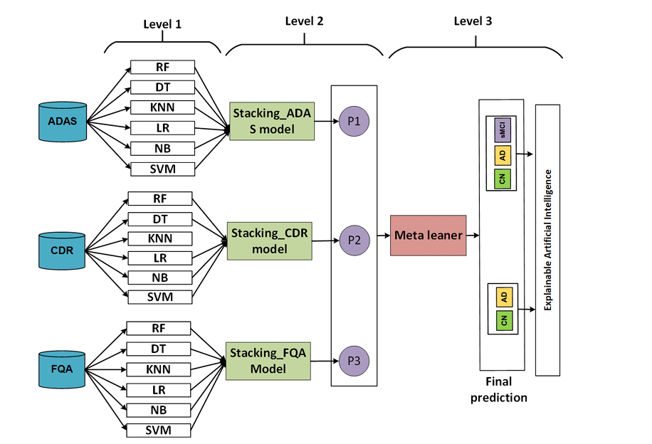
The Proposed Framework:
Figure : Single Level Stacking Ensemble
Figure : The Proposed Framework
Figure : The Multi-Level Stacking Ensemble

Slide 11
Materials & Methods:
Particle Swarm Optimization ( PSO )
Algorithm
Input: N: sample size
p:problem dimension
M:Maximum iterations
LS:the lower bound of the search space
US:the upper bound of the search space
Output: S_{best} :the best solution
1 Start
2 Initialize the search process randomly.
.

Slide 12
Materials & Methods:
Particle Swarm Optimization ( PSO )
3 for i←1 to N do
4 v_{i}⁰← random volicty vector [LS∪US]^{p}
//initialize the practical velocity
5. x_{i}⁰←random position [LS∪US]^{p}
//initialize position
6. p_{best}⁰←x_{i}⁰
initialize the best solution
7. Apply Precision performance matrix to get g_{best}⁰
8. m←1
.

Slide 13
Materials & Methods:
Particle Swarm Optimization ( PSO )
9. While m ≤ M do
10. For i=1 to N do
11. r¹ r²←are two independent vectors that
generated randomly [0.1]^{D}
12. Apply Recall performance matrix //update the velocity.
13. Apply F-score performance matrix//update the position.

Slide 14
Materials & Methods:
Particle Swarm Optimization ( PSO )
14. If f(x^{t}_{i})<f(x^{t-1}_{best}) then
15. ( x^{t}_{best_i} )←f(x^{t}_{best_i})
16. Apply precision performance matrix to get the best solution //update the over all best position.
17. m←m+1
.

Slide 15
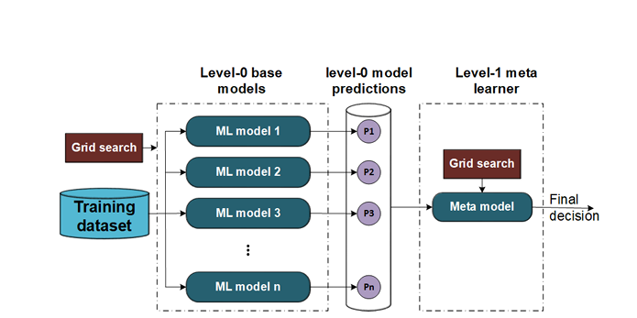
Materials & Methods:
Single Level Stacking Ensemble
Figure : Single Level Stacking Ensemble

Slide 16
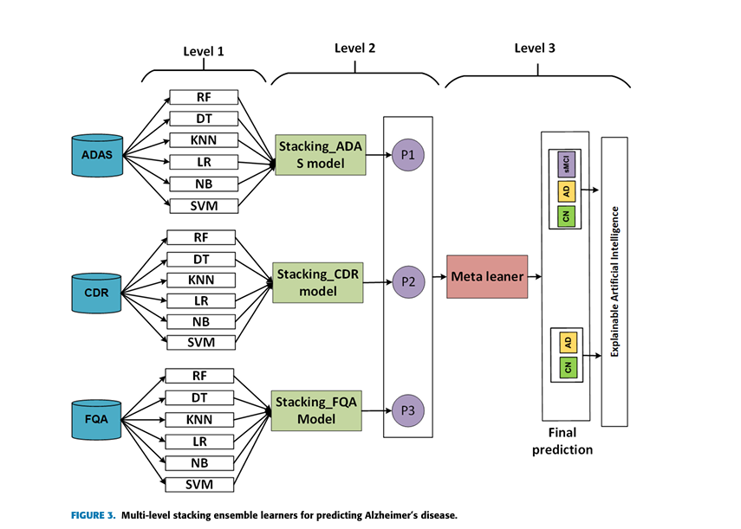
Materials & Methods:
Multi-level stacking ensemble model Development

Slide 17
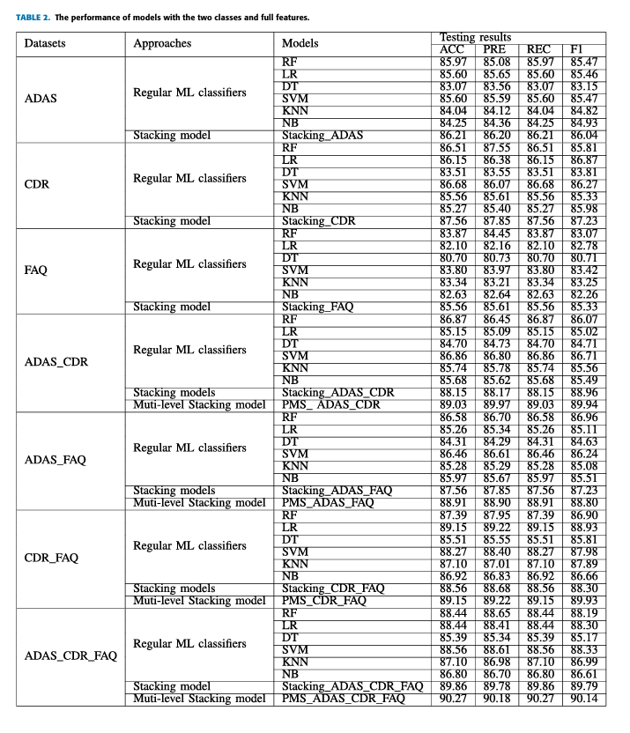
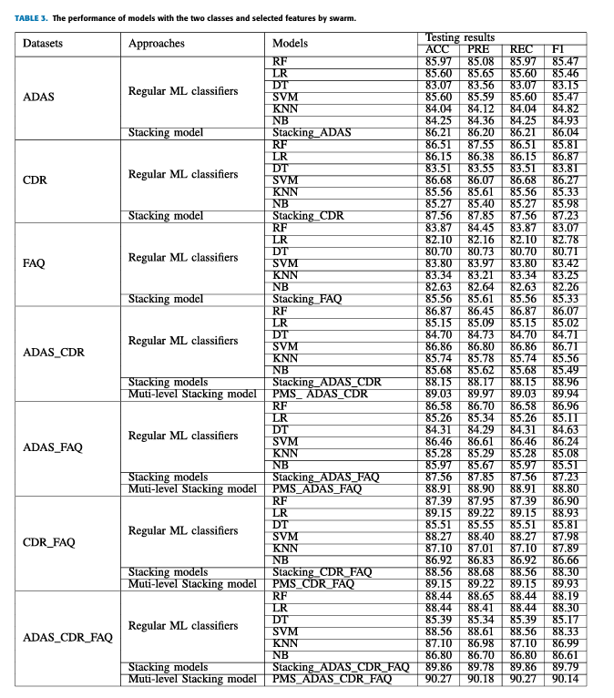
Results and Analysis:

Slide 18
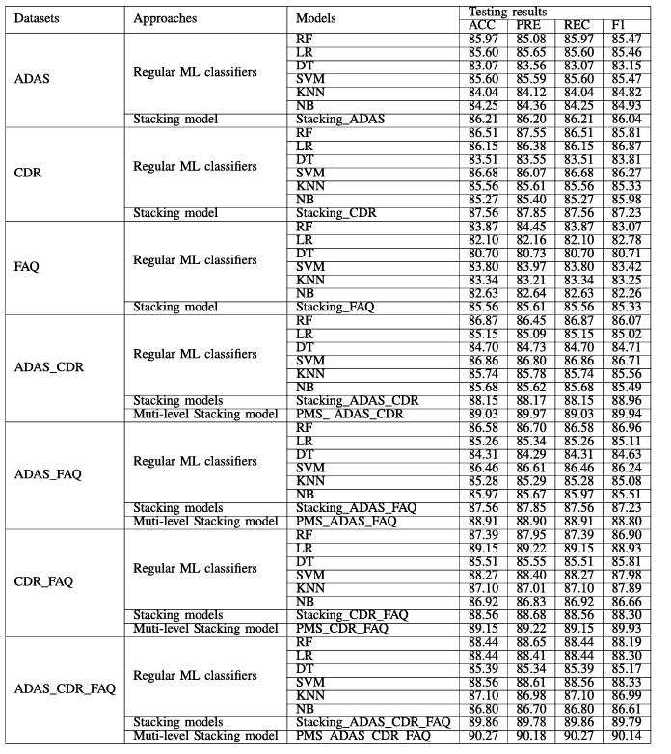
Results and Analysis:

Slide 19
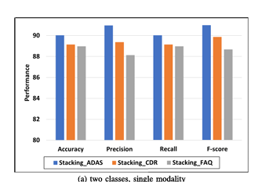
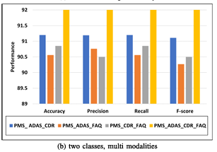
Visual Comparison:
The results of two classes AD and CN The best models for each modality
Figure : The best models for each modality with two classes and selected features

Slide 20
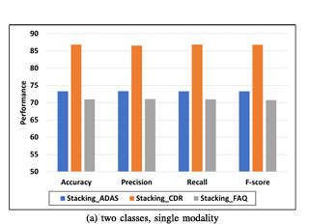
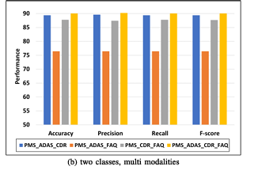
Visual Comparison:
Figure : The best models for each modality with three classes and selected features

Slide 21
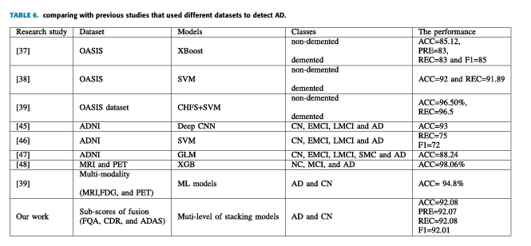
Comparison
.

Slide 22
SHAP AnalysisSHAP (SHapley Additive exPlanations)
SHAP (SHapley Additive exPlanations) values are a way to explain the output of any machine learning model.
Model Interpretability
Used to make the machine learning model interpretable
Transparency in Black-Box Models
Explains the model’s predictions, making them easier for doctors to interpret

Slide 23
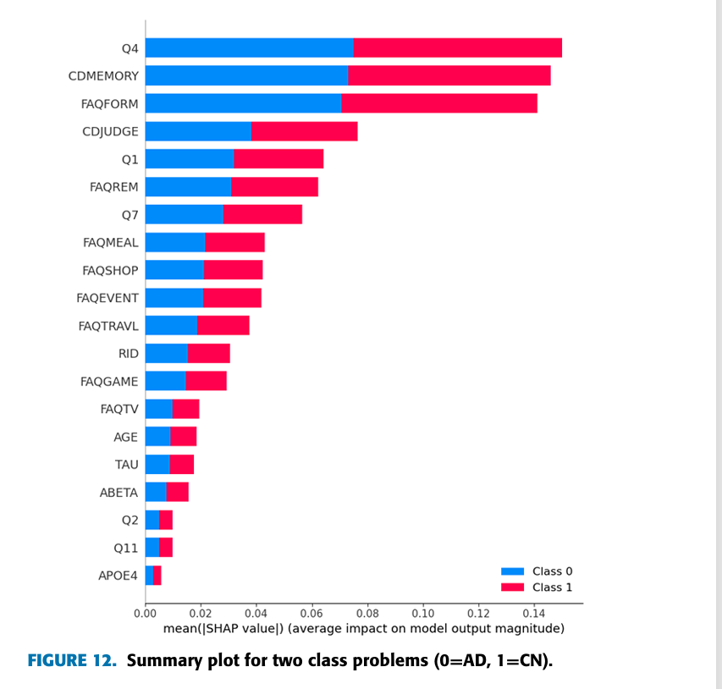
SHAP Analysis:
.
Figure :

Slide 24
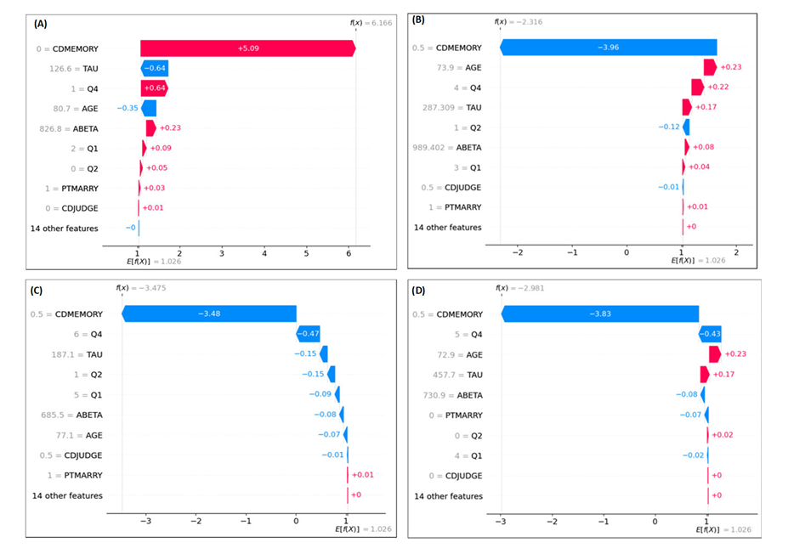
SHAP Analysis
.
Figure : Waterfall for three classes problem

Slide 25
References:
[1] A.Association, ‘‘2018 Alzheimer’s disease facts and figures,’’ Alzheimer’s Dementia, vol. 14, no. 3, pp. 367–429, Mar. 2018.
[2] S. Al-Shoukry, T. H. Rassem, and N. M. Makbol, ‘‘Alzheimer’s diseases detection byusingdeeplearningalgorithms:Amini-review,’’IEEEAccess, vol. 8, pp. 77131–77141, 2020.
[3] R. H. Blank and R. H. Blank, ‘‘Alzheimer’s disease and other dementias: An introduction,’’ in Social & Public Policy of Alzheimer’s Disease in the United States, 2019, pp. 1–26.
[4] World Health Origination. Accessed: 2023. [Online]. Available: https://www.who.int/news/item/07-12-2017-dementia-number-of-people affected-to-triple-in-next-30-years
[5] J.NeugroschlandS.Wang,‘‘Alzheimer’sdisease:Diagnosisandtreatment across the spectrum of disease severity,’’ Mount Sinai J. Med., J. Transl. Personalized Med., vol. 78, no. 4, pp. 596–612, Jul. 2011.
[6] M. S. Albert, S. T. DeKosky, D. Dickson, B. Dubois, H. H. Feldman, N. C. Fox, A. Gamst, D. M. Holtzman, W. J. Jagust, and R. C. Petersen, ‘‘The diagnosis of mild cognitive impairment due to Alzheimer’s disease: Recommendations from the national institute on aging-Alzheimer’s asso ciation workgroups on diagnostic guidelines for Alzheimer’s disease,’’ Focus, vol. 11, no. 1, pp. 96–106, 2013.

Slide 26
Conclusion:
A new multi-level stacking model has been proposed to predict Alzheimer's Disease (AD) with higher accuracy.
The study addresses classification problems with two classes (AD, CN) and three classes (AD, CN, sMCI).
The proposed multi-level stacking model outperformed single-level stacking and classical ML models, achieving the highest performance with selected features for both two-class (accuracy = 92.08%) and three-class (accuracy = 90.03%) problems.
Multi-modalities demonstrated superior results compared to single modalities.

Slide 27
A systematic review on machine learning and deep learning techniques in the effective diagnosis of Alzheimer’s disease
Authors:
Akhilesh Deep Arya,
Sourabh Singh Verma,
Prasun Chakarabarti,
Tulika Chakrabarti,
Ahmed A. Elngar,
Ali‑Mohammad Kamali and
Mohammad Nami

Slide 28
Table of contents
01
02
04
05
Visual Comparison
01
Introduction
06
02
Objectives
Limitations
03
03
Literature selection
07
Conclusion
04
Methodes & Models
28

Slide 29
Introduction:
Different Stages of MCI/AD:
Overview of Alzheimer's Disease (AD):
Progressive neurodegenerative condition
Primarily affects cognitive and memory functions in the elderly
Most cases of this disease are observed in people aging 65 and above
It is observed that people with higher education are at less risk
Early detection is crucial for:
Delaying mental health effects
Improving patient quality of life
Stage No | Stage Name
1 | Pre-clinical Alzheimer's disease
2 | Mild cognitive impairment (MCI)
3 | Mild dementia
4 | Moderate dementia
5 | Severe dementia due to Alzheimer’s disease

Slide 30
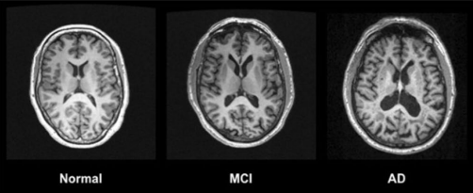
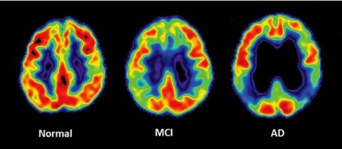
Current State of Research:
Advanced Diagnostics:
MRI and PET scans
Integration of machine learning and deep learning models for better diagnostic accuracy
Figure 1: MRI scans images of different stages of AD
Figure 2: PET scans images of different stages of AD

Slide 31
Objectives:
To analysis the models and methods used in different papers
Compare the accuracy of the models
Provide an overview about all the research works

Slide 32
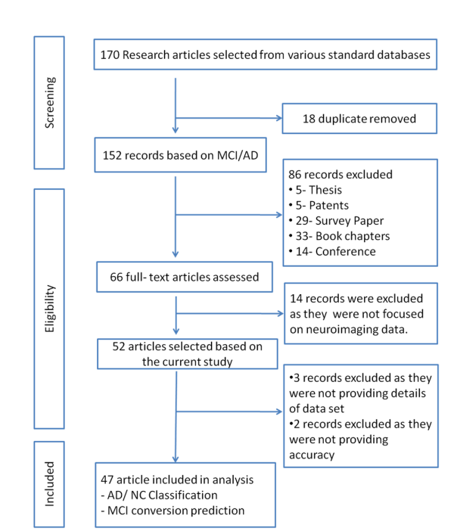
Literature selection:

Slide 33
Methodes and Models:
Pre-processing methods:
Image normalization
Image cropping and resizing
Image augmentation
Feature extraction
Data augmentation

Slide 34
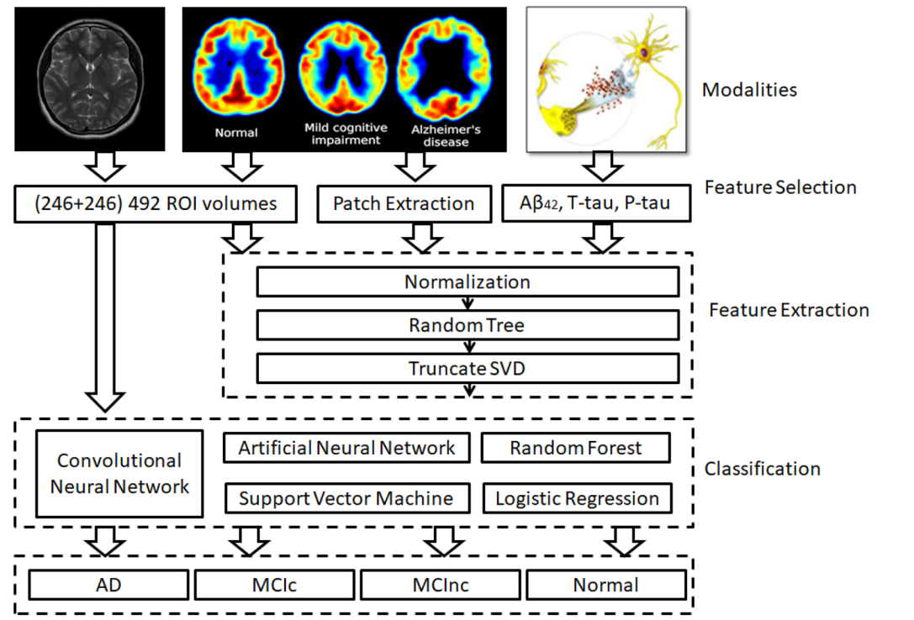
Methodes and Models
Figure: Description of modalities, feature selection, feature extraction, and classification algorithms used to predict AD and NC cases

Slide 35
Methodes and Models
Machine Learning Models:
Logistic Regression
Predicts the probability of a binary outcome (e.g., disease vs. no disease)
Works well for linear relationships
Support Vector Machine
Separates data into categories using a hyperplane
Effective for both linear and non-linear data
Random Forest
Uses multiple decision trees for predictions
Reduces overfitting and improves accuracy
Linear Discriminant Analysis (LDA):
Useful for classification tasks with multiple categories
Assumes data is normally distributed
Projects data into lower-dimensional space while maximizing class separability

Slide 36
Methodes and Models
Deep Learning Models:
ANN
A basic neural network with 1-2 hidden layers
DNN
A neural network with multiple hidden layers (deep architecture)
Learns hierarchical representations of data
RNN
Retains information from previous inputs (memory)
Can analyze progression over time, useful for disease progression prediction

Slide 37
Methodes and Models
CNN
Designed for image processing and pattern recognition
Captures spatial features like edges, shapes, and textures.
Widely used in medical imaging tasks
There are some specific CNN models used in prediction of Alzheimer's disease. Some models which provide better accuracy are given below:
ResNet101
Deep CNN with 101 layers
Excels in processing complex and detailed images
VGG
Deep CNN with a simple architecture (e.g., 16 or 19 layers)
Performs well on image classification tasks

Slide 38
Methodes and Models
VoxCNN
A CNN specifically designed for volumetric data (e.g., 3D brain scans)
Captures spatial and volumetric features effectively
DenseNet
Deep CNN where each layer connects to every other layer
Reduces redundancy and enhances feature propagation

Slide 39
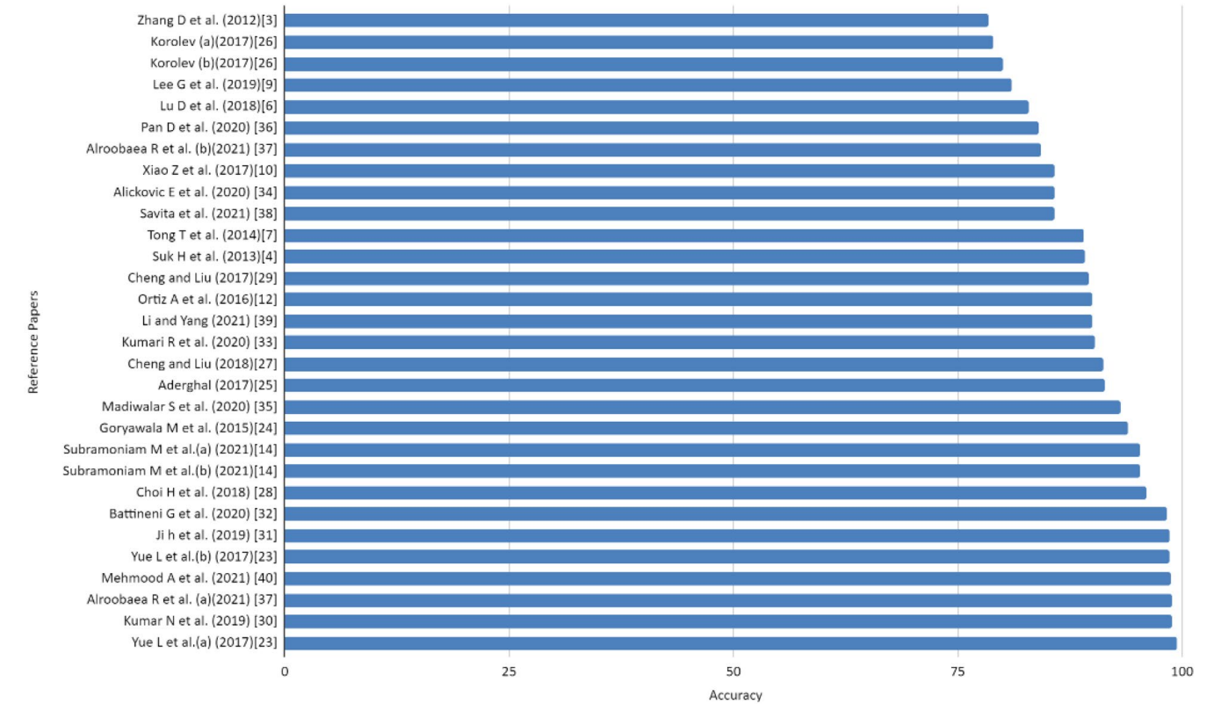
Visual Comparison
Comparison chart of accuracy derived from different articles:

Slide 40
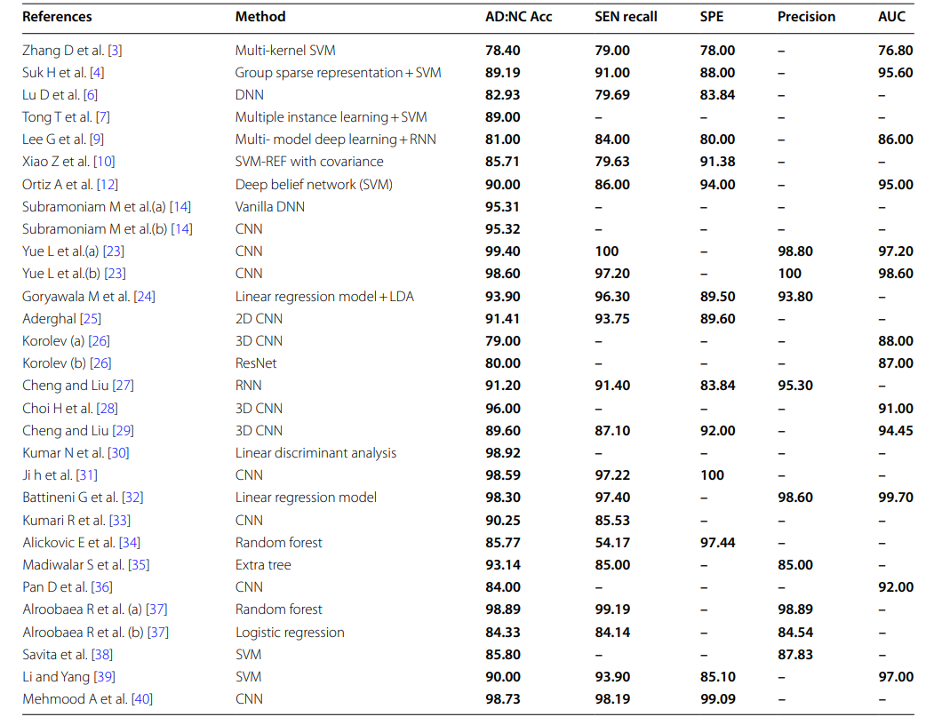
Table to represent Methodes and accuracy of the papers:

Slide 41
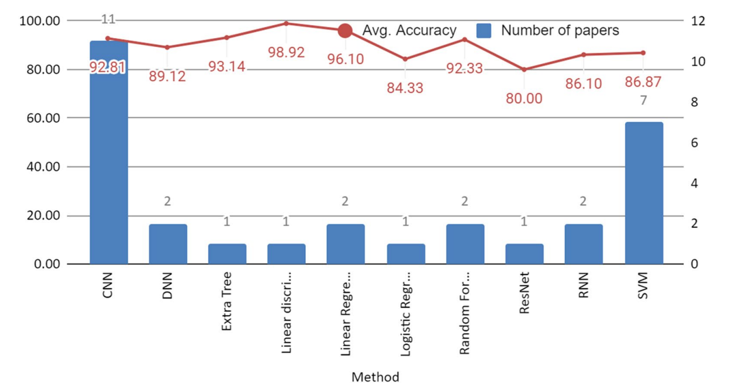
Frequency of methods used in different articles taken in the study, and average accuracy using different classifiers:

Slide 42
Limitations
Only worked with image data
XAI can be added

Slide 43
References
Alzheimer’s Association (2019) Alzheimer’s Disease Facts and Figures.
Alzheimer’s Association Report, 01 March 2019 15:321. https://doi.org/10.1016/j.jalz.2019.01.010
Bhushan I, Kour M, Kour G, et al. Alzheimer’s disease: Causes and treatment – A review. Ann Biotechnol. 2018; 1(1): 1002.
Zhang D (2012) Predicting future clinical changes of MCI Patients using longitudinal and multimodal biomarkers. PLoS ONE 7:1–15
Wee CY, Suk HII (2013) Discriminative Group Sparse Representation for Mild Cognitive Impairment Classification. Springer International Switzerland, Cham, pp 131–138
Verma SS, Prasad A, Kumar A (2022) CovXmlc: High performance COVID19 detection on Xray images using multimodal classification. Biomed Signal Processing Control 71:103272 6. Popuri K, Donghuan Lu (2018)
Multimodal and multiscale deep neural networks for the early diagnosis of Alzheimer’s disease using structural MR and FDG PET images. Sci Rep 8:1–13 7. Wolz R, Tong T (2014)

Slide 44
Conclusion
In the paper, authors tried to provide a review of all the research works published
By studying the paper, researchers can easily understand about all the published research works and get idea about proposed methodologies
This paper makes it easier for the researchers to grasp where they can contribute and how they can contribute

Slide 45


