Slide 1

Advancements in Alzheimer's Disease Research and Diagnosis
Presented by-
Farhana Akter Suci (B190305001)
Rifah Sajida Deya (B190305004)
Presented to-
Dr. Aminul Islam, PhD
Associate Professor, Jagannath University

Slide 2
A systematic review on machine learning and deep learning techniques in the effective diagnosis of Alzheimer’s disease
Akhilesh Deep Arya,
Sourabh Singh Verma,
Prasun Chakarabarti,
Tulika Chakrabarti,
Ahmed A. Elngar,
Ali‑mohammad Kamali and
Mohammad Nami

Slide 3
Table of contents
01
02
07
04
01
05
Introduction
Visual Comparison
02
Objectives
06
Limitations
03
03
Literature selection
Conclusion
04
Methodes & Models
1

Slide 4
Introduction
Different Stages of MCI/AD:
Overview of Alzheimer's Disease (AD):
Progressive neurodegenerative condition
Primarily affects cognitive and memory functions in the elderly
Most cases of this disease are observed in people aging 65 and above
It is observed that people with higher education are at less risk
Early detection is crucial for:
Delaying mental health effects
Improving patient quality of life
Stage No | Stage Name
1 | Pre-clinical Alzheimer's disease
2 | Mild cognitive impairment (MCI)
3 | Mild dementia
4 | Moderate dementia
5 | Severe dementia due to Alzheimer’s disease

Slide 5
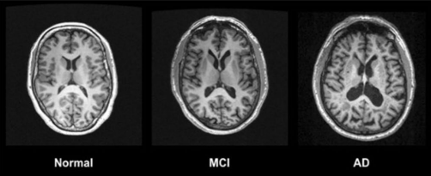
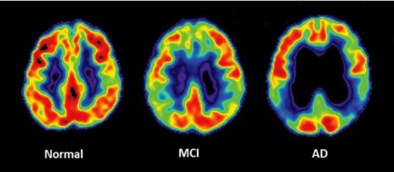
Current State of Research:
Advanced Diagnostics:
MRI and PET scans
Integration of machine learning and deep learning models for better diagnostic accuracy
Figure 1: MRI scans images of different stages of AD
Figure 2: PET scans images of different stages of AD

Slide 6
Objectives
To analysis the models and methods used in different papers
Compare the accuracy of the models
Provide an overview about all the research works

Slide 7
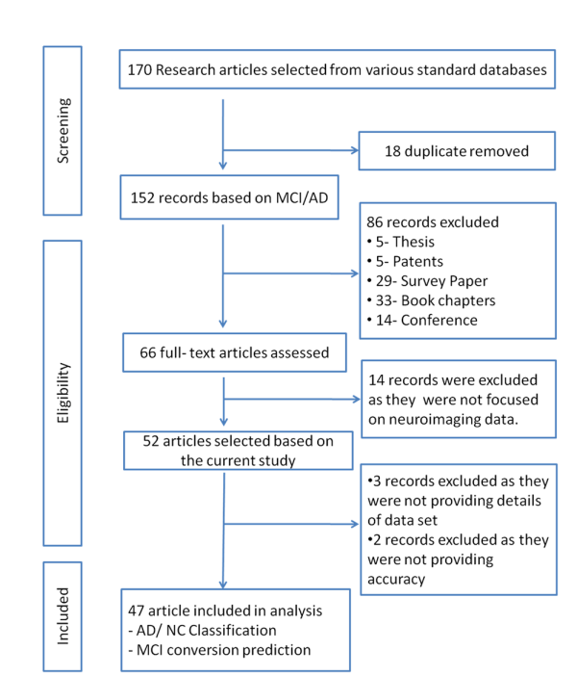
Literature selection

Slide 8
Methodes and Models
Pre-processing methods:
Image normalization
Image cropping and resizing
Image augmentation
Feature extraction
Data augmentation

Slide 9
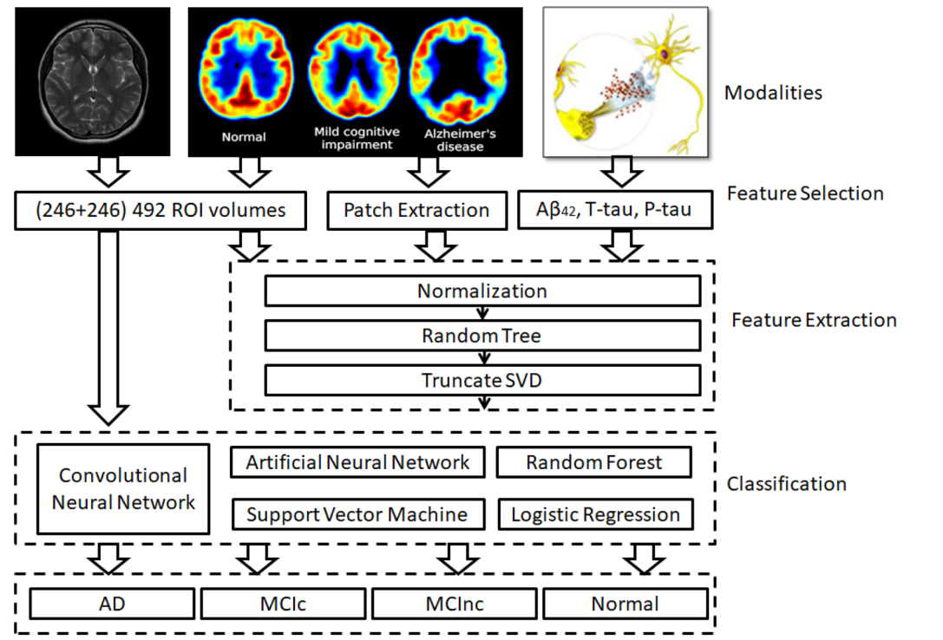
Methodes and Models
Figure: Description of modalities, feature selection, feature extraction, and classification algorithms used to predict AD and NC cases

Slide 10
Methodes and Models
Machine Learning Models:
Logistic Regression
Predicts the probability of a binary outcome (e.g., disease vs. no disease)
Works well for linear relationships
Support Vector Machine
Separates data into categories using a hyperplane
Effective for both linear and non-linear data
Random Forest
Uses multiple decision trees for predictions
Reduces overfitting and improves accuracy
Linear Discriminant Analysis (LDA):
Useful for classification tasks with multiple categories
Assumes data is normally distributed
Projects data into lower-dimensional space while maximizing class separability

Slide 11
Methodes and Models
Deep Learning Models:
ANN
A basic neural network with 1-2 hidden layers
DNN
A neural network with multiple hidden layers (deep architecture)
Learns hierarchical representations of data
RNN
Retains information from previous inputs (memory)
Can analyze progression over time, useful for disease progression prediction

Slide 12
Methodes and Models
CNN
Designed for image processing and pattern recognition
Captures spatial features like edges, shapes, and textures.
Widely used in medical imaging tasks
There are some specific CNN models used in prediction of Alzheimer's disease. Some models which provide better accuracy are given below:
ResNet101
Deep CNN with 101 layers
Excels in processing complex and detailed images
VGG
Deep CNN with a simple architecture (e.g., 16 or 19 layers)
Performs well on image classification tasks

Slide 13
Methodes and Models
VoxCNN
A CNN specifically designed for volumetric data (e.g., 3D brain scans)
Captures spatial and volumetric features effectively
DenseNet
Deep CNN where each layer connects to every other layer
Reduces redundancy and enhances feature propagation

Slide 14
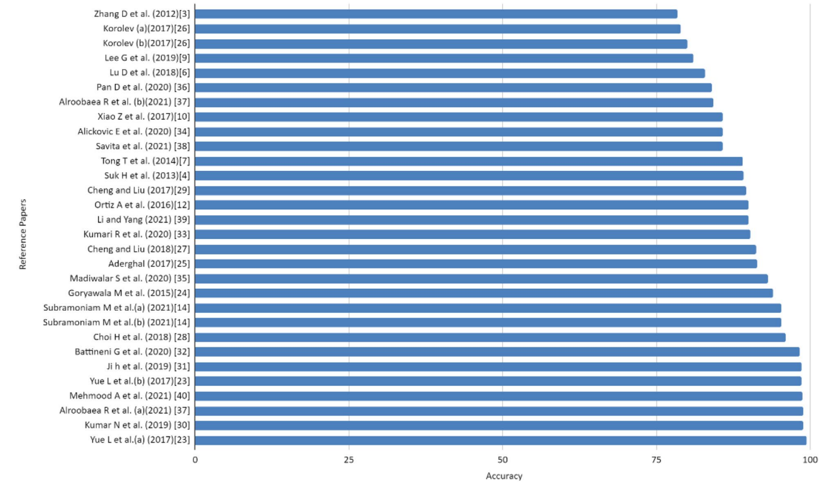
Visual Comparison
Comparison chart of accuracy derived from different articles:

Slide 15
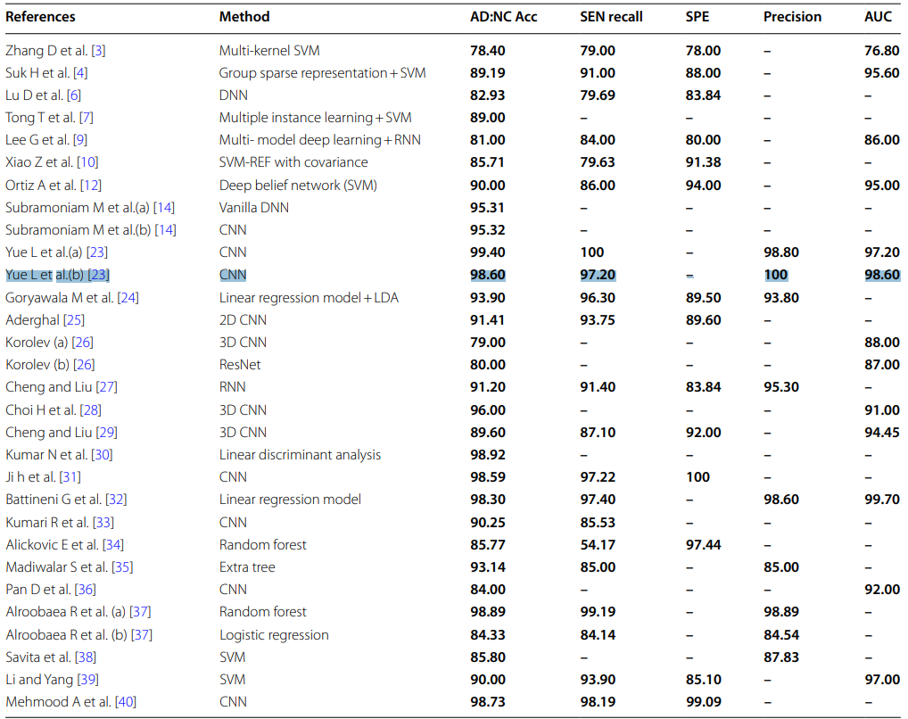
Table to represent Methodes and accuracy of the papers:

Slide 16
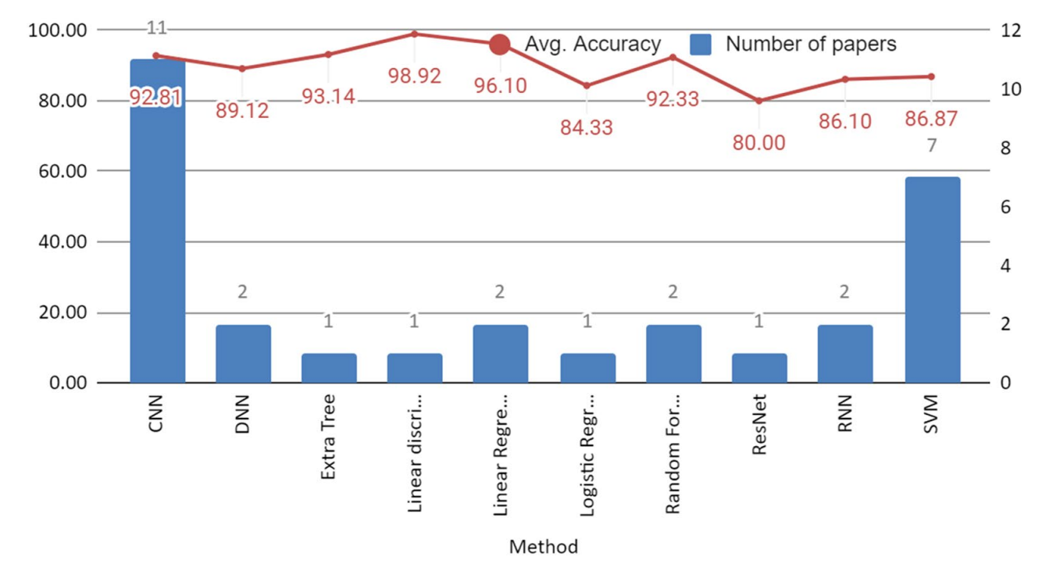
Frequency of methods used in different articles taken in the study, and average accuracy using different classifiers:

Slide 17
Limitations
Only worked with image data
XAI can be added

Slide 18
Conclusion
In the paper, authors tried to provide a review of all the research works published
By studying the paper, researchers can easily understand about all research works happened
This paper makes it easier for the researchers to grasp where they can contribute and how they can contribute

Slide 19
References
Alzheimer’s Association (2019) Alzheimer’s Disease Facts and Figures.
Alzheimer’s Association Report, 01 March 2019 15:321. https://doi.org/10.1016/j.jalz.2019.01.010
Bhushan I, Kour M, Kour G, et al. Alzheimer’s disease: Causes and treatment – A review. Ann Biotechnol. 2018; 1(1): 1002.
Zhang D (2012) Predicting future clinical changes of MCI Patients using longitudinal and multimodal biomarkers. PLoS ONE 7:1–15
Wee CY, Suk HII (2013) Discriminative Group Sparse Representation for Mild Cognitive Impairment Classification. Springer International Switzerland, Cham, pp 131–138
Verma SS, Prasad A, Kumar A (2022) CovXmlc: High performance COVID19 detection on Xray images using multimodal classification. Biomed Signal Processing Control 71:103272 6. Popuri K, Donghuan Lu (2018)
Multimodal and multiscale deep neural networks for the early diagnosis of Alzheimer’s disease using structural MR and FDG PET images. Sci Rep 8:1–13 7. Wolz R, Tong T (2014)

