Slide 1


Abstract Syntax Tree Generator for Python

Slide 2
Project Supervised by:
Kishan Kumar Ganguly,
Assistant Professor,
Institute of Information Technology,
University of Dhaka.
Project Presented by:
Rifah Tashfiha Faria
Roll: 1213
Exam Roll: 60902
BSSE 12th batch

Slide 3

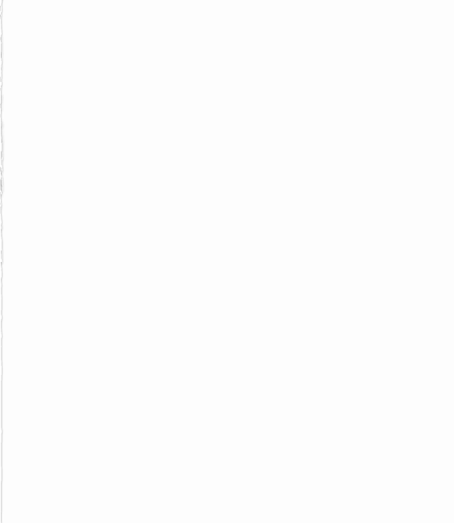
Table of Contents
01
What is Abstract Syntax Tree
02
Background Study of the Project
03
Implementation of the Project and Input & Output
04
Challenges
05
References and Github Link

Slide 4
What is Abstract Syntax Tree?
Abstract Syntax Tree (also known as AST) is tree representations of code.
It is called abstract because it does not represent every detail of the code, rather only the structural details.
It shows the logical structure of the code
Each node represents an action taken by the program
Acts as intermediate step of compiler/interpreter design

Slide 5
Background Study
Lexical Analysis Syntax Analysis Tree Making

Slide 6
Background Study
Lexical analysis reads the source code one character at a time and converts it into meaningful lexemes (tokens)
Syntax analysis takes tokens and produce a parse tree as an output
Tree representation for the AST
Prints the tree following the Syntax tree pattern

Slide 7
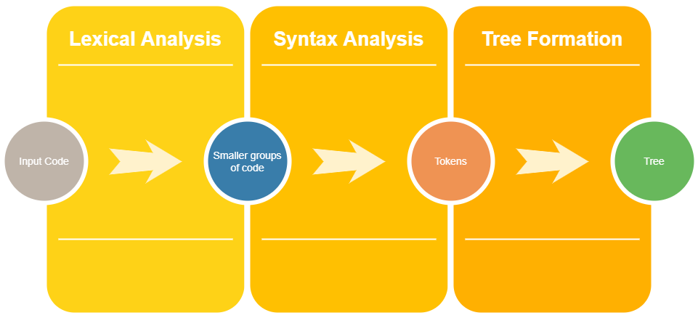
Implementation of the Project
It breaks down the code into small meaningful parts which are known as lexemes.
Syntax analysis is the process where syntactical structure is checked.
AST is a tree representation of code.

Slide 8
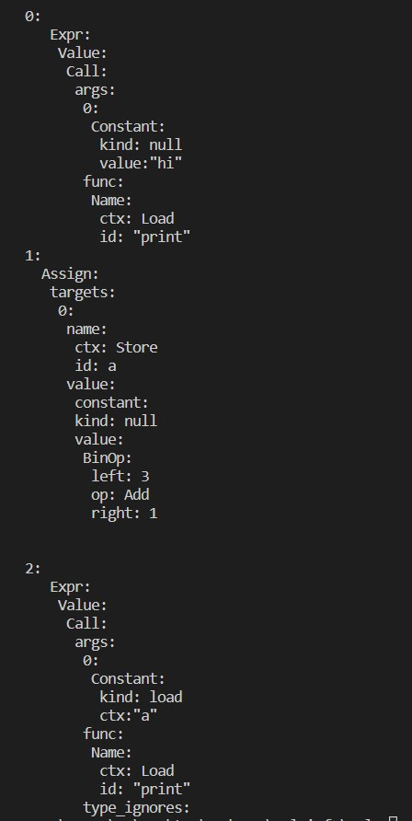

Input and Output of the Project
Input
Output

Slide 9
Challenges
Dealing with the input file
Tokenizing the file with different types of symbols, characters and spaces.
Removing comments
Counting indentation
Building header files
Using multiple header files
Printing the tree in the fixed format for python abstract syntax tree

Slide 10
References
[1] https://rosettacode.org/wiki/Compiler/lexical_analyzer#C.2B.2B , compiler/lexical analyzer, last accessed on 12-02-2022
[2] https://ruslanspivak.com/lsbasi-part7/, Abstract Syntax Tree, last accessed on 03-05-2022
[3]https://en.wikipedia.org/wiki/Abstract_syntax_tree#:~:text=Parse%20trees%20are%20typically%20built,analysis%20and%20program%20transformation%20systems., Abstract Syntax Tree, last accessed on 21-04-2022
[4]https://docs.python.org/3/library/ast.html#:~:text=The%20ast%20module%20helps%20Python,the%20Python%20abstract%20syntax%20grammar.&amp;text=The%20result%20will%20be%20a,built%2Din%20compile()%20function., Abstract Grammar, last accessed on 26-05-2022
[5] https://en.cppreference.com/w/cpp/header , Headers in C++, last accessed on 23-05-2022
[6] https://medium.com/basecs/leveling-up-ones-parsing-game-with-asts-d7a6fc2400ff, Abstract Syntax Tree, last accessed on 26-05-2022

Slide 11
Github Link
https://github.com/rifah43/SPL-1

Slide 12


