Slide 1
AEGIS
CLIMATE EMERGENCY RESPONSE NETWORK
FLOOD RESPONSE, RECONNECTED
RESIDENT
In a flood, information arrives fast. Help still arrives fragmented.
Wheelchair user upstairs
ROAD
South access is blocked
SHELTER
Residents, volunteers, shelters, weather, and field reports rarely meet in one trusted operating picture.
18 spaces available
VOLUNTEER
Transport within 8 km
The dangerous gap is between receiving a signal and coordinating verified action.
Team 04 | Climate Emergency Response Assistant
01
Notes:
During a severe flood, the problem is not silence. It is a flood of disconnected signals. A resident may report a mobility need, a road may close, a shelter may have capacity, and a volunteer may be nearby. Without one trusted operating picture, the people with the greatest need wait the longest.

Slide 2
THE FAILURE
Response breaks where disconnected channels collide.
RAW REPORTS
Duplicate, conflicting, incomplete
PRIORITY
→
MANUAL
BOTTLENECK
One coordinator
Multiple spreadsheets
No shared status
Life-safety needs stay buried
COMMUNITY AID
Offers without verification
CAPACITY
→
→
Useful resources sit idle
LIVE CONDITIONS
Weather and access change quickly
TRUST
→
Automation can amplify bad data
AEGIS
Problem framing from implemented AEGIS workflows
02
Notes:
Legacy response fails at the coordination point. Unstructured reports, community offers, and changing conditions all arrive at one manual bottleneck. The result is delayed priority, unused capacity, and a dangerous temptation to automate decisions before evidence is verified.

Slide 3
THE SOLUTION
AEGIS creates one verified operating loop.
1
→
2
→
3
→
4
→
5
ASK
VERIFY
MATCH
ROUTE
AUTHORIZE
Residents describe need and location
Coordinators separate evidence from claims
Verified volunteers and shelters fit the need
Live staging and route options support action
A person approves the response and alert
AEGIS does not dispatch independently. It organizes evidence, proposes matches and routes, and records the authorized human decision.
AEGIS
Human authorization is an implemented control
03
Notes:
AEGIS connects the full response loop without removing human authority. The system structures the request, supports verification, finds compatible verified resources, calculates route options, and then waits for a coordinator to authorize action. Every decision remains visible and auditable.

Slide 4
THE USERS
Three focused experiences create one shared operational truth.
RESIDENT
COMMUNITY
COORDINATOR
Get help
Offer support
Coordinate response
State the need, location, and vulnerability. See immediate safety guidance and verified nearby capacity.
Register volunteer skills, travel radius, shelter space, accessibility, pets, and backup power.
Verify evidence and offers, choose staging sites, match resources, route aid, and authorize action.
One record follows the incident from request to verification, assignment, alert, and audit.
AEGIS
Implemented entry points: /help, /support, /operations
04
Notes:
Each user gets a focused interface. Residents do not see a command dashboard. Volunteers and shelter providers do not authorize assignments. Coordinators do not have to reinterpret disconnected forms. All three experiences contribute to one shared operational record.

Slide 5
ARCHITECTURE
Specialized agents turn live signals into one reviewable response plan.
RESIDENTS
Help requests
PRIORITY
Verified incident queue
→
AEGIS ORCHESTRATION
Alert aggregation
Collect and normalize
Risk assessment
Severity and confidence
PLAN
Matched resources and routes
COMMUNITY
Volunteer and shelter capacity
Resident guidance
Localized instructions
Vulnerability priority
Accessibility and transport
→
→
COMMUNICATION
Bilingual public guidance
Volunteer coordination
Skills and radius
Aid routing
Capability and route
LIVE SOURCES
Weather, map, staging, routes
→
Emergency summary
Coordinator briefing
AUDIT
Recommendations and approvals
Nominatim • Open-Meteo • Overpass • OSRM • Gemini or rules fallback
HUMAN AUTHORIZATION
AEGIS
Implemented architecture and specialized agent workflow
05
Notes:
The architecture has four concrete parts. Residents, community providers, and live sources supply current inputs. Seven specialized agents structure alerts, risk, guidance, vulnerability, volunteers, routing, and summaries. Nominatim, Open-Meteo, Overpass, OSRM, and Gemini or the rules fallback provide operational services. The result is a priority queue, response plan, public guidance, and audit record that still require human authorization.

Slide 6
DECISION QUALITY
Confidence and severity remain separate throughout the decision.
SEVERITY ↑
Monitor
Low severity
Low confidence
Prepare
Low severity
High confidence
WHAT THE SYSTEM DOES
1
Corroborates
Groups matching reports without turning repetition into certainty.
2
Preserves uncertainty
Verify fast
High severity
Low confidence
Escalate
High severity
High confidence
Unique or unsupported claims stay visibly unverified.
3
Escalates vulnerability
Mobility, medical, child, older-adult, and transport needs affect priority.
EVIDENCE CONFIDENCE →
AEGIS
AEGIS incident assessment and verification logic
06
Notes:
A severe report can still be uncertain, and a well-corroborated report can still be low severity. AEGIS keeps those dimensions separate. This prevents false certainty while still escalating cases that contain life-safety or accessibility needs.

Slide 7
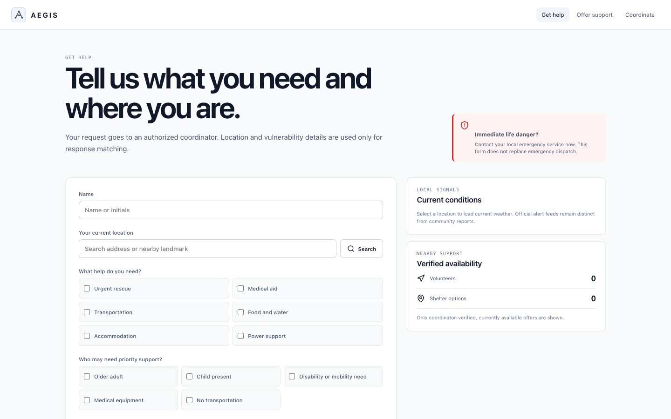
RESIDENT JOURNEY
People can ask for the right help without learning emergency jargon.
1
Enter name or initials
2
Search an address or landmark
3
Choose needs and vulnerability
4
Submit for coordinator verification
Immediate danger guidance stays visible.
AEGIS
Live product screenshot captured from /help
07
Notes:
The resident starts from Get help. They enter a name or initials, search their real location, choose the help they need, and identify anyone who may require priority support. The interface also makes clear that immediate life danger still requires the local emergency service. The submitted request goes to a coordinator for verification.

Slide 8
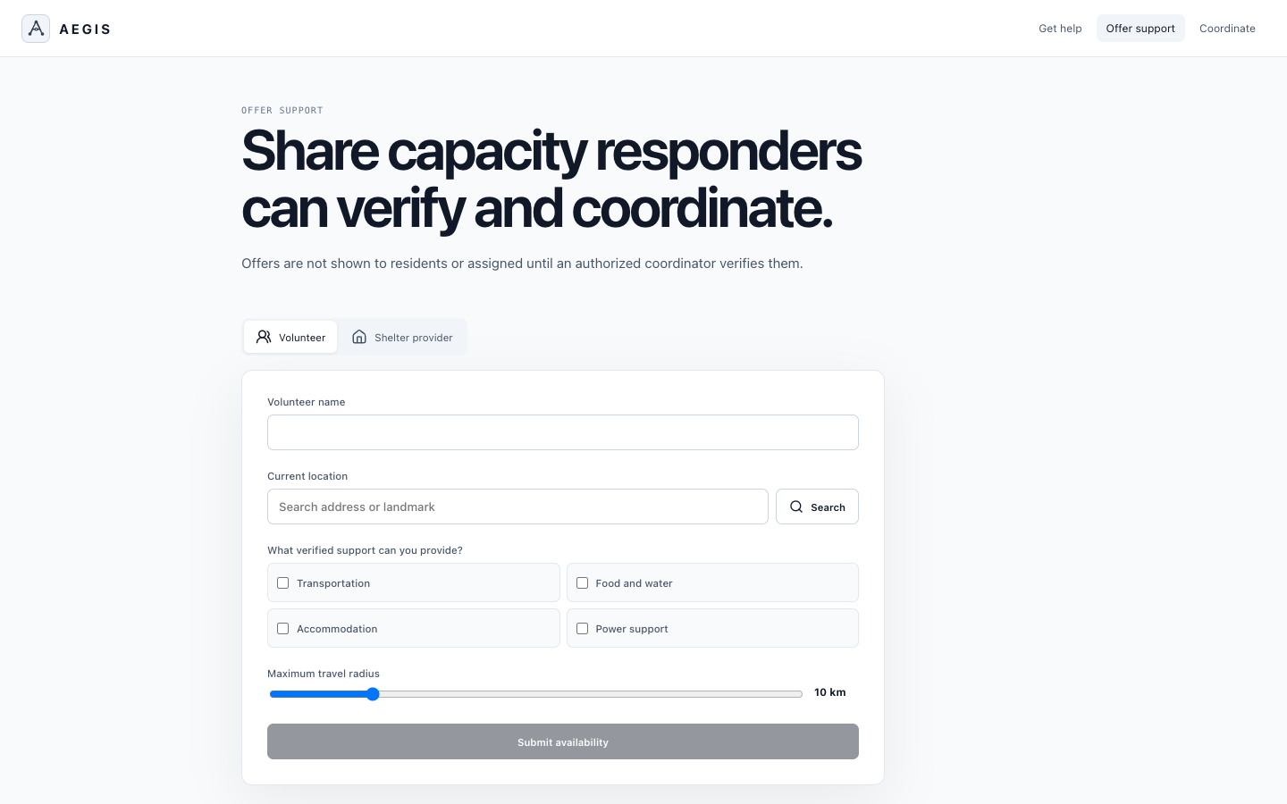
COMMUNITY CAPACITY
Volunteer and shelter offers become useful only after verification.
REGISTER
Volunteer
Location, skills, travel radius, availability
Shelter provider
Spaces, step-free access, pets, backup power
↓
Coordinator verifies identity, capability, and current capacity before matching.
AEGIS
Live product screenshot captured from /support
08
Notes:
The Offer support path contains two registration modes. Volunteers provide a location, skills, travel radius, and availability. Shelter providers publish spaces and operational constraints such as accessibility, pets, and backup power. Nothing is exposed or assigned until an authorized coordinator verifies it.

Slide 9
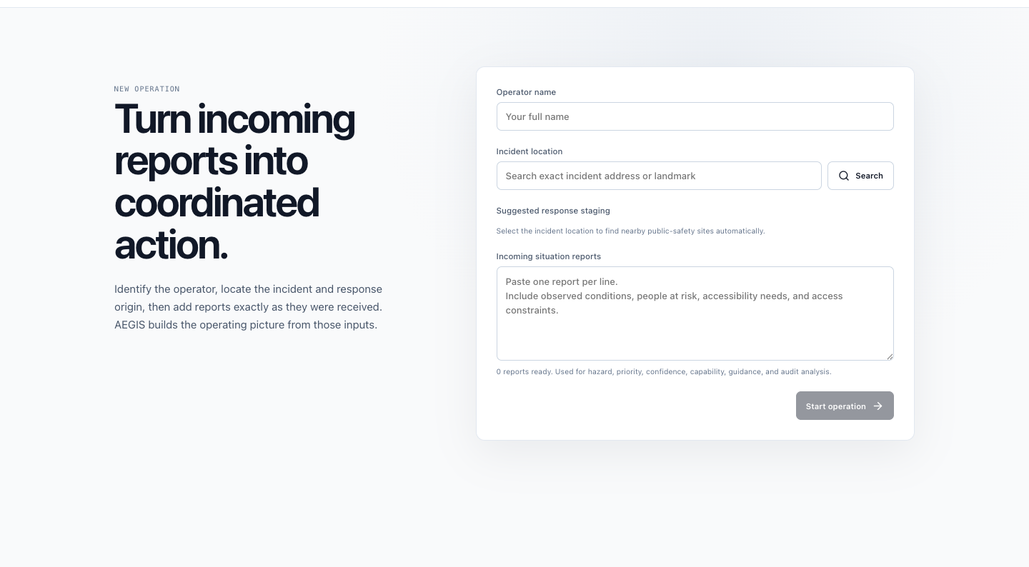
COMMAND WORKFLOW
Coordinators see priority, staging, routes, and accountability together.
1
Import or enter reports
2
Review all suggested staging sites
3
Select multiple staging points
4
Verify offers and match resources
5
Approve route, alert, and audit
One decision record, from intake to authorization.
AEGIS
Live product screenshot captured from /operations
09
Notes:
The coordinator begins with real reports and a searched incident location. AEGIS automatically finds nearby public-safety staging candidates and allows multiple sites for parallel response. The coordinator verifies volunteer and shelter offers, reviews the proposed route, and authorizes the plan. Every step contributes to the final audit record.

Slide 10
LIVE DEMO
The complete value story fits in two minutes.
0:00
0:25
0:45
1:05
1:28
1:45
2:00
START
MAP
VERIFY
ROUTE
ALERT
AUDIT
CLOSE
Choose a role and enter real inputs
Geocode the location and load weather
Separate evidence from claims
Select staging and response capacity
Review English and French guidance
Show recommendations and approvals
Verified, routed, human-authorized
Demo point of view: a municipal or NGO duty officer coordinating one evolving flood incident.
AEGIS
Detailed script in docs/DEMO_SCRIPT.md
10
Notes:
For the live demo, we act as a municipal or NGO duty officer. We enter real inputs, show live location and weather, inspect evidence and vulnerability, choose staging and resources, review the route, authorize a bilingual alert, and finish with the accountability record. The entire narrative takes two minutes.

Slide 11
AI AND DATA
AI accelerates judgment without replacing it.
ACTIVE RESPONSE
PREPAREDNESS CONTEXT
169,109
historical disaster reports
Resident and community reports
Current evidence
58
Toronto climate variables
Nominatim, Open-Meteo, Overpass, OSRM
Live services
1,023
resident survey responses
Gemini 3.5 Flash or rules fallback
Structured assessment
54
African country indicator files
5
Montréal emissions sectors
HUMAN AUTHORIZATION
Preparedness data does not decide active triage.
AEGIS
docs/DATA_AUDIT.md and implemented service adapters
11
Notes:
AEGIS uses current reports and live services for active response. Gemini structures the assessment when available, and a deterministic rules engine preserves the workflow when it is not. Historical climate, survey, and emissions datasets support preparedness and product calibration. They are deliberately separated from active incident triage to avoid geographic or demographic bias.

Slide 12
SOCIETAL VALUE
AEGIS strengthens resilience before, during, and after a flood.
BEFORE
DURING
AFTER
Preparedness
Coordination
Accountability
Understand climate exposure, accessibility gaps, and community capacity.
Prioritize vulnerability, verify resources, route aid, and communicate clearly.
Review evidence, decisions, response gaps, and readiness improvements.
One request. The right verified help. A coordinated response people can trust.
AEGIS
AEGIS closing thesis
12
Notes:
The societal value extends across the whole emergency cycle. Before a flood, cities and NGOs can understand readiness gaps. During the event, they can coordinate verified help around vulnerability and real conditions. Afterward, they can review the complete decision record and improve the next response. AEGIS turns one request into coordinated action people can trust.

