Slide 1
A Thesis on Predicting Club Football Player Transfer Possibility
based on
Machine Learning and Ensemble Learning
International Islamic University Chittagong
Department of Computer Science & Engineering
Supervised by
Mohammad Mahmudur Rahman
Assistant Professor
Dept of CSE
IIUC
Presented by
Md. Rifat Talukder
ID: C151112
Mahmudul Hasan
ID: C151118
Department of CSE,IIUC

Slide 2
Presentation Outline
01
Introduction
Objective
Literature Review
Contribution
Proposed Work
Methodology
Dataset
Data Pre-Processing
Tokenization
Remove Stop Words
Lemmatization
Feature Extraction
Result of Machine Learning Classifier (TF-IDF)
ROC and Precision, Recall Curve (TF-IDF)
Result of Machine Learning Classifier (Bag-of-Words)
ROC and Precision, Recall Curve (Bag-of-Words)
Result of Ensemble Learning Classifier (GloVe)
ROC and Precision, Recall Curve (GloVe)
Result of Ensemble Learning Classifier (GoogleNews)
ROC and Precision, Recall Curve (GoogleNews)
Classifier
Experimental Result
Experimental Result (SVM)
Experimental Result (Naïve Bayes)
Experimental Result (Logistic Regression)
Experimental Result (Random Forest)
Experimental Result (AdaBoost)
Evaluation
Accuracy of Machine Learning Classifier
Precision in Machine Learning Classifier
Recall in Machine Learning Classifier
F1-score in Machine Learning Classifier
Timeline Diagram
Conclusion
Future Work
Reference

Slide 3
Introduction
02
We have investigated the possibility to use machine learning and ensemble learning algorithms for classify the probability of a football player transfer chance using text classification.
This thesis compares these techniques in terms of their accuracy, precision, recall, and f1 score by testing their performances using a sports news corpus dataset that is developed here.
This thesis also is a algorithmic analysis to find the best technique for text classification.

Slide 4
Objective
03
To drive the international and national research agenda in text classification informed by the collected experience of the club football community, allied to existing and developing knowledge and evaluation of the state of art.
To consolidate, evolve and promulgate best practice from sports related text classification into other domain.
To widen awareness and participation in text classification in the club football player transfer in the time of player transfer window.
To maintain and develop links with football club and tools suppliers, to establish best practice and provision.
To find out which classification algorithm and methods of data preparation are most useful in text classification.

Slide 5
Literature Review
04
Sr No. | Title | Author | Method | Description
1. | A Comprehensive Study of Text Classification Algorithms | Vikas K Vijayan, Bindu K.R, Latha Parameswaran | KNN, Naïve Bayes, SVM,Regression, Decision Tree | In this paper, author discussed a detailed survey on the text classification process and various algorithms used in this field.
2. | A Survey on Text Classification Techniques for Sentiment Polarity Detection | Mr.Arunachalam N, MadhuMathi G | ID3, Naïve Bayes, SVM | In This paper, author discussed various text classification techniques for opinion mining. This paper mainly focuses on various existing issues that cause difficulties to perform text classification for mining the opinions of users.
3. | Comparing text classifiers for sports news | Tarik S. Zakzouk and Hassan I. Mathkour | SVM, Naïve Bayes, C4.5 | In this paper, author revisit text classification field using both commodity software and hardware to show progress of both efficiency and effectiveness of a group of ML-based methods in classifying Cricket sports news articles.

Slide 6
Literature Review (2)
05
4. | An Improved Multi-label Classification Ensemble Learning Algorithm | Zhongliang Fu, Lili Wang, and Danpu Zhang | AdaBoost | In this paper, author proposed an improved algorithm based on minimizing the weighted error of mistake labels and miss labels in multi-label classification ensemble learning algorithm. The new algorithm aims to avoid local optimum by redefining weak classifiers.
5. | Evaluation of Text Classification Techniques for Inappropriate Web Content Blocking | Igor Kotenko, Andrey Chechulin,Dmitry Komashinsky | Decision Tree Classifiers | In this paper, author devoted to the issues of automated categorization of textual information which can be applied in the systems intended to block inappropriate content. The text classification component, developed as a result of this paper, is intended for realization in F-Secure systems aiming to block inappropriate web content.
6. | Research on Energy-Efficient Text Classification | Hao Lin | WCNB, SVM, Perceptron | In this paper, author evaluated the energy cost of different classifiers and reduce energy cost by parallelization, trying to find a classifier that performs best on both aspects – effectiveness and efficiency.

Slide 7
Literature Review (3)
06
7. | Multi-Label Classification: An Overview | Grigorios Tsoumakas, Ioannis Katakis | KNN, C4.5, Naïve Bayes, SMO | In this paper, author introduced the task of multi-label classification, organizes the sparse related literature into a structured presentation and performs comparative experimental results of certain multi-label classification methods.
8. | Model-Shared Subspace Boosting for Multi-label Classification | Rong Yan, elena Tesic, John R. Smith | MSSBoost, NSBoost, RSBag | In this paper, author propose an efficient and effective multi-label learning algorithm called model-shared subspace boosting (MSSBoost) as an attempt to reduce the information redundancy in the learning process. This algorithm automatically finds, shares and combines a number of base models across multiple labels, where each model is learned from random feature subspace and bootstrap data samples.
9. | An Enhanced Data Mining Model for Text Classification | K. Nithya, P C D.Kalaivaani, R.Thangarajan | SVM, Naïve Bayes, KNN, Logistic Regression | In this paper, author proposed a mining model consists of sentence-based concept analysis, document-based concept analysis, and corpus-based concept-analysis. Then they analyze the term that contributes to the sentence semantics on the sentence, document, and corpus levels rather than the traditional analysis of the document only.

Slide 8
Contribution
07
We created the dataset by web scrapping from different sports news corpus.
We have created our dataset with 3000 valid data from the last club football player transfer window news.
We used machine learning and ensemble learning approach for analyzing, which best classification techniques are most useful?
We used different feature extraction approach and try to find out which methods of data preparation are most useful.
There is not any existing work on club football player transfer window news and sports news corpus text classification.

Slide 9
Proposed Work
The system will be provided text classification using Naïve Bayes, SVM, Logistic Regression, Random Forest and AdaBoost algorithm.
Machine learning and Ensemble learning both approaches are used in this text classification system.
Data cleaning, tokenization, stop word removal and lemmatization are done for dataset preprocessing.
TF-IDF, BOW, Word2vec method are used in the feature extraction process.
Dataset for simulation: 2 group
A comparison of the existing and proposed systems will be provided.
08

Slide 10
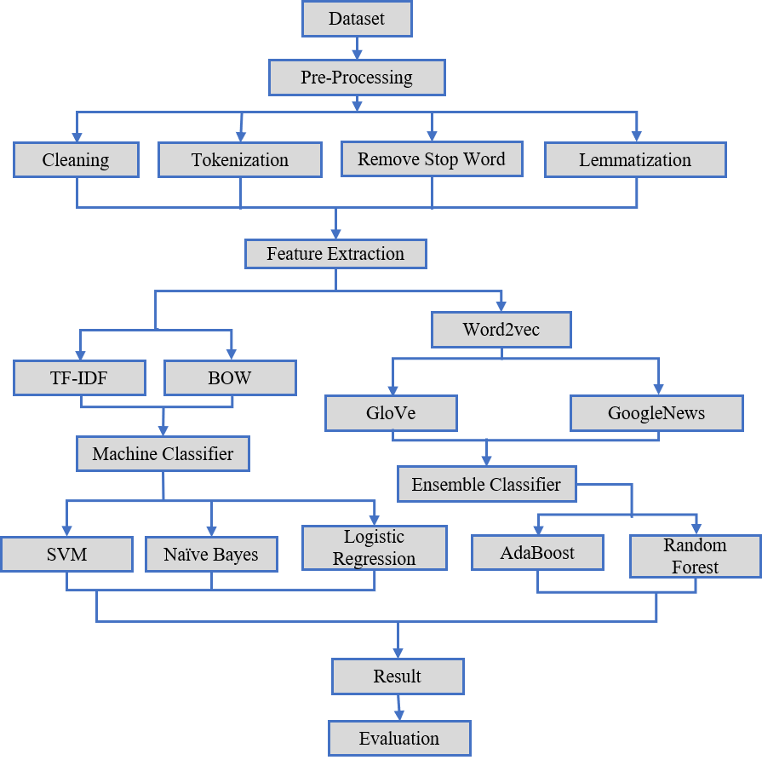
Methodology
09

Slide 11
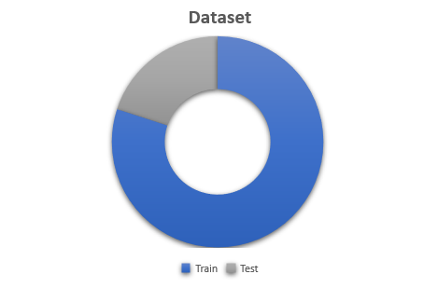
Dataset
News
Rooney didn’t want to leave Man Utd for City but I had to fight to keep him, admits Moyes.
There are certainly clubs interested in Kane.
Solskjaer confirms Man Utd are looking to sign a striker.
Maddison urged to snub Man Utd move by former Leicester boss Adams.
Messi could return for Barcelona's Champions League clash with Inter.
Japan legend Honda offers to play for Man Utd.
Barca want Chelsea's Willian on free transfer.
Liverpool boss Klopp confirms new contract talks with Milner.
Perez signs new Barcelona contract after first-team breakthrough.
10
The dataset used for the experiments contains sentences sampled from player transfer news.
Data found on different sports news agency website.
We collect 3000 data by scrapping the sports news agency website.
Source:www.newsnow.co.uk, www.90min.com, www.goal.com, www.express.co.uk, www.foxsports.com.au, www.espnfc.com, www.skysports.com
We label these data manually like; Negative data labels by 0 and Positive data label by 1.
We split 2400 data to train our model and use 600 data to test our model.

Slide 12
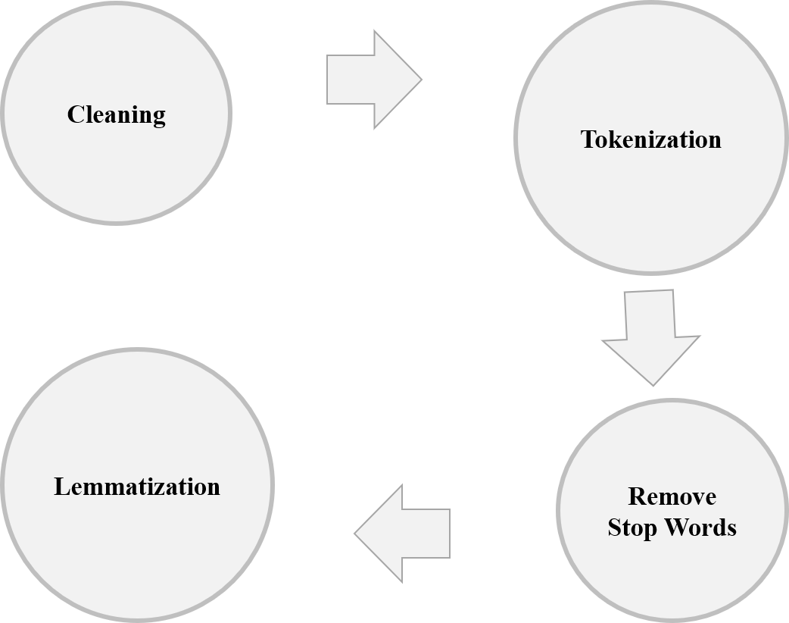
Data Pre-Processing
11

Slide 13
Cleaning
12
Used regular expression to find out the text fields that have to be in a certain patterns.
Detect unexpected, incorrect, and inconsistent data from our dataset.
Fix and remove the anomalies discovered.
After cleaning, the results are inspected to verify correctness.

Slide 14
Tokenization
13
Word | Word-level type | Sentence-level type
Manchester United 's Marcus Rashford could be out for a little while , manager Ole Gunnar Solskjaer has said . | WORD WORD SUFFIX WORD WORD WORD WORD WORD WORD WORD WORD WORD PUNCTUATION WORD WORD WORD WORD WORD WORD PUNCTUATION | BEGINOFSENTENCE NEWPARAGRAPH NOSPACE ENDOFSENTENCE
We use Ucto tokenization in our system.
Ucto first splits a text into fragments based on spaces.
These fragments are then compared to language-specific regular expressions.
If a match is found, the matching part of the fragment is marked as a word token, and labeled with the matching regular expression.
Remaining parts are seen as a separate fragments that are subsequently matched.

Slide 15
Remove Stop Words
14
Input Data | Output Data
Liverpool Manager Jurgen Klopp Has Described The Signing Of Joel Matip On A Free Transfer From Schalke04 as The Club Has Done In Recent Years . | ‘ Liverpool’ ’ manager’ ’ Jurgen’ ’ Klopp’ ’ described’ ’ signing’ ’ Joel’ ‘Matip’ ’ free’ ’ transfer’ ’ from’ ’ Schalke04’ ’ club’ ’ done’ ’ recent’ ’ years’ ’.’
“Stop words” are the most common words in a language like “the”, “a”, “on”, “is”, “all”.
These words do not carry important meaning and are usually removed from texts.
We used NLTK libraries for removed stop words from our data.

Slide 16
Lemmatization
15
Lemmatization is the process of converting a word to its base form.
We use lemmatization because it considers the context and converts the word to its meaningful base form.
We use WordNetLemmatizer() in our system.
Before Lemmatization | After Lemmatization
Liverpool Manager Jurgen Klopp Delineate Signing Joel Matip Free Transfer From Schalke04 Club Done Begun Years . | liverpool manager jurgen klopp describe sign Joel Matip free transfer from schalke04 club do recent year .

Slide 17
Feature Extraction
16
One of the most important aspects of machine learning is to decide which features to use.
For various types of text classification problems similar to the one in this thesis, we used the most common baseline approach is the Bag-of-Words model, TF-IDF and Word2vec.
For word embedding purpose we used two pretrained model one is GoogleNews and another is Glove.

Slide 18
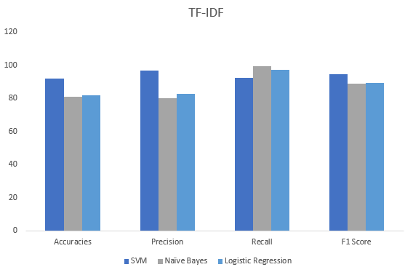
Result of Machine Learning Classifier (TF-IDF)
17
 | SVM | Naïve Bayes | Logistic Regression
Accuracies | 92 | 81 | 81.83
Precision | 96.78 | 80.15 | 82.92
Recall | 92.51 | 99.56 | 97.35
F1 Score | 94.59 | 88.81 | 89.56

Slide 19
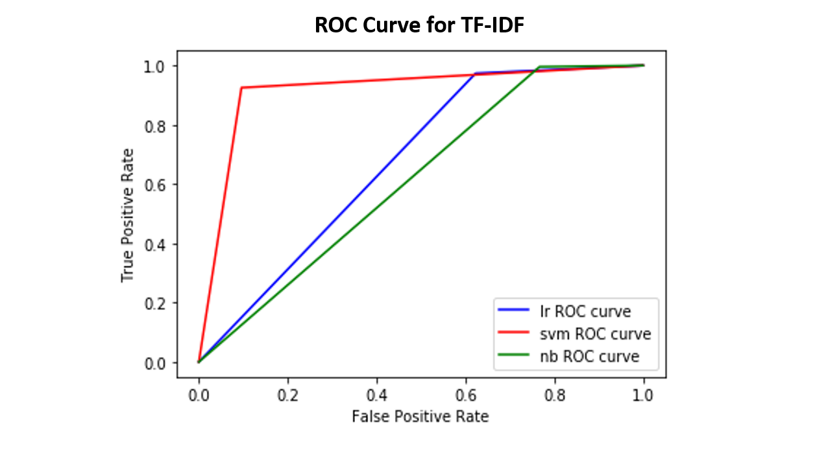
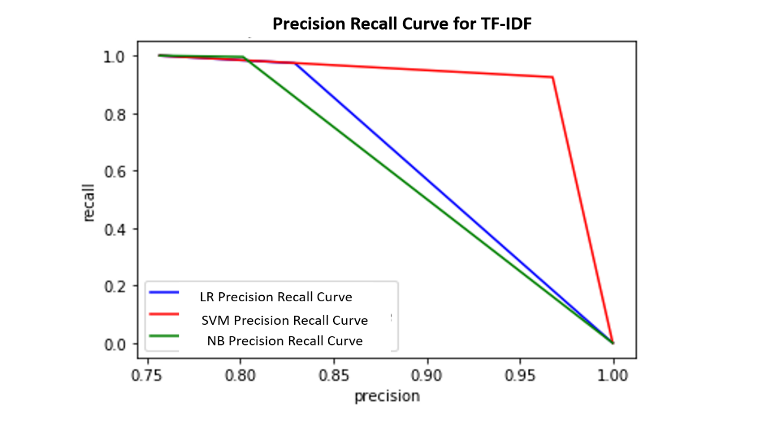
ROC and Precision, Recall Curve (TF-IDF)
18

Slide 20
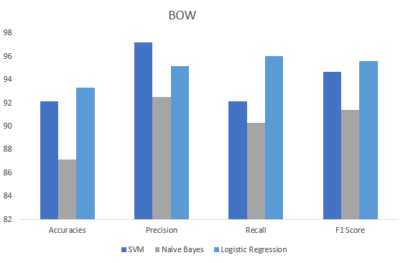
Result of Machine Learning Classifier (Bag-of-Words)
19
 | SVM | Naïve Bayes | Logistic Regression
Accuracies | 92.16 | 87.16 | 93.33
Precision | 97.21 | 92.55 | 95.19
Recall | 92.16 | 90.3 | 96.03
F1 Score | 94.68 | 91.41 | 95.61

Slide 21
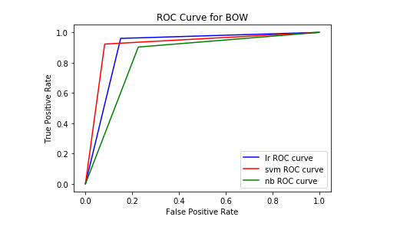
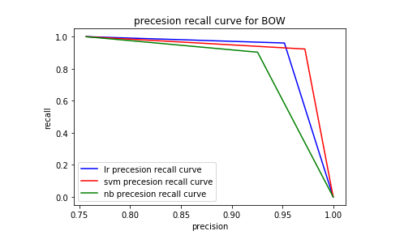
ROC and Precision, Recall Curve (BOW)
20

Slide 22
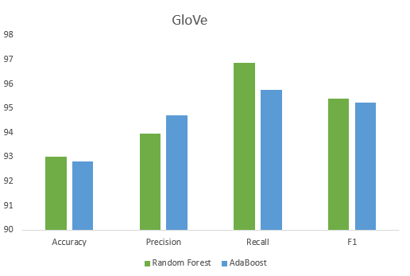
Result of Ensemble Learning Classifier (GloVe)
21
 | Accuracy | Precision | Recall | F1
Random Forest | 93 | 93.96 | 96.88 | 95.4
AdaBoost | 92.83 | 94.72 | 95.77 | 95.24

Slide 23
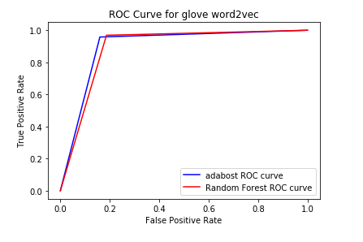
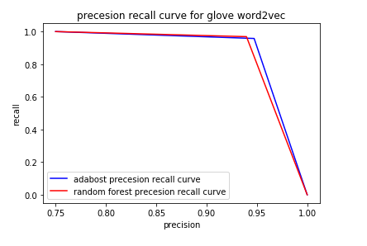
ROC and Precision, Recall Curve (GloVe)
22

Slide 24
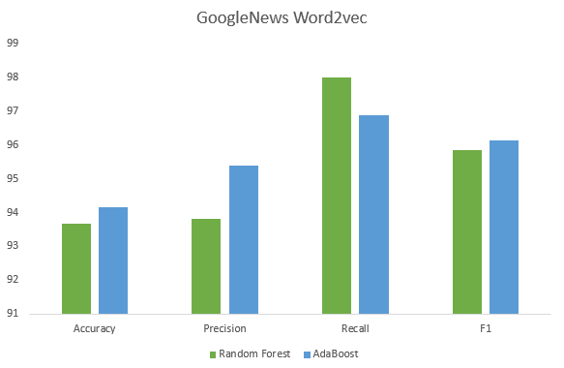
Result of Ensemble Learning Classifier (GoogleNews)
23
 | Accuracy | Precision | Recall | F1
Random Forest | 93.66 | 93.82 | 98 | 95.86
AdaBoost | 94.16 | 95.4 | 96.88 | 96.14

Slide 25
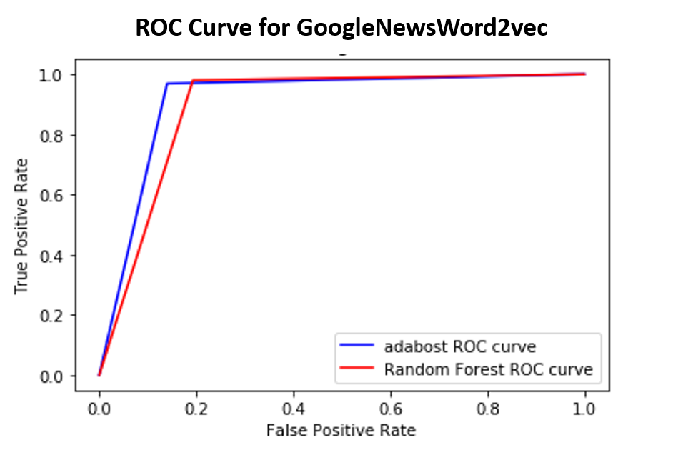
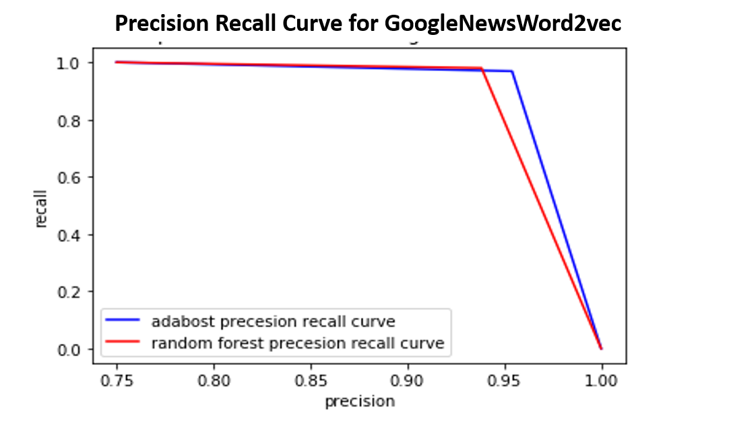
ROC and Precision, Recall Curve (GoogleNews)
24

Slide 26
Classifier
25
Machine Learning
Support Vector Machine
Naïve Bayes
Logistic Regression
Ensemble Learning
Random Forest
AdaBoost

Slide 27
Experimental Result
26
The Logistic Regression and SVM classifier produce the best results in the machine learning approach.
Logistic Regression classifier performs better with the Bag-of-Words feature extraction method.
SVM classifier performs better with the TF-IDF feature extraction method.
Naïve Bayes performs worst in the machine learning approach.
AdaBoost and the Random Forest classifier produce almost similar results in an ensemble learning approach.
AdaBoost classifier performs better than Random Forest with Glove.
Random Forest performs better than AdaBoost with GoogleNews.

Slide 28
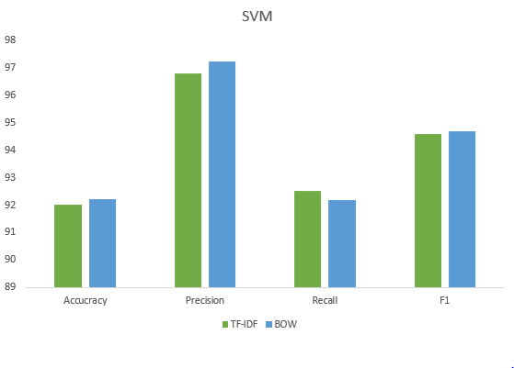
Experimental Result (SVM)
27
 | Accuracy | Precision | Recall | F1
TF-IDF | 92 | 96.78 | 92.51 | 94.59
BOW | 92.19 | 97.21 | 92.16 | 94.68

Slide 29
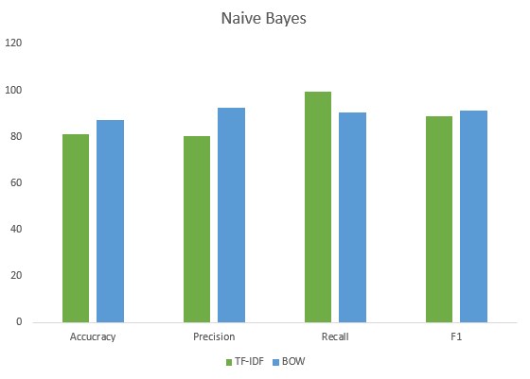
Experimental Result (Naïve Bayes)
28
 | Accuracy | Precision | Recall | F1
TF-IDF | 81 | 80.15 | 99.56 | 88.81
BOW | 87.16 | 92.55 | 90.31 | 91.41

Slide 30
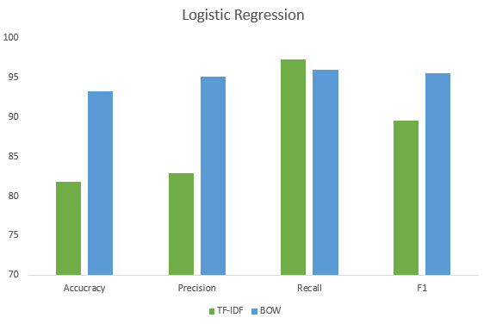
Experimental Result (Logistic Regression)
29
 | Accuracy | Precision | Recall | F1
TF-IDF | 81.83 | 82.92 | 97.35 | 89.56
BOW | 93.33 | 95.19 | 96.03 | 95.61

Slide 31
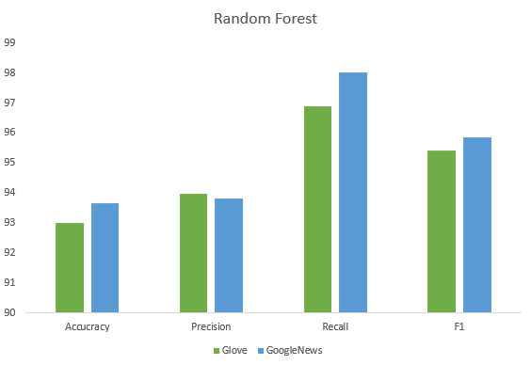
Experimental Result (Random Forest)
30
 | Accuracy | Precision | Recall | F1
Glove | 93 | 93.96 | 96.88 | 95.41
GoogleNews | 93.66 | 93.82 | 98 | 95.86

Slide 32
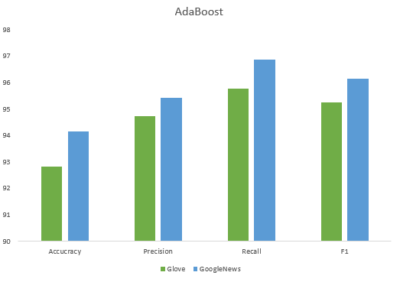
Experimental Result (AdaBoost)
31
 | Accuracy | Precision | Recall | F1
Glove | 92.83 | 94.72 | 95.77 | 95.24
GoogleNews | 94.16 | 95.41 | 96.88 | 96.14

Slide 33
32
Evaluation

Slide 34
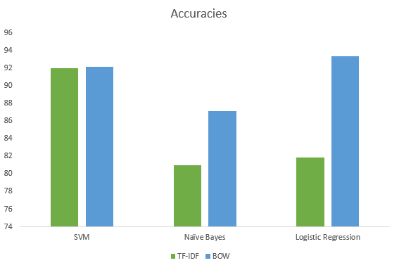
Accuracy of Machine Learning Classifier
33
 | SVM | Naïve Bayes | Logistic Regression
TF-IDF | 92 | 81 | 81.83
BOW | 92.16 | 87.16 | 93.33

Slide 35
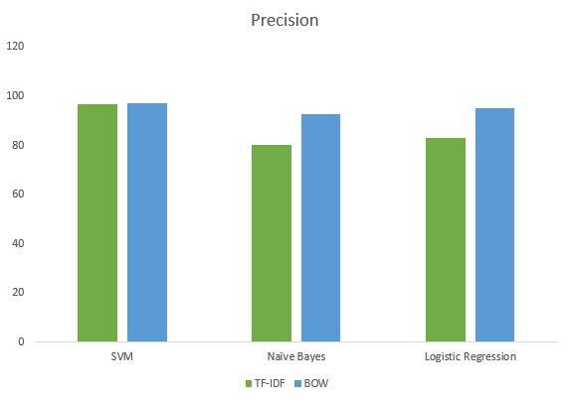
Precision of Machine Learning Classifier
34
 | SVM | Naïve Bayes | Logistic Regression
TF-IDF | 96.78 | 80.15 | 82.92
BOW | 97.21 | 92.55 | 95.19

Slide 36
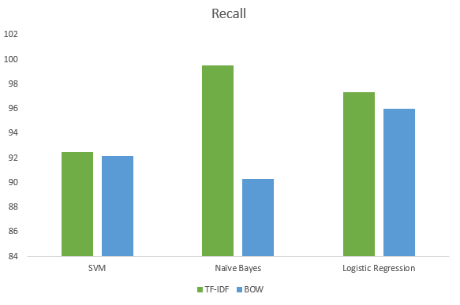
Recall of Machine Learning Classifier
35
 | SVM | Naïve Bayes | Logistic Regression
TF-IDF | 92.51 | 99.56 | 97.35
BOW | 92.16 | 90.3 | 96.03

Slide 37
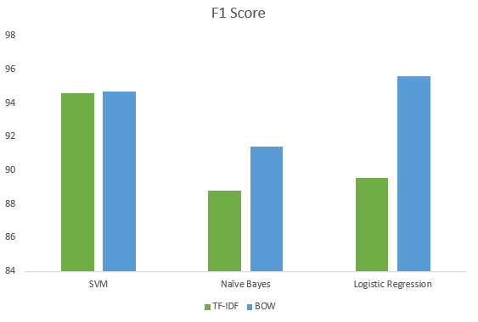
F1-score of Machine Learning Classifier
36
 | SVM | Naïve Bayes | Logistic Regression
TF-IDF | 94.59 | 88.81 | 89.56
BOW | 94.68 | 91.41 | 95.61

Slide 38
Timeline Diagram
37
Research
Briefing
Literature
Review
Data Collection
Data Analysis
Thesis Writings
Publications
MAR
APR
MAY
JUN
JUL
AUG
SEP
OCT

Slide 39
Conclusion
38
This thesis proposes a news corpus based machine learning and ensemble learning approach that uses club football player transfer news text classification to classify the player transfer chance
AdaBoost algorithm is better to other classification algorithms employed in this research
With the increasing amount of news data and need for accuracy, the automation of text classification process is required
Deep learning algorithms such as GloVe or Word2Vec are also used in order to obtain better vector representations for words and improve the accuracy of classifiers trained with traditional ensemble learning algorithms

Slide 40
Future Work
39
Data redundancy should be reduced during data processing
This thesis did not have enough data to experiment with these algorithms, in future we will work with the large amount of dataset, thereby increasing the chances of improvement are reasonably high.
We will work with the data of some certain players, so that we can work on a real time application
By modifying the general naïve bayes algorithm, we will try to increase the performance of the modified naïve bayes algorithm
In the future, deep learning algorithms can be used to test on the same dataset for better results.

Slide 41
Reference
40
[1] Vijayan, V.K., Bindu, K.R. and Parameswaran, L., 2017, September. A comprehensive study of text classification algorithms. In 2017 International Conference on Advances in Computing, Communications and Informatics (ICACCI) (pp. 1109-1113). IEEE.
[2] Arunachalam, N., Sneka, S.J. and MadhuMathi, G., 2017, April. A survey on text classification techniques for sentiment polarity detection. In 2017 Innovations in Power and Advanced Computing Technologies (i-PACT) (pp. 1-5). IEEE.
[3] Bobicev, V., 2016, June. Text classification: the case of multiple labels. In 2016 International Conference on Communications (COMM) (pp. 39-42). IEEE.
[4] Fu, Z., Wang, L. and Zhang, D., 2014, November. An improved multi-label classification ensemble learning algorithm. In Chinese Conference on Pattern Recognition (pp. 243-252). Springer, Berlin, Heidelberg.
[5] Kotenko, I., Chechulin, A. and Komashinsky, D., 2015, September. Evaluation of text classification techniques for inappropriate web content blocking. In 2015 IEEE 8th International Conference on Intelligent Data Acquisition and Advanced Computing Systems: Technology and Applications (IDAACS) (Vol. 1, pp. 412-417). IEEE.
[6] Zakzouk, Tarik S., and Hassan I. Mathkour. "Comparing text classifiers for sports news." Procedia Technology 1 (2012): 474-480.
[7] Tsoumakas, G. and Katakis, I., 2007. Multi-label classification: An overview. International Journal of Data Warehousing and Mining (IJDWM), 3(3), pp.1-13.
[8] Yan, R., Tesic, J. and Smith, J.R., 2007, August. Model-shared subspace boosting for multi-label classification. In Proceedings of the 13th ACM SIGKDD international conference on Knowledge discovery and data mining (pp. 834-843). ACM.
[9] Nithya, K., Kalaivaani, P.D. and Thangarajan, R., 2012, February. An enhanced data mining model for text classification. In 2012 International Conference on Computing, Communication and Applications (pp. 1-4). IEEE.

Slide 42
Query?

Slide 43
Thank You

