Slide 1
Team 80
MA317 Modelling Experimental Data
Rifat Monzur(2200367) Shashi Ranjan Choudhary(2200755)

Slide 2
INTRODUCTION
Development of linear model which will explain the life expectancy of the world in 2019. We will use the predictor variables of dataset to design the model and further investigate the response variable life expectancy.
R programming is used to perform the statistical analysis.

Slide 3
Exploratory Data Analysis
To understand the given world development indicator expectancy of life datasets. Therefore, to conduct the following process an explanatory data analysis is conducted. In the report, a descriptive statistical analysis process is conducted to elaborate and explain the analysis of the datasets, the data-based information is reflected using a few tools.
Multiple data segments in the world development indicator in the datasheets related to the child mortality stats consist of a very significant number of metrics, and the presence of the omitted variable in the data is also identified.

Slide 4
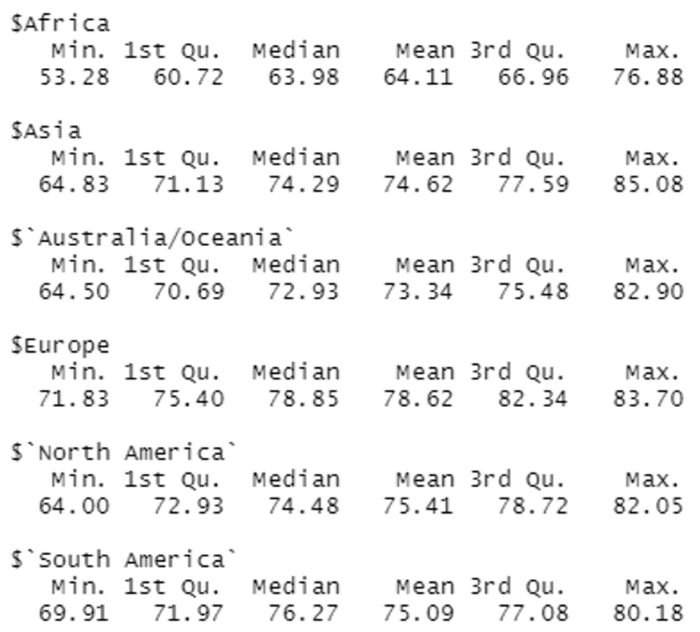
Task-1 Descriptive Statistics
Various mathematical variables are highlighted by considering the use of statistical analysis. The concerned data set analysis consists of a mathematical feature known as life expectancy. Based on the different continents’ lowest, the confidence interval, mean, and R-value of the developed statistical calculation have been marked. The following is the segmentation of the summer analysis that was utilised.

Slide 5
Cont.
From the above breakdown structure, it can be determined the average expectancy of life in the cited continents. It has been observed that the African continent has an average life expectancy of around 64.11 years, along with a maximum age of 76.8 and the least age of 53.28. the life expectancy values of the third quartile and the first quadrant are also shown in the above-created table. The above table highlights the complex lifetime period value reflecting that Europe continent has the highest infant mortality rate compared to all the cited continents. The average life expectancy of the European landmass is 78.62 years (Salvatore, 2021). It has been identified that the African continent has the lower average life expectancy whereas the Asian peninsula region has the greatest life expectancy with an average measure of 85.08 years. Although the average life expectancy in Asia is 74.62 years.

Slide 6
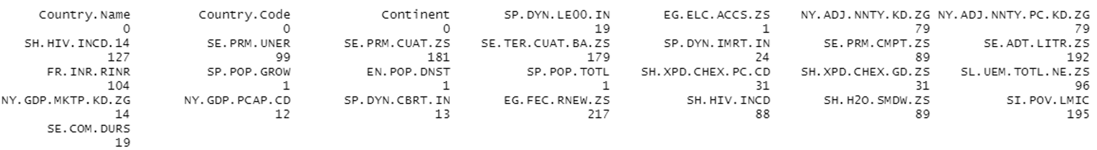
Task-2 Missing Value Imputations
The cited columns containing various sorts of data for the recommended set of data contain a high rate of omission in the data. the following picture represents the dataset’s entirely null value.

Slide 7
Cont.
For the provided data column, the great value of the number that is not able to identify is 217. As per the concerned case, not considering the rows with filtered data will not prove to be an intelligent decision taken by the person responsible. Although all the data can be erased. Hence, it is very important that all the null values are computed properly (Jaeger, and et.al 2021).
The alternates for the numerical attributes are median and mode values. Still exchanging the median and mode value with the null value will skew the entire data that has been developed. There are extremes in the data-sets it is customary to exchange the median with a negative value. Since every data column in the selected dataset has null values, all of the data columns have been changed. Before computing the statistical data, the null values are removed using the average values of the data column.

Slide 8
Fitting The Model
In the previous section, it has been established that the null values are replace with mean values. After imputation, data still have 28 columns and 217 rows. After forward selection, we left with 10 features Having primary education and safe drinking water also have a great impact on the life expectancy. The better water the population of a country have, the more life expectancy expected. Access to electricity also have a positive impact on the population. The people of a country tend to have more life span if they have access to electricity. Unsurprisingly, expense on health structure also have a beneficial effect on life expectancy. P – value less than 1 and closer to 0 in a negative exponential form. So, it can be said that null hypothesis is rejected. From the best model, the residual standad error is 2.575 with 206 degree freedom. From the best model, Multiple R-squared is 0.8757 and Adjusted R-squared is 0.8697

Slide 9
Cont
VIF
From VIF values, it can be said all the predictor variables are correlated as all the values are greater than 1. Birth rate, mortality rate and electricity access have the biggest VIF values. Now, it becomes clear why HIV has a positive impact on the population. It is due to correlation.

Slide 10
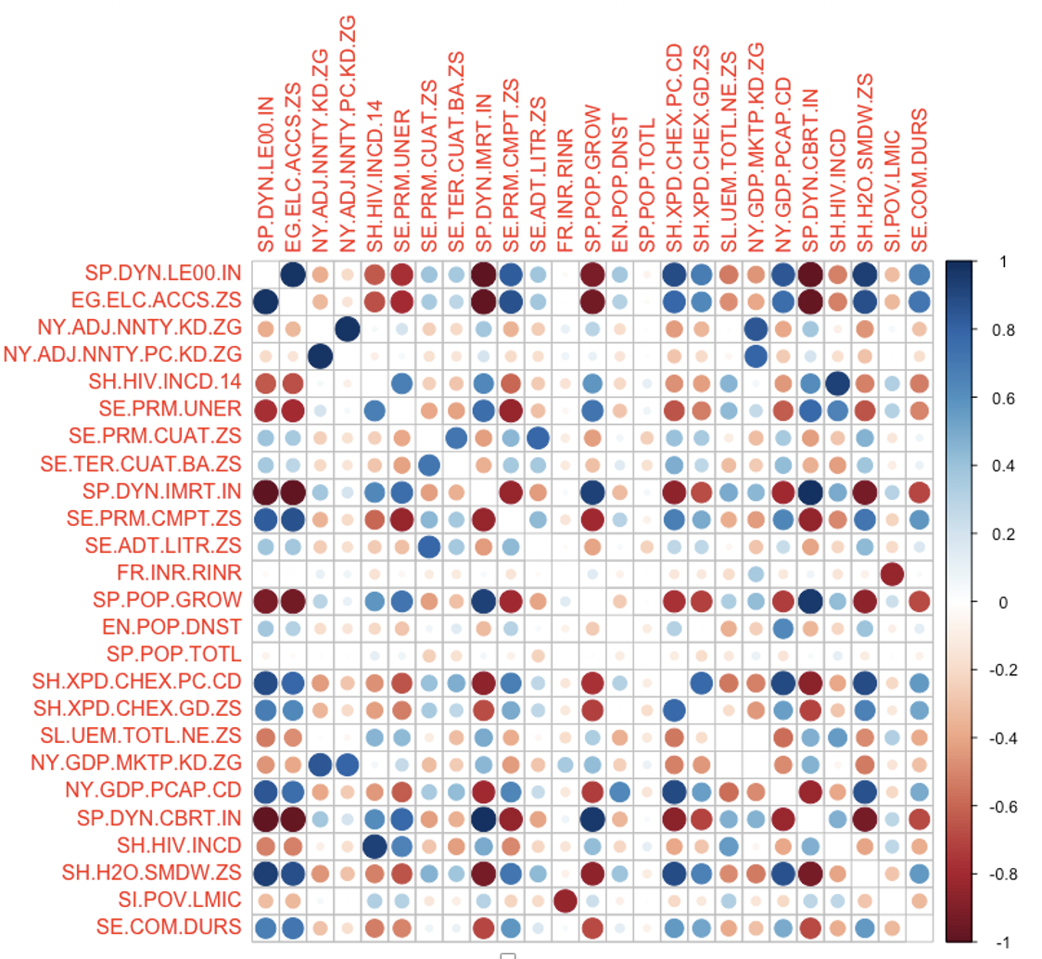
Cont.
Pairwise Correlation

Slide 11
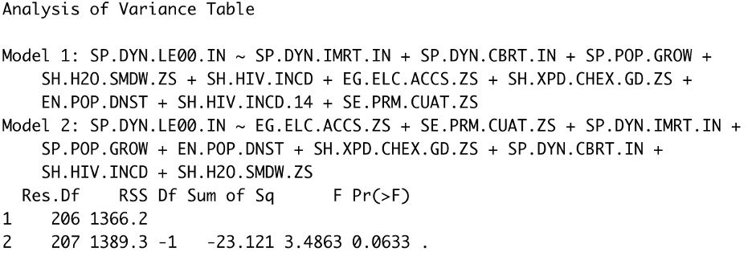
Anova Test
After removing SH.HIV.INCD.14 Children (ages 0-14) newly infected with HIV predictor, model become smaller but with same result. Anova test show that, we fail to reject the null hypothesis at any reasonable significance level..

Slide 12
Thank You

