Slide 1
CSE414: WEB ENGINEERING
Daffodil International University

Slide 3
LEARNING OUTCOME
CONTENTS
Analyze System Requirements For,
Existing Systems
Design Requirement Specification For,
New Systems
Choose Right Testing Methodology
Requirement Engineering
Testing Methodology

Slide 4
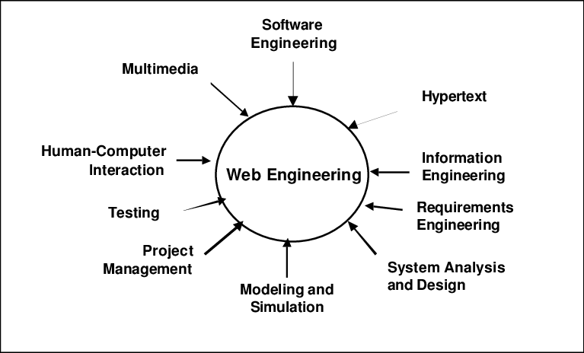
SOFTWARE ENGINEERING VS WEB ENGINEERING
You already know about software engineering from CSE333!
So, what’s new about web engineering?
Good news:
This lecture reviews a lot from SWE!
On a different note, you will see the power of these theories in upcoming days! We use them all!

Slide 5
IS THERE ANY DIFFERENCE OR RELATION?
“In theory, there is no difference between theory and practice. But, in practice, there is.”
Software engineering is an engineering discipline that is concerned with all aspects of software production.
Web Engineering is the application of systematic, disciplined and quantifiable approaches to development, operation, and maintenance of Web-based applications.

Slide 6
WHAT DIFFERENCES HAS THE WEB MADE TO SOFTWARE ENGINEERING?
Availability of software services
Developing highly distributed service-based systems
Led to important advances in-
Programming languages
Software reuse

Slide 7
REQUIREMENT ENGINEERING
Descriptions of the system services and constraints generated during the requirements engineering process
Requirements should describe what the system should do, but not how it should do it.
Two kinds of requirements based on the intended purpose and target audience:
User Requirements
System Requirements
Three classes of requirements:
Functional requirements
Non-functional requirements
Domain requirements
More…

Slide 8
USER REQUIREMENTS & SYSTEM REQUIREMENTS
User requirements
High-level abstract requirements
Written as statements, in a natural language plus diagrams,
services the system is expected to provide to system users
constraints under which it must operate.
System requirements
Detailed description of system
functions, services, and operational constraints.
The system requirements document (sometimes called a functional specification) should define exactly what is to be implemented.

Slide 9
FUNCTIONAL REQUIREMENTS
Describe functionality or system services
Depends on the type of software, expected users and the type of system where the software is used
High-level statements of what the system should do
Describe the system services in detail
Problems arise when-
Requirements are not precise and interpreted in different ways by developers and users.
In principle, requirements should be both
Complete: include descriptions of all facilities required
Consistent: should be no contradictions in descriptions
In practice, it is impossible!

Slide 10
NON-FUNCTIONAL REQUIREMENTS(1/2)
System properties and constraints
e.g. reliability, response time and storage requirements
Constraints are I/O device capability, system representations, etc.
Process requirements may also be specified mandating a particular IDE, programming language or development method.
Non-functional requirements may affect the overall architecture
A single non-functional requirement, such as a security requirement, may generate a number of related functional requirements that define system services that are required.
It may also generate requirements that restrict existing requirements.

Slide 11
NON-FUNCTIONAL REQUIREMENTS(2/2)
Three classes of non-functional requirements:
Product requirements
Requirements which specify that the delivered product must behave in a particular way
e.g. execution speed, reliability, etc.
Organizational requirements
Requirements which are a consequence of organizational policies and procedures
e.g. process standards used, implementation requirements, etc.
External requirements
Requirements which arise from factors which are external to the system and its development process
e.g. interoperability requirements, legislative requirements, etc.

Slide 12
DOMAIN REQUIREMENTS
The system's operational domain imposes requirements on the system.
Domain requirements may be new functional requirements, constraints on existing requirements or define specific computations.
If domain requirements are not satisfied, the system may be unworkable.
Two main problems :
Understandability
Requirements are expressed in the language of the application domain, which is not always understood by software engineers developing the system.
Implicitness
Domain specialists understand the area so well that they do not think of making the domain requirements explicit.

Slide 13
REQUIREMENTS ENGINEERING PROCESS
Processes vary widely depending on the application domain, the people involved and the organization developing the requirements.
In practice, requirements engineering is an iterative process in which the following generic activities are interleaved:
Requirements elicitation;
Requirements analysis;
Requirements validation;
Requirements management.

Slide 14
ELICITATION AND ANALYSIS
Range of system stakeholders
Requirements discovery by interacting with stakeholders
Requirements are grouped and organized into coherent clusters
Prioritizing requirements and resolving requirements conflicts
Requirements are documented and input into the next round of the spiral
Open interviews with stakeholders are a part of the RE process.
User stories and scenarios can be used and easy for stakeholders to understand
i.e., Use-case diagram
Problems :
Stakeholders don't know what they really want.
Stakeholders express requirements in their own terms.
Different stakeholders may have conflicting requirements.
Organizational and political factors.
Requirements change during the analysis process.(More on this…)

Slide 15
REQUIREMENTS SPECIFICATION AND VALIDATION
Requirements specification
Writing down user and system requirements in a requirements document
Written in natural language supplemented by appropriate diagrams and tables
Structured natural language is used to maintain a standard way.
Requirements Validation
Demonstrates that the requirements define the system that the customer really wants
Regular reviews should be held while the requirements definition is being formulated
Using an executable model of the system to check requirements
Developing tests for requirements to check testability

Slide 16
REQUIREMENTS CHANGE
Challenge-
Requirements are ever changing
New requirements emerge-
As the system being developed
After it has gone into use
Reasons why requirements change after the system's deployment:
Business and technical environment always changes
Customers and Users are two different group people
Large systems usually have a diverse user community
different requirements and priorities that may be conflicting or contradictory.

Slide 17
TESTING(1/2)
Testing is intended
to show that a program does what it is intended to do
to discover program defects before it is put into use.
Testing can reveal the presence of errors, but NOT their absence
Testing is part of a more general verification and validation process
Error
the actual result deviates from the expected.
Our expected results should (theoretically) come from our requirements definition.
Most often, the goals/concerns/expectations of stakeholders serve as the testing basis.

Slide 18
TESTING(2/2)
Test Case
a set of inputs, execution conditions, and expected results for testing an object
Complete test coverage is impossible, so testing focuses on mitigating the largest risks.
Where’s the greatest potential for loss?
What are the sources of this risk?
Start testing as early as possible – even with restricted resources and time.

Slide 19
GOALS OF SOFTWARE TESTING
To demonstrate to the developer and the customer that the software meets its requirements.
Leads to validation testing:
you expect the system to perform correctly using a given set of test cases that reflect the system's expected use.
A successful test shows that the system operates as intended.
To discover situations in which the behavior of the software is incorrect, undesirable or does not conform to its specification.
Leads to defect testing: the test cases are designed to expose defects; the test cases can be deliberately obscure and need not reflect how the system is normally used.
A successful test is a test that makes the system perform incorrectly and so exposes a defect in the system.

Slide 20
VERIFICATION AND VALIDATION
Verification: Are we building the product right?
The software should conform to its specification.
Validation: Are we building the right product?
The software should do what the user really requires.
Establish confidence that the system is good enough for its intended use, which depends on:
Software purpose: the level of confidence depends on how critical the software is to an organization.
User expectations: users may have low expectations of certain kinds of software.
Marketing environment: getting a product to market early may be more important than finding defects in the program.

Slide 21
THREE STAGES OF TESTING
Development testing: the system is tested during development to discover bugs and defects.
Release testing: a separate testing team test a complete version of the system before it is released to users.
User testing: users or potential users of a system test the system in their own environment.

Slide 22
DEVELOPMENT TESTING
Development testing includes all testing activities that are carried out by the team developing the system:
Unit testing:
individual program units or object classes are tested; should focus on testing the functionality of objects or methods.
Component testing:
several individual units are integrated to create composite components; should focus on testing component interfaces.
System testing:
some or all of the components in a system are integrated and the system is tested as a whole; should focus on testing component interactions.

Slide 23
RELEASE TESTING
Release testing
testing a particular release
Intended for use outside of the development team
Convince the customer of the system that it is good enough for use.
Requirements-based testing
examining each requirement and developing a test or tests for it
demonstrate that the system has properly implemented its requirements
Scenario testing
devise typical scenarios of use and use these to develop test cases for the system
Scenarios should be realistic and real system users should be able to relate to them.
If scenarios were developed as part of the requirements engineering process, it can be reused as testing scenarios.

Slide 24
USER TESTING
User or customer testing is a stage in the testing process in which users or customers provide input and advice on system testing.
User testing is essential, even when comprehensive system and release testing have been carried out. Types of user testing include:
Alpha testing:
Users of the software work with the development team to test the software at the developer's site.
Beta testing:
A release of the software is made available to users to allow them to experiment and to raise problems that they discover with the system developers.
Acceptance testing:
Customers test a system to decide whether or not it is ready to be accepted from the system developers and deployed in the customer environment.

Slide 25
TEST METHODS AND TECHNIQUES
Link Testing : Finding broken links, orphan pages etc.
Browser Testing : variety of browsers exists. Thus need to test.
Load Testing: Does the system meet required response times and throughput?
Stress Testing: How does the system behave under abnormal/extreme conditions?
Continuous Testing : Typically, running the operation a few times doesn’t produce an error, hence the need for continuous testing.
Security Testing:
Is our SSL certificate working?
What happens if I try to access a protected page/site in a non-secure way (i.e., http://)?

Slide 26
EXERCISE AND READINGS
EXERCISE
Develop SRS for you course project (soft copy submission)
Write a short notes on
Web Project Management
Testing tools.
READINGS
Requirement Engineering
https://cs.ccsu.edu/~stan/classes/CS410/Notes16/04-Requirements.html
Software Testing
https://cs.ccsu.edu/~stan/classes/CS410/Notes16/08-SoftwareTesting.html
Project Management
https://cs.ccsu.edu/~stan/classes/CS410/Notes16/22-ProjectManagement.html
Testing tools
https://medium.com/@briananderson2209/best-automation-testing-tools-for-2018-top-10-reviews-8a4a19f664d2

Slide 27
REFERENCES
Requirements Engineering
Reference: Sommerville, Software Engineering, 10 ed., Chapter 4
Testing
Sommerville, Software Engineering, 10 ed., Chapter 8
Project Management
Sommerville, Software Engineering, 9 ed., Chapter 22
https://www.researchgate.net/figure/Web-Engineering-A-multidisciplinary-field_fig1_220795871
https://www.quora.com/What-is-web-engineering

