Slide 1
CSE417: WEB ENGINEERING
Daffodil International University
I hear, and I forget.
I see, and I remember.
I do, and I understand.
-Chinese Proverb

Slide 2
Learning Outcome
Use DOM to manipulate your content
Make your page dynamic
Use Forms
Handle events
Contents
Window Object
DOM and Events
Class and Objects
HTML Form
Events

Slide 3
Window Object
Represents an open window in a browser
Many window object properties and methods area available
No public standard but major browsers support it
If a document contain frames, then there is
  one window object, window, for the HTML document • and one additional window object for each frame,
  accessible via an array window.frames
Methods provided by a window object include
    close() - closes a browser window/tab
    focus() - give focus to a window (bring the window to the front)
    blur() - removes focus from a window (moves the window behind others)
    print() - prints (sends to a printer) the contents of the current window
Window Object: Dialog Boxes
  Example:
alert("Local time: " + (new Date).toString())
And many more…

Slide 4
navigator Object
<html>
<!–- CSE391 js14.html -->
<head>
<title>Dynamic Style Page</title>
<script type="text/javascript">
if (navigator.appName == "Netscape") {
document.write('<link rel=stylesheet '+
'type="text/css" href="Netscape.css">');
}
else {
document.write('<link rel=stylesheet ' +
'type="text/css" href="MSIE.css">');
}
</script>
</head>
<body>
Here is some text with a
<a href="javascript:alert('GO AWAY')">link</a>.
</body>
</html>
navigator.appName property that gives the browser name
navigator.appVersion property that gives the browser version
<!-- MSIE.css -->
a {text-decoration:none;
font-size:larger;
color:red;
font-family:Arial}
a:hover {color:blue}
<!-- Netscape.css -->
a {font-family:Arial;
color:white;
background-color:red}
view page

Slide 5

The HTML DOM (Document Object Model)
When a web page is loaded, the browser creates a Document Object Model of the page.
The HTML DOM model is constructed as a tree of Objects:
Standard object model and programming interface for HTML.
It defines:
  The HTML elements as objects
  The properties of all HTML elements
  The methods to access all HTML elements
  The events for all HTML elements

Slide 6
Document Object
Acces information about an HTML document using the document object (Note: not a class!)
<html>
<!–- CSE391 js13.html -->
<head>
<title>Documentation page</title>
</head>
<body>
<table width="100%">
<tr>
<td><small><i>
<script type="text/javascript">
document.write(document.URL);
</script>
</i></small></td>
<td style=“text-align: right;"><small><i>
<script type="text/javascript">
document.write(document.lastModified);
</script>
</i></small></td>
</tr>
</table>
</body>
</html>
document.write(…)
  method that displays text in the page
document.URL
  property that gives the location of the HTML document
document.lastModified
  property that gives the date & time the HTML document was last changed
view page

Slide 7
Reacting to Events
JavaScript's interaction with HTML is handled through events that occur when the user or the browser manipulates a page.
  a page loads, user clicks a button, press any key, closing a window, resizing a window, etc.
Developers can use these events to execute JavaScript coded responses,
  which cause buttons to close windows, messages to be displayed to users, data to be validated, and virtually any other type of response imaginable.
Events are a part of the DOM
JavaScript can be executed when an event occurs
  To execute code when a user clicks on an element, add JavaScript code to an HTML event attribute:
  onclick=JavaScript’
onsubmit , onmouseover and onmouseout etc are different event type.
One example in next slide!

Slide 8
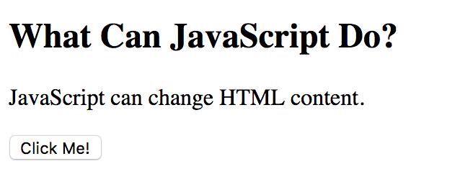
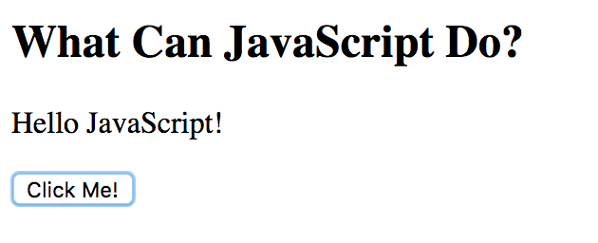
Example
<!DOCTYPE html>
<html>
<body>
<h2>What Can JavaScript Do?</h2>
<p id="demo">JavaScript can change HTML content.</p>
<button type="button" onclick='document.getElementById("demo").innerHTML = "Hello JavaScript!"'>Click Me!</button>
</body>
</html>
Before
After

Slide 9
User-Defined Classes
JavaScript is an object-oriented language, but one without classes
Instead of defining a class, we can define a function that acts as object constructor
  specify data fields & methods using this
  no data hiding: can't protect data or methods
define Die function (i.e., constructor)
initialize data fields in the function, preceded with this
similarly, assign method to separately defined function (which uses this to access data)
// CSE391 Die.js //
// Die class definition
////////////////////////////////////////////
function Die(sides)
{
this.numSides = sides;
this.numRolls = 0;
this.Roll = Roll; // define a pointer to a function
}
function Roll()
{
this.numRolls++;
return Math.floor(Math.random()*this.numSides) + 1;
}

Slide 10
Class Example
<html>
<!–- js15.html -->
<head>
<title>Dice page</title>
<script type="text/javascript"
src="Die.js">
</script>
</head>
<body>
<script type="text/javascript">
die6 = new Die(6);
die8 = new Die(8);
roll6 = -1; // dummy value to start loop
roll8 = -2; // dummy value to start loop
while (roll6 != roll8) {
roll6 = die6.Roll();
roll8 = die8.Roll();
document.write("6-sided: " + roll6 +
"&nbsp;&nbsp;&nbsp;&nbsp;" +
"8-sided: " + roll8 + "<br />");
}
document.write("<br />Number of rolls: " +
die6.numRolls);
</script>
</body>
</html>
create a Die object using new (similar to String and Array)
here, the argument to Die initializes numSides for that particular object
each Die object has its own properties (numSides & numRolls)
Roll(), when called on a particular Die, accesses its numSides property and updates its NumRolls

Slide 11
ECMAScript 2015
ES6, also known as ECMAScript2015, introduced classes.
A class is a type of function, but instead of using the keyword function to initiate it, we use the keyword class, and the properties are assigned inside a constructor() method.
Class Definition
  Use the keyword class to create a class, and always add the constructor() method.
  The constructor method is called each time the class object is initialized.
  class Car {
  constructor(brand) {
  this.carname = brand;
  }
  }
  mycar = new Car(“Ford”)
We will not go into further details…
Question to ponder:
  What are the other OOP properties you can have?
  https://www.w3schools.com/js/js_classes.asp
  Again, what is ECMAScript?
Notes:
https://en.wikipedia.org/wiki/ECMAScript

Slide 12
Event-driven programs
with C++ or Java, programs are usually serially executed
  start with main function, execute sequentially from first statement
  may loop or skip sections of code, but the program generally proceeds step-by-step
    the programmer specifies the sequence in which execution occurs (with some variability due to input values)
    there is a beginning and an end to program execution
computation within a Web page is rarely serial instead, the page reacts to events such as mouse clicks, buttons, …
  much of JavaScript's utility is in specifying actions that are to occur in the page as a result of some event
    the programmer may have little or no control over when code will (if ever) be executed, e.g., code that reacts to a button click
    there is no set sequence, the page waits for events and reacts

Slide 13
OnLoad & OnUnload
<html>
<!–- form01.html 12.10.2006 -->
<head>
<title>Hello/Goodbye page</title>
<script type="text/javascript">
function Hello()
{
globalName=prompt("Welcome to my page. " +
"What is your name?","");
}
function Goodbye()
{
alert("So long, " + globalName +
" come back real soon.");
}
</script>
</head>
<body onload="Hello();" onunload="Goodbye();">
Whatever text appears in the page.
</body>
</html>
the simplest events are when the page is loaded or unloaded
  the onload attribute of the <body> tag specifies JavaScript code that is automatically executed when the page is loaded
  the onunload attribute similarly specifies JavaScript code that is automatically executed when the browser leaves the page

Slide 14
HTML forms
most event-handling in JavaScript is associated with form elements
an HTML form is a collection of elements for handling input, output, and events in a page
  <form name="FormName">
  …
  </form>
form elements might include:
  for input: button, selection list, radio button, check box, password, …
  for input/output: text box, text area, …

Slide 15
Button Element
the simplest form element is a button
  analogous to a real-world button, a click can be used to trigger events
  <input type="button" value="LABEL" onclick="JAVASCRIPT_CODE"/>
<html>
<!–- form02.html 12.10.2006 -->
<head>
<title> Fun with Buttons</title>
<script type="text/javascript"
src="JS/random.js">
</script>
</head>
<body>
<form name="ButtonForm">
<input type="button" value="Click for Lucky Number"
onclick=“var num = RandomInt(1, 100);
alert('The lucky number for the day is ' + num);" />
</form>
</body>
</html>

Slide 16
Buttons & Functions
<html>
<!–- form03.html 13.10.2006 -->
<head>
<title>Fun with Buttons</title>
<script type="text/javascript">
function Greeting()
// Results: displays a time-sensitive greeting
{
var now = new Date();
if (now.getHours() < 12) {
alert("Good morning");
}
else if (now.getHours() < 18) {
alert("Good afternoon");
}
else {
alert("Good evening");
}
}
</script>
</head>
<body>
<form name="ButtonForm">
<input type="button" value="Click for Greeting"
onclick="Greeting();" />
</form>
</body>
</html>
for complex tasks, should define function(s) and have the onclick event trigger a function call

Slide 17
Buttons & Windows
alert boxes are fine for displaying short, infrequent messages
  not well-suited for displaying longer, formatted text
  not integrated into the page, requires the user to explicitly close the box
QUESTION: could we instead use document.write ?
  NO -- would overwrite the current page, including form elements
but could open a new browser window and write there
var OutputWindow = window.open(); // open a window and assign
// a name to that object
// (first arg is an HREF)
OutputWindow.document.open(); // open that window for
// writing
OutputWindow.document.write("WHATEVER"); // write text to that
// window as before
OutputWindow.document.close(); // close the window

Slide 18
Window Example
<html>
<!-–form04.html 13.10.2006 -->
<head>
<title> Fun with Buttons </title>
<script type="text/javascript">
function Help()
// Results: displays a help message in a separate window
{
var OutputWindow = window.open();
OutputWindow.document.open();
OutputWindow.document.write("This might be a context-" +
"sensitive help message, depending on the " +
"application and state of the page.");
OutputWindow.document.close();
}
</script>
</head>
<body>
<form name="ButtonForm">
<input type="button" value="Click for Help"
onclick="Help();" />
</form>
</body>
</html>

Slide 19
Text Boxes
a text box allows for user input
  unlike prompt, user input persists on the page & can be edited
  <input type="text" id=“BOX_NAME” name="BOX_NAME"… />
  optional attributes: size : width of the box (number of characters)
  value : initial contents of the box
  JavaScript code can access the contents as document.BoxForm.userName.value
<html>
<!-– form06.html 13.10.2006 -->
<head> <title> Fun with Text Boxes </title> </head>
<body>
<form name="BoxForm">
Enter your name here:
<input type="text" name="userName" id=“userName” size=“12” value="" />
<br /><br />
<input type="button" value="Click Me"
onclick="alert('Thanks, ' + document.BoxForm.userName.value +
', I needed that.');" />
</form>
</body>
</html>

Slide 20
Read/Write Text Boxes
similarly, can change the contents with an assignment
  Note: the contents are raw text, no HTML formatting
  Also: contents are accessed as a string, must parseFloat or parseInt if want a number
<html>
<!-–form07.html 13.10.2006 -->
<head>
<title> Fun with Text Boxes </title>
</head>
<body>
<form name="BoxForm">
Enter a number here:
<input type="text" size=“12” name="number" value=“2” />
<br /><br />
<input type="button" value="Double"
onclick="document.BoxForm.number.value=
parseFloat(document.BoxForm.number.value) * 2;" />
</form>
</body>
</html>

Slide 21
Text Box Events
<html>
<!-– CSE391 form08.html 13.10.2006 -->
<head>
<title> Fun with Text Boxes </title>
<script type="text/javascript">
function FahrToCelsius(tempInFahr)
// Assumes: tempInFahr is a number (degrees Fahrenheit)
// Returns: corresponding temperature in degrees Celsius
{
return (5/9)*(tempInFahr - 32);
}
</script>
</head>
<body>
<form name="BoxForm">
Temperature in Fahrenheit:
<input type="text" name="Fahr" size=“10” value=“0"
onchange="document.BoxForm.Celsius.value =
FahrToCelsius(parseFloat(document.BoxForm.Fahr.value));" />
&nbsp; <tt>----></tt> &nbsp;
<input type="text" name="Celsius" size=“10” value=""
onfocus="blur();" />
in Celsius
</form>
</body>
</html>
onchange triggered when the contents of the box are changed
onfocus
triggered when the mouse clicks in the box
blur() removes focus

Slide 22
Text Areas
a TEXT box is limited to one line of input/output
a TEXTAREA is similar to a text box in functionality, but can specify any number of rows and columns
  <textarea name="TextAreaName" rows=“NumRows” cols=“NumCols”>
  Initial Text
  </textarea>
  Note: unlike a text box, a TEXTAREA has a separate closing tag
    initial contents of the TEXTAREA appear between the tags
  as with a text box, no HTML formatting of TEXTAREA contents

Slide 23
Better (and easier?) methods to access data
  So far, we have been accessing data input fields by giving them names, and using the “dotted” names from the Document Object Model tree structure.
  What if someone modifies the HTML document?
  Then, all those multiply referenced items can no longer be accessed.
  A more reliable manner (more resistant to changes in the webpage code) would be to give each element an ID (using the “id” attibute) and use the JavaScript getElementById method.

Slide 24
Using getElementById
<html>
<!-–form09.html 16.10.2008 -->
<head>
<title> Fun with Text Boxes </title>
<script type="text/javascript"
src="JS/verify.js">
</script>
<script type="text/javascript">
function FahrToCelsius(tempInFahr)
{
return (5/9)*(tempInFahr - 32);
}
</script>
</head>
<body>
<form name="BoxForm">
Temperature in Fahrenheit:
<input type="text" id="Fahr" size=“10” value=“0”
onchange="if (VerifyNum(this)) { // this refers to current element
var F=document.getElementById(‘Fahr’);
document.BoxForm.Celsius.value =
FahrToCelsius(parseFloat(F.value));
}" />
&nbsp; <tt>----></tt> &nbsp;
<input type="text" name="Celsius" size=“10” value=“”
onfocus=“getElementById(‘F’).focus();" />
in Celsius
</form> </body>
</html>

Slide 25
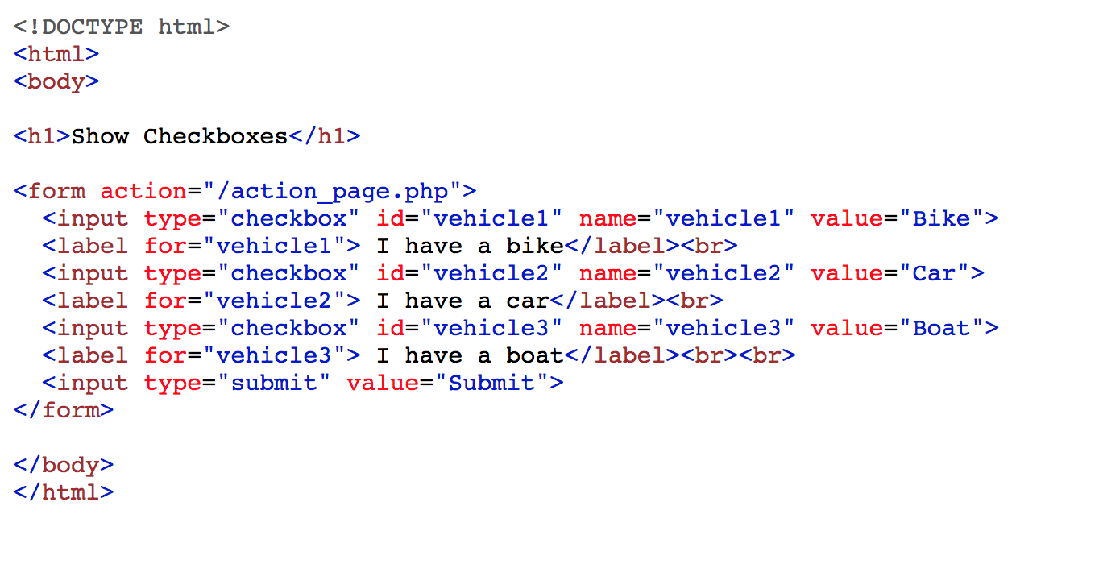
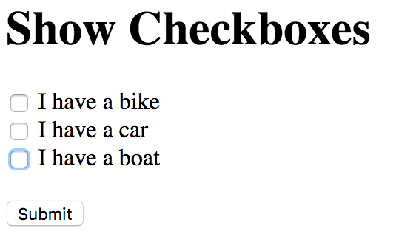
Check Boxes and Radio buttons
Radio buttons are similar to check boxes, but only one of them can be selected at any time.
They are defined by <input type=“radio”> tags (similar to the checkbox tags in the previous example, with similar properties) and accessed in the same manner.

Slide 26
JavaScript & Timeouts
the setTimeout function can be used to execute code at a later time
  setTimeout(JavaScriptCodeToBeExecuted, MillisecondsUntilExecution)
example: forward link to a moved page
<html>
<!–- form13.html 13.10.2006 -->
<head>
<title> Fun with Timeouts </title>
<script type="text/javascript">
function Move()
// Results: sets the current page contents to be newhome.html
{
self.location.href = "newhome.html";
}
</script>
</head>
<body onload="setTimeout('Move()', 3000);">
This page has moved to <a href="newhome.html">newhome.html</a>.
</body>
</html>

Slide 27
Exercise
Exercise
Design a form which calculate sum of two integers given by the user
How to access Cookie with JS?
READINGS/Practice
  M Schafer: Ch. 19, 20, 22
  https://www.w3schools.com/js/default.asp
  http://www.csc.liv.ac.uk/~martin/teaching/comp519/NOTES/JavaScript.pdf

Slide 28
Acknowledgement
This module is designed and created with the help from following sources-
  https://cgi.csc.liv.ac.uk/~ullrich/COMP519/
  http://www.csc.liv.ac.uk/~martin/teaching/comp519/
  Anup Majumder, Jahangirnagar University

