Slide 1
CSE414: WEB ENGINEERING
Daffodil International University

Slide 2
LEARNING OUTCOMES
You will know MVC design pattern
You will be able to apply Project management techniques

Slide 3
DISTRIBUTED SYSTEMS: FUNDAMENTAL QUESTIONS
Software developers have to consider a wide, but rather stable, range of questions including:
Where can or should computations take place?
Where can or should data be stored?
How fast can data be transferred/communicated?
What is the cost of data storage/computations/communication depending on how/where we do it?
How robustly/securely can data storage/computations/communication be done depending on how/where we do it?
How much energy is available to support data storage/computations/communication depending on how/where we do it?
What is the legality of data storage/computations/communications depending on how/where we do it?
The possible answers to each of these questions is also rather stable, but the ‘right’ answers change

Slide 4
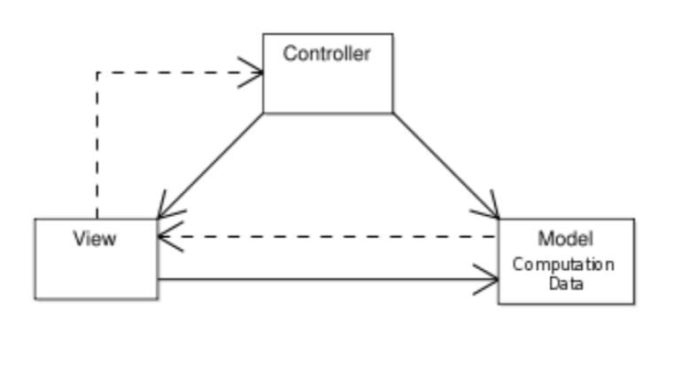
DISTRIBUTED SYSTEMS: MVC(1/3)
We use the Model-View-Controller(MVC) software design pattern to discuss some of these questions in more detail:
The model manages the behavior and data
The view renders the model into a form suitable for interaction
The controller receives user input and translates it into instructions for the model

Slide 5
DISTRIBUTED SYSTEMS: MVC(2/3)
Where should the view be rendered?
On the user’s computer
On a central server (farm) possibly shared by a multitude of users
Where should the behaviour of the model be computed?
Close to the user,
on a single computer exclusively used by the user
Away from the user,
on a central server (farm) shared by a multitude of users
Distributed,
on several computers owned by a large group of users

Slide 6
DISTRIBUTED SYSTEMS: MVC(3/3)
Where should the data for the model be held?
Close to the user,
on a single computer exclusively used by the user
Away from the user,
on a central server (farm) shared by a multitude of users
Distributed,
on several computers owned by a large group of users

Slide 7
DISTRIBUTED SYSTEMS: FUNDAMENTAL QUESTIONS
Software developers have to consider a wide, but rather stable, range of questions
The possible answers to each of these questions is also rather stable
The ‘right’ answer to each these questions will depend on
the domain in which the question is posed
available technology
available resources
The ‘right’ answer to each of the questions changes over time
We may go back and forth between the various answers
The reasons for that are not purely technological, but includes
legal factors
social factors
economic factors

Slide 8
A BASIC EXAMPLE
In order for a program to get data from a database, it has to undergo a list of actions:
Connect to the database server
Select a database
Query the database
Fetch the data
Use the Data
A framework may handle steps 1-4 for you, so that your responsibilities are reduced to:
Tell the framework to fetch the data
Use the data
There are many frameworks that use MVC design pattern.
Laravel, CodeIgniter, Symfony, CakePHP etc. are few of them

Slide 9
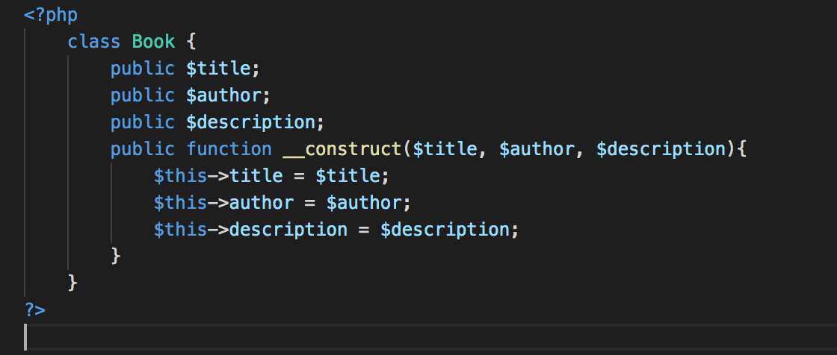
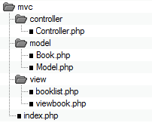
EXAMPLE
directory structure
model/Book.php

Slide 10
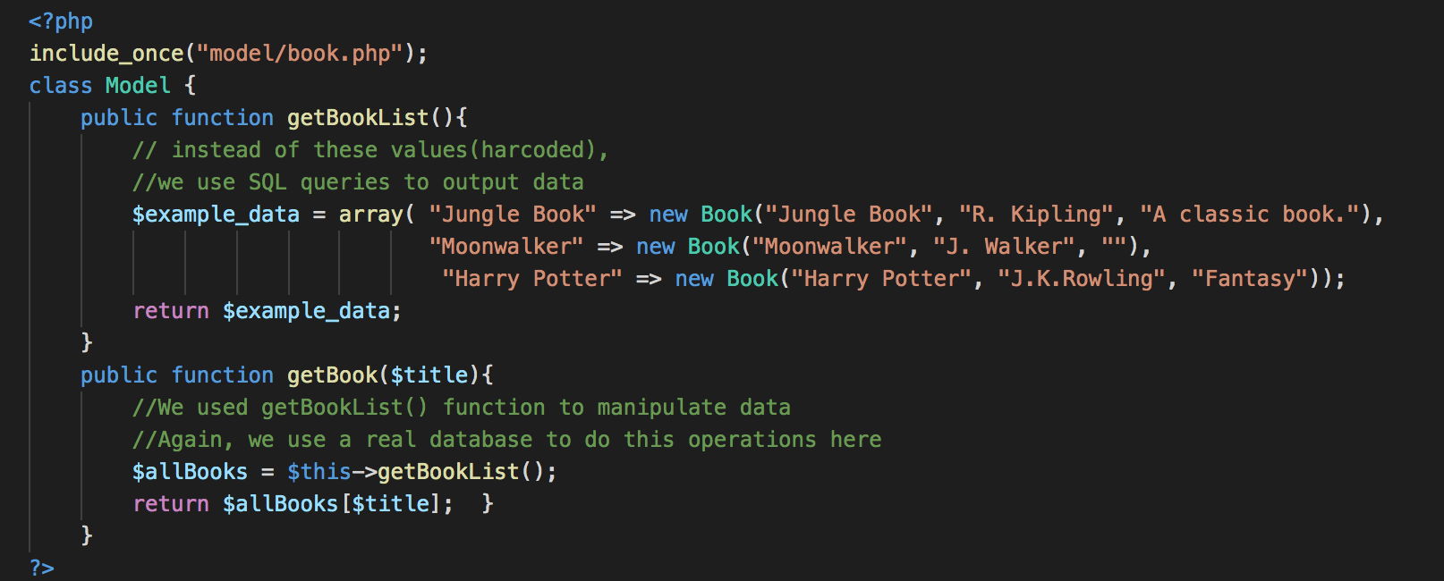
EXAMPLE
model/Model.php

Slide 11
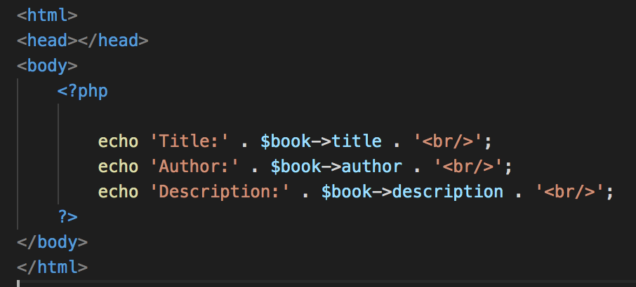
EXAMPLE
view/abook.php

Slide 12
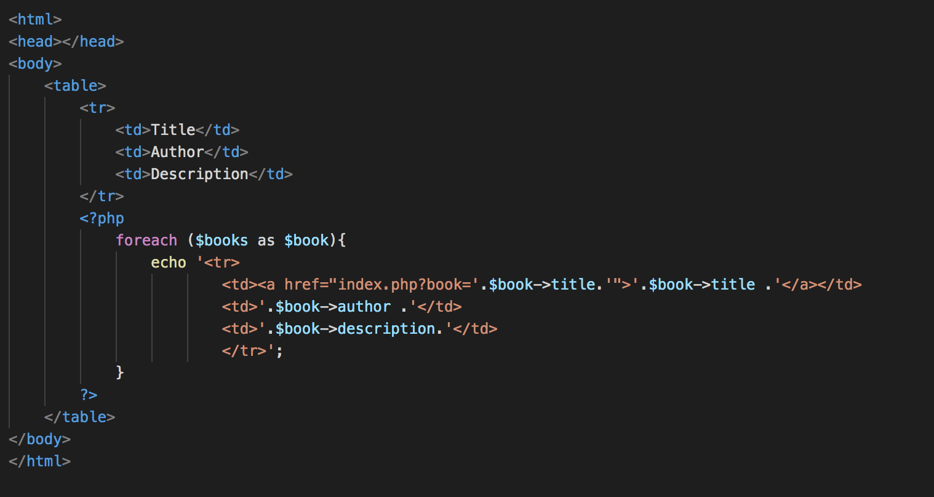
EXAMPLE
view/booklist.php

Slide 13
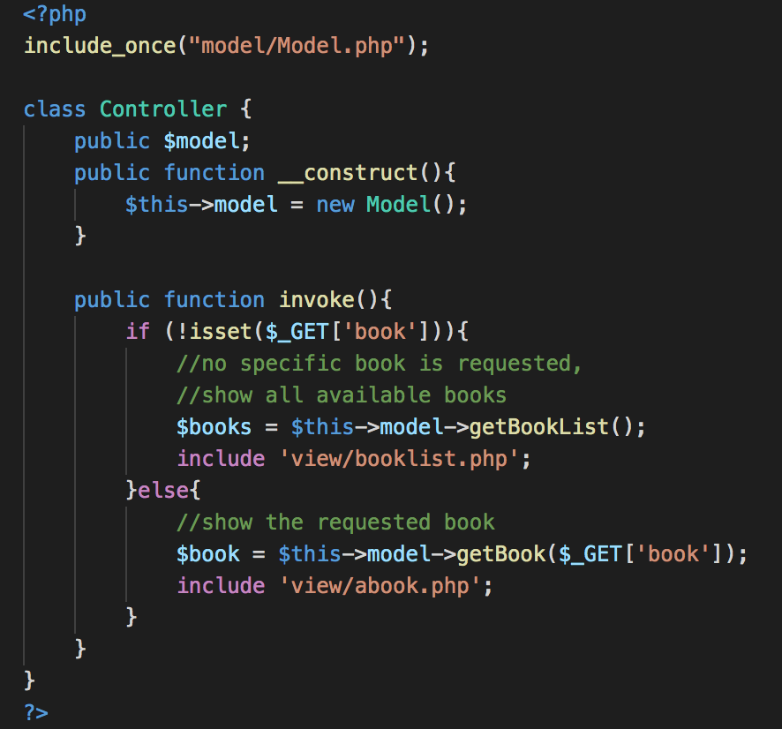
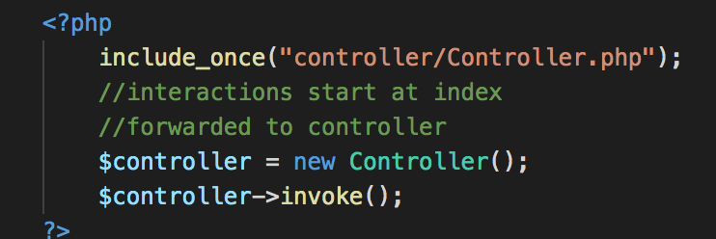
EXAMPLE
controller/Controller.php
index.php
Remember, everything starts at index.php
Apply this basic pattern in your project!

Slide 14
PROJECT MANAGEMENT
Deliver on time and on schedule and in accordance with the requirements
Budget and schedule constraints
The product is intangible
Cannot be seen or touched.
Project managers can not see progress by simply looking at the artifact
Many software projects are 'one-off' projects
Large software projects are usually different from previous projects
Experience does not help.
Software processes are variable and organization specific
cannot predict when a process is likely to lead to development

Slide 15
PROJECT MANAGEMENT ACTIVITIES(1/2)
Project planning
Project managers are responsible for planning. estimating and scheduling project development and assigning people to tasks.
Reporting
Project managers are usually responsible for reporting on the progress of a project to customers and to the managers of the company developing the software.
Risk management
Project managers assess the risks that may affect a project, monitor these risks and take action when problems arise.

Slide 16
PROJECT MANAGEMENT ACTIVITIES(2/2)
People management
Project managers have to choose people for their team and establish ways of working that leads to effective team performance.
Proposal writing
The first stage in a software project may involve writing a proposal to win a contract to carry out an item of work. The proposal describes the objectives of the project and how it will be carried out.

Slide 17
PROJECT MANAGEMENT CHALLENGES
Unique software systems: the experience from the past project is too little to be able to make reliable cost estimates.
Extremely technical leadership perspective: dominated by technology freaks.
Poor planning: many projects are characterize by unclear or incomplete planning objectives, frequent changes to planning objectives, defects in project organization.
Development Challenges
Individuality of programmers
High number of alternative solutions
Rapid technological change
Monitoring Challenges
The immaterial state of software products

Slide 18
EXERCISE
What are the drawbacks and benefits of using MVC design pattern?
Apply MVC while structuring your project
Write briefly about obstacles faced in your project
READINGS
https://developer.chrome.com/apps/app_frameworks
https://www.guru99.com/mvc-tutorial.html

Slide 19
ACKNOWLEDGEMENT
This module is designed and created with the help from following sources-
https://cgi.csc.liv.ac.uk/~ullrich/COMP519/
http://www.csc.liv.ac.uk/~martin/teaching/comp519/
Materials of MVC, S Rahman Shammi, Daffodil International University

