Slide 1
CSE414: WEB ENGINEERING
Daffodil International University

Slide 2
LEARNING OUTCOMES
Basic concepts of-
XML
JSON
Ajax

Slide 3
XML
XML stands for eXtensible Markup Language.
XML was designed to store and transport data.
XML was designed to be both human- and machine-readable.
Why Study XML?
XML plays an important role in many different IT systems.
XML is often used for distributing data over the Internet.
It is important (for all types of software developers!) to have a good understanding of XML.

Slide 4
XML USAGE
XML Separates Data from Presentation
XML does not carry any information about how to be displayed.
The same XML data can be used in many different presentation scenarios.
Because of this, with XML, there is a full separation between data and presentation.
XML is Often a Complement to HTML
In many HTML applications, XML is used to store or transport data, while HTML is used to format and display the same data.
XML Separates Data from HTML
When displaying data in HTML, you should not have to edit the HTML file when the data changes.
With XML, the data can be stored in separate XML files.
With a few lines of JavaScript code, you can read an XML file and update the data content of any HTML page.

Slide 5
XML EXAMPLE
<?xml version="1.0" encoding="UTF-8"?> <bookstore> <book category="cooking"> <title lang="en">Everyday Italian</title> <author>Giada De Laurentiis</author> <year>2005</year> <price>30.00</price> </book> <book category="children"> <title lang="en">Harry Potter</title> <author>J K. Rowling</author> <year>2005</year> <price>29.99</price> </book> <book category="web"> <title lang="en">XQuery Kick Start</title> <author>James McGovern</author> <author>Per Bothner</author> <author>Kurt Cagle</author> <author>James Linn</author> <author>Vaidyanathan Nagarajan</author> <year>2003</year> <price>49.99</price> </book> </bookstore>
Example 1
<?xml version="1.0" encoding="UTF-8"?> <note> <to>Tove</to> <from>Jani</from> <heading>Reminder</heading> <body>Don't forget me this weekend!</body> </note>
Example-2

Slide 6
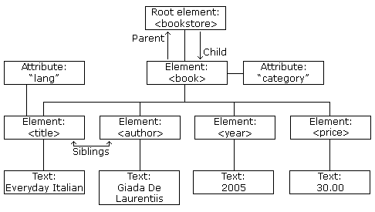
XML…
The image in left represents books in this XML:
<?xml version="1.0" encoding="UTF-8"?> <bookstore> <book category="cooking"> <title lang="en">Everyday Italian</title> <author>Giada De Laurentiis</author> <year>2005</year> <price>30.00</price> </book> <book category="children"> <title lang="en">Harry Potter</title> <author>J K. Rowling</author> <year>2005</year> <price>29.99</price> </book> <book category="web"> <title lang="en">Learning XML</title> <author>Erik T. Ray</author> <year>2003</year> <price>39.95</price> </book> </bookstore>
XML Tree Structure
More on XML…

Slide 7
JSON
JSON: JavaScript Object Notation.
JSON is a syntax for storing and exchanging data.
JSON is text, written with JavaScript object notation
Exchanging Data
Data between a browser and a server, the data can only be text.
JSON is text, and we can convert any JavaScript object into JSON, and send JSON to the server.
We can also convert any JSON received from the server into JavaScript objects.

Slide 8
JSON SYNTAX
JSON syntax is derived from JavaScript object notation syntax:
Data is in name/value pairs
Data is separated by commas
Curly braces hold objects
Square brackets hold arrays
JSON data is written as name/value pairs.
"name":"John"
In JSON, keys must be strings, written with double quotes:
{ "name":"John" }
In JavaScript, keys can be strings, numbers, or identifier names:
{ name:"John" }

Slide 9
MORE JSON SYNTAX…
With JavaScript you can create an object and assign data to it, like this:
You can access a JavaScript object like this:
Data can be modified like this:
JavaScript arrays can also be used as JSON. [How?]
var person = { name: "John", age: 31, city: "New York" };
person.name; // returns John
person["name"];// this also works
person.name = "Gilbert";//Another way to do it?
Parse the data with JSON.parse(), and the data becomes a JavaScript object.

Slide 10
MORE…
Arrays in PHP will also be converted into JSON when using the PHP function json_encode()
<?php $myArr = array("John", "Mary", "Peter", "Sally"); $myJSON = json_encode($myArr); echo $myJSON; ?>
JSON can be used along with Ajax, html, php, JS too…
There are other functions too: json_decode(), stringify() etc.
What are the purpose of these functions?

Slide 11
JSON VS XML
JSON is Like XML Because
Both JSON and XML are "self describing" (human readable)
Both JSON and XML are hierarchical (values within values)
Both JSON and XML can be parsed and used by lots of programming languages
Both JSON and XML can be fetched with an XMLHttpRequest
JSON is Unlike XML Because
JSON doesn't use end tag
JSON is shorter
JSON is quicker to read and write
JSON can use arrays
Question: Why JSON is Better Than XML?

Slide 12
AJAX
AJAX = Asynchronous JavaScript And XML.
AJAX is not a programming language.
Read data from a web server - after the page has loaded
Update a web page without reloading the page
Send data to a web server - in the background
AJAX just uses a combination of:
A browser built-in XMLHttpRequest object (to request data from a web server)
JavaScript and HTML DOM (to display or use the data)
AJAX is a misleading name. AJAX applications might use XML to transport data, but it is equally common to transport data as plain text or JSON text.

Slide 13
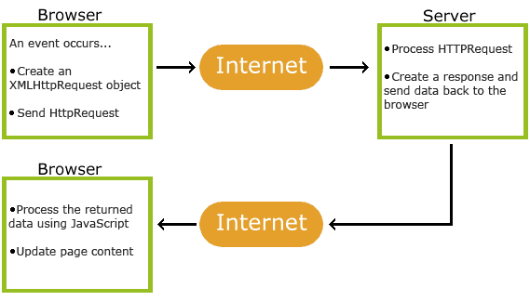
HOW AJAX WORKS
1. An event occurs in a web page (the page is loaded, a button is clicked)
2. An XMLHttpRequest object is created by JavaScript
3. The XMLHttpRequest object sends a request to a web server
4. The server processes the request
5. The server sends a response back to the web page
6. The response is read by JavaScript
7. Proper action (like page update) is performed by JavaScript

Slide 14
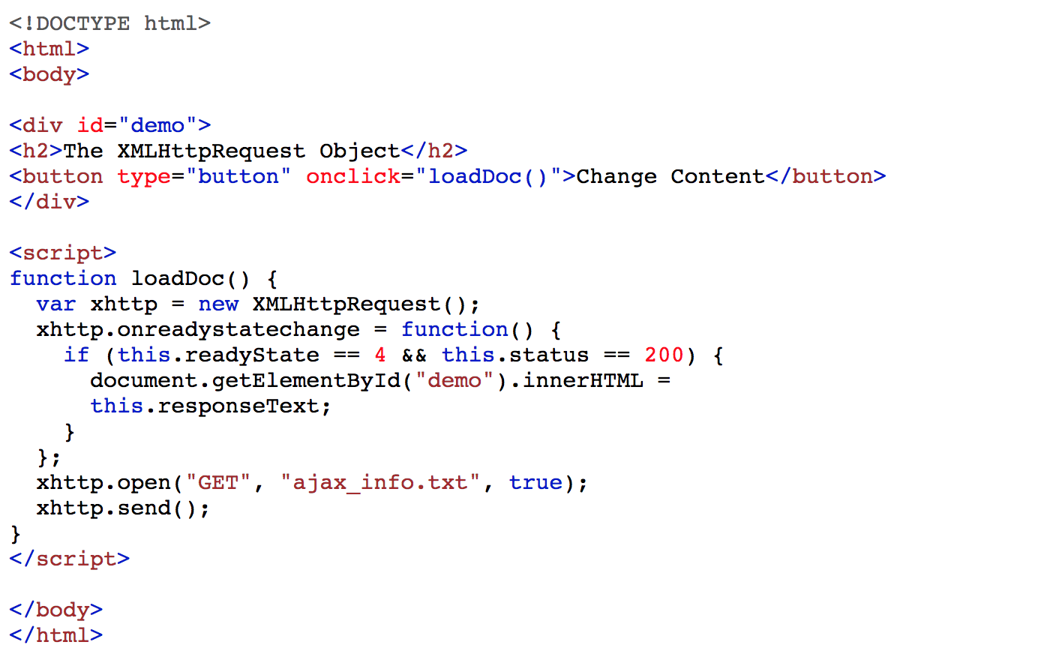
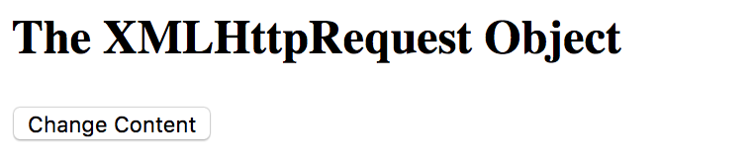
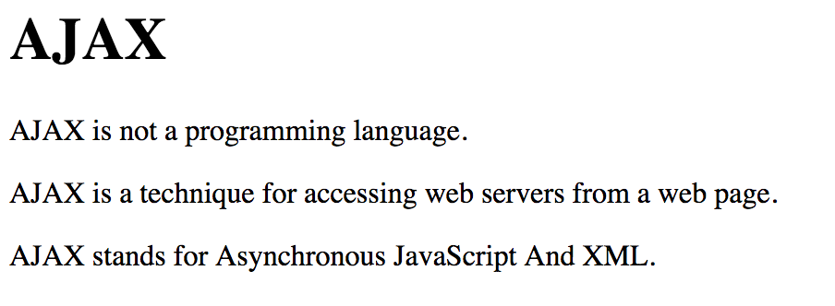
Example
Before
After

Slide 15
More Ajax…Request
The keystone of AJAX is the XMLHttpRequest object.
The XMLHttpRequest object is used to exchange data with a server.
Can we use POST method?
With the XMLHttpRequest object you can define a function to be executed when the request receives an answer.
The function is defined in the onreadystatechange property of the XMLHttpRequest object:
var xhttp = new XMLHttpRequest(); //Creates a new XMLHttpRequest object
xhttp.open("GET", "demo_get.asp", true);xhttp.send();
xhttp.onreadystatechange = function() { if (this.readyState == 4 && this.status == 200) { document.getElementById("demo").innerHTML = this.responseText; } }; xhttp.open("GET", "ajax_info.txt", true); xhttp.send();
More…

Slide 16
THE ONREADYSTATECHANGE PROPERTY
The readyState property holds the status of the XMLHttpRequest.
The onreadystatechange property defines a function to be executed when the readyState changes.
The status property and the statusText property holds the status of the XMLHttpRequest object.
Property | Description
onreadystatechange | Defines a function to be called when the readyState property changes
readyState | Holds the status of the XMLHttpRequest. 0: request not initialized 1: server connection established 2: request received 3: processing request 4: request finished and response is ready
status | 200: "OK" 403: "Forbidden" 404: "Page not found" For a complete list go to the Http Messages Reference
statusText | Returns the status-text (e.g. "OK" or "Not Found")

Slide 17
More Ajax…Response
The onreadystatechange function is called every time the readyState changes.
When readyState is 4 and status is 200, the response is ready:
function loadDoc() { var xhttp = new XMLHttpRequest(); xhttp.onreadystatechange = function() { if (this.readyState == 4 && this.status == 200) { document.getElementById("demo").innerHTML = this.responseText; } }; xhttp.open("GET", "ajax_info.txt", true); xhttp.send(); }

Slide 18
WHAT’S MORE in this course?
Now we will be choosing an Independent topic!!
For each group, there will be one topic, it can be anything…
Implement basic idea of that
You will present/demonstrate
You have one week to do that!
Few topics:
Web Services
Django
Laravel
REST
CGI Programming
Cloud
look-why-these-top-web-development-trends-technologies-will-rule

Slide 19
EXERCISE
Use JSON, XML and Ajax at least once in your project!
READINGS
https://www.w3schools.com/xml/
https://www.w3schools.com/js/js_json_intro.asp
https://www.php.net/manual/en/book.json.php

Slide 20
ACKNOWLEDGEMENT
This module is designed and created with the help from following sources-
https://cgi.csc.liv.ac.uk/~ullrich/COMP519/
http://www.csc.liv.ac.uk/~martin/teaching/comp519/
Md. Al-Amin Hossain, Daffodil International University

Slide 21
WEB SERVICES
Web services are open standard (XML, SOAP, HTTP, etc.)
Based on web applications
Interaction between web applications
Purpose of exchanging data.
Web services are web application components.
Web services can be published, found, and used on the Web.

Slide 22
WEB SERVICES…
WSDL
Web Services Description Language
XML-based language for describing Web services.
SOAP
Simple Object Access Protocol
XML based protocol for accessing Web Services.
RDF
Resource Description Framework
Framework for describing resources on the web
RDF is written in XML

Slide 23
WEB SERVICES…
RSS
Really Simple Syndication
Allows you to syndicate your site content
Easy way to share and view headlines and content
RSS files can be automatically updated
RSS allows personalized views for different sites
RSS is written in XML

Slide 24
XML RSS
RSS is useful for web sites that are updated frequently, like:
News sites - Lists news with title, date and descriptions
Companies - Lists news and new products
Calendars - Lists upcoming events and important days
Site changes - Lists changed pages or new pages
WSDL, SOAP, RDF are W3C recommendation
//By the way, what is w3c?
There is no official standard for RSS.

Slide 25
RSS EXAMPLE
<?xml version="1.0" encoding="UTF-8" ?> <rss version="2.0"> <channel> <title>W3Schools Home Page</title> <link>https://www.w3schools.com</link> <description>Free web building tutorials</description> <item> <title>RSS Tutorial</title> <link>https://www.w3schools.com/xml/xml_rss.asp</link> <description>New RSS tutorial on W3Schools</description> </item> <item> <title>XML Tutorial</title> <link>https://www.w3schools.com/xml</link> <description>New XML tutorial on W3Schools</description> </item> </channel> </rss>
More…

