Slide 1
Web Engineering
HTTP Protocol

Slide 2
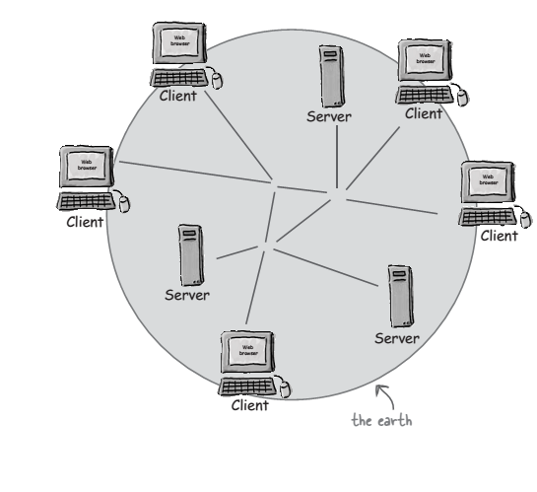
Internet and Web

Slide 3
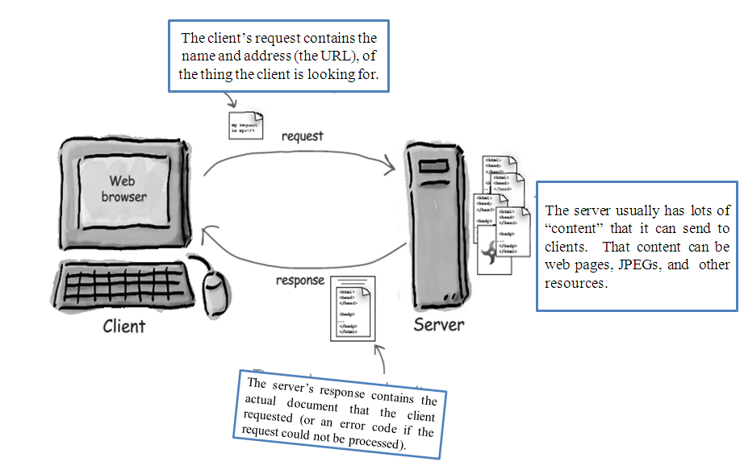

Slide 4
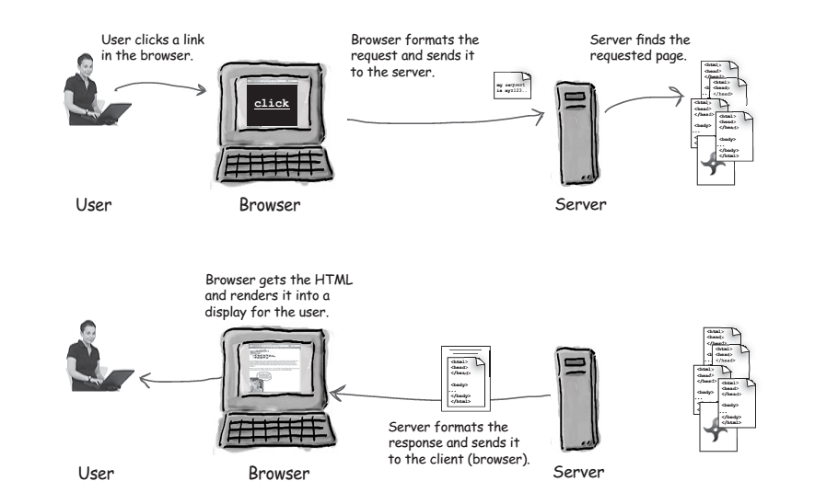
HTML tells the browser how to present the
content to the user.

Slide 5
Web and HyperText Transfer Protocol (HTTP)
First some jargon
Web page consists of objects
Object can be HTML file, JPEG image, Java applet, audio file,…
Web page consists of base HTML-file which includes several referenced objects
Each object is addressable by a URL
Example URL:
www.someschool.edu/someDept/pic.gif
host name
path name

Slide 6
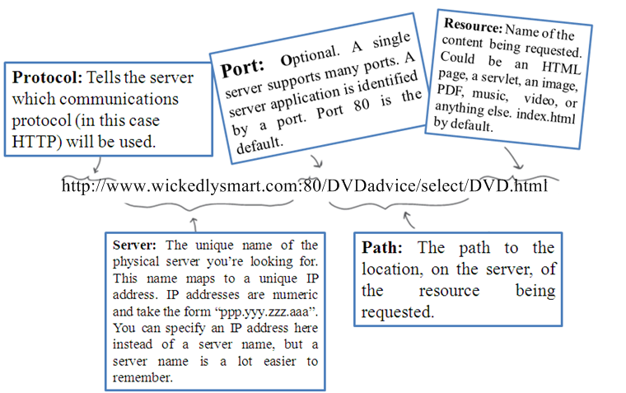
URL

Slide 7
HTTP overview
HTTP: hypertext transfer protocol
Web’s application layer protocol
client/server model
client: browser that requests, receives, “displays” Web objects
server: Web server sends objects in response to requests
HTTP 1.0: RFC 1945
HTTP 1.1: RFC 2068
HTTP request
PC running
Explorer
HTTP response
HTTP request
Server
running
Apache Web
server
HTTP response
Mac running
Navigator

Slide 8
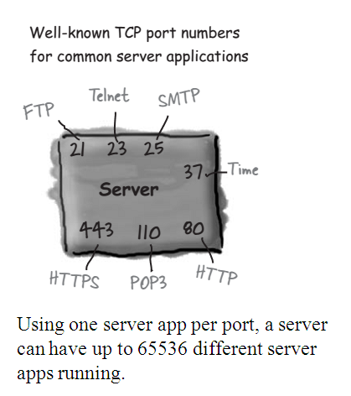
Ports
The TCP port numbers from 0 to 1023 are reserved for well-known services.
Don’t use these ports for your own custom server programs!

Slide 9
HTTP overview (continued)
Uses TCP:
client initiates TCP connection (creates socket) to server, port 80
server accepts TCP connection from client
HTTP messages (application-layer protocol messages) exchanged between browser (HTTP client) and Web server (HTTP server)
TCP connection closed
HTTP is “stateless”
server maintains no information about past client requests
aside
Protocols that maintain “state” are complex!
past history (state) must be maintained
if server/client crashes, their views of “state” may be inconsistent, must be reconciled

Slide 10
HTTP connections
Nonpersistent HTTP
At most one object is sent over a TCP connection.
HTTP/1.0 uses nonpersistent HTTP
Persistent HTTP
Multiple objects can be sent over single TCP connection between client and server.
HTTP/1.1 uses persistent connections in default mode

Slide 11
Nonpersistent HTTP
Suppose user enters URL www.someSchool.edu/someDepartment/home.index
(contains text,
references to 10
jpeg images)
1a. HTTP client initiates TCP connection to HTTP server (process) at www.someSchool.edu on port 80
1b. HTTP server at host www.someSchool.edu waiting for TCP connection at port 80. “accepts” connection, notifying client
2. HTTP client sends HTTP request message (containing URL) into TCP connection socket. Message indicates that client wants object someDepartment/home.index
3. HTTP server receives request message, forms response message containing requested object, and sends message into its socket
time

Slide 12
Nonpersistent HTTP (cont.)
4. HTTP server closes TCP connection.
5. HTTP client receives response message containing html file, displays html. Parsing html file, finds 10 referenced jpeg objects
time
6. Steps 1-5 repeated for each of 10 jpeg objects

Slide 13
Response time modeling
Definition of RRT: time to send a small packet to travel from client to server and back.
Response time:
one RTT to initiate TCP connection
one RTT for HTTP request and first few bytes of HTTP response to return
file transmission time
total = 2RTT+transmit time
initiate TCP
connection
RTT
request
file
RTT
time to
transmit
file
file
received
time
time

Slide 14
Persistent HTTP
Nonpersistent HTTP issues:
requires 2 RTTs per object
OS must work and allocate host resources for each TCP connection
but browsers often open parallel TCP connections to fetch referenced objects
Persistent HTTP
server leaves connection open after sending response
subsequent HTTP messages between same client/server are sent over connection
Persistent without pipelining:
client issues new request only when previous response has been received
one RTT for each referenced object
Persistent with pipelining:
default in HTTP/1.1
client sends requests as soon as it encounters a referenced object
as little as one RTT for all the referenced objects

Slide 15
HTTP request message
two types of HTTP messages: request, response
HTTP request message:
ASCII (human-readable format)
request line
(GET, POST,
HEAD commands)
GET /somedir/page.html HTTP/1.1
Host: www.someschool.edu
User-agent: Mozilla/4.0
Connection: close
Accept-language:fr
(extra carriage return, line feed)
header
lines
Carriage return,
line feed
indicates end
of message

Slide 16
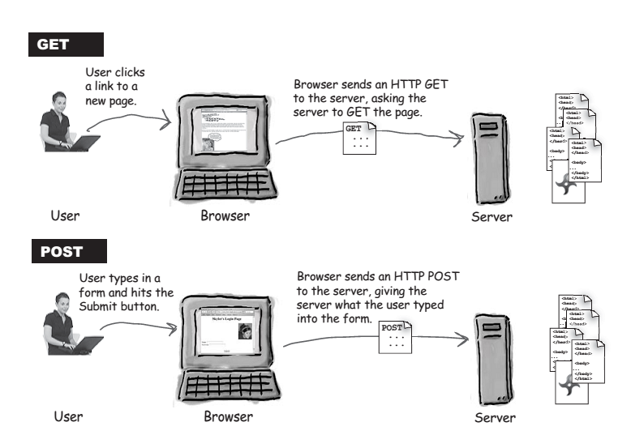
HTTP request message

Slide 17
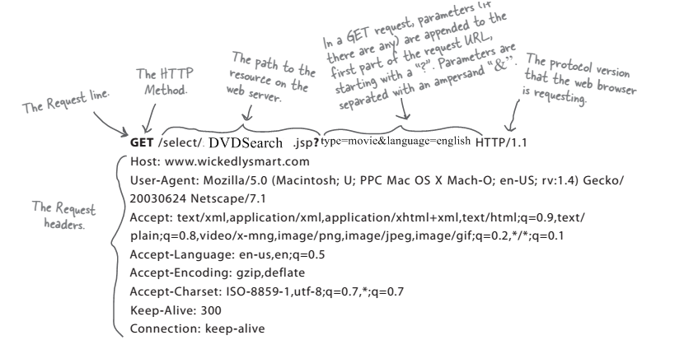
Anatomy of an HTTP GET request

Slide 18
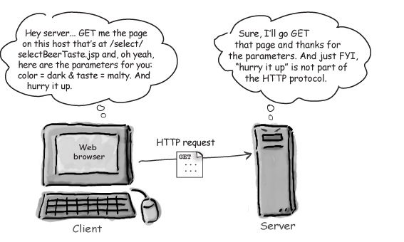
Anatomy of an HTTP GET request

Slide 19
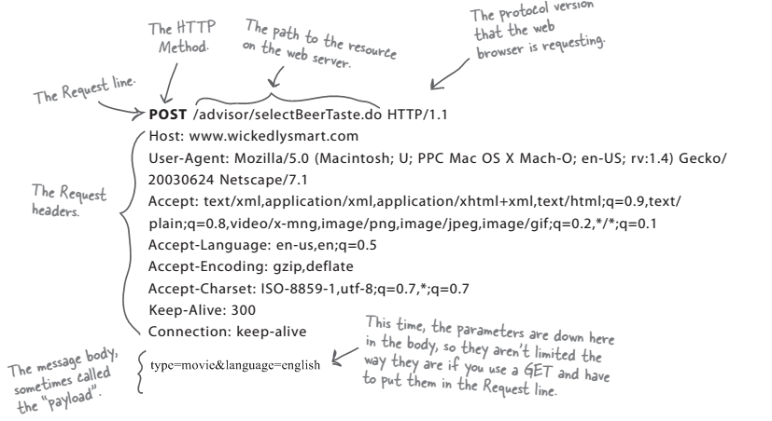
Anatomy of an HTTP POST request

Slide 20
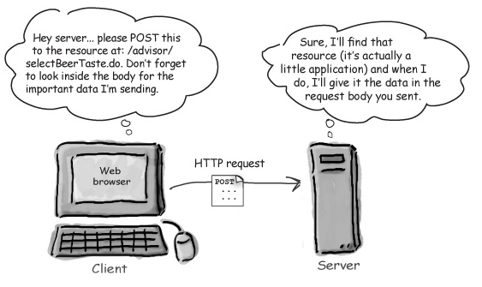
Anatomy of an HTTP POST request

Slide 21
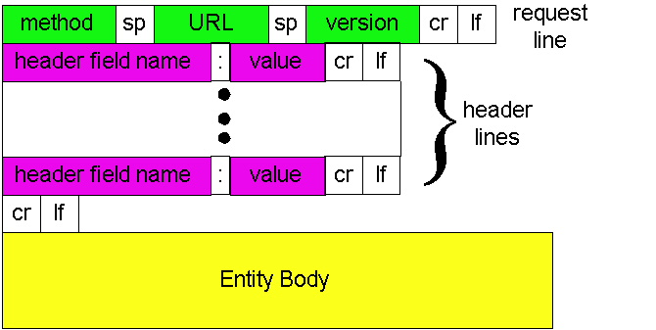
HTTP request message: general format
GET /somedir/page.html HTTP/1.1
Host: www.someschool.edu
User-agent: Mozilla/4.0
Connection: close
Accept-language:fr
(extra carriage return, line feed)

Slide 22
HTTP request message: general format
Now let's look at the header lines in the example. The header line HOST: www.someschool.edu specifies the host on which the object resides. You night think that this header line is unnecessary, as there is already a TCP connection in place to the host. But, as we'll see in Section 2.2.6, the information provided by the host header line is required by Web proxy caches. By including theConnection:close header line, the browser is telling the server that it doesn't want to use persistent connections; it wants the server to close the connection after sending the requested object. Thus the browser that generated this request message implements HTTP/1.1 but it doesn't want to bother with persistent connections. The User-agent: header line specifies the user agent, that is, the browser type that is making the request to the server . Here the user agent is Mozilla/4.0, a Netscape browser. This header line is useful because the server can actually send different versions of the same object to different types of user agents. (Each of the versions is addressed by the same URL.) Finally, the Accept-language: header indicates that the user prefers to receive a French version of the object, if such an object exists on the server; otherwise, the server should send its default version.
The Entity Body is not used with the GET method, but is used with the POST method. The HTTP client uses the POST method when the user fills out a form

Slide 23
Method types
HTTP/1.0
GET
POST
HEAD
asks server to leave requested object out of response
HTTP/1.1
GET, POST, HEAD
PUT
uploads file in entity body to path specified in URL field
DELETE
deletes file specified in the URL field

Slide 24
HTTP response message
status line
(protocol
status code
status phrase)
HTTP/1.1 200 OK
Connection close
Date: Thu, 06 Aug 1998 12:00:15 GMT
Server: Apache/1.3.0 (Unix)
Last-Modified: Mon, 22 Jun 1998 …...
Content-Length: 6821
Content-Type: text/html
data data data data data ...
header
lines
data, e.g.,
requested
HTML file

Slide 25
HTTP response status codes
In first line in server->client response message.
A few sample codes:
200 OK
request succeeded, requested object later in this message
301 Moved Permanently
requested object moved, new location specified later in this message (Location:)
400 Bad Request
request message not understood by server
404 Not Found
requested document not found on this server
505 HTTP Version Not Supported

Slide 26
User-Server Interaction: Authorization and Cookies
HTTP server is stateless – simplifies server design
Sometime server needs to identify user
Two mechanism for identification:
1. Authorization & 2. CooKies
Authorization :
1) Provide username and password to access documents on server
2) Status code 401: Authorization Required

Slide 27
User-server state: cookies
Many major Web sites use cookies
Four components:
1) cookie header line in the HTTP response message
2) cookie header line in HTTP request message
3) cookie file kept on user’s host and managed by user’s browser
4) back-end database at Web site
Example:
Susan access Internet always from same PC
She visits a specific e-commerce site for first time
When initial HTTP requests arrives at site, site creates a unique ID and creates an entry in backend database for ID

Slide 28
Cookies: keeping “state” (cont.)
client
server
Cookie file
usual http request msg
server
creates ID
1678 for user
ebay: 8734
usual http response +
Set-cookie: 1678
entry in backend
database
Cookie file
usual http request msg
cookie: 1678
amazon: 1678
ebay: 8734
cookie-
specific
action
access
usual http response msg
one week later:
access
Cookie file
usual http request msg
cookie: 1678
cookie-
spectific
action
amazon: 1678
ebay: 8734
usual http response msg

Slide 29
Cookies (continued)
aside
What cookies can bring:
authorization
shopping carts
recommendations
user session state (Web e-mail)
Cookies and privacy:
cookies permit sites to learn a lot about you
you may supply name and e-mail to sites
search engines use redirection & cookies to learn yet more
advertising companies obtain info across sites

Slide 30
Thank you

