Slide 1
CSE414: WEB ENGINEERING
Daffodil International University

Slide 2
OVERVIEW
Course Policies-
Zero Tolerance on Plagiarism
Grading will be based on university policy
Contact Details-
Office –
Cell – [Text Preferred]
Email – [Write E-mail subject properly]
Google Classroom Code - arld4o4
BLC/Online Module Link- [Will be updated soon]
More at, my google site

Slide 3
COURSE STRUCTURE
Two lecture sessions and one lab session per week
Everything and anything discussed in lecture session will be implemented in the following lab
At least FOUR major assignments in LAB as a part of continuous evaluation
Deadlines will be strictly maintained
Notes and additional resources will be provided to read/go through beforehand

Slide 4
LECTURE OUTCOME
CONTENTS-
Internet and the Web
Client-Server Paradigm
Differentiate between Web and Internet
Understand Client-Server Paradigm
Select the appropriate tools

Slide 5
WEB ≠ INTERNET
Internet
A physical network of networks connecting billions of computers and other devices using common protocols (TCP/IP) for sharing and transmitting information
World Wide Web [Old]
A collection of interlinked multimedia documents (web pages stored on internet connected devices and accessed using a common protocol (HTTP))
Key distinction:
The internet is hardware plus protocols while the world wide web is software plus protocols
The world wide web is an application using the internet to transmit information, just like many others, for example, email, SSH, FTP

Slide 6
HISTORY(1/3)
1969: ARPANET (precursor of the Internet)
1971: First e-mail transmission, File Transfer Protocol
1972-1980:
Vadic VA3400 modem (1,200 bit/s over phone network)
RSA public-key cryptography
EPSS/SERCnet (first UK networks between research institutions)
1981: IBM PC 5150
1982: TCP/IP standardized
1985 : FTP on TCP standardized

Slide 7
HISTORY(2/3)
mid 1980s: Janet (UK network between research institutions with 2 Mbit/s backbone and 64 kbit/s access links)
1986:U.S. Robotics HST modem (9600 bit/s) TCP/IP networks expand across the world
Late 1980s: TCP/IP networks expand across the world
1991:
Janet adds IP service
Gopher / World Wide Web
GSM (second generation cellular network) digital, circuit switched network for full duplex voice telephony
1995: First public releases of JavaScript and PHP
1997: World Wide Web slowly arrives on mobile phones

Slide 8
HISTORY(3/3)
Current Applications:
Communication via e-mail, Twitter, etc
Joint manipulation of concepts and actions: Collaborative editing, Crowd sourcing, Wikis (Wikipedia)
E-Commerce: Online auctions and markets
Social media, social networks,
virtual learning environments

Slide 9
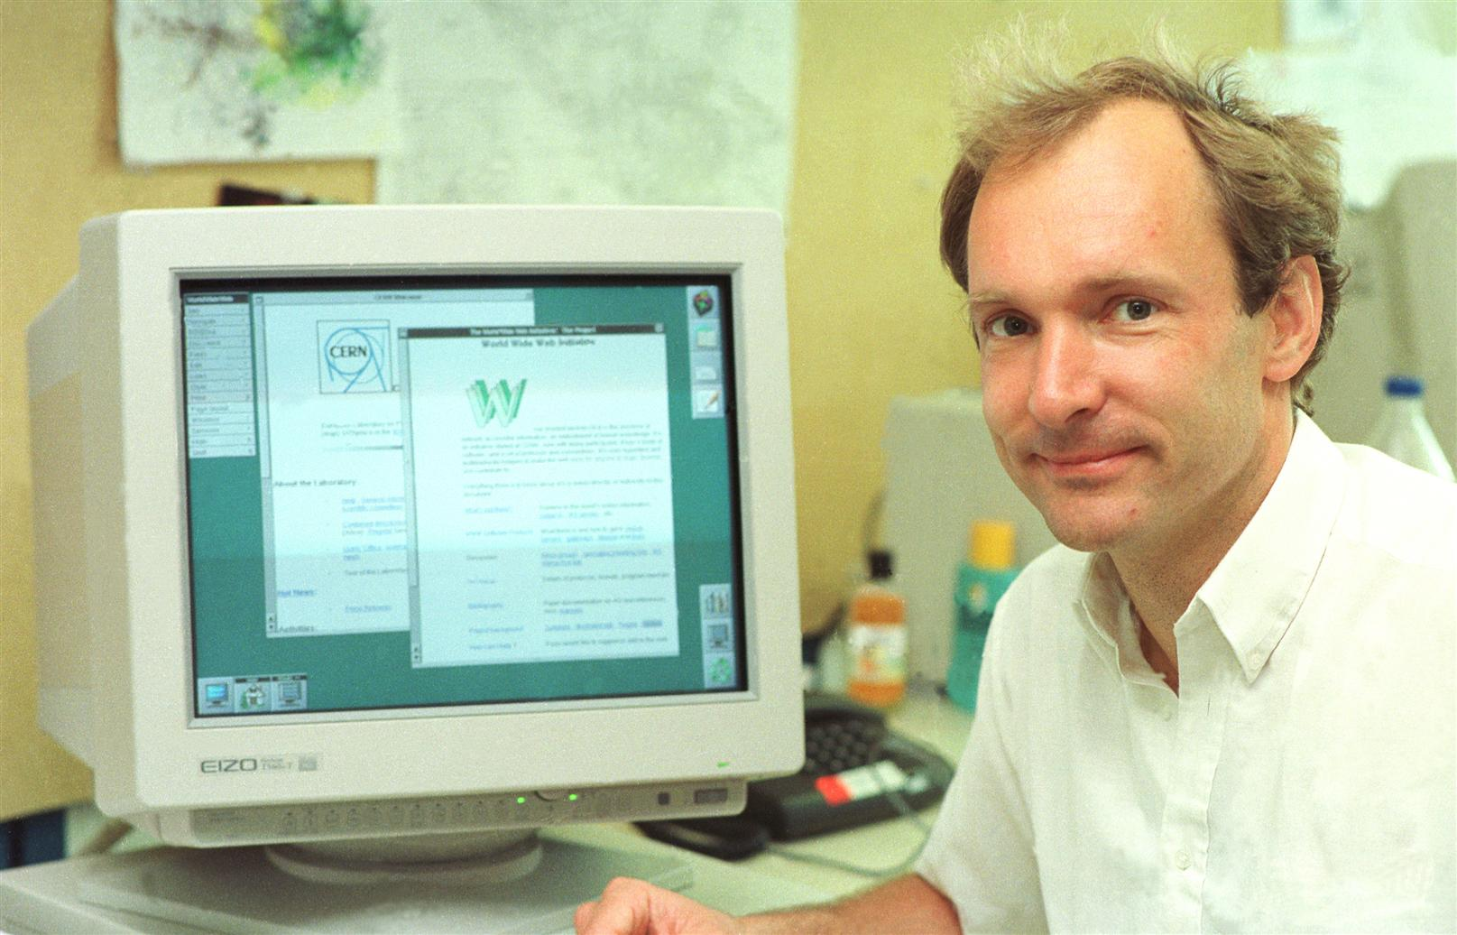
WHERE THE WEB WAS BORN
“Tim Berners-Lee, a British scientist, invented the World Wide Web (WWW) in 1989, while working at CERN. The Web was originally conceived and developed to meet the demand for automated information-sharing between scientists in universities and institutes around the world.”
Go to CERN’s official site

Slide 10
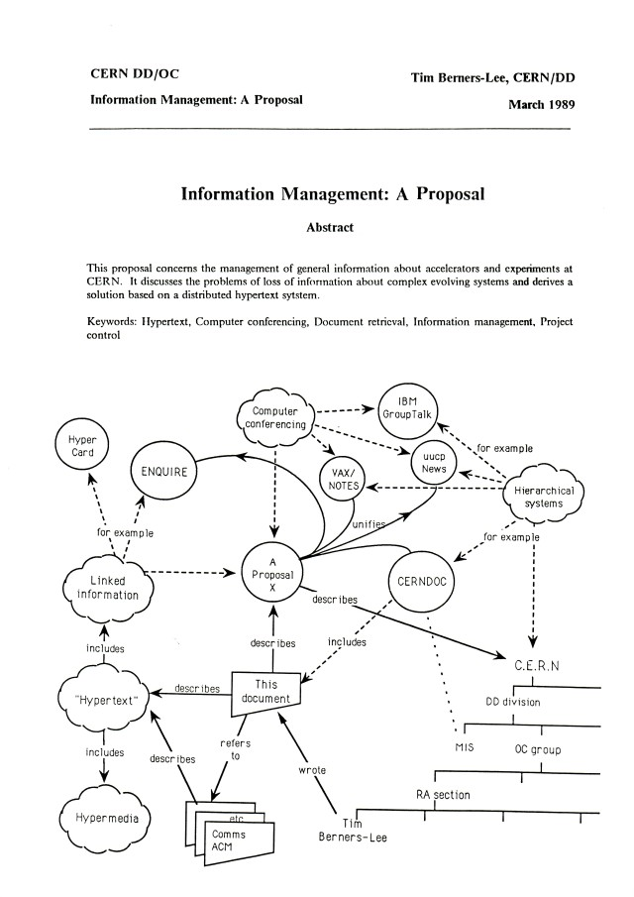
HOW THE WEB BEGAN
An image of the first page of Tim Berners-Lee's proposal for the World Wide Web in March 1989

Slide 11
WEB ≠ INTERNET (Again?)
World Wide Web [New]
An infrastructure that allows to easily develop, deploy, and use distributed systems
Distributed systems
A system in which components located on networked computers communicate and coordinate their actions by passing messages in order to achieve a common goal
More …

Slide 12
WEB ≠ INTERNET (Ok! Last Time!)
World Wide Web [New]
An infrastructure that allows to easily develop, deploy, and use distributed systems
Key points:
The internet already eased the development of distributed systems by providing an appropriate infrastructure for that
The world wide web eases the development and deployment of interfaces to such system via a combination of web pages and ubiquitous web bowsers
The world wide web then allows every (authorized) person to instantaneously interact with such systems
Search engines allow users to easily find distributed systems that are useful to them

Slide 13
WEB PROGRAMMING VERSUS APP PROGRAMMING
Web Programming relies on web browsers as means to render user interfaces that are coded in HTML/CSS
Web Programming relies on HTTP as the main protocol to exchange information within a distributed system
Web-based apps use a mix of server-side and client-side computing
Web-based apps can be changed almost instantaneously and on a per-user / per-use basis
App Programming relies on directly coded ‘native’ interfaces (Swift/Java)
App Programming can rely on arbitrary protocols to exchange information within a distributed system
Programmers have more flexibility and more control when developing ‘traditional’ apps
It is not obvious which approach is better and in which situation

Slide 14
STATIC VS. DYNAMIC WEBPAGES(1/2)
STATIC WEBPAGE
Many Web pages are still static in nature.
Contents (text/links/images) are the same each time the webpage is accessed.
e.g., online documents, many personal homepages
HyperText Markup Language (HTML) and Cascading Style Sheets (CSS) are used to specify text, image, and page format, along with styling the page for various effects (backgrounds, colors, table layout, page margins, etc.).

Slide 15
STATIC VS. DYNAMIC WEBPAGES(2/2)
DYNAMIC PAGE
As the Web continues towards more and more online services and e-commerce continues to grow, Web pages must also provide dynamic content.
Pages can be fluid, changeable (e.g., rotating banners, inclusion of “real-time” data, etc.).
Must be able to react to the user’s actions, request and process info, tailor services.
e.g., amazon.com, YouTube, any e-commerce website, online email services, etc.

Slide 16
DISTRIBUTED SYSTEM
Also known as distributed computing
System with multiple components
Located on different machines that communicate and coordinate actions
Appear as a single coherent system to the end-user.
Benefits and challenges of distributed systems
Computing happens independently on each node
easy and generally inexpensive to add additional nodes and functionality as necessary
Fault-tolerant as they can be made up of hundreds of nodes that work together
The system generally doesn’t experience any disruptions if a single machine fails
Efficient because work loads can be broken up and sent to multiple machines

Slide 17
CLIENT-SIDE PROGRAMMING(2/2)
Jquery
first released in 2006, is a JavaScript library to help with cross-browser compatibility issues.
Java applets
Can define small, special-purpose programs in Java called applets.
Provides (almost) full expressive power of Java (but with more overhead).
Good for data-heavy tasks or more complex tasks such as graphics

Slide 18
TYPES OF DISTRIBUTED SYSTEMS
Client-server—Clients contact the server for data, then format it and display it to the end-user. The end-user can also make a change from the client-side and commit it back to the server to make it permanent.
Peer-to-peer—There are no additional machines used to provide services or manage resources. Responsibilities are uniformly distributed among machines in the system, known as peers, which can serve as either client or server.
Three-tier—Information about the client is stored in a middle tier rather than on the client to simplify application deployment. This architecture model is most common for web applications.
n-tier—Generally used when an application or server needs to forward requests to additional enterprise services on the network.

Slide 19
CLIENT-SERVER PARADIGM
You already know this from CSE313: Computer Networks
Let’s revisit,
Server program sends copies of documents on request
Requires computer on Internet and server software always running
Client program sends message to server to request copy of document
Clients and servers communicate via TCP/IP
Client and server may establish "persistent connection" so that all pages after first arrive more quickly
More…

Slide 20
CLIENT-SIDE PROGRAMMING(1/2)
Can download program with a webpage, execute the program on the client’s machine.
Simple, generic, but sometimes insecure (e.g. cross-site scripting attacks).
JavaScript
A scripting language for Web pages, developed by Netscape in 1995.
Uses a C++/Java-like syntax, so familiar to many programmers, but simpler.
JavaScript is good for adding dynamic features to Web page, controlling forms, and the GUI.
Requires users to have this technology enabled on their browsers.

Slide 21
SERVER-SIDE PROGRAMMING(1/2)
Can store a program on a web server, and supply a link from a webpage to execute that program. And you can also accept input from a user in terms of “filling in blanks” and/or file upload(s), etc.
The process of doing this can be more complex, requires server privileges, but can still be (mostly) secure with proper precautions.
Common Gateway Interface (CGI) programming
Programs are written to conform to the CGI.
When a webpage submits, the data from the page is sent as input to the CGI program. CGI program executes on the server and sends its results back to browser as a webpage.
Good if computation is large/complex or requires access to private data.

Slide 22
SERVER-SIDE PROGRAMMING(2/2)
Other server-side programming technologies include:
Active Server Pages (ASP)
Java Servlets
PHP (You will learn this one in this course!)
Server Side Includes
Ajax (using JavaScript on the client side too)
Some of these are vendor-specific alternatives to CGI (such as Microsoft’s ASP).
They often provide many of the same capabilities as CGI programs but use HTML-like tags (such as PHP).
Some of these technologies might require functionality to be enabled in the client’s browser (e.g. Ajax)

Slide 23
AN EXERCISE
Pick some of your favorite websites and try to identify
the static components
the dynamic components
Which sites are using JavaScript?
Which are using Java applets?
Which are using server-side elements such as CGI programs?
READINGS
http://cgi.csc.liv.ac.uk/~ullrich/COMP519/notes/lect01.pdf
https://cgi.csc.liv.ac.uk/~martin/teaching/comp519/NOTES/overview.pdf

Slide 24
REFERENCES
https://home.cern/science/computing/birth-web/short-history-web
https://www.cs.purdue.edu/homes/bxd/inter/tableOfContents.html

Slide 25
ACKNOWLEDGEMENT
This module is designed and created with the help from following sources-
https://cgi.csc.liv.ac.uk/~ullrich/COMP519/
http://www.csc.liv.ac.uk/~martin/teaching/comp519/
My sincere grattitude to Professor Hustadt and Professor Martin for their support and materials.
Following lecture materials also use different sources including this and will be mostly mentioned at reference section.

